Slide 1
AVR STATUS REGISTER
Presented by
Maisha Farzana
Roll: 2003025
Section: A

Slide 2
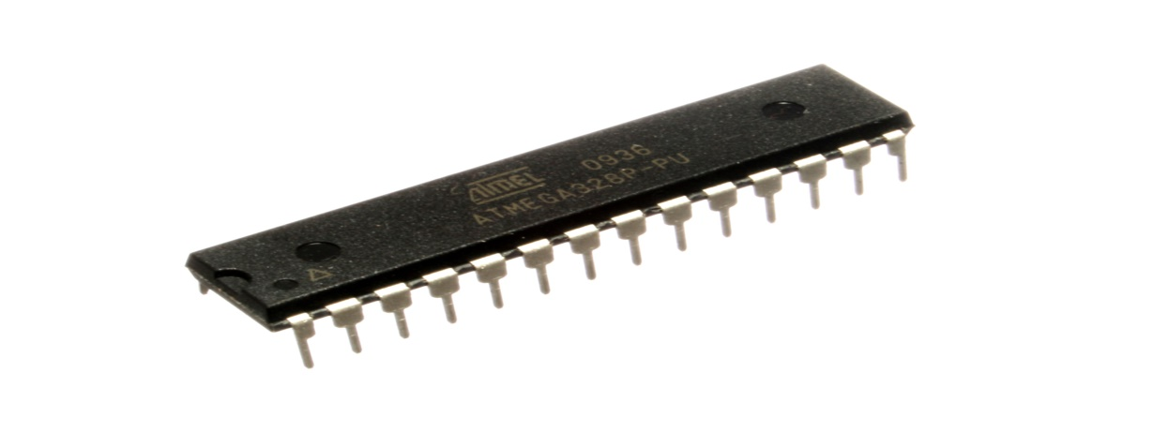
DECODING THE AVR STATUS REGISTER : Understanding the bits that influence the program flow
Fig: AVR Microcontroller Chip
The AVR Status Register(SREG) is an 8-bit register that stores status flags resulting from arithmetic and logical operations.
These flags play a crucial role in conditional branching and decision making within AVR programs.

Slide 3
SREG BIT LAYOUT
Bit
SREG
D7
D0
I | T | H | S | V | N | Z | C
C- Carry flag
Z- Zero flag
N- Negative flag
V- Overflow flag
S-Sign flag
H- Half carry
T- Bit copy storage
I- Global interrupt enable

Slide 4
SREG FLAGS
Carry flag:
Set if an arithmetic operation results in a carry or borrow.
Used for multi-byte operations shift/rotate instruction.
Zero flag:
Set if the result of an operation is zero.
Used for conditional branching and comparisons.
Negative flag:
Set if the result of an operation is negative.
Indicates the MSB(most significant bit) of the result.
Overflow flag:
Set if a signed arithmetic operation overflows.
Essential for detecting errors in signed calculations.

Slide 5
SREG FLAGS
Sign flag:
Set if N ⊕ V (exclusive OR of N and V)
Simplified way to check for negative results in signed operations
Half carry flag:
Set if a carry occurs from bit 3 to bit 4 in an arithmetic operation
Primarily used for BCD (Binary-Coded Decimal) arithmetic
Bit copy storage:
Used for bit-level operations with BLD (Bit Load) and BST (Bit Store) instructions
Not directly affected by most ALU operations
Global interrupt enable:
Enables or disables all interrupts globally
Set to enable interrupts, cleared to disable them

Slide 6
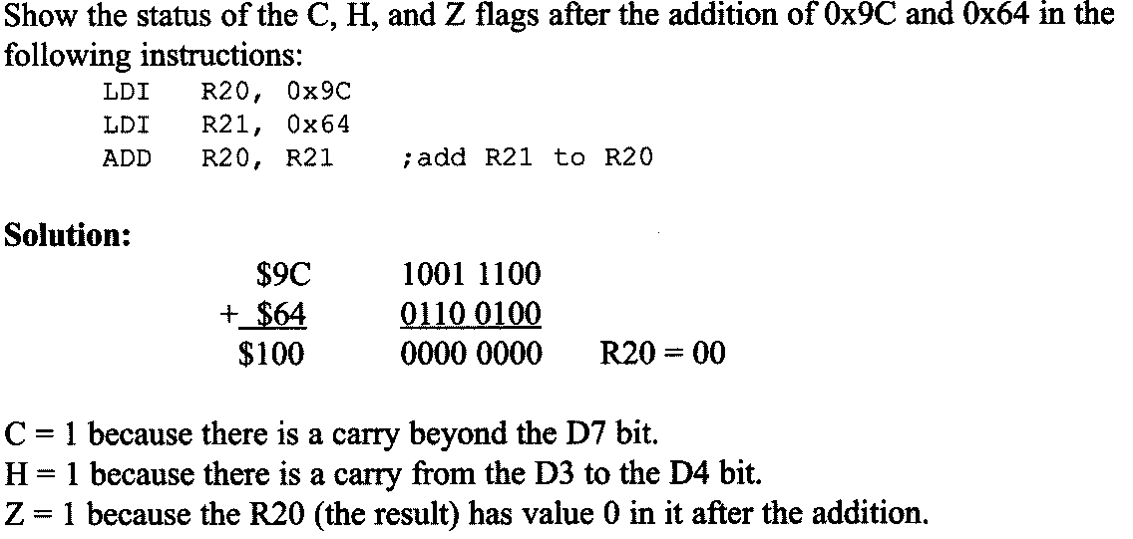
ADD INSTRUCTION AND STATUS REGISTER
Example:

Slide 7
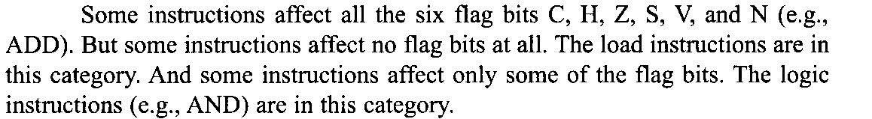
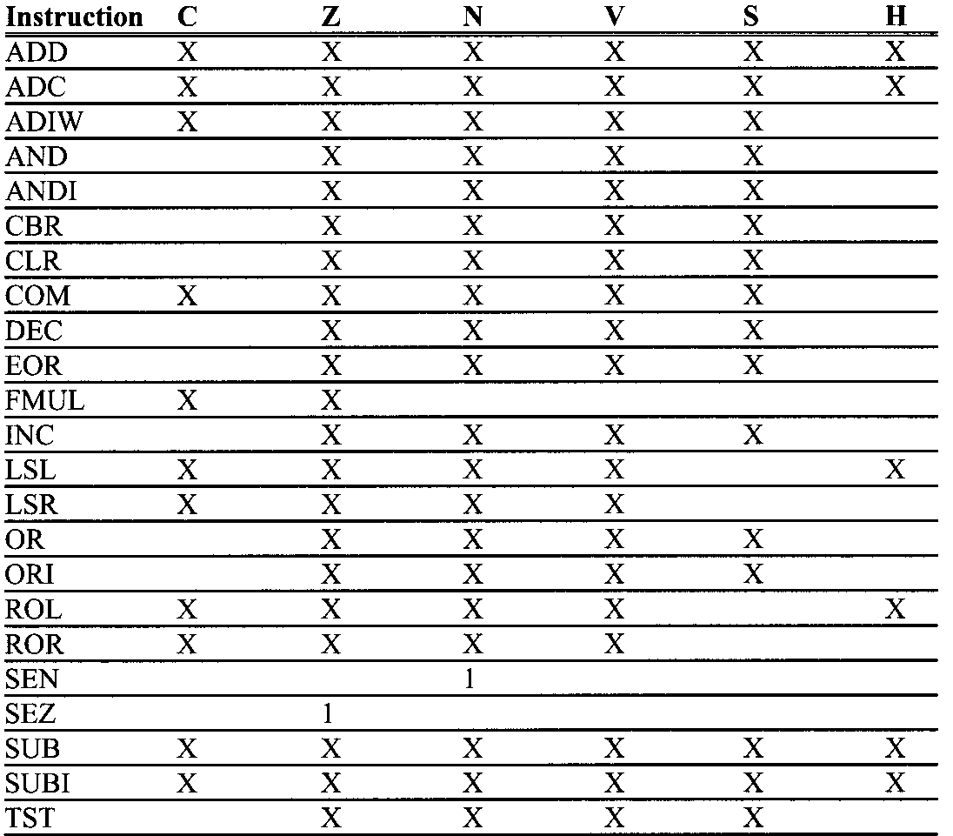
INSTRUCTIONS THAT AFFECT FLAG BITS
Here, X can be 0 or 1

Slide 8
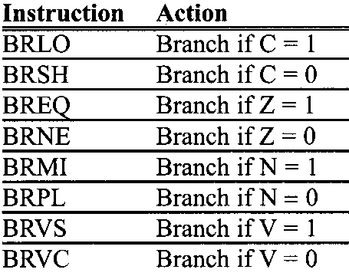
FLAG BITS AND DECISION MAKING
There are instructions that will make a conditional jump(branch)
based on the status of the flag bits.
AVR branch(jump) instructions using flag bits:

Slide 9
THANK YOU

