Slide 1
Microcontroller Data Memory
There are two kinds of memory space in AVR microcontroller.
1.Code Memory Space 2.Data Memory Space
The Data memory is composed of three(3) Parts :
A.GPRs(general purpose register)
B.I/O memory
C. Internal Data SRAM
By Shaju-2003029

Slide 2
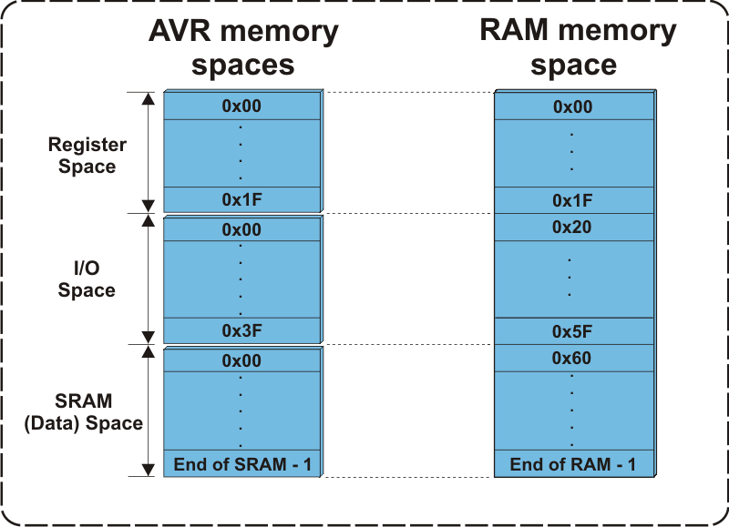
Figure : The Data Memory For AVRs

Slide 3
GPRs(general purpose register)
The GPRs use 32 bytes of Data Memory .
They always take the address location $00-$1F in the data memory space , regardless of the AVR chip number.
GPRs are an integral part of the CPU's register file, and they play a crucial role in executing instructions and performing arithmetic and logic operations.

Slide 4
I/O memory
1.The I/O memory is dedicated to spacfic functions such as register , timers, serial communication ,I/O ports, ADC and so on.
2.The AVR I/O memory is made of 8 bit registers.
3.The number of locations in the data memory set aside for I/O memory depends on the pin numbers .
4. ATmega64, ATmega128 and ATmega256 are the AVRS with more than 32 I/O pins.

Slide 5
Internal Data SRAM
SRAM stands for Static Random-Access Memory. It is a type of volatile semiconductor memory that stores data in a static form, meaning it doesn't need to be periodically refreshed like dynamic RAM (DRAM)
Internal data SRAM in widely used for storing data and parameters by AVR programmers and C compilers.
Each location of SRAM can be accessed directly by its address.
The size of SRAM can vary to vary from chip to chip.

Slide 6
USING INSTRUCTION WITH THE DATA MEMORY
LDS Instruction:
LDS R16, 0x0100
“LDS” is the instruction mnemonic
“R16” is the destination register pair.
“0x0100” is the 16 bit address from which the data will be loaded.
STS Instruction :
“STS” is the instruction mnemonic.
“0x0100” is the 16-bit address in data memory where the data will be stored.
“R16” is the source register containing the data to be stored.

