Slide 1

Branch instructions and looping For AVR Microcontroller Assembly
This topic discusses
Instructions used for looping
Instructions for conditional branches
Instructions unconditional branches (jumps).
By Tanjim 2003030

Slide 2
Using BRNE instruction for looping
;this program adds value 3 to the R20 ten times
.INCLUDE “M32DEF.INC”
LDI R16, 10 ;R16 = 10 (decimal) for counter
LDI R20, 0 ;R20 = 0
LDI R21, 3 ;R21 = 3
AGAIN:ADD R20, R21
;add 03 to R20 (R20 = sum)
DEC R16 ;decrement R16 (counter)
BRNE AGAIN ;repeat until COUNT = 0
OUT PORTB,R20 ;send sum to PORTB
The BRNE (branch if not equal) instruction uses the zero flag in the status register.
In each iteration, the DEC instruction decrements the R16 and sets the flag bits accordingly. If R16 is not zero (Z = 0), it jumps to the target address associated with the label “AGAIN”. This looping action continues until R16 becomes zero.

Slide 3
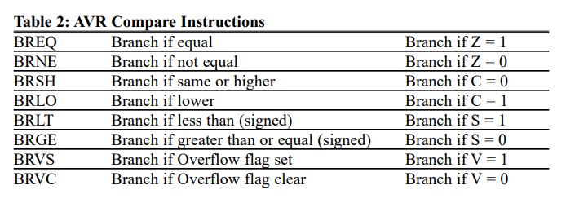
Other Conditional Jumps

Slide 4
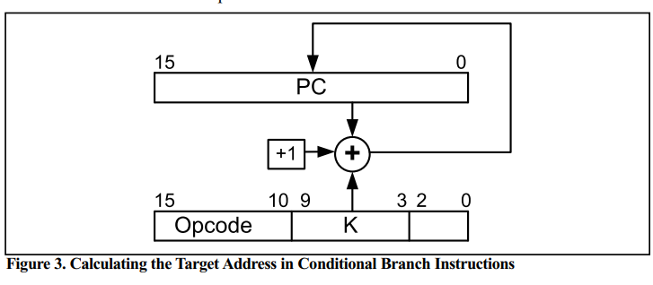
All conditional branches are short jumps
It must be noted that all conditional jumps are short jumps, meaning that the address of the target must be within 64 bytes of the program counter (PC)
Target Address = Relative Address+ PC
If the relative address is positive, the jump is forward. If the relative address is negative, then the jump is backwards.

Slide 5
Unconditional branch instructions
RJMP (relative jump)
In this 2-byte (16-bit) instruction, the first 4 bits are the opcode, and the rest(lower 12 bits) is the relative address of the target location.
IJMP (indirect jump)
IJMP is a 2-byte instruction. When the instruction executes, the PC is loaded with the contents of the Z register
JMP (JMP is a long jump)
JMP is an unconditional jump that can go to any memory location in the 4M (word) address space of the AVR. It is a 4-byte (32-bit) instruction in which 10 bits are used for the opcode, and the other 22 bits represent the 22-bit address of the target location.

Slide 6
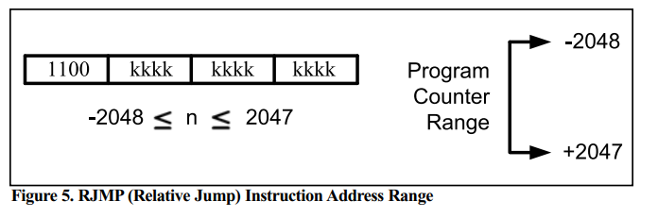
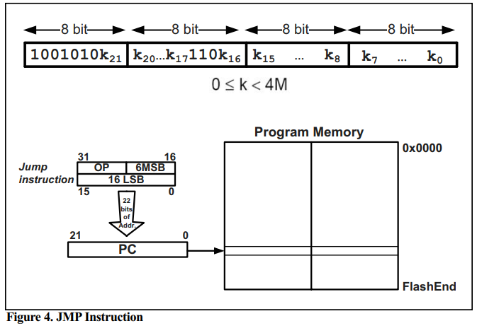
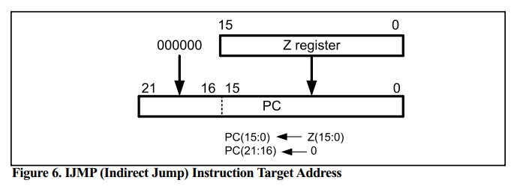
Figurative Explanation

