Slide 1
AVR time delay and Instruction pipeline
AVR multistage execution pipeline
Instruction cycle time for the AVR
Branch penalty
Delay calculation for the AVR
By:
Tonmoy-2003027
Section: A
CSE,RUET

Slide 2
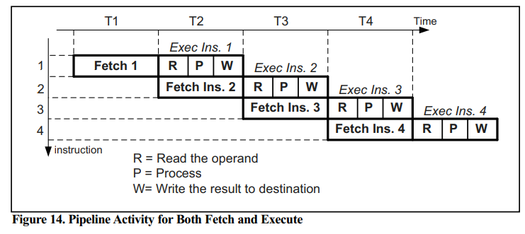
AVR multistage execution pipeline
In the AVR, each instruction is executed in 3 stages:
Operand fetch (R)
ALU operation execution (P)
Result write back. (W)

Slide 3
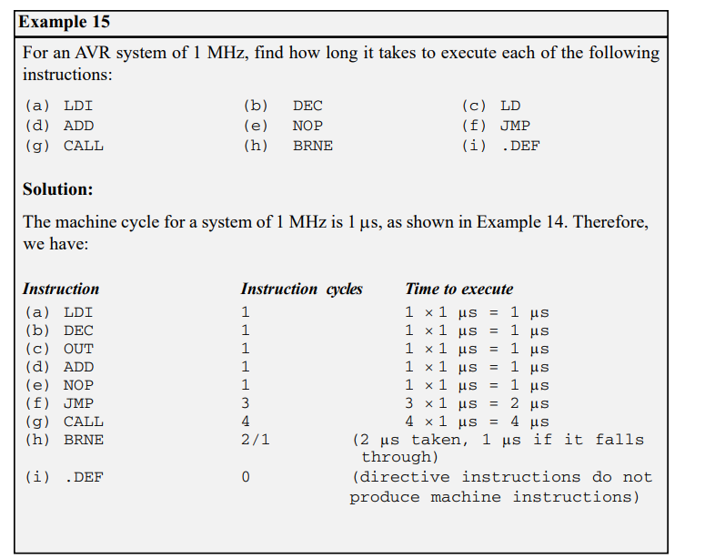
Instruction cycle time for the AVR
To calculate the machine cycle for the AVR, we take the inverse of the crystal frequency

Slide 4
Branch penalty
When a branch instruction is executed, the CPU starts to fetch codes from the new memory location, and the code in the queue that was fetched previously is discarded. In this case, the execution unit must wait until the fetch unit fetches the new instruction. This is called a branch penalty
This means that while the vast majority of AVR instructions take only one machine cycle, some instructions take two, three, or four machine cycles. These are JMP, CALL, RET, and all the conditional branch instructions such as BRNE, BRLO, and so on.

Slide 5
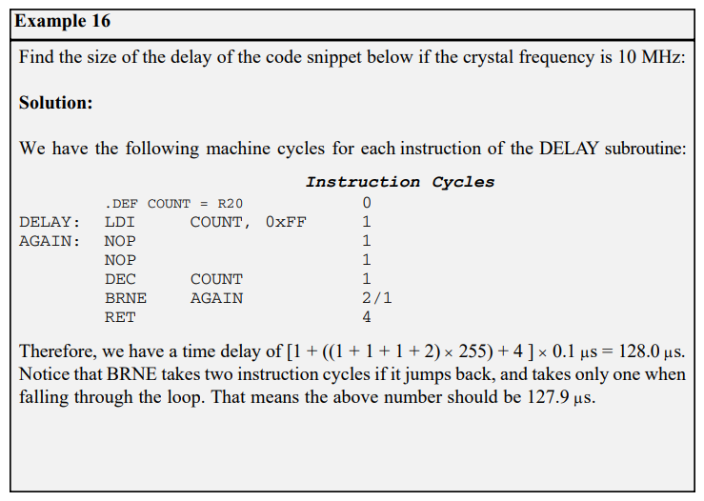
Delay calculation for the AVR
Two factors that can affect the accuracy of the delay:
The crystal frequency
The AVR design

Slide 6

Arithmetic instructions of AVR
Addition
Subtraction
Multiplication
Division
For Both Signed and Unsigned Numbers

Slide 7

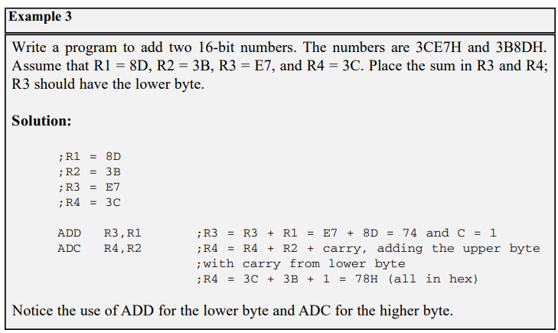
Addition of numbers
When adding two 16-bit data operands, we need to be concerned with the propagation of a carry from the lower byte to the higher byte. This is called multibyte addition to distinguish it from the addition of individual bytes. The instruction ADC (ADD with carry) is used on such occasions.
The instruction adds Rr (resource) to Rd (destination) and stores the result in Rd. It could change any of the Z, C, N, V, H or S bits of the status register, depending on the operands involved

Slide 8
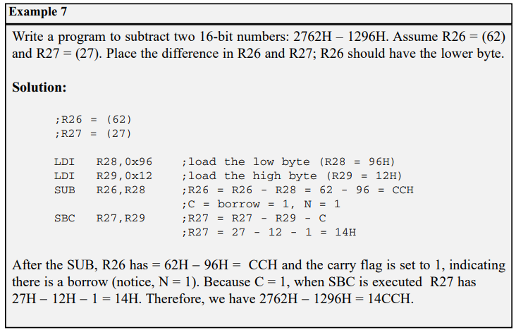
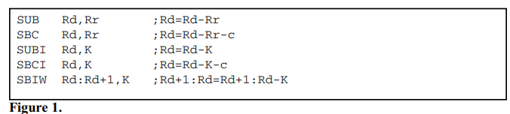
Subtraction of numbers
In the AVR we have five instructions for subtraction: SUB, SBC, SUBI, SBCI, and SBIW

Slide 9
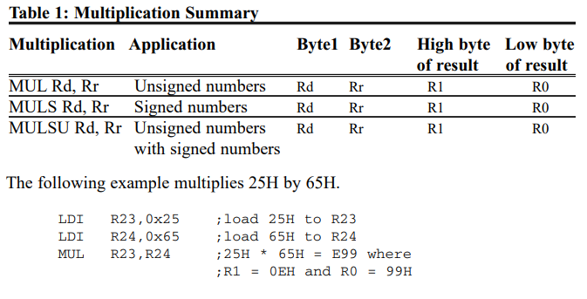
Multiplication of numbers
MUL is a byte-by-byte multiply instruction. In byte-by-byte multiplication, operands must be in registers. After multiplication, the 16-bit unsigned product is placed in R1 (high byte) and R0 (low byte).

Slide 10
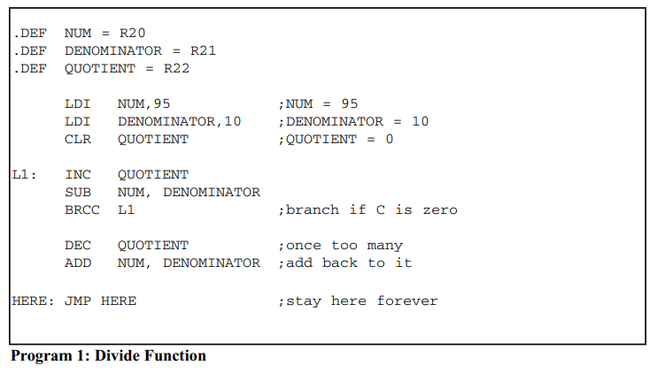
Division of unsigned numbers
AVR has no instruction for divide operation. We can write a program to perform division by repeated subtraction. In dividing a byte by a byte, the numerator is placed in a register and the denominator is subtracted from it repeatedly. The quotient is the number of times we subtracted, and the remainder is in the reg

Slide 11
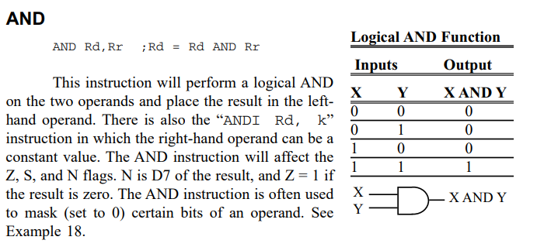
LOGIC AND COMPARE INSTRUCTIONS
Apart from I/O and arithmetic instructions, logic instructions are some of the most widely used instructions. In this section we cover Boolean logic instructions such as AND, OR, Exclusive-OR (XOR), and complement. We will also study the compare instruction

Slide 12
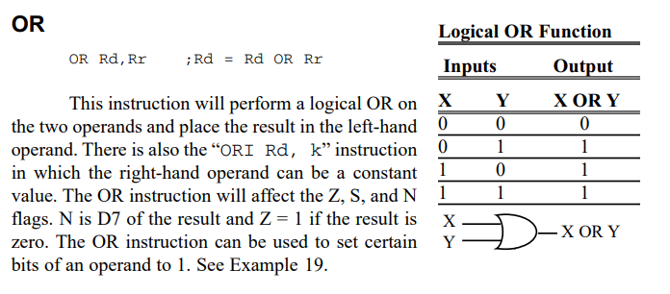
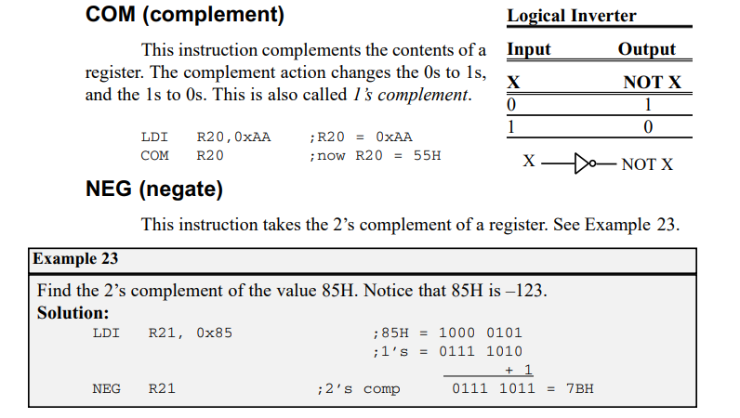
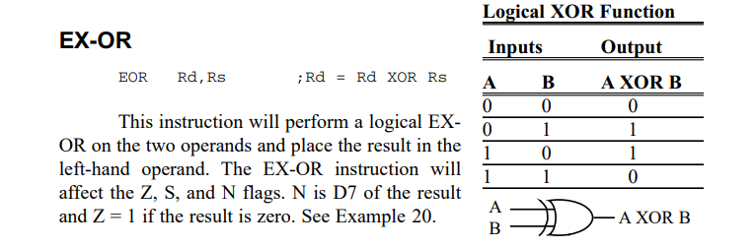
LOGIC AND COMPARE INSTRUCTIONS

Slide 13
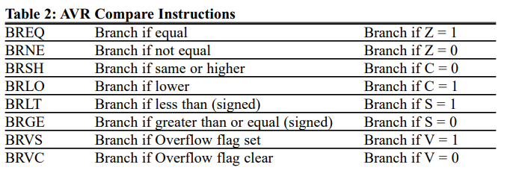
Compare instructions
The AVR has the CP instruction for the compare operation. The compare instruction is really a subtraction, except that the values of the operands do not change. There is also the “CPI Rd, k” instruction in which the right-hand operand can be a constant value.

Slide 14
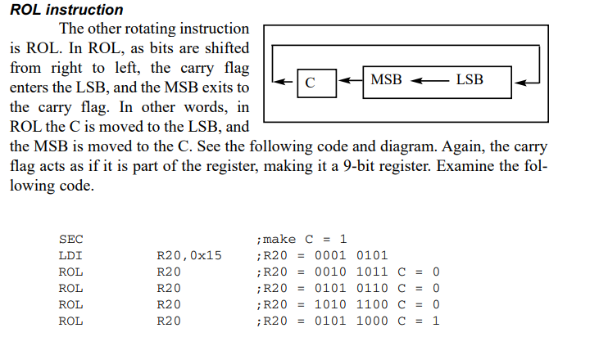
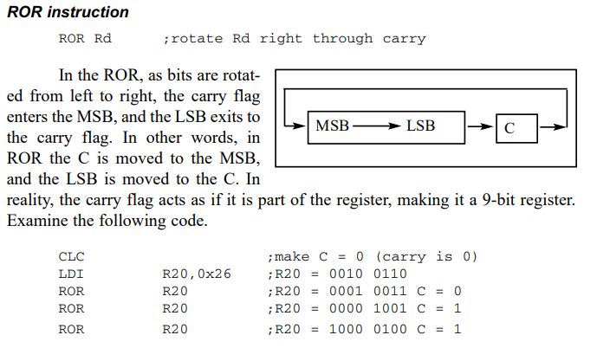
ROTATE AND SHIFT INSTRUCTIONS AND DATA SERIALIZATION
There are two ROTATE instructions in the AVR. They involve the carry flag. Each is shown next

Slide 15
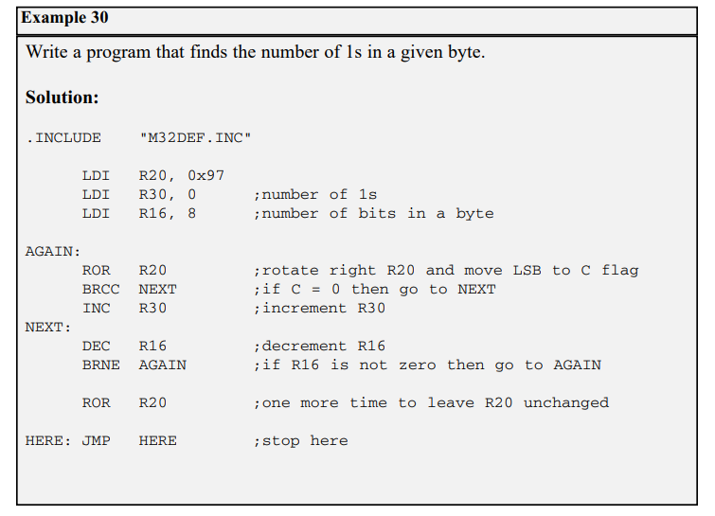
Serializing data
Using the serial port
transfer data one bit at a time and control the sequence of data and spaces between them

Slide 16
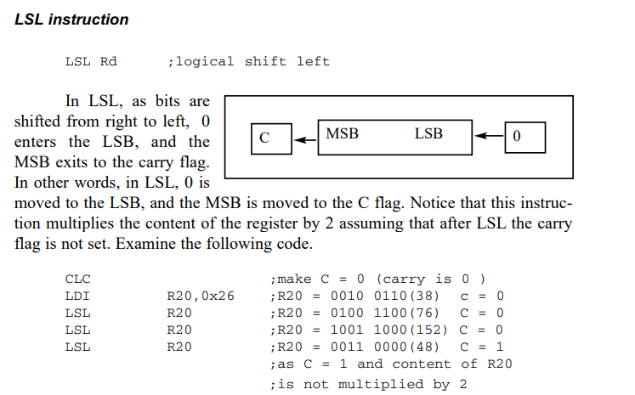
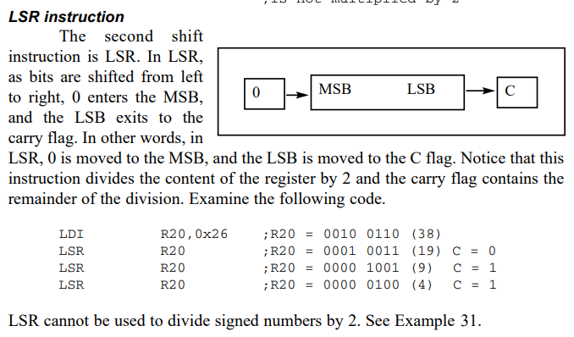
Shift instructions
There are three shift instructions in the AVR. All of them involve the carry flag. Each is shown next.

Slide 17
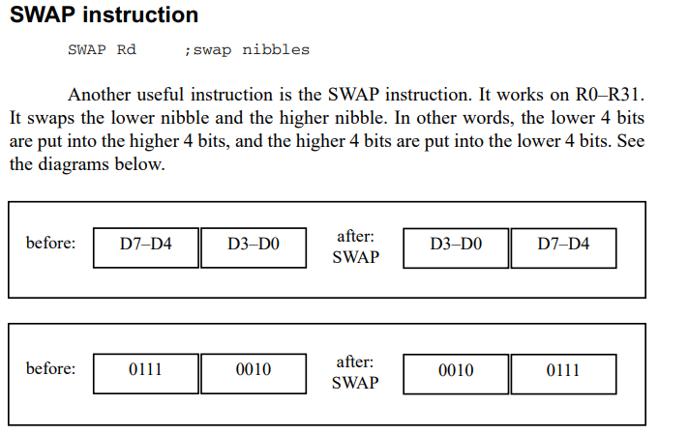
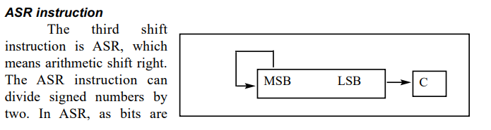
Swap and ASR instruction

Slide 18

Thank You

