Slide 1
Traffic Signs Recognition using CNN in Keras
Presentation prepared by
Team: 0_Confidence
Members From RUET CSE
Taki Tamim(2003002)
Tonmoy(2003027)
Md Abu Sufyan(2003085)

Slide 2
Introduction
Traffic sign recognition is a critical component for autonomous vehicles and driver assistance systems
Enables safer navigation by interpreting road signs automatically
Deep learning approaches, particularly Convolutional Neural Networks (CNNs), have shown remarkable accuracy in this task
This presentation covers a comprehensive implementation of traffic sign recognition using CNN with Keras which is a part of Advanced driver-assistance systems (ADAS)

Slide 3
Project Overview
{Dataset}: German Traffic Sign Recognition Benchmark (GTSRB)
{Classification}: 43 different classes of traffic signs
{Framework}: TensorFlow and Keras
{Approach}: CNN architecture for feature extraction and classification
{Implementation}: Complete pipeline from data preprocessing to web application deployment

Slide 4
Dataset Description
The German Traffic Sign Recognition Benchmark (GTSRB)
Contains more than 50,000 images of traffic signs
43 classes of signs (speed limits, no entry, stop, etc.)
Images are of varying sizes and lighting conditions
Real-world challenges: occlusion, weather effects, and viewpoint variations
Data organized into training, validation, and test sets

Slide 5
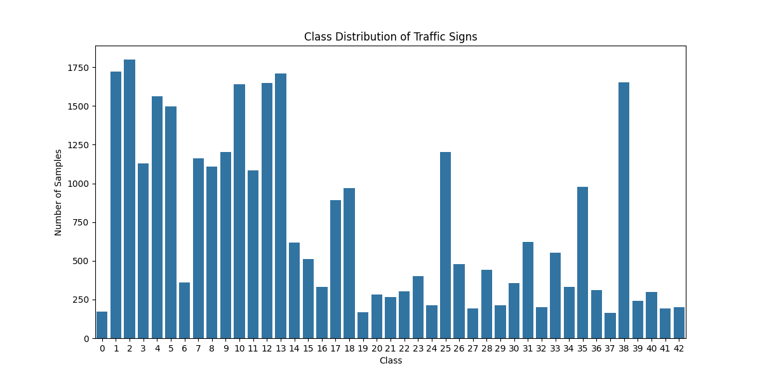
Exploratory Data Analysis
Analysis of class distribution shows imbalanced representation Visualization of sample images from each class Data insights inform preprocessing decisions

Slide 6
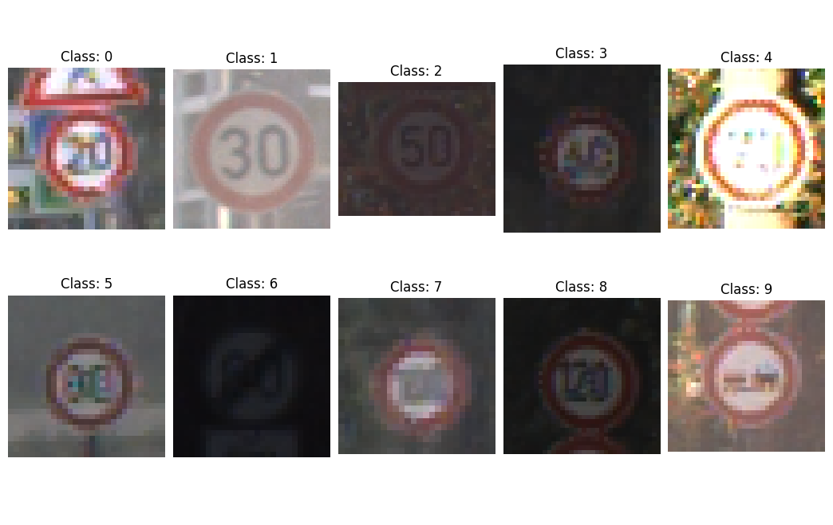
Sample Images Visualization
Visualization helps understand diversity in the dataset Variety in illumination, perspective, and quality Challenges for model training become apparent

Slide 7
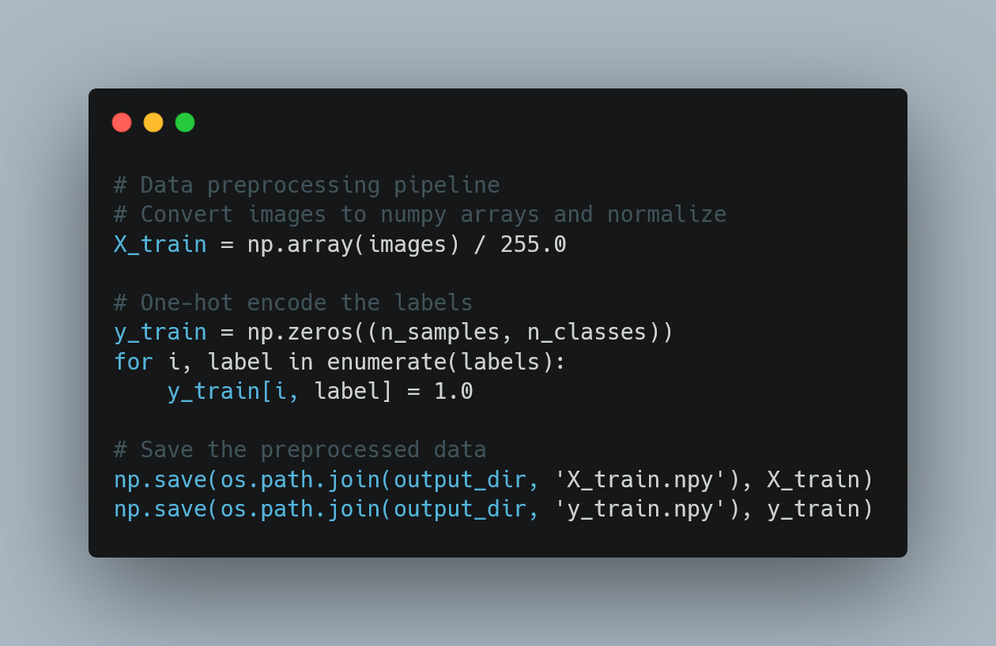
Data Preprocessing Strategy
{Image Resizing}: All images resized to 30×30 pixels for uniform input
{Normalization}: Pixel values scaled to [0,1] range
{Label Encoding}: One-hot encoding for multi-class classification
{Train-Test Split}: Data divided for training and evaluation
{Data Augmentation}: (Optional) To address class imbalance

Slide 8
CNN Architecture Overview
Convolutional Neural Networks are ideal for image classification, Architecture components:
Convolutional layers: Feature extraction.
Pooling layers: Dimensionality reduction.
Dropout layers: Regularization to prevent overfitting.
Dense layers: Classification based on extracted features.

Slide 9
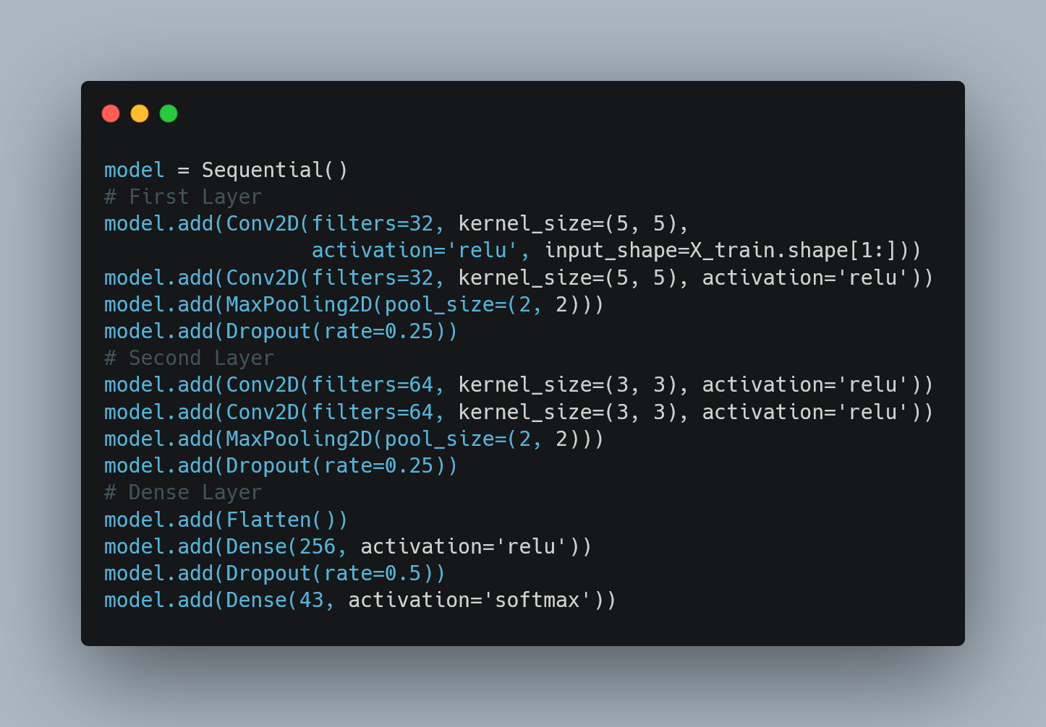
Model Architecture Implementation

Slide 10
Architectural Design ChoicesOutput Layer: 43 neurons with softmax activation for multi-class probabilities
Convolutional Layers:
Regularization Strategy:
Two blocks with increasing filter sizes (32 → 64)
Smaller kernel sizes in deeper layers (5×5 → 3×3)
ReLU activation for non-linearity
Dropout layers with varying rates (0.25 in conv blocks, 0.5 in dense)
MaxPooling for spatial downsampling and parameter reduction
Output Layer: 43 neurons with SoftMax activation for multi-class probabilities

Slide 11
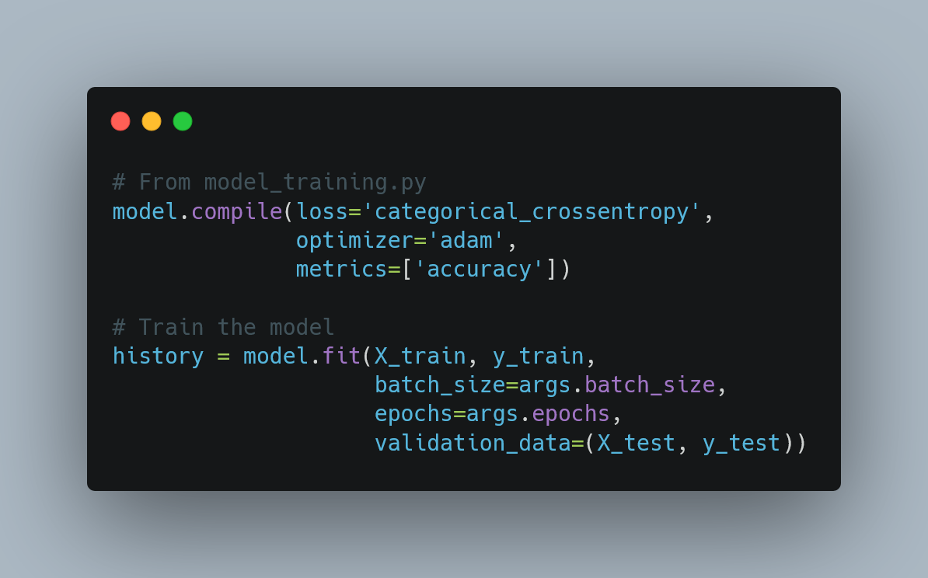
Training Configuration
{Loss Function}: Categorical Cross-Entropy (appropriate for multi-class)
{Optimizer}: Adam (adaptive learning rate)
{Metrics}: Accuracy to monitor performance
{Batch Size}: 64 (default)
{Epochs}: 20 (default, configurable via command line)

Slide 12
Model Training Workflow
Load preprocessed data from NumPy arrays.
Build the CNN model.
Configure training parameters.
Train with validation monitoring.
Save the best model and training history.

Slide 13
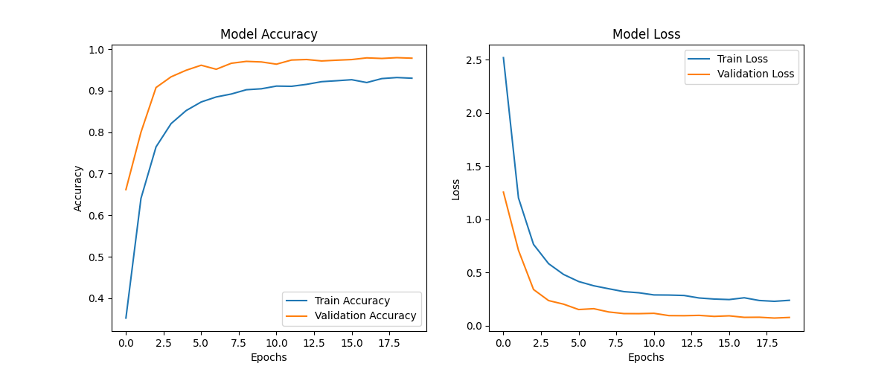
Evaluation Metrics
{Loss}: How far predictions deviate from actual labels
{Accuracy}: Percentage of correctly classified signs
{Training vs. Validation}: Monitoring for overfitting
{Confusion Matrix}: (Not implemented but valuable addition)
{Class-specific Performance}: Understanding per-class accuracy

Slide 14
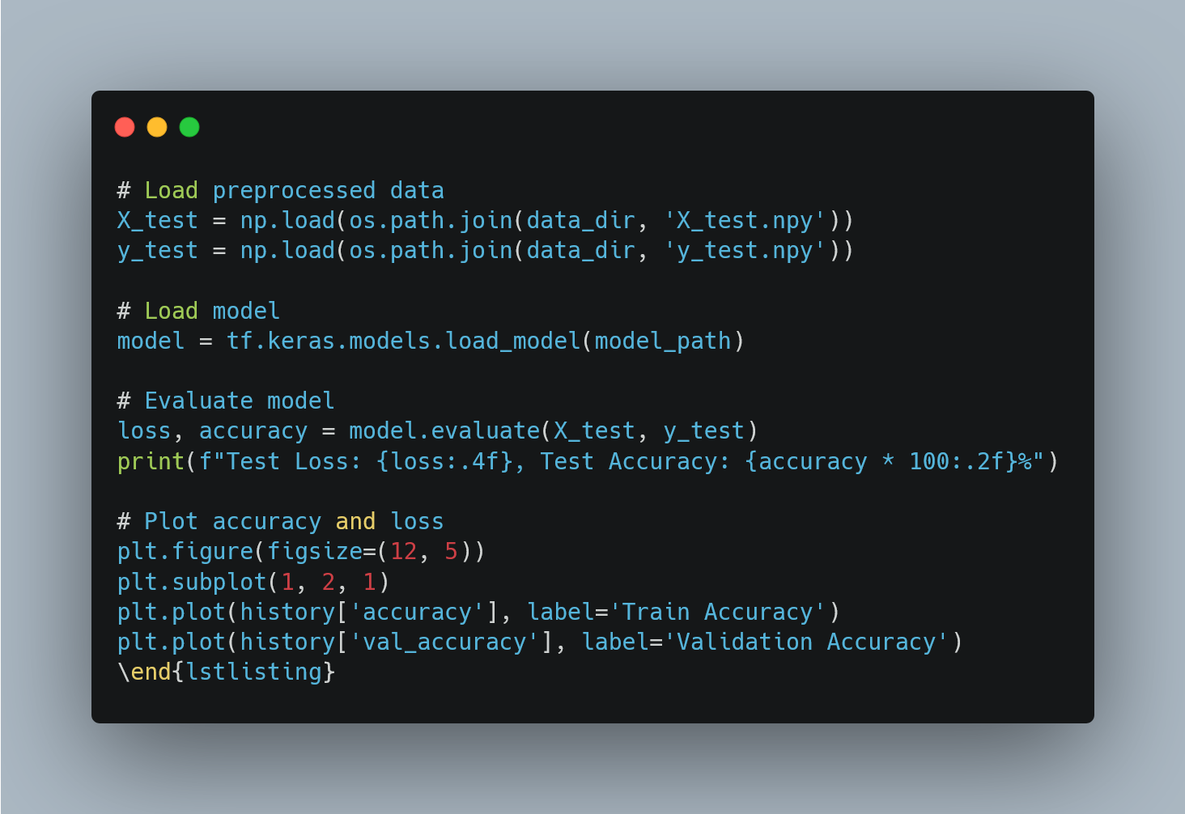
Evaluation Implementation
Training and validation curves provide insights:
Convergence: Is the model learning?
Overfitting: Is there a gap between training and validation?
Early stopping points: When did improvement plateau?

Slide 15
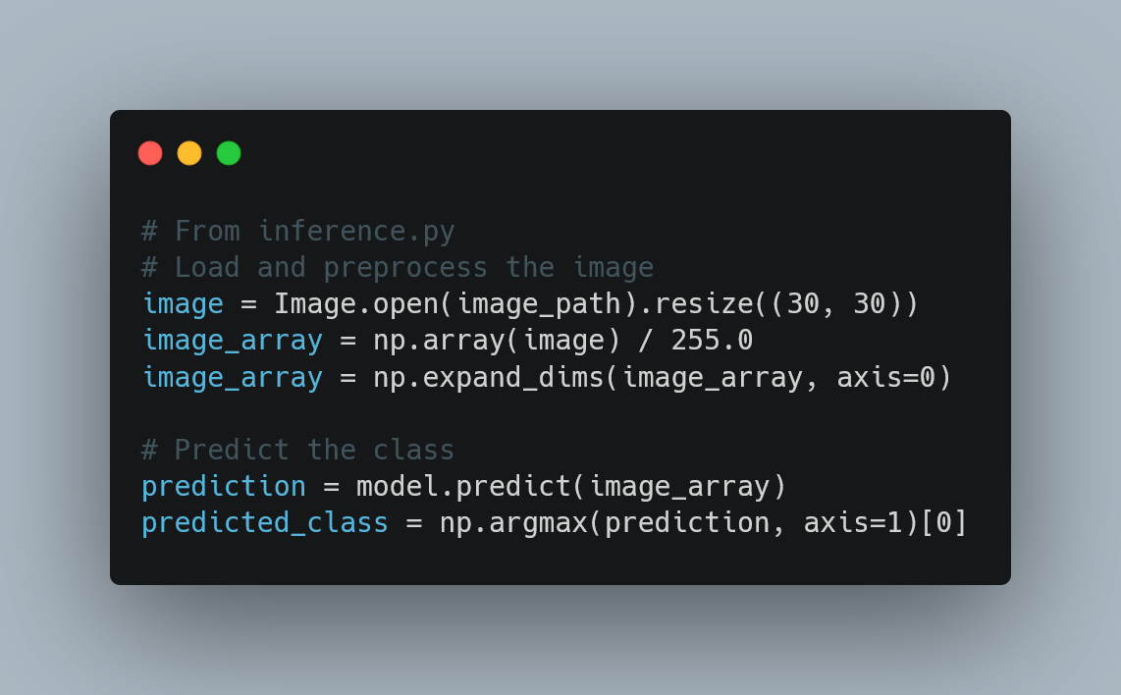
Inference Pipeline
Standalone inference module for testing single images.
Same preprocessing steps ensure consistency.

Slide 16
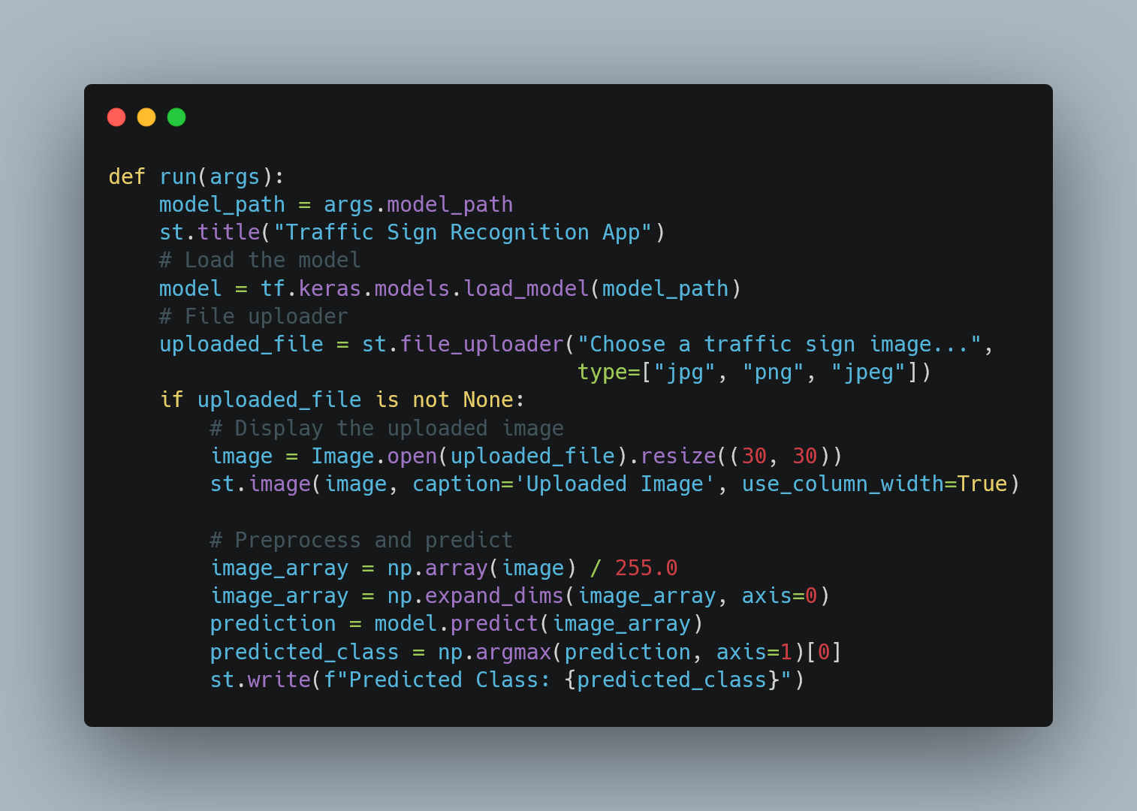
Streamlit Web Application

Slide 17
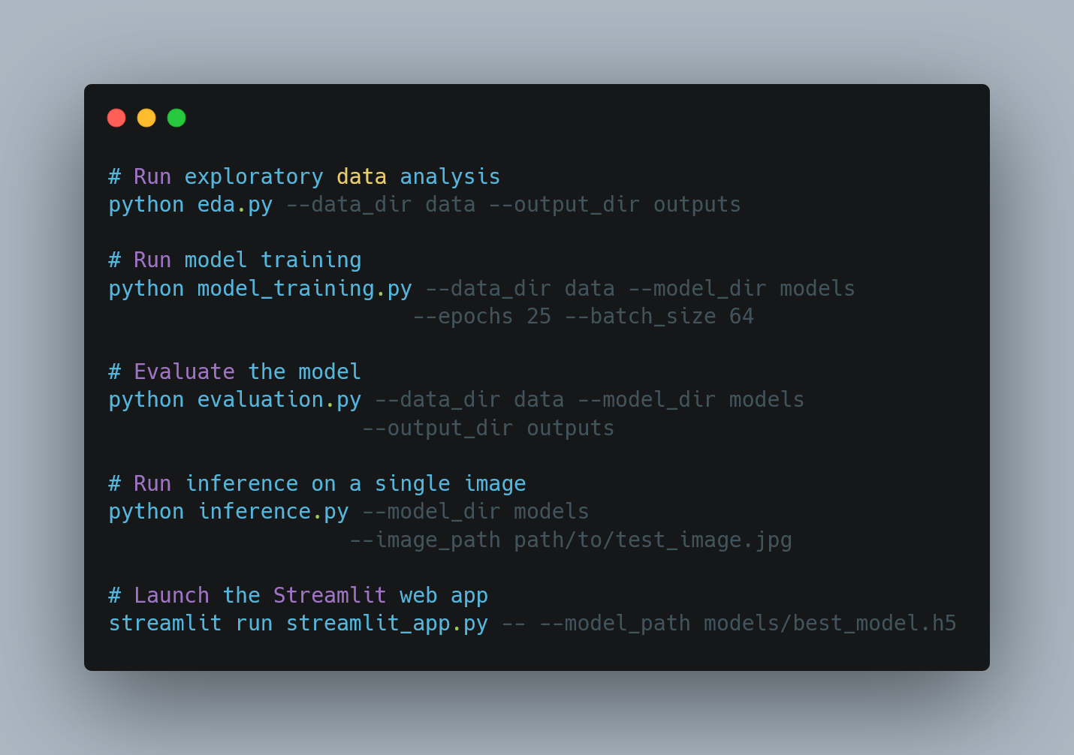
Command Line Execution

Slide 18
User Interface Features
Features:
Image upload capability
Real-time preprocessing and inference
Immediate display of results
User-friendly interface
Potential enhancements:
Class descriptions instead of just numbers
Confidence scores
Multiple prediction options
Beautiful Frontend Design

Slide 19
Complete Project Pipeline
{Data Collection}: Using GTSRB dataset
{Exploratory Data Analysis}: Understanding data characteristics
{Data Preprocessing}: Resizing, normalization, and encoding
{Model Development}: CNN architecture design
{Model Training}: Parameter optimization and validation
{Model Evaluation}: Performance assessment
{Inference}: Real-world testing
{Application Development}: User interface creation

Slide 20
Conclusion and Thank you
Traffic sign recognition is crucial for autonomous driving safety, CNN-based approach provides high accuracy and robust performance.
Complete pipeline from data preparation to deployment demonstration and The modular design allows for easy extension and improvement.

Slide 21
Traffic Signs Recognition using CNN in Keras
Presentation prepared by
Team: 0_Confidence
Members From RUET CSE
Taki Tamim(2003002)
Tonmoy(2003027)
Md Abu Sufyan(2003085)

Slide 22
Introduction
Traffic sign recognition is a critical component for autonomous vehicles and driver assistance systems
Enables safer navigation by interpreting road signs automatically
Deep learning approaches, particularly Convolutional Neural Networks (CNNs), have shown remarkable accuracy in this task
This presentation covers a comprehensive implementation of traffic sign recognition using CNN with Keras which is a part of ASDS.

Slide 23
Project Overview
{Dataset}: German Traffic Sign Recognition Benchmark (GTSRB)
{Classification}: 43 different classes of traffic signs
{Framework}: TensorFlow and Keras
{Approach}: CNN architecture for feature extraction and classification
{Implementation}: Complete pipeline from data preprocessing to web application deployment

Slide 24
Dataset Description
The German Traffic Sign Recognition Benchmark (GTSRB)
Contains more than 50,000 images of traffic signs
43 classes of signs (speed limits, no entry, stop, etc.)
Images are of varying sizes and lighting conditions
Real-world challenges: occlusion, weather effects, and viewpoint variations
Data organized into training, validation, and test sets

Slide 25
Exploratory Data Analysis
Analysis of class distribution shows imbalanced representation Visualization of sample images from each class Data insights inform preprocessing decisions

Slide 26
Sample Images Visualization
Visualization helps understand diversity in the dataset Variety in illumination, perspective, and quality Challenges for model training become apparent

Slide 27
Data Preprocessing Strategy
{Image Resizing}: All images resized to 30×30 pixels for uniform input
{Normalization}: Pixel values scaled to [0,1] range
{Label Encoding}: One-hot encoding for multi-class classification
{Train-Test Split}: Data divided for training and evaluation
{Data Augmentation}: (Optional) To address class imbalance

Slide 28
CNN Architecture Overview
Convolutional Neural Networks are ideal for image classification, Architecture components:
Convolutional layers: Feature extraction.
Pooling layers: Dimensionality reduction.
Dropout layers: Regularization to prevent overfitting.
Dense layers: Classification based on extracted features.

Slide 29
Model Architecture Implementation

Slide 30
Architectural Design ChoicesOutput Layer: 43 neurons with softmax activation for multi-class probabilities
Convolutional Layers:
Regularization Strategy:
Two blocks with increasing filter sizes (32 → 64)
Smaller kernel sizes in deeper layers (5×5 → 3×3)
ReLU activation for non-linearity
Dropout layers with varying rates (0.25 in conv blocks, 0.5 in dense)
MaxPooling for spatial downsampling and parameter reduction
Output Layer: 43 neurons with SoftMax activation for multi-class probabilities

Slide 31
Training Configuration
{Loss Function}: Categorical Cross-Entropy (appropriate for multi-class)
{Optimizer}: Adam (adaptive learning rate)
{Metrics}: Accuracy to monitor performance
{Batch Size}: 64 (default)
{Epochs}: 20 (default, configurable via command line)

Slide 32
Model Training Workflow
Load preprocessed data from NumPy arrays.
Build the CNN model.
Configure training parameters.
Train with validation monitoring.
Save the best model and training history.

Slide 33
Evaluation Metrics
{Loss}: How far predictions deviate from actual labels
{Accuracy}: Percentage of correctly classified signs
{Training vs. Validation}: Monitoring for overfitting
{Confusion Matrix}: (Not implemented but valuable addition)
{Class-specific Performance}: Understanding per-class accuracy

Slide 34
Evaluation Implementation
Training and validation curves provide insights:
Convergence: Is the model learning?
Overfitting: Is there a gap between training and validation?
Early stopping points: When did improvement plateau?

Slide 35
Inference Pipeline
Standalone inference module for testing single images.
Same preprocessing steps ensure consistency.

Slide 36
Streamlit Web Application

Slide 37
Command Line Execution

Slide 38
User Interface Features
Features:
Image upload capability
Real-time preprocessing and inference
Immediate display of results
User-friendly interface
Potential enhancements:
Class descriptions instead of just numbers
Confidence scores
Multiple prediction options
Beautiful Frontend Design

Slide 39
Complete Project Pipeline
{Data Collection}: Using GTSRB dataset
{Exploratory Data Analysis}: Understanding data characteristics
{Data Preprocessing}: Resizing, normalization, and encoding
{Model Development}: CNN architecture design
{Model Training}: Parameter optimization and validation
{Model Evaluation}: Performance assessment
{Inference}: Real-world testing
{Application Development}: User interface creation

Slide 40
Conclusion and Thank you
Traffic sign recognition is crucial for autonomous driving safety, CNN-based approach provides high accuracy and robust performance.
Complete pipeline from data preparation to deployment demonstration and The modular design allows for easy extension and improvement.

