Slide 1
Presentation By
Team 1:
Md. Anik Biswas
Md. Shoriful Islam
Siben Kumar

Slide 2
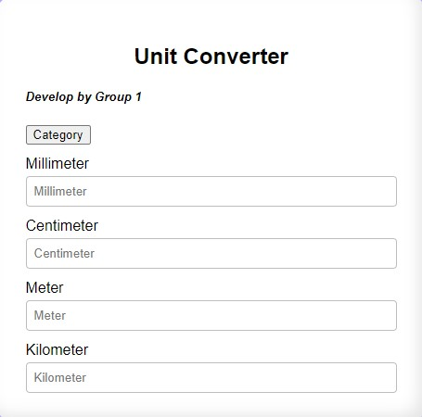
(Measurement, CGPA, Number Conversion)

Slide 3
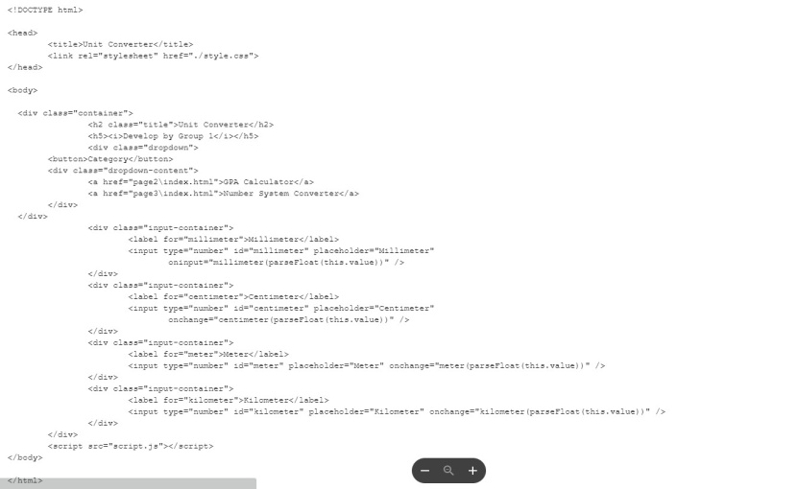
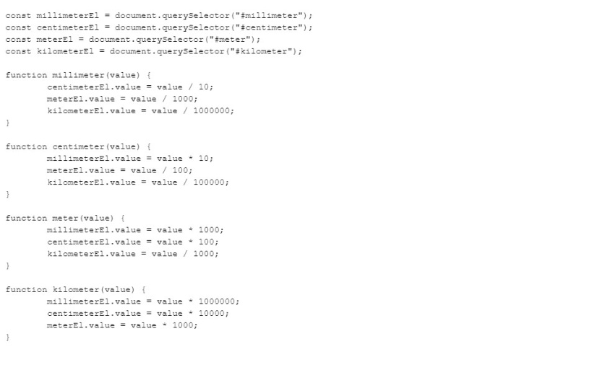
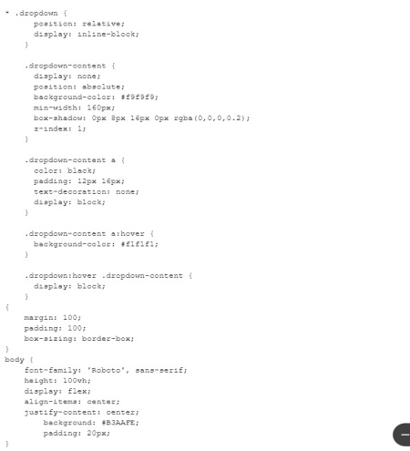
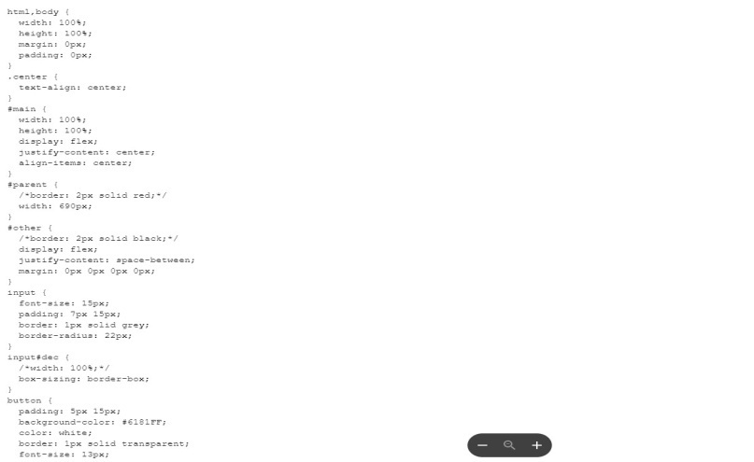
Some Copy's of Our coding

Slide 4
Discussion About Project
This Project Created to Based on Water Fall Model.
This Project Follow SDLC Steps.
It Helps Everyone to Solve Their Daily Task.
This Converter Gives the Correct Solutions.
This Project are Online Prototype Converter.

Slide 5
Why This is Water Fall Model
Because
Requirement Gathering :
Our Projects are Three Headed Converter, So At First We Gather All Requirements For Design.
Design :
When We Gather All Requirements, We Design and Coding Different Raw Design For Three type Converter.
Implementation :
After Design We Implement Our Different Design in One Frame and Make a Final Copy.

Slide 6
Why This is Water Fall Model
Testing :
After Design and Coding, We Run It and Find Errors and Debug all Errors.
Maintenance :
Complete Testing Step, When We Find Errors, Again We Looped on 1st Step and Continue All Steps Again Wheatear Fix all Errors .

Slide 7
Thank You

