Slide 1
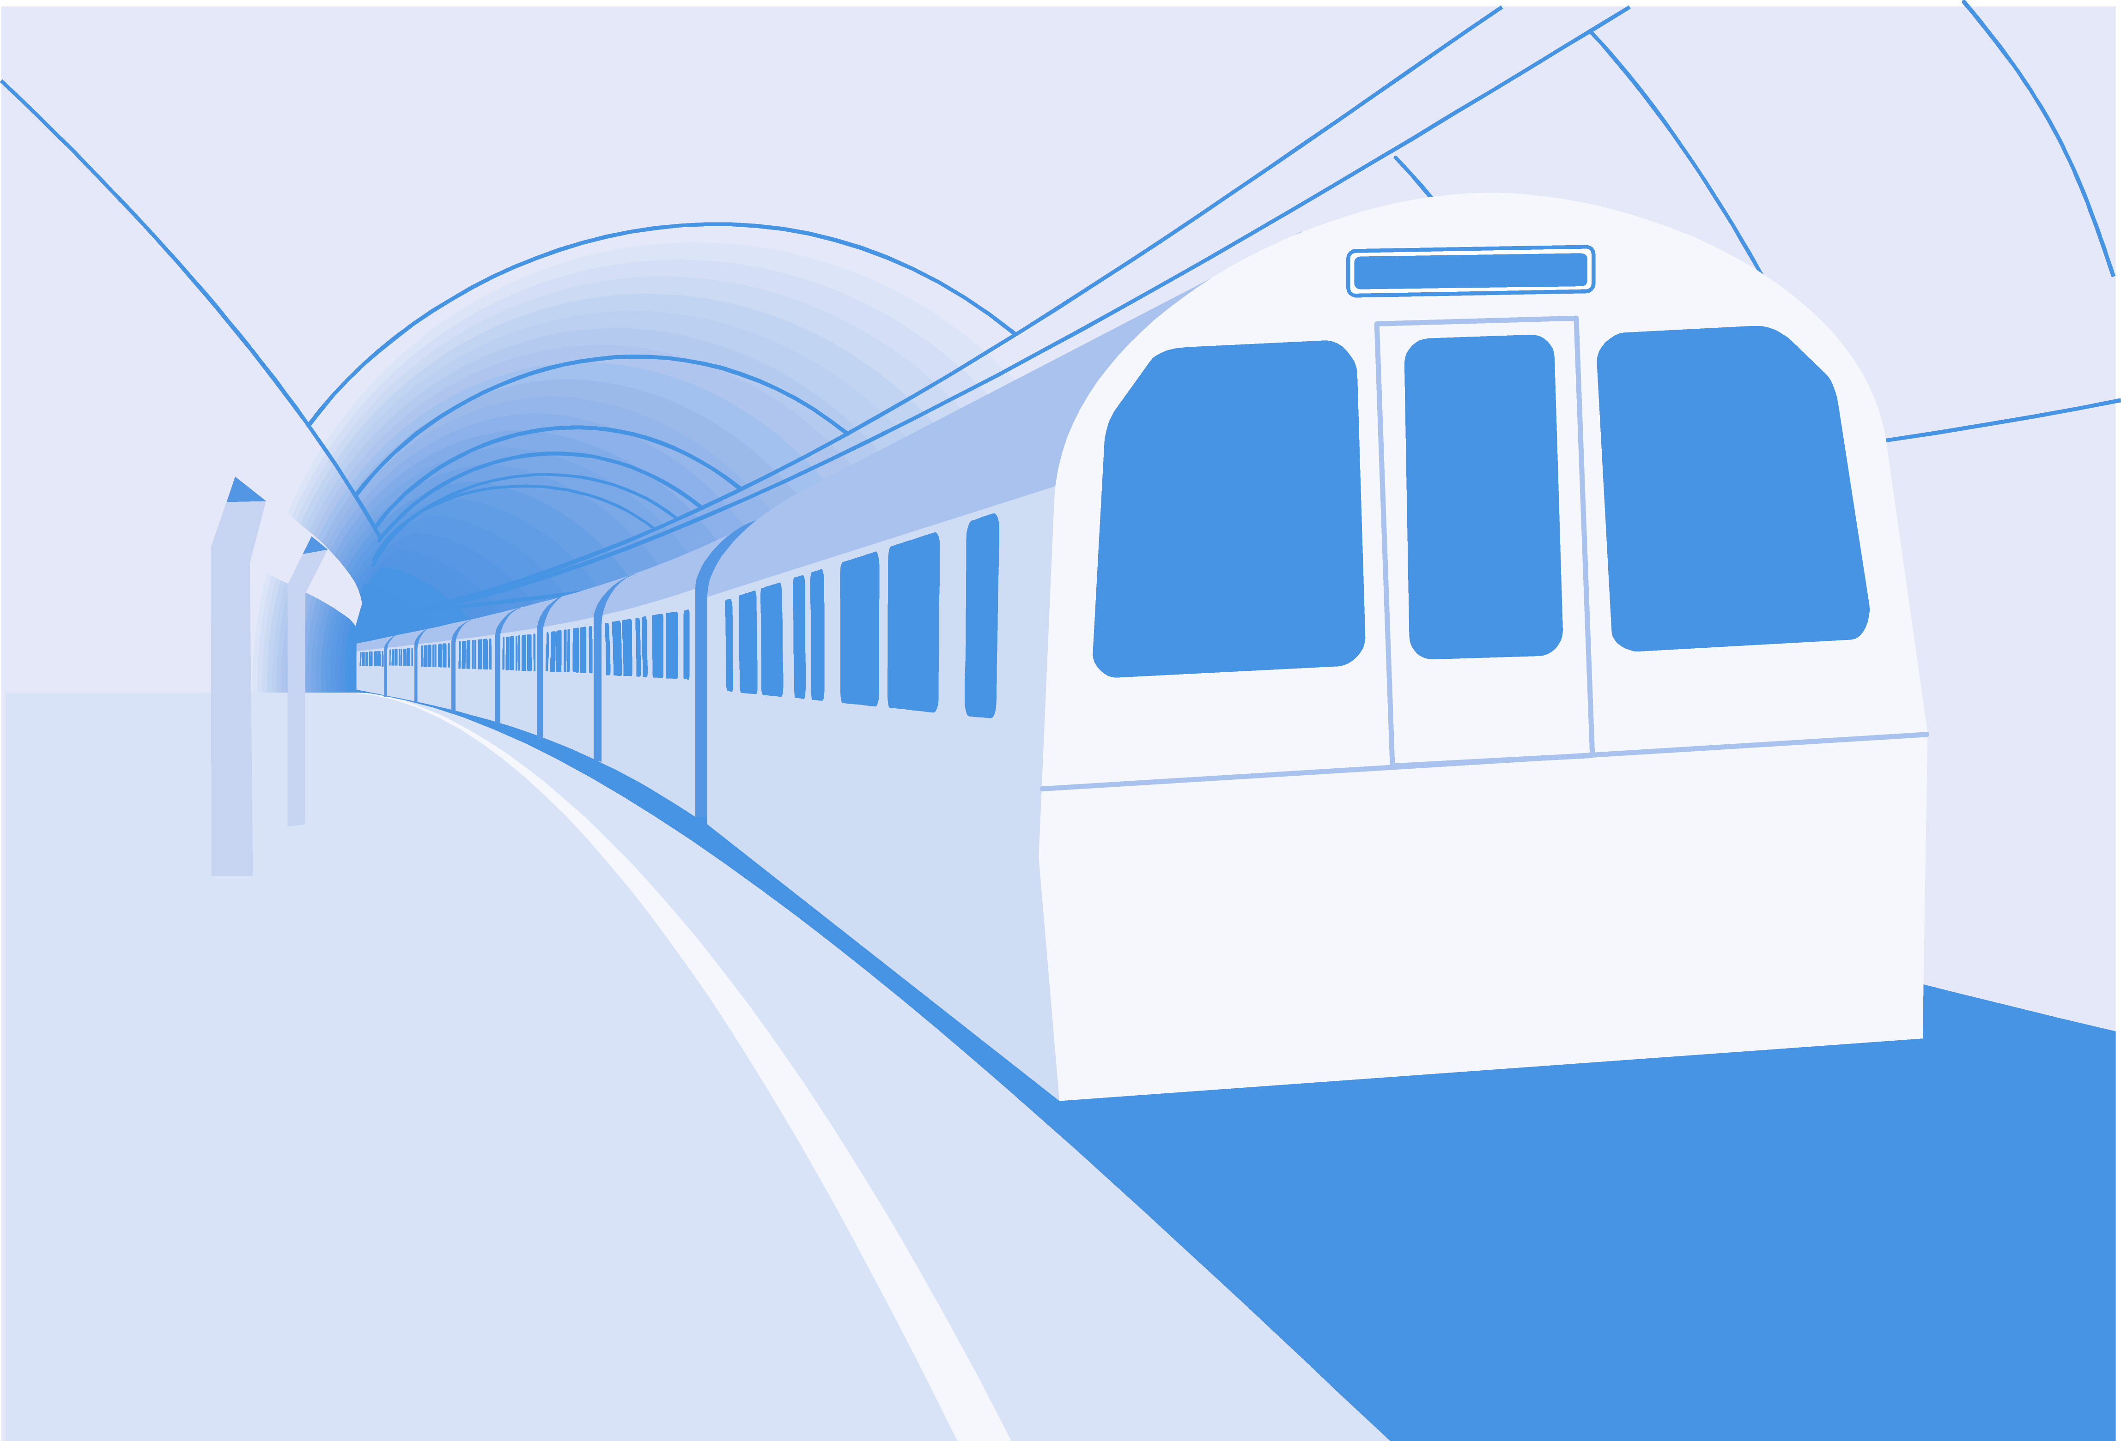
Game
Programming
© Wiley Publishing. 2006. All Rights Reserved.

Slide 2
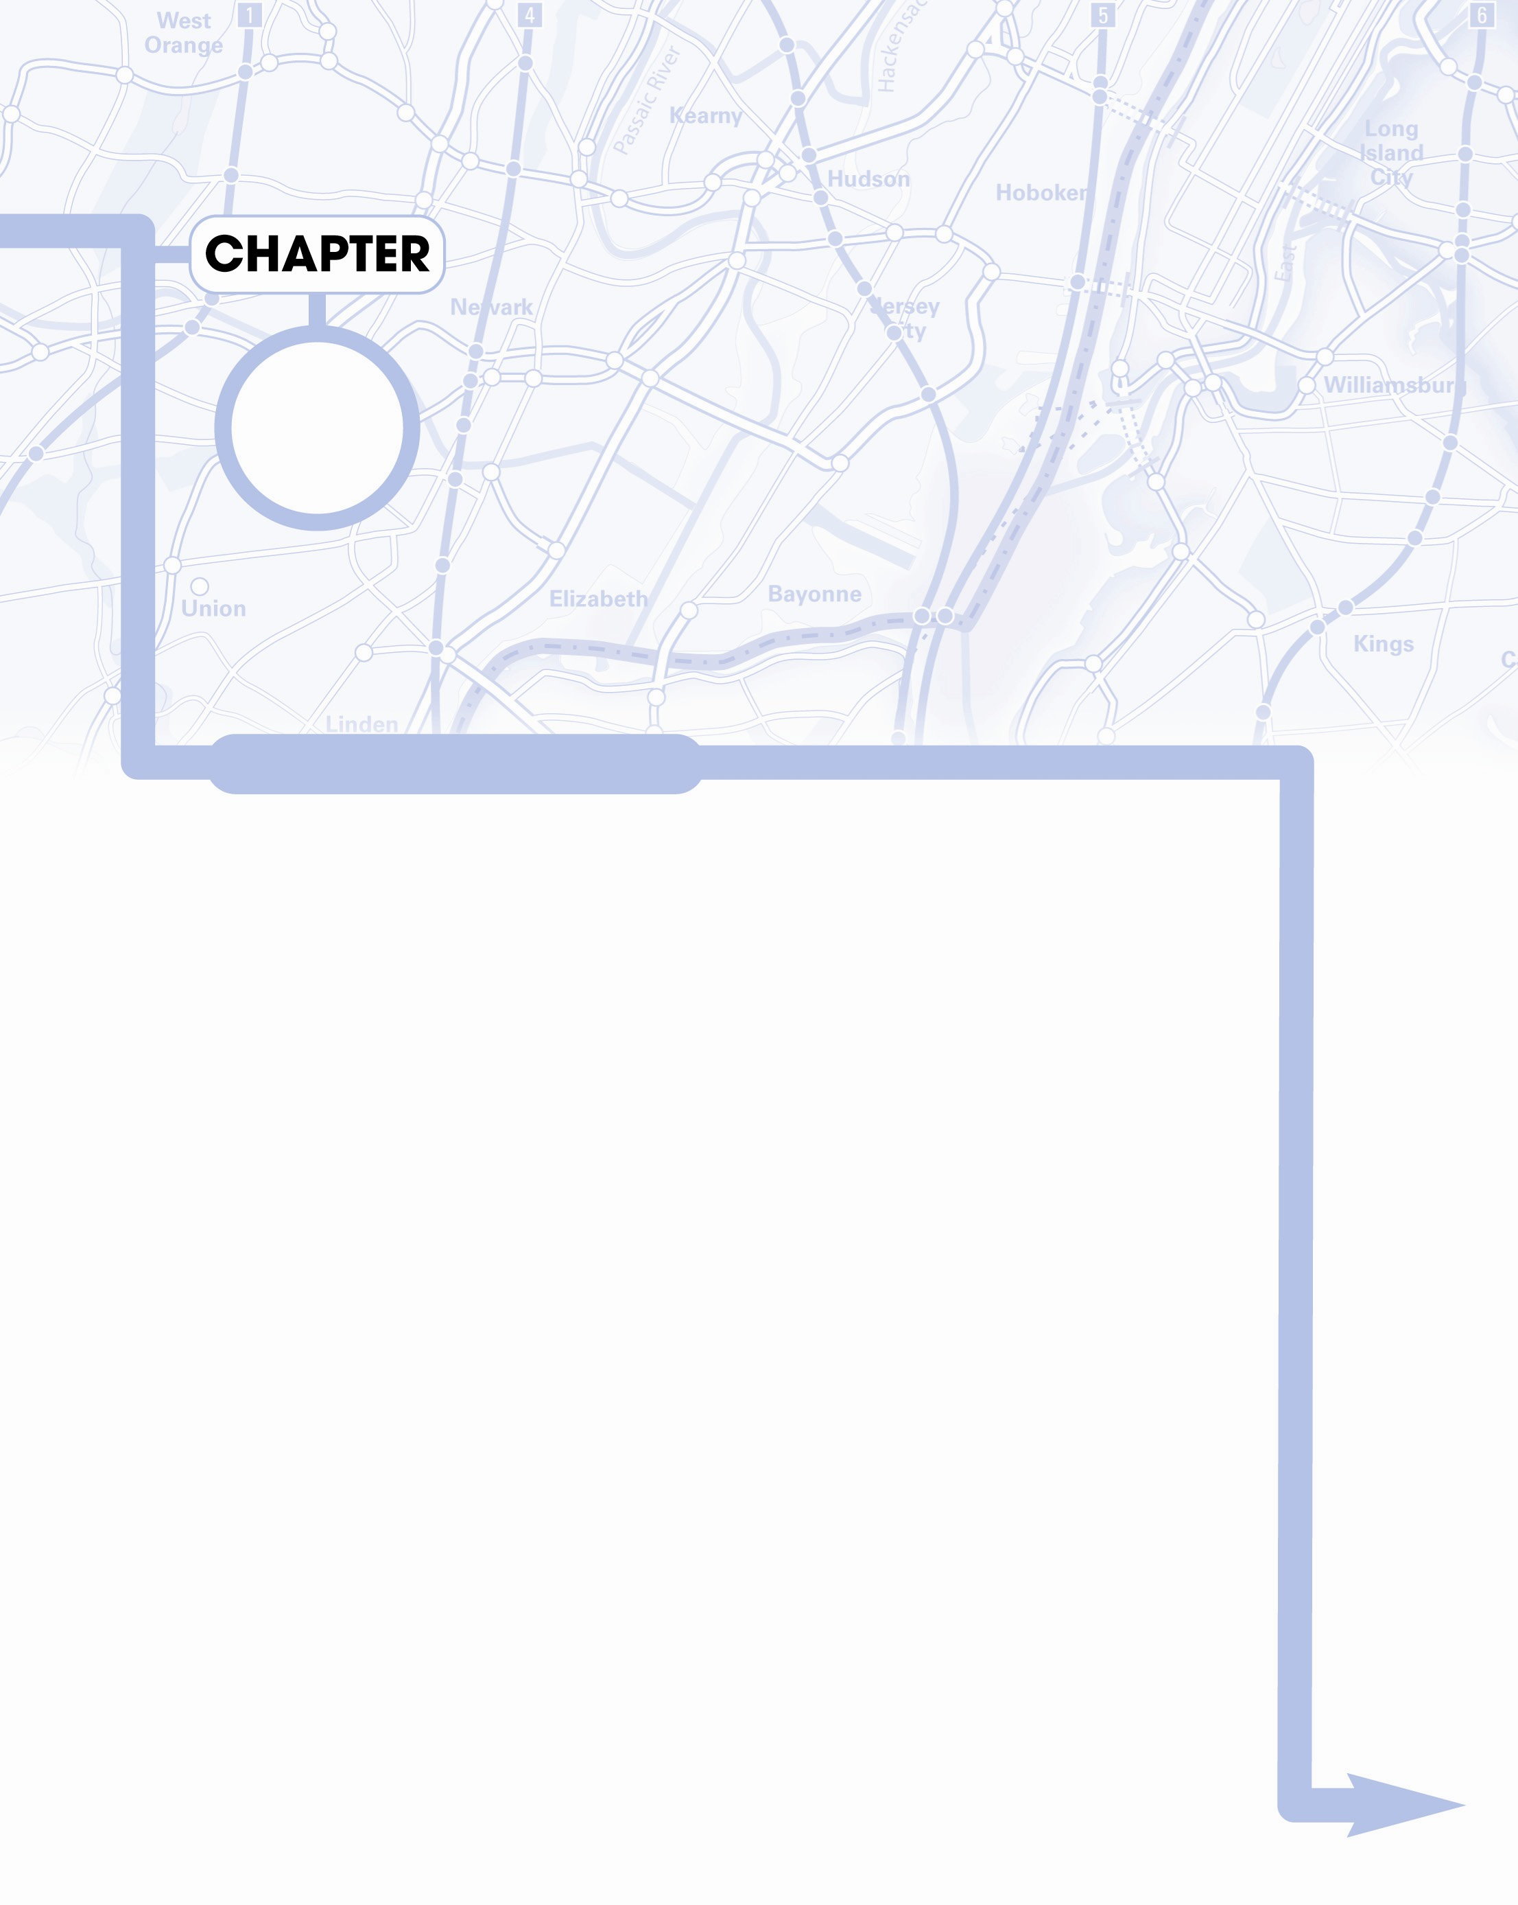
Realistic
Movement
9
Stations Along the Way
Understanding basic rules of motion
Getting continuous input from the keyboard
Firing missiles from sprites
Using vector projection
Calculating distance and angle between points

Slide 3
Realistic
Movement
(cont'd)
9
Stations Along the Way
Following the mouse
Handling basic gravity
Building a vehicle model with power, turning rate, and drag
Modeling spacecraft motion
Handling orbital physics

Slide 4
Gaming and Physics
Games are about things moving around
To get motion right, you must understand how it works in the real world
Basic physics describes these phenomena
You should still take a more formal physics course

Slide 5
Newton's Laws
Describe how things move
Three primary laws
  An object at rest stays at rest
  Force = mass * acceleration
  Every action has an equal and opposite reaction
Understanding these principles gives you ability to model motion

Slide 6
Vectors
Vector - has direction and magnitude. Object motion is a vector, because magnitude is speed, direction is an angle
Vector components - a vector can also be described in dx, dy terms. Converting from speed/direction to dx/dy is vector projection

Slide 7
Motion Terms
Position - the current position of an object, usually an (x, y) coordinate pair
Velocity- a change in position during a time frame. Often determined as a vector and converted to dx/dy components for convenience. Measured in pixels per frame (ppf)
Acceleration - a change in velocity. A vector often changed to ddx/ddy. Sometimes called a force vector

Slide 8
Multiple Force Vectors
Motion is a combination of various forces
A balloon has weight pulling it down
Helium adds a buoyant force pulling it up
Wind adds a sideways force
How will the balloon move?

Slide 9
Adding force Vectors
It's easy to calculate multiple force vectors
Convert each force into dx/dy components
Add all dx values to get a total dx
Add all dy values to get a total dy

Slide 10
Force Vector Example
Force | X component | Y component
Gravity | 0 | 1
Buoyancy | 0 | -3
Wind | 4 | 0
Total | 4 | 2

Slide 11
Getting continuous keyboard input
So far keyboard has been one event per keypress
Sometimes you want continuous action as long as key is down
This uses a technique called hardware polling

Slide 12
Advantages of hardware polling
Sprite can handle its own key presses
Keyboard input can be continuous
Motion appears much smoother
It's pretty easy to implement
See turret.py
  Continuous keyboard input
  Very smooth rotation

Slide 13
Building a Rotating Turret
def __init__(self):
pygame.sprite.Sprite.__init__(self)
self.imageMaster = pygame.image.load("turret.gif")
self.imageMaster = self.imageMaster.convert()
self.rect = self.imageMaster.get_rect()
self.rect.center = (320, 240)
self.turnRate = 10
self.dir = 0
def update(self):
self.checkKeys()
self.rotate()

Slide 14
Notes on Turret class
Load image into a master image
  (to preserve quality when rotating)
Keep turret in center of screen
Set up turnRate constant
  Smaller is slower and smoother
Set a dir constant
Update involves:
  Checking keyboard
  Rotating turret

Slide 15
Checking the Keyboard
Done in the Turret's checkKeys() method
def checkKeys(self):
keys = pygame.key.get_pressed()
if keys[pygame.K_LEFT]:
self.dir += self.turnRate
if self.dir > 360:
self.dir = self.turnRate
if keys[pygame.K_RIGHT]:
self.dir -= self.turnRate
if self.dir < 0:
self.dir = 360 - self.turnRate

Slide 16
How it works
Store pygame.key.get_pressed() in a variable
It is a tuple of binary values, one for each key on the keyboard
Use a keyboard constant to check a particular key
Checking for left arrow:
keys = pygame.key.get_pressed()
if keys[pygame.K_LEFT]:

Slide 17
Rotating the Turret
Just like chapter 8:
  Save center
  Transform new image from imgMaster
  Place back in center
def rotate(self):
oldCenter = self.rect.center
self.image = pygame.transform.rotate(self.imageMaster,
self.dir)
self.rect = self.image.get_rect()
self.rect.center = oldCenter

Slide 18
Building Main Loop
No keyboard handling!
  NOTE: you still need the event.get() mechanism
keepGoing = True
while keepGoing:
clock.tick(30)
for event in pygame.event.get():
if event.type == pygame.QUIT:
keepGoing = False
allSprites.clear(screen, background)
allSprites.update()
allSprites.draw(screen)
pygame.display.flip()

Slide 19
Vector Projection
Chapter eight projects a vector in eight directions
What if you want any direction, any speed?
You should be able to convert any vector into its dx/dy components
This process is vector projection

Slide 20
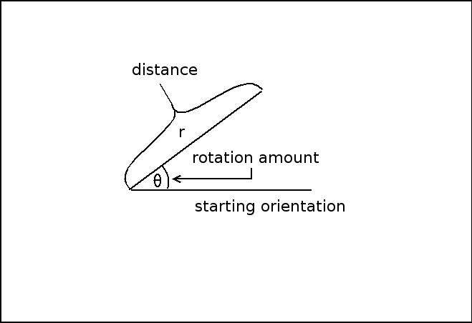
Looking at the problem

Slide 21
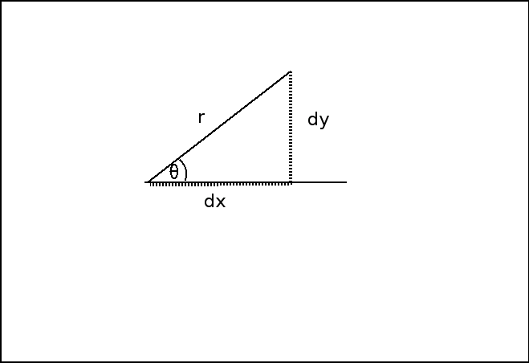
Building a Triangle

Slide 22
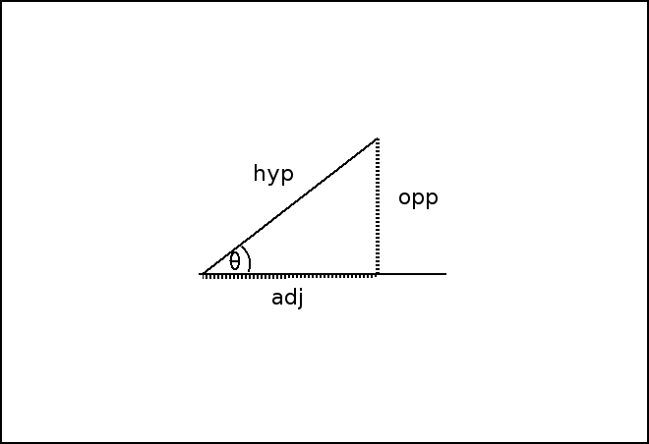
Using Trig Terms

Slide 23
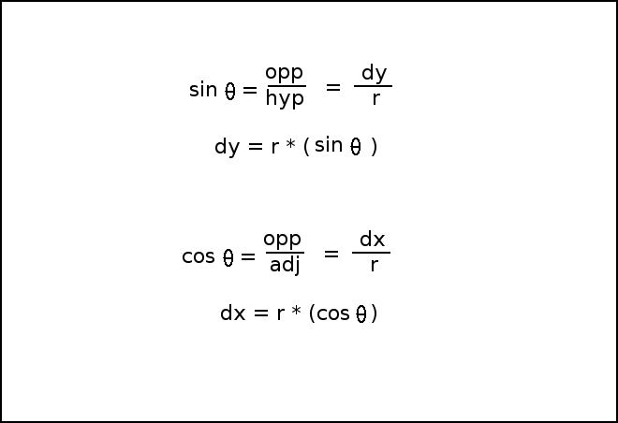
Solving for dy and dx

Slide 24
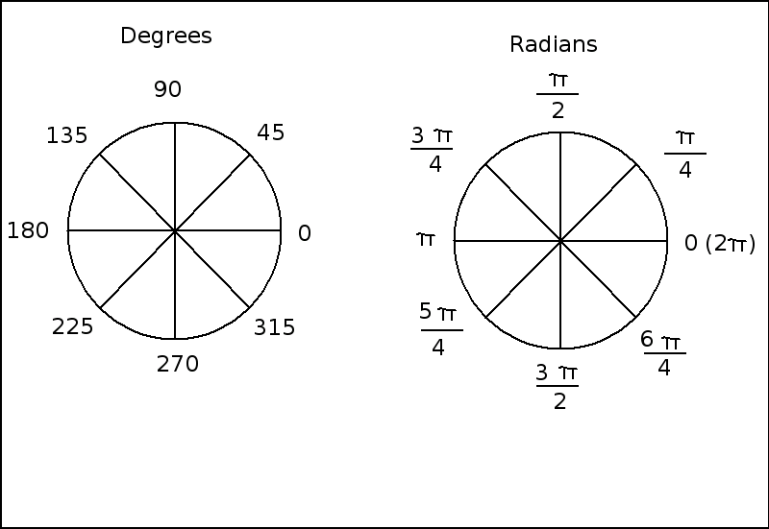
Dealing with radians

Slide 25
How vecProj.py works
Done in text mode for simplicity
Import math module to get trig functions
Begin a loop
Input values for angle and distance
Convert angle to radians
Calculate dx and dy
Invert dy (in math y increases upward)
Output value
Ask user if he wants to repeat

Slide 26
The vecProj.py program
""" vecProj
given any angle and distance,
converts to dx and dy
No GUI.
"""
import math
def main():
keepGoing = True
while keepGoing:
print
print "Give me an angle and distance,"
print "and I'll convert to dx and dy values"
print
r = float(raw_input("distance: "))
degrees = float(raw_input("angle (degrees): "))

Slide 27
vecProj.py continued
theta = degrees * math.pi / 180
dx = r * math.cos(theta)
dy = r * math.sin(theta)
# compensate for inverted y axis
dy *= -1
print "dx: %f, dy: %f" % (dx, dy)
response = raw_input("Again? (Y/N)")
if response.upper() != "Y":
keepGoing = False

Slide 28
Making the Turret Fire
With vector projection, you can make the turret fire a projectile
The bullet gets dx and dy by projecting the turret's direction
A label is added to output direction and charge
See turretFire.py

Slide 29
Adding a Label Class
class Label(pygame.sprite.Sprite):
""" Label Class (simplest version)
Properties:
font: any pygame font object
text: text to display
center: desired position of label center (x, y)
"""
def __init__(self):
pygame.sprite.Sprite.__init__(self)
self.font = pygame.font.SysFont("None", 30)
self.text = ""
self.center = (320, 240)
def update(self):
self.image = self.font.render(self.text, 1, (0, 0, 0))
self.rect = self.image.get_rect()
self.rect.center = self.center

Slide 30
Updating the Shell class
The turret instance needs to know about the shell instance
Pass the shell as a parameter to turret constructor
Store shell as an attribute of the turret
class Turret(pygame.sprite.Sprite):
def __init__(self, shell):
self.shell = shell
# … other init code here…

Slide 31
Add a charge property to the turret
The turret doesn't move, so it isn't correct to call it speed.
The charge indicates the speed of the shell when it is fired.
Add a charge attribute in turret constructor
class Turret(pygame.sprite.Sprite):
def __init__(self, shell):
# … other init code here …
self.charge = 5

Slide 32
Modify checkKeys() method
Up and down keys - change charge
Space bar fires shell
if keys[pygame.K_UP]:
self.charge += 1
if self.charge > 20:
self.charge = 20
if keys[pygame.K_DOWN]:
self.charge -= 1
if self.charge < 0:
self.charge = 0
if keys[pygame.K_SPACE]:
self.shell.x = self.rect.centerx
self.shell.y = self.rect.centery
self.shell.speed = self.charge
self.shell.dir = self.dir

Slide 33
Firing the shell
Set shell's position equal to turret's position
  (so shell seems to be coming from turret)
Set shell's speed to turret's charge
Set shell's direction to turret's direction

Slide 34
Creating the Shell class
The shell itself is very ordinary
I drew a circle rather than importing an image
It hides offstage(-100, -100) when not needed
It doesn't really get created by the turret - it's always around, just offstage
This kind of illusion is very common

Slide 35
Calculating the shell's vector
Use trig functions to determine dx and dy
Don't forget to invert dy to compensate for y increasing downward
def calcVector(self):
radians = self.dir * math.pi / 180
self.dx = self.speed * math.cos(radians)
self.dy = self.speed * math.sin(radians)
self.dy *= -1

Slide 36
Resetting the shell
Move the shell offstage
Set speed to 0 so it doesn't wander back
def reset(self):
""" move off stage and stop"""
self.x = -100
self.y = -100
self.speed = 0

Slide 37
Modifying the main code
Make all three sprites
Update the label in main loop
shell = Shell(screen)
turret = Turret(shell)
lblOutput = Label()
lblOutput.center = (100, 20)
allSprites = pygame.sprite.Group(shell, turret, lblOutput)
lblOutput.text = "dir: %d speed %d" % (turret.dir,
turret.charge)
allSprites.clear(screen, background)
allSprites.update()
allSprites.draw(screen)
pygame.display.flip()

Slide 38
Following the Mouse
Vector projection converts angle and distance to dx/dy.
Sometimes you have dx/dy and want angle and distance
More often you have two points and want angle and distance between them
See followMouse.py

Slide 39
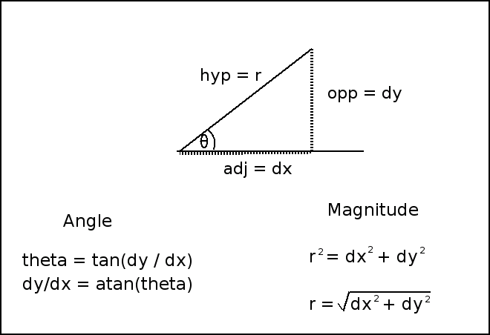
Converting components back to vectors

Slide 40
Modifying the Turret class
The turret class no longer reads the keyboard, so now its update calls a followMouse() method
def update(self):
self.followMouse()
self.rotate()

Slide 41
Making a turret point towards the mouse
Compare turret position with mouse position
Subtract x values for dx
Subtract y values for dy
Use atan() function to find inverse tangent
Convert to degrees
Rotate turret

Slide 42
Following the Mouse
def followMouse(self):
(mouseX, mouseY) = pygame.mouse.get_pos()
dx = self.rect.centerx - mouseX
dy = self.rect.centery - mouseY
dy *= -1
radians = math.atan2(dy, dx)
self.dir = radians * 180 / math.pi
self.dir += 180
#calculate distance
self.distance = math.sqrt((dx * dx) + (dy * dy))

Slide 43
How followMouse() works
Subtract positions to get dx, dy
Compensate for inverted y axis
Calculate angle between turret and mouse
  atan2() function works even when dy is 0
Convert radian result to degrees
Offset by 180
  Result of atan2() is between -180 and 180
Calculate distance with Pythagorean Theorem

Slide 44
Basic Gravity Concepts
Trajectories normally (near a planet) follow parabolic paths
The horizontal speed of a projectile stays nearly constant (at least in game)
The vertical velocity decreases
The object appears to pause at the top of the arc
It hits the ground at the same speed it left the cannon

Slide 45
Simulating Basic Gravity
See turretGrav.py
Turret is now viewed from the side
The shell follows a realistic arc
The arc is drawn on the screen as the shell moves

Slide 46
Adding gravity to the shell class
Add a gravitational constant to the shell
Set the initial dx and dy when the shell is fired
Add a call to calcPos() in update()
self.gravity = .5
def update(self):
self.calcPos()
self.checkBounds()
self.rect.center = (self.x, self.y)

Slide 47
Adding the gravitational force
Compensate for gravity in calcPos()
Draw the shell's path
def calcPos(self):
#compensate for gravity
self.dy += self.gravity
#get old position for drawing
oldx = self.x
oldy = self.y
self.x += self.dx
self.y += self.dy
pygame.draw.line(self.background,
(0,0,0), (oldx, oldy), (self.x, self.y))

Slide 48
Drawing on the background
Drawing on the screen is temporary
To keep the drawings, draw on the background instead
Pass the background to the shell as a parameter
Shell draws its path on the background
To erase the drawing, re-fill the background surface

Slide 49
Building a vector-based vehicle
Vector-projection can add realism to vehicle models
Write sprite code like done in chapter eight
Change calcVector() method to incorporate vector projection
See carVec.py

Slide 50
Creating a vector-based car sprite
Add turnRate and accel properties to the car in its init() method:
Design an update() method to pass control around:
self.turnRate = 3
self.accel = .1
self.x = 320
self.y = 240
def update(self):
self.checkKeys()
self.rotate()
self.calcVector()
self.checkBounds()
self.rect.center = (self.x, self.y)

Slide 51
Checking the keys
def checkKeys(self):
keys = pygame.key.get_pressed()
if keys[pygame.K_RIGHT]:
self.dir -= self.turnRate
if self.dir < 0:
self.dir = 360 - self.turnRate
if keys[pygame.K_LEFT]:
self.dir += self.turnRate
if self.dir > 360:
self.dir = self.turnRate
if keys[pygame.K_UP]:
self.speed += self.accel
if self.speed > 10:
self.speed = 10
if keys[pygame.K_DOWN]:
self.speed -= self.accel
if self.speed < -3:
self.speed = -3

Slide 52
Calculating the vector
Use vector projection
Check code for other details - they are just like chapter 8
def calcVector(self):
radians = self.dir * math.pi / 180
self.dx = math.cos(radians)
self.dy = math.sin(radians)
self.dx *= self.speed
self.dy *= self.speed
self.dy *= -1
self.x += self.dx
self.y += self.dy

Slide 53
Making a more versatile vehicle model
New parameters can make a better-behaved vehicle that's easier to tune
  Power - Strength of vehicle's engine in relationship to its mass
  Drag - sum of all forces that cause a vehicle to slow down
  Turn rate - speed at which a vehicle turns
  Speed - no longer set directly, but a function of power and drag
See carParam.py

Slide 54
The miniGUI module
The carParam.py makes use of several Graphic User Interface (GUI) widgets
I created them in a module called miniGUI.py
They are not central to this discussion, so I won't dwell on them here
They are fully developed as part of a gaming library in chapter 10

Slide 55
Building the user interface
The carParam.py program communicates with user through labels and scrollers from miniGUI.py
Copy miniGUI.py to current directory
import miniGUI at top of program
Each element is a sprite
They're added to the sprite group like any other sprite

Slide 56
Building the GUI elements
Import miniGUI
Create label
Create scroller
lblPower = miniGUI.Label()
lblPower.center = (80, 20)
lblPower.text = "Power"
scrPower = miniGUI.Scroller()
scrPower.center = (250, 20)
scrPower.bgColor = (0xFF, 0xFF, 0xFF)
scrPower.value = 5
scrPower.maxValue = 10
scrPower.increment = .5

Slide 57
Communicating with the User
In the main loop, get power, turnRate, and drag from scrollers
Copy speed to the label for output
car.power = scrPower.value
car.turnRate = scrTurn.value
car.drag = scrDrag.value
lblSpeed1.text = "%.2f" % car.speed

Slide 58
Checking the Keys in carParam
def checkKeys(self):
keys = pygame.key.get_pressed()
if keys[pygame.K_RIGHT]:
self.dir -= self.turnRate
if self.dir < 0:
self.dir = 360 - self.turnRate
if keys[pygame.K_LEFT]:
self.dir += self.turnRate
if self.dir > 360:
self.dir = self.turnRate
if keys[pygame.K_UP]:
self.speed += self.power
#no need to check for a max speed anymore
if keys[pygame.K_DOWN]:
self.speed -= self.power
if self.speed < -3:
self.speed = -3

Slide 59
Changes in checkKeys()
Up and down keys affect self.power rather than self.accel
No need to check for maximum speed - that will be handled later
power handles braking as well as acceleration (but brakes are now much less important as car will slow down on its own.)

Slide 60
Compensating for drag
Drag coefficient is a float between 0 and 1
Smaller value means more efficient
Subtract drag from one
Multiply speed by resulting percentage
Set slow speeds to zero

Slide 61
Drag code in calcVector()
def calcVector(self):
radians = self.dir * math.pi / 180
self.dx = math.cos(radians)
self.dy = math.sin(radians)
#compensate for drag
self.speed *= (1 - self.drag)
if self.speed < .5:
if self.speed > -.5:
self.speed = 0
self.dx *= self.speed
self.dy *= self.speed
self.dy *= -1

Slide 62
Building a spacecraft model
Cars tend to go in the direction they're pointing (except dirt racers, but that's a different problem)
Spacecraft travel differently
When you fire a thruster, it adds thrust in a particular direction
You can easily fly perpendicular to the motion of travel in space
See space.py

Slide 63
Creating a multi-state ship
It's useful to see thrust
Spaceship has four master sprites:
  imgCruise - no thrust
  imgThrust - main thrusters
  imgLeft - thrust rotating to left
  imgRight - thrust rotating to right

Slide 64
Checking keys in space
Set image to default (imgCruise)
Change image when turning or applying thrust
Turn left or right the normal way
  Turning just changes the dir property
Give thrust a small value up arrow is pressed
If not, set thrust to 0

Slide 65
space.py checkKeys()
def checkKeys(self):
keys = pygame.key.get_pressed()
self.imageMaster = self.imageCruise
if keys[pygame.K_RIGHT]:
self.dir -= self.turnRate
if self.dir < 0:
self.dir = 360 - self.turnRate
self.imageMaster = self.imageRight
if keys[pygame.K_LEFT]:
self.dir += self.turnRate
if self.dir > 360:
self.dir = self.turnRate
self.imageMaster = self.imageLeft
if keys[pygame.K_UP]:
self.thrust = .1
self.imageMaster = self.imageThrust
else:
self.thrust = 0

Slide 66
Creating a Motion Vector
Movement in space is reflective of Newton's First Law
Ship's current motion is a vector
If the user thrusts, add a small motion vector in the current direction

Slide 67
The calcVector() method
Calculate thrust vector
Will be zero if thrust is zero
Add thrustDX to self.dx, thrustDY to self.dy
def calcVector(self):
radians = self.dir * math.pi / 180
thrustDx = self.thrust * math.cos(radians)
thrustDy = self.thrust * math.sin(radians)
thrustDy *= -1
self.dx += thrustDx
self.dy += thrustDy
self.speed = math.sqrt((self.dx * self.dx) + <cont'd>
(self.dy * self.dy))

Slide 68
Introducing orbits
Orbits are a staple feature of space games
Objects exert a force on each other
Small stationary objects will be pulled towards larger objects
With enough sideways velocity, an object will "skip past" rather than being drawn in
An orbit happens when the small object's sideways speed is fast enough to avoid being pulled in but not fast enough to escape

Slide 69
Characteristics of an orbital path
Lower orbits are faster than higher orbits
Raise an orbit by thrusting in the orbital direction
Lower an orbit by thrusting against the orbital direction
Thrust affects the opposite side of the orbit
See orbit.py

Slide 70
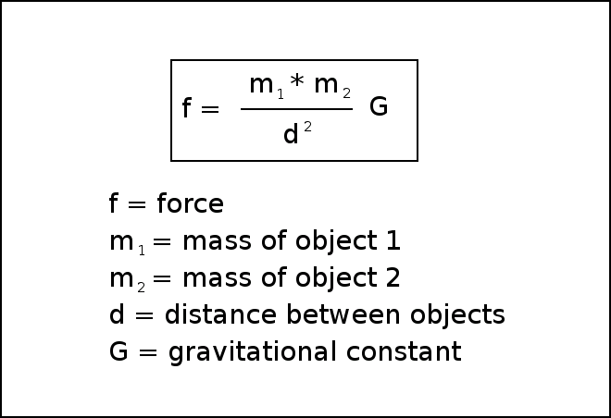
Newton's Law of Universal Gravitation

Slide 71
Working with planetary gravity
The mass of the two objects is important
The distance between the objects is also critical
There's a gravitational constant G
Both objects exert a force on each other

Slide 72
Simplifying Newton's formula
For an arcade game, we can simplify things quite a bit
One object is usually much smaller than the other, so I'll give the ship a mass of 1
The force of the small object on the large on is so miniscule it will be ignored
G can be left out for now

Slide 73
Modifying the ship to orbit
Add a mass attribute
  set the mass to 1 initially
The ship no longer needs a checkbounds() method
  Bouncing or wrapping would change the orbit
The ship draws it's own path
  This makes it easier to visualize the orbits

Slide 74
Building a planet
The planet also needs a mass property
It also has a gravitate() method that calculates the planet's pull on any object fed as a parameter
The orbiting object's dx and dy attributes are adjusted to compensate for the gravitational pull
This method is called once per frame

Slide 75
The gravitate() method
def gravitate(self, body):
""" calculates gravitational pull on
object """
(self.x, self.y) = self.rect.center
#get dx, dy, distance
dx = self.x - body.x
dy = self.y - body.y
distance = math.sqrt((dx * dx) + (dy * dy))
#normalize dx and dy
dx /= distance
dy /= distance
force = (body.mass * self.mass)/(math.pow(distance, 2))
dx *= force
dy *= force
body.dx += dx
body.dy += dy

Slide 76
How gravitate() works
Accept a sprite as a parameter (the sprite must have a mass attribute)
Determine the planet's x and y values
Calculate the dx and dy between objects
Calculate the distance between them
Divide dx and dy by distance
  This creates a motion vector of length one drawing the ship and planet together

Slide 77
More on gravitate()
Calculate the force of gravity
Use a simplified form of the gravitation formula:
Multiply dx and dy by gravitational force
Add the new gravity vector to the ship's motion vector
force = (body.mass * self.mass)/(math.pow(distance, 2))

Slide 78
Discussion Questions
How do Newton's laws effect game development?
When is continuous keyboard motion preferred?
How does vector projection simplify motion code?
How might you make a system with a ship orbiting between a planet and the planet's moon?

