Slide 1
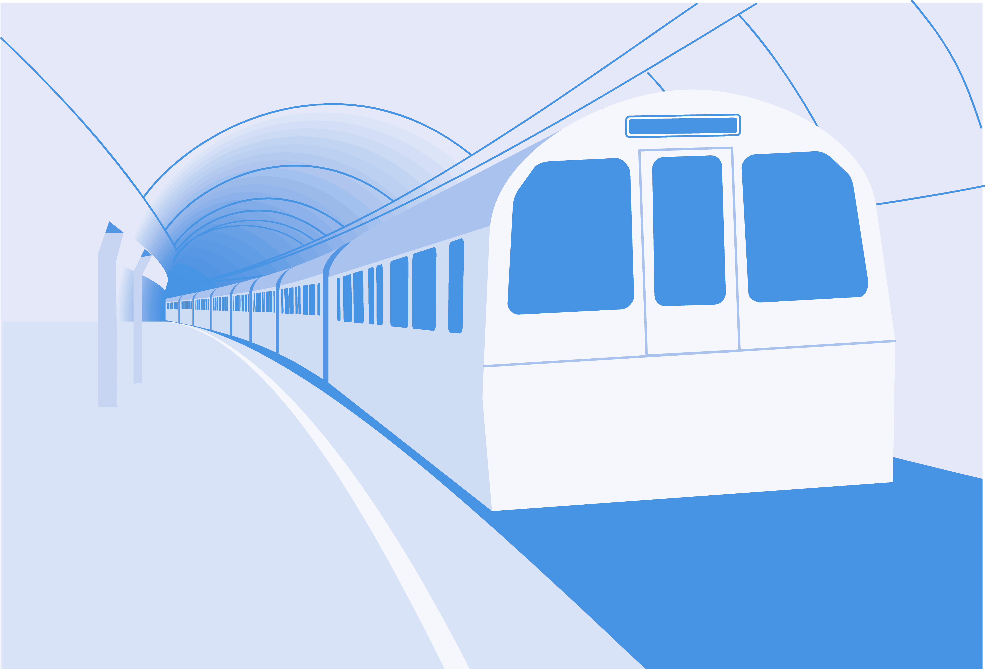
Game
Programming
© Wiley Publishing. 2006. All Rights Reserved.

Slide 2
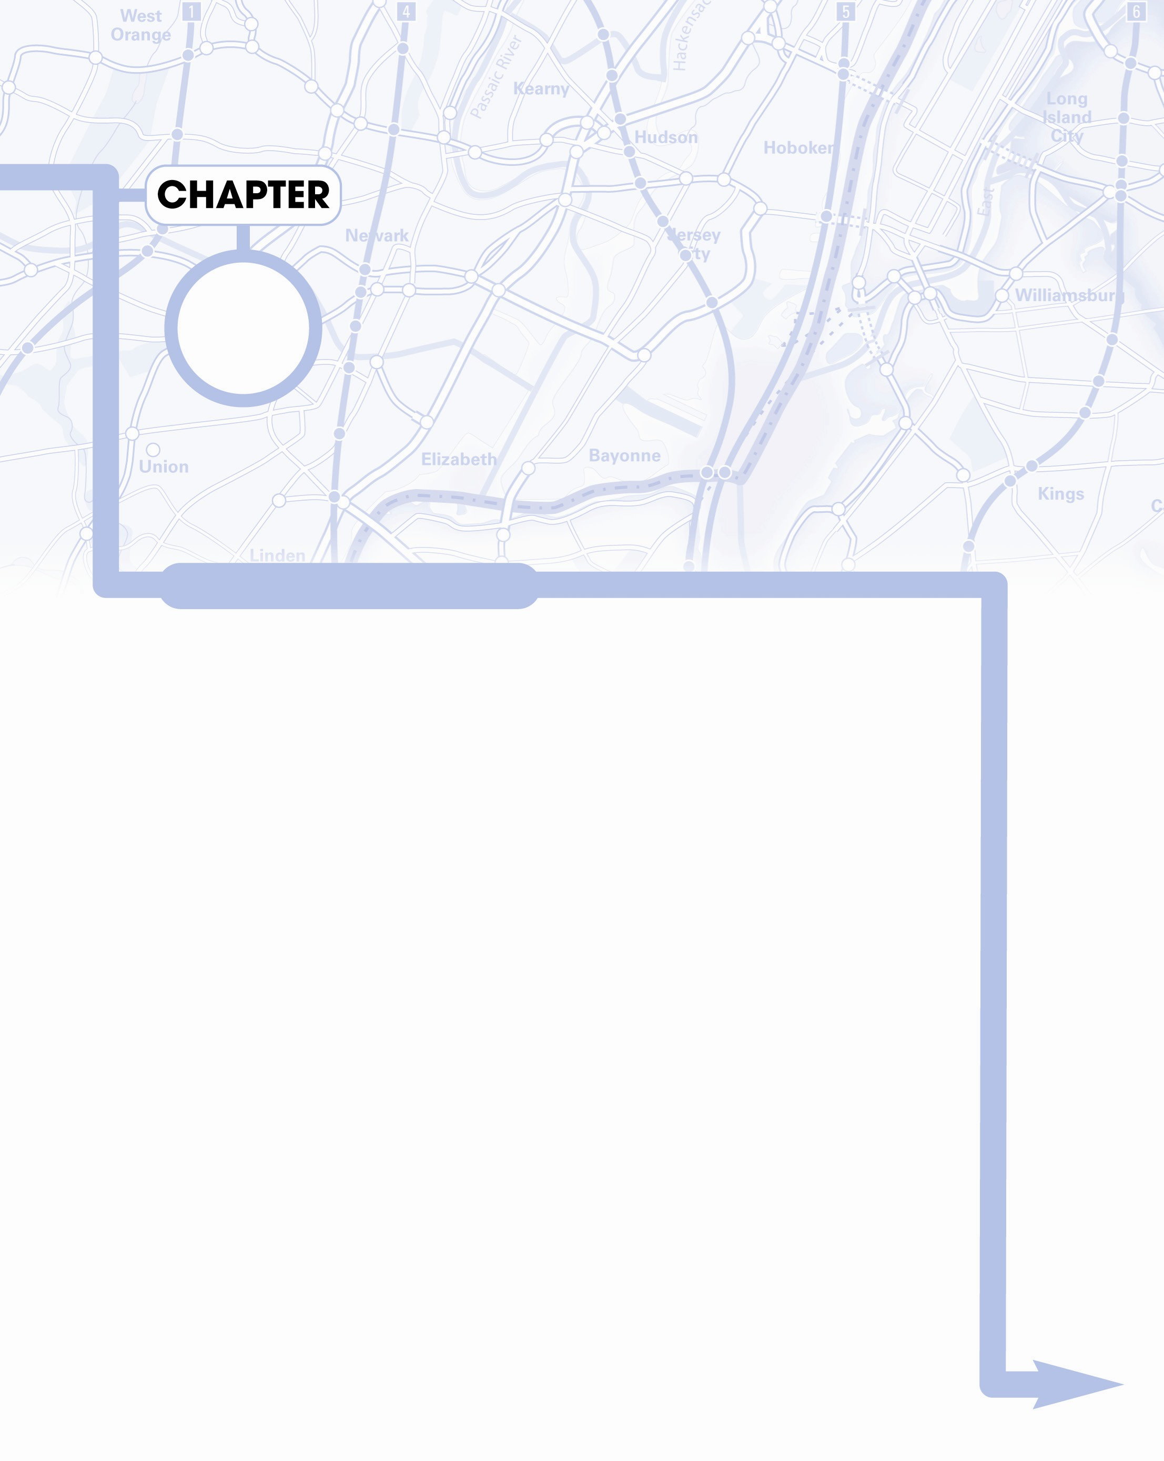
Building a Game
Engine
10
Stations Along the Way
Exploring the features of a higher-level game engine
Building a more powerful sprite class
Building a class to simplify the main loop
Creating custom graphic interface widgets
Building games with the game engine

Slide 3
Why build a high-level engine?
You understand the concepts now
It's time to use them in interesting new ways
The game engine encapsulates what you already know
It frees you to think about solving harder problems
You can modify it to make an engine that makes your own programming more efficient

Slide 4
Examining the gameEngine code
The gameEngine is just a Python module
There's very little new in the code
It's mainly a series of class definitions
There's a main function used only for testing
Normally gameEngine is imported
See gameEngine.py for code details

Slide 5
Classes in gameEngine
Scene
SuperSprite
Label
Button
Scroller
MultiScroller

Slide 6
gameEngine initialization
When gameEngine is started, it does some basic initialization
  Import pygame
  Import math
  Initialize pygame

Slide 7
Making a scene
The game engine vastly simplifies building a simple game.
""" simpleGe.py
example of simplest possible
game engine program
"""
import pygame, gameEngine
game = gameEngine.Scene()
game.start()

Slide 8
How it works
The program imports pygame and gameEngine
It creates an instance of gameEngine.Scene, which encapsulates the main loop
Starting the scene starts the program, and everything else is automatic

Slide 9
Introducing the Super Sprite
The gameEngine module has an improved sprite class.
This sprite adds various capabilities to the standard Sprite class.
It can be easily added to a scene.
See superSprite.py

Slide 10
Building a SuperSprite
""" superSprite.py
show a very basic form of supersprite
"""
import pygame, gameEngine
def main():
game = gameEngine.Scene()
ship = gameEngine.SuperSprite(game)
#customize the ship sprite
ship.setImage("ship.gif")
ship.setAngle(135)
ship.setSpeed(5)
ship.setBoundAction(ship.BOUNCE)

Slide 11
Notes about the SuperSprite
It takes a scene as its parameter
It has a setImage() method for easy image-loading
You can set its speed and angle
You can set a boundary action and the sprite will "know" how to wrap, bounce, or stop automatically
You can make a subclass of the SuperSprite to add your own enhancements

Slide 12
Modifying the Scene
#customize the scene
game.setCaption("Introducing Super Sprite!")
game.background.fill((0x33, 0x33, 0x99))
game.sprites = [ship]
#let 'er rip!
game.start()
if __name__ == "__main__":
main()
Once you've created a scene instance, you can make basic changes by modifying its public attributes
Later I show how to make more dramatic changes by extending the scene class

Slide 13
Notes on the Scene
The scene object can be modified
It's caption can be changed
You can assign any number of sprites
It has a number of other useful characteristics that will be detailed shortly

Slide 14
Extending the SuperSprite
Things get more interesting when you make your own extensions of the base classes
carGE.py demonstrates building a car using a custom variant of the SuperSprite class

Slide 15
Making a custom car class
The Car class is an extension of SuperSprite
Begin by initializing the parent class
Set its image to an appropriate figure
""" carGE.py
extend SuperSprite to add keyboard input
"""
import pygame, gameEngine
class Car(gameEngine.SuperSprite):
def __init__(self, scene):
gameEngine.SuperSprite.__init__(self, scene)
self.setImage("car.gif")

Slide 16
Checking events supersprite-style
The checkEvents() method is called by update() automatically.
It can be used to handle input from keyboard or mouse, collisions.
Code placed here will be activated early in the update() process, before moving the object

Slide 17
The car.checkEvents() method
def checkEvents(self):
keys = pygame.key.get_pressed()
if keys[pygame.K_LEFT]:
self.turnBy(5)
if keys[pygame.K_RIGHT]:
self.turnBy(-5)
if keys[pygame.K_UP]:
self.speedUp(.2)
if keys[pygame.K_DOWN]:
self.speedUp(-.2)
self.drawTrace()

Slide 18
What happens in checkEvents()
Get input from the keyboard
If user presses left or right, use turnBy() method to turn sprite
Up and down keypresses call the speedUp() method to change speed
Draw the car's path on the background (I did this simply for the sake of the screen shot - so you can tell the car is moving)

Slide 19
Starting the game
carGE uses a stock Scene class
Create an instance of the car
Add it to the game's sprite list
Start the game engine
def main():
game = gameEngine.Scene()
game.background.fill((0xCC, 0xCC, 0xCC))
car = Car(game)
game.sprites = [car]
game.start()

Slide 20
Extending the Scene Class
You can also make a custom extension of the scene class
Most real gameEngine games have one scene class per state (intro, help, play, game over)
Extending the Scene class allows you to add event-handling at the scene level
See spaceGE.py

Slide 21
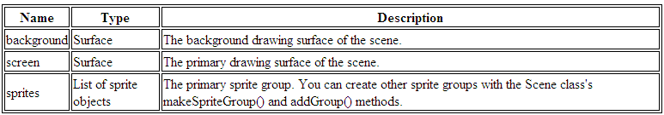
Scene attributes
You can directly modify these attributes of the screen class
This can be done on a standard scene or a custom (extended) scene

Slide 22
Scene attribute notes
Use the background attribute if you want to draw directly on the screen's background
Use screen to determine the size of the screen, or to draw or blit directly to the screen
sprites is the standard list of sprites. Any sprites in this list are automatically drawn and updated every frame

Slide 23
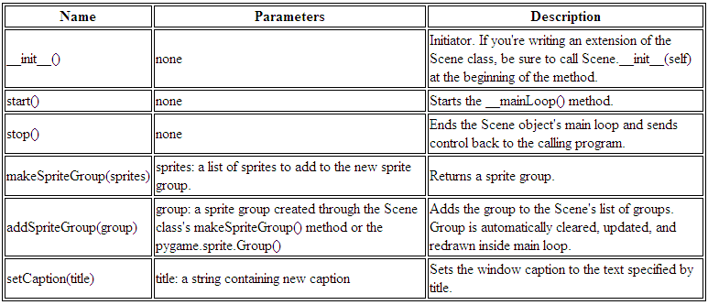
Scene methods

Slide 24
Scene control methods
start() is used to start the scene's main loop
stop() exits the scene's main loop and returns control to the calling module
These features allow you to write a program with multiple scenes
Each scene can be thought of as a program state (intro, instructions, game, end)

Slide 25
Scene sprite group management tools
All scenes have the built in sprites list
A scene can have more than one sprite group
Use scene.createSpriteGroup() and scene.addSpriteGroup() to add additional sprite groups
All will be automatically updated and drawn
asteroids.py (described later) demonstrates this technique

Slide 26
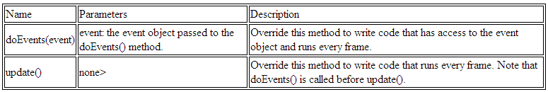
Scene event methods
These methods are intended to be overwritten in a subclass of Scene
Use doEvents() when you want access to the pygame event object

Slide 27
How spaceGE.py works
It uses an ordinary SuperSprite
It extends Scene for event-handling
All event-handling happens in the scene
class Game(gameEngine.Scene):
def __init__(self):
gameEngine.Scene.__init__(self)
self.setCaption("Space-style Motion in GameEngine")
self.ship = gameEngine.SuperSprite(self)
self.ship.setImage("ship.gif")
self.sprites = [self.ship]

Slide 28
Initializing the scene
class Game(gameEngine.Scene):
def __init__(self):
gameEngine.Scene.__init__(self)
self.setCaption("Space-style Motion in GameEngine")
self.ship = gameEngine.SuperSprite(self)
self.ship.setImage("ship.gif")
self.sprites = [self.ship]
Initialize the parent class (Scene)
Add a superSprite as an attribute
Assign ship to sprites list

Slide 29
Checking events in the Scene
The scene object also has techniques for event handling
The update() method handles keystrokes
update() is automatically called every frame (as it is in sprites)
Note I used ship.addForce() to change the ship's force vector

Slide 30
The spaceGE.update() code
def update(self):
#change rotation to change orientation of ship
#but not direction of motion
keys = pygame.key.get_pressed()
if keys[pygame.K_RIGHT]:
self.ship.rotateBy(-5)
if keys[pygame.K_LEFT]:
self.ship.rotateBy(5)
if keys[pygame.K_UP]:
#add a force vector to the ship in the
#direction it's currently pointing
self.ship.addForce(.2, self.ship.rotation)

Slide 31
Exploring graphical widgets
You've already seen how useful elements like labels and buttons can be
GameEngine has a simple set of GUI elements built in
These elements are sprites, so they are manipulated along with all other sprites
They have special features for position and display of information

Slide 32
Graphical widgets in gameEngine
Label - displays information, has color, position, size, text, and font attributes
Button - all label features plus active (true when being clicked) and clicked (true when clicked and released)
Scroller - a simple scrollbar substitute, used to input numeric information
Multiline text - a special label for handling multiple lines of text.
See GUIDemoGE.py

Slide 33
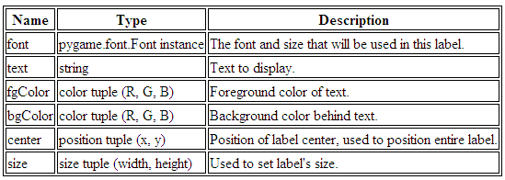
Label attributes
Manipulate the label by modifying these public attributes

Slide 34
Building a Label
Create the label
Set its properties
self.label = gameEngine.Label()
self.label.font = pygame.font.Font("goodfoot.ttf", 40)
self.label.text = "Label"
self.label.fgColor = (0xCC, 0x00, 0x00)
self.label.bgColor = (0xCC, 0xCC, 0x00)
self.label.center = (320, 100)
self.label.size = (100, 50)

Slide 35
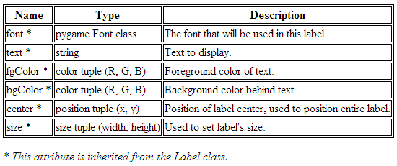
Button attributes
Most button attributes are inherited from the label

Slide 36

Read-only button attributes
The Button class has two special Boolean attributes
Both are used to detect mouse clicks on the button
These are read-only attributes; there's no point in setting them through code

Slide 37
Creating a Button
Buttons have all the same properties as labels (because they are extended from the Label class)
All properties have default values, so they can be left blank
self.button = gameEngine.Button()
self.button.center = (450, 180)
self.button.text = "don't click me"

Slide 38
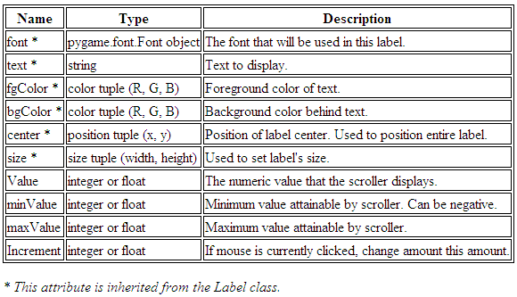
Scroller attributes

Slide 39
Making a scroller
The Scroller is derived from Button (which in turn comes from Label)
Its most important attribute is value (a numeric value)
self.scroller = gameEngine.Scroller()
self.scroller.center = (450, 250)
self.scroller.minValue= 0
self.scroller.maxValue = 250
self.scroller.value = 200
self.scroller.increment = 5

Slide 40
Scroller attribute notes
value - the numeric value of scroller. Can be an integer or a float
minValue, maxValue - indicate range of possible values
increment - indicates how much scroller will move on each click
Click on left half of scroller to decrement, right half to increment

Slide 41
Building a MultiLabel
The multi-line label is also derived from Label
It takes a list of strings called textLines
All other attributes are just like Label
def addMultiLabel(self):
self.multi = gameEngine.MultiLabel()
self.multi.textLines = [
"This is a multiline text box.",
"It's useful when you want to",
"put larger amounts of text",
"on the screen. Of course, you",
"can change the colors and font."
]
self.multi.size = (400, 120)
self.multi.center = (320, 400)

Slide 42
SuperSprite overview
SuperSprite is controlled with public methods broken into the following categories:
  Primary methods - basic setup and movement
  Vector manipulation - more advanced vector-based motion methods
  Utility methods - set behavior, check collisions, compare with other objects

Slide 43
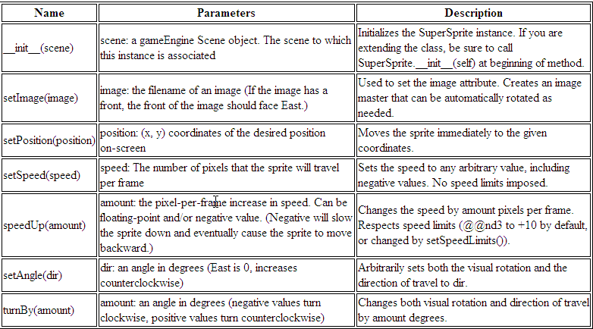
SuperSprite primary methods

Slide 44
SuperSprite primary method notes
These are the methods you will most frequently use to manipulate the SuperSprite and its derivatives
Use these methods rather than relying on attributes
dx and dy are automatically calculated
The sprite automatically moves itself based on speed and direction

Slide 45
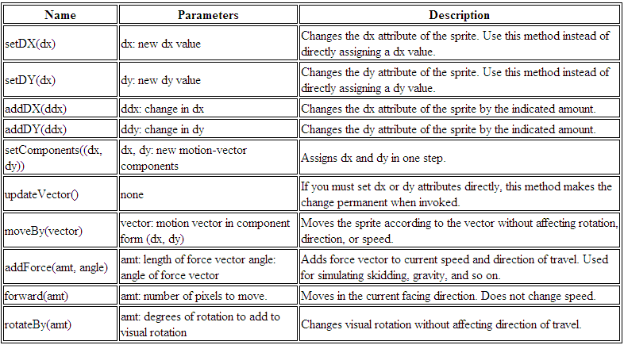
SuperSprite vector methods

Slide 46
SuperSprite vector method notes
Sometimes you need more sophisticated control
Use these methods to directly control various sprite characteristics, especially dx and dy
You can also move by a certain vector or add a force vector to the current motion vector
You can move forward in the current motion of travel with forward()
You can rotate the visual orientation without changing dx and dy using the rotate() method

Slide 47
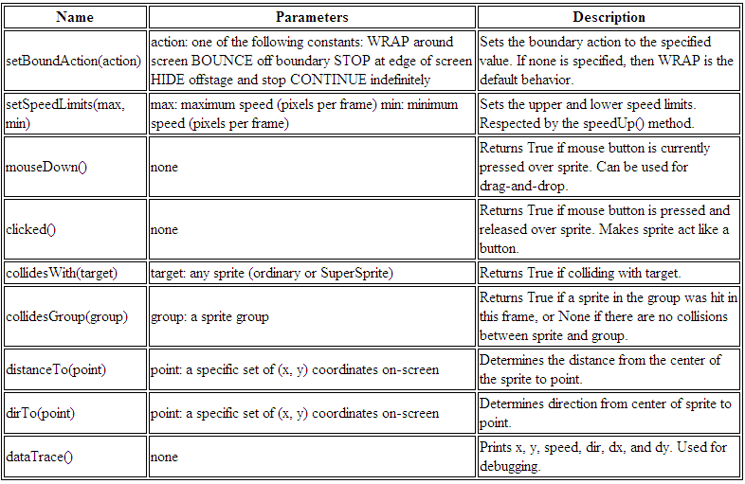
SuperSprite utility methods

Slide 48
SuperSprite utility method notes
setBoundAction() and setSpeedLimits() are used to alter the behavior of the sprite
mouseDown and clicked check for mouse events
Two collision methods simplify collision detection
distanceTo() and dirTo() help compare the sprite with other elements
dataTrace() prints helpful debugging information to the console

Slide 49
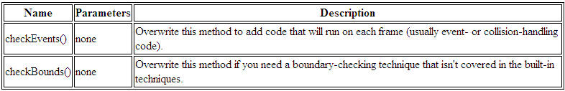
SuperSprite event methods
The event methods are not meant to be called directly
Overwrite them in a subclass of SuperSprite to add event-handling
Overwrite checkBounds() if you need a specialized type of boundary-checking

Slide 50
Example: The adventure game
This game uses a special Node class to store data about each node
The node information is copied to the screen using GUI elements
One screen is re-used for the entire game
See adventure.py

Slide 51
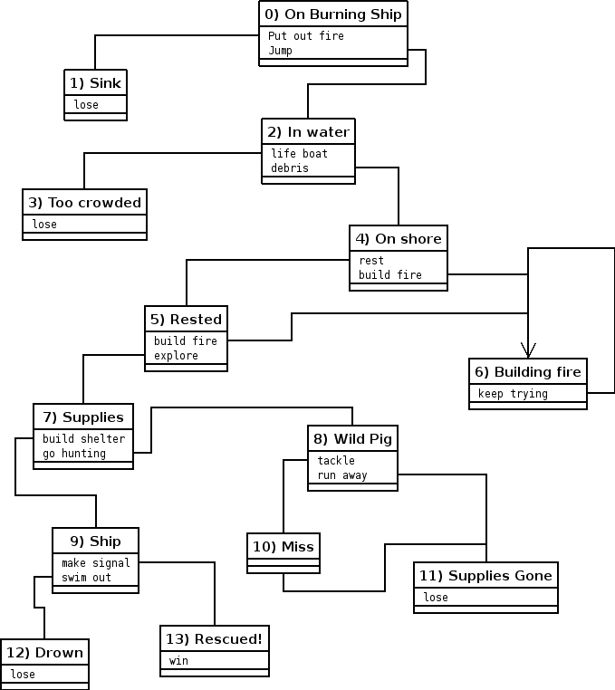
Adventure game overview

Slide 52
Adventure game node information
The adventure game is based on nodes.
Node is a class with attributes but no methods.
The entire game is stored as a list of nodes
The custom scene has methods to read the nodes and populate GUI widgets

Slide 53
Sample adventure node
#0
nodeList.append( Node(
"On Burning Ship",
[ "Your vacation is going fine",
"except you wake up to find",
"your cruise ship is on fire.",
"",
"Do you attempt to fight the",
"fire or jump overboard?"
],
"Put out Fire", 1,
"Jump", 2
))

Slide 54
Example: Lunar Lander
GameEngine makes it easy to build this type of game
Make a Lander and Platform based on SuperSprite
Add gravity
User input controls motion
check for a proper landing
See lander.py

Slide 55
Example: Asteroids
Build three custom SuperSprites:
  Ship - the user avatar
  Bullet - fired from the ship
  Rock - A list of these will be the enemies
Custom Scene:
  Builds the objects
  Manages collisions
See asteroids.py

Slide 56
There's More!
The web site includes several appendices
  A includes answers to all exercises in book
  B is the documentation for gameEngine with some additional examples
  C explains how to create installable modules, Windows executables, and installation programs
  D demonstrates basic graphic and audio skills using open source tools.

Slide 57
Discussion Questions
What are some advantages of a game engine?
Why might you make subclasses of the SuperSprite and Scene classes?
Why might you want multiple scenes in a game?
What additions would you add to the game engine?

