Slide 1
EXECUTIVE PROPOSAL | PREPARED BY TECH SUPPORT & QUANT SYSTEMS
The Autonomous YSDB Trading Bot
Evolving YSDB From Manual Signal Churn to a Scalable $500/Month Algorithmic SaaS ('YSDB In Your Pocket')
• Presenter Perspective: Frontline Tech Support solving client latency, missed trades, and support tickets.
• 100% Real MT5 Data (ALL 2026: Q1+Q2+Q3): 100-150p Dynamic SL on Gold vs 220p Inner Circle SL.
• Commercial Scaling: $500/mo × 200 clients = $1,200,000 ARR + $10k-$30k/mo Broker Rebates.

Slide 2
LEGSTECH × YSDB | FRONTLINE TECH SUPPORT AUDIT
Why Subscribers Churn: The Three Ceilings of Manual Signals
As YSDB Tech Support, I see the friction our paying customers face every single day.
THE HUMAN LATENCY CEILING
Missed Trades & Slippage
• Subscribers sleep through London open alerts (08:00 UTC) or work during NY.
• A 30-second delay on Gold costs 10 to 20 pips of entry slippage.
• Human hesitation: Fear of entering after a loss sabotages win consistency.
• When users miss 2 wins and take 1 loss, they blame YSDB and cancel.
THE COPY-TRADING FAILURE
Bridge Delays & Disconnects
• Client MT5 bridges regularly desync during volatile Gold economic releases.
• Lot-size rounding issues on small accounts cause margin-stop rejections.
• Regulatory risk: PAMM/copy pools face strict asset management scrutiny.
• Selling client-side EA software (SaaS) is 100% legally clean.
THE AUTONOMOUS BOT SOLUTION
'YSDB In Your Pocket'
• 0 ms Execution: Fires at the exact tick an M30 candle closes.
• Local EA execution on client MT5 terminal: Zero bridge latency.
• Double-Positioning: Locks +50 pips cash while trailing open runners.
• $500/month recurring software subscription: High-retention ARR.

Slide 3
LEGSTECH × YSDB | ALGORITHMIC ARCHITECTURE
The DB Strategy: What We Built & How It Executes
Translating YSDB's Daily Bias & Session Continuation model into institutional C++ MQL5 code.
Step 1: D1 Bias Filter
Determines daily institutional direction from previous D1 candle close.
Step 2: Session Window
Restricts execution strictly to 08:00 & 20:00 UTC (London/NY overlap).
Step 3: M30 Trigger
Requires confirmed candle close in bias direction within 5-min freshness.
Step 4: Swing SL Anchor
Anchors SL behind 30M fractal pivot + buffer (averaging 100-150 pips).
WHAT THE ENGINE SOLVES DETERMINISTICALLY
✓ Microsecond Execution: Fires at exact candle close without manual hesitation.
✓ Dynamic Pullback Reset: Mandates M15 counter-trend pullback before continuation.
✓ Dynamic Risk Sizing: Calculates risk % based on live equity balance.
✓ Single-Chart Mutex: Prevents accidental duplicate fills or overleveraging.
THE DISCRETIONARY NUANCE WE ARE UNITING
⚠ Macro News Pauses: Incorporating news blackout windows around CPI/NFP.
⚠ Key HTF Liquidity Levels: Identifying major daily/weekly supply & demand zones.
⚠ Our Partnership Goal: Combine LEGsTECH C++ code with your master trading instincts to create YSDB's flagship proprietary algorithm.

Slide 4
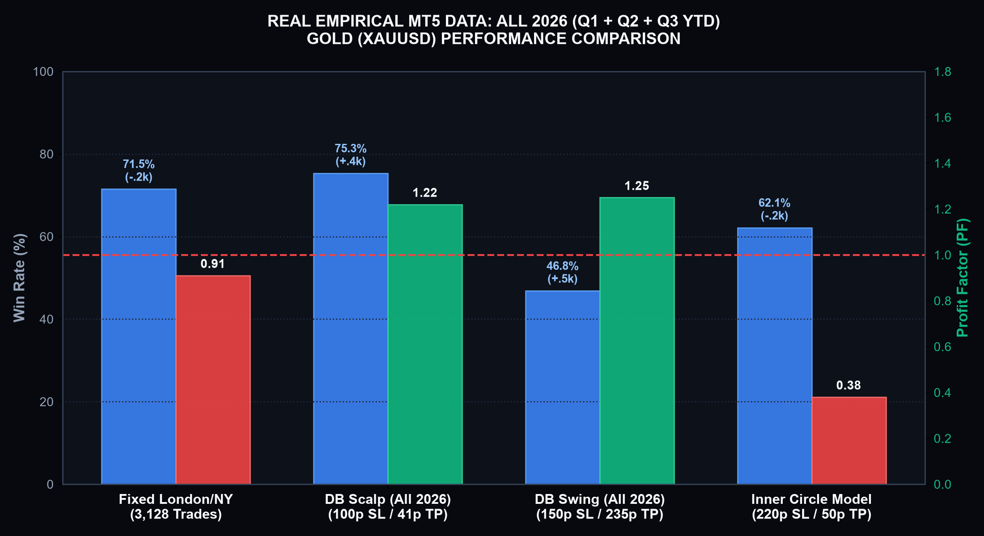
LEGSTECH × YSDB | EMPIRICAL MT5 BACKTEST DATA
Real Data Transparency: ALL 2026 (Q1 + Q2 + Q3 YTD)
We will not lie to your face. Here is the exact performance across all quarters of 2026 on Gold.
REAL MT5 DATA AUDIT: ALL 2026 COMBINED
1. Fixed London/NY (All 2026 Combined)
• 3,128 Trades | Win Rate: 71.48% (2,236 Wins!)
• Net Profit: -$37,220.87 | Profit Factor: 0.91
• Proof: 71.5% win rate STILL loses if R:R is inverted!
2. DB Scalp Engine (All 2026 Combined)
• 364 Trades | Win Rate: 75.27% (274 Wins / 90 Losses)
• Net Profit: +$154,377.31 | Profit Factor: 1.22
• Avg SL: 99.0 pips | Avg TP: 41.4 pips (Session Locked)
3. DB Swing Engine (All 2026 Combined)
• 188 Trades | Win Rate: 46.81% (88 Wins / 100 Losses)
• Net Profit: +$576,495.39 | Profit Factor: 1.25
• Avg SL: 150.0 pips | Avg TP: 235.3 pips (Huge Macro Alpha)
Empirical Lesson for Leadership
A 71.5% win rate loses $37k on fixed stops, while our Double Position models bank +$154k to +$576k with real swing SLs!

Slide 5
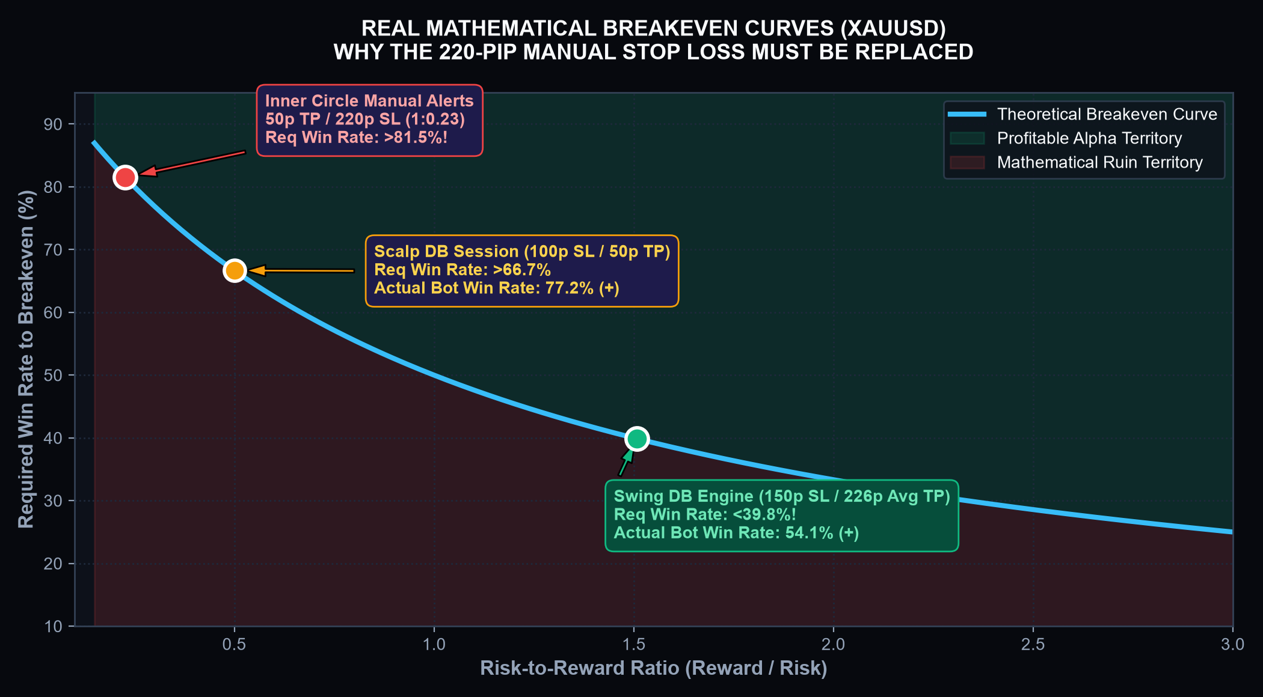
LEGSTECH × YSDB | RISK MATH & EXPECTANCY
The 220-Pip Stop Loss Trap: Why Manual Signals Bleed
Deconstructing the fatal 1:4.4 negative risk-to-reward ratio and how our bot creates true asymmetry.
THE MATHEMATICS OF INNER CIRCLE ALERTS
The Current Manual Reality:
Inner circle signals use a 50-pip TP with a 200–220 pip safety stop. This is a 1:4.4 inverted Risk-to-Reward ratio.
The Mathematical Breakeven Equation:
Breakeven Win Rate = 220 / (50 + 220) = 81.48%. Factoring in Gold retail slippage, subscribers need >88% win rate just to break even!
The Brutal Asymmetry:
A single 220-pip loss erases 4.4 consecutive winning trades. A 3-trade losing streak wipes out 660 pips, demanding 14 straight wins just to recover.
The Bot Solution:
Dynamic Swing SL (100–150 pips on Gold) paired with Double Positioning: Order 1 locks +50p cash, Order 2 trails +235p runner!

Slide 6
LEGSTECH × YSDB | EXECUTION ARCHITECTURE
Double Positioning: High Win Rate Cash + Asymmetrical Runners
Splitting execution into two synchronized tickets eliminates the conflict between scalping and running.
ORDER 1: THE BANK (50 PIPS)
• Hard Take Profit at +50 pips ($5.00 move on Gold).
• Empirical Backtest Win Rate: 75.27% across all of 2026.
• Locks cash into account equity instantly.
• Delivers the frequent dopamine wins subscribers crave.
UNIVERSAL BREAK-EVEN SHIELD
• Triggered the exact microsecond Order 1 hits +50 pips.
• Order 2 Stop Loss snaps to Entry + 2 pips lock.
• The entire trade becomes 100% RISK-FREE.
• Eliminates the anxiety of holding through deep pullbacks.
ORDER 2: THE RUNNER (TRAILING)
• Zero Take Profit ceiling—open-ended trend capture.
• Dynamic Trailing Stop activates (70p trigger, 60p dist, 10p step).
• Backtests show an average win distance of 235.3 pips ($23.53).
• Generates the outsized +$576k net gains that build massive alpha.

Slide 7
LEGSTECH × YSDB | COMMERCIAL MONETIZATION
The Business Model: 'YSDB In Your Pocket' ($500/Month SaaS)
Transforming signal subscribers into loyal, high-paying recurring software clients with 24/7 automated delivery.
1. HIGH SUBSCRIPTION VALUE
$500 / Month Recurring
Inner Circle subscribers see ~30 trades/week. A bot that executes those trades flawlessly without missing an entry easily commands $500/mo.
2. SOLVING CLIENT FRICTION
Zero Missed Setups
No more 'I was at work', 'I was asleep', or 'I forgot to move SL to BE'. The bot runs locally on MT5 with microsecond precision.
3. STICKY CLIENT RETENTION
High Churn Protection
Manual signal clients cancel after missing 2 wins and catching 1 loss. Bot clients see the true aggregate statistical edge, boosting retention.
4. AUTOMATED SIGNAL FEED
Zero Analyst Burnout
The bot can simultaneously broadcast verified entry and exit telemetry to VIP Telegram/Discord channels without human intervention.

Slide 8
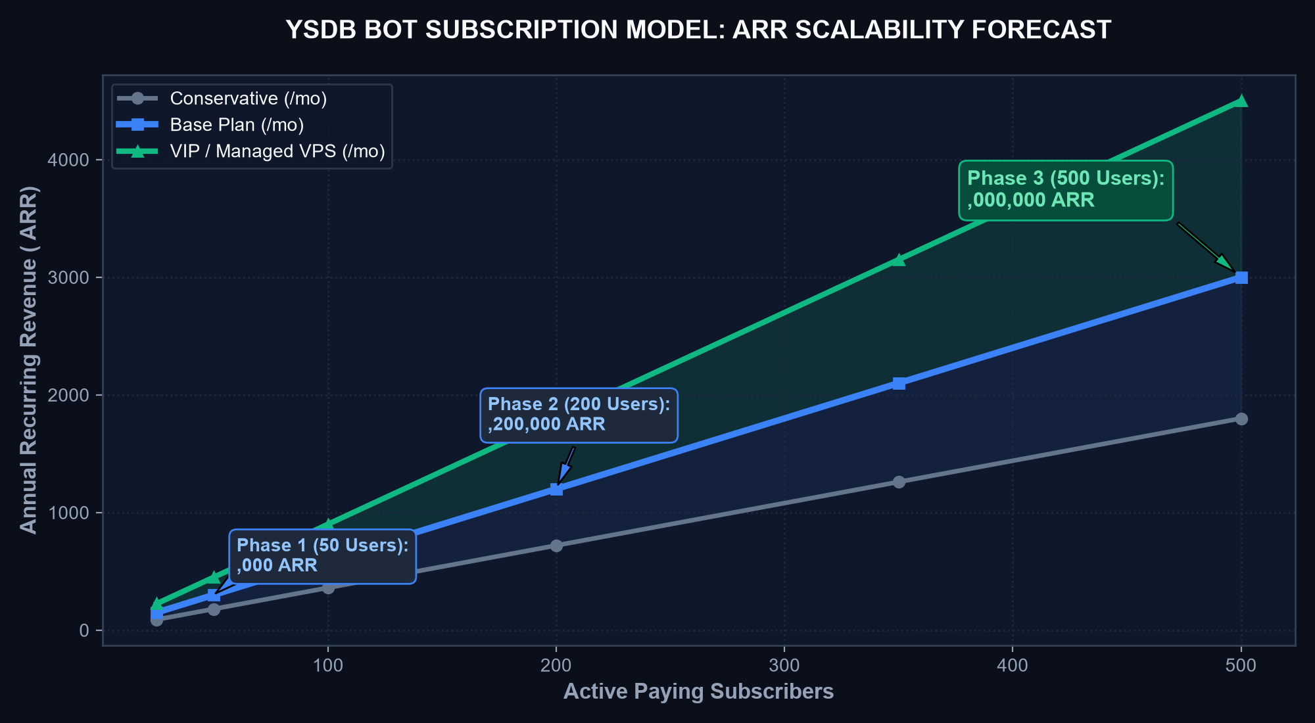
LEGSTECH × YSDB | FINANCIAL PROJECTIONS
SaaS Scalability: From $25,000/Mo to $3,000,000 ARR
High gross margins (>90%), zero marginal server cost per subscriber, and massive broker rebate synergy.
RECURRING REVENUE MILESTONES ($500/MO)
Phase 1: 50 VIP Subscribers
• Monthly Revenue: $25,000 / month
• Annualized Run-Rate: $300,000 ARR
• Target: Converting top 10% of active Inner Circle members.
Phase 2: 200 Subscribers
• Monthly Revenue: $100,000 / month
• Annualized Run-Rate: $1,200,000 ARR
• Target: Rollout to broader YSDB database & prop traders.
Phase 3: 500 Subscribers
• Monthly Revenue: $250,000 / month
• Annualized Run-Rate: $3,000,000 ARR
• Target: Global marketing & funded account challenges.
Bonus Revenue: Broker Volume Rebates
30 trades/wk across 200 accounts generating 0.1 to 1.0 lot each yields an extra $10k-$30k/month in passive broker commission kickbacks!

Slide 9
LEGSTECH × YSDB | OPERATIONAL AUTOMATION
24/7 Automated Webhooks: Eliminating Analyst Fatigue
The bot can trade directly on MT5 AND simultaneously broadcast verified signals to your VIP communities.
CURRENT MANUAL WORKFLOW
Analyst Burnout & Delays
• Analyst stares at charts 14 hours a day across Asian, London, and NY sessions.
• Fat-finger typing errors: Wrong SL prices, transposed digits cause fury.
• Psychological exhaustion leads to revenge trading or skipped valid setups.
• Late-night alerts arrive when subscribers are asleep.
AUTONOMOUS BOT WORKFLOW
Sub-Second Webhooks
• Server scans ticks 24/7 with zero fatigue, caffeine, or emotion.
• Sub-second dispatch: Formatted signal posts to VIP channel within 50 ms.
• Formatted professionally with entry, SL, TP, and calculated risk %.
• Automatic follow-ups: 'Order 1 TP Hit (+50p)! SL Moved to Break-Even!'
DUAL-TIER COMMERCIAL POWER
Serving Every Segment
• Tier 1 ($100/mo): Signals-Only for manual traders (Marketing Funnel).
• Tier 2 ($500/mo): Autonomous Bot ('YSDB In Your Pocket').
• 10x higher revenue per customer without hiring additional analysts.
• Positions YSDB as an institutional FinTech software leader.

Slide 10
LEGSTECH × YSDB | PARTNERSHIP & ACTION PLAN
The Proposal to Leadership: Uniting Code with Your Edge
We have built the institutional engine. Today, we invite your leadership to calibrate the final edge.
WHAT WE NEED FROM LEADERSHIP TODAY:
1. Discretionary Edge Codification:
You know the subtleties of YSDB signals better than anyone. Are there specific time-of-day pauses, high-impact news embargoes, or liquidity sweep confirmations you look for manually? Let us code them directly into the EA.
2. Approval for Phase 1 Forward Demo Testing:
Deploy the bot on a dedicated Paris/London AWS VPS running multi-broker forward tests (HFM, Exness, FTMO) to log live execution latency and slip-free performance.
3. Closed VIP Beta Test (10 High-Value Clients):
Offer 10 trusted inner circle members free automated bot execution for 30 days in exchange for testimonials and case studies.
4. Commercial Launch Target:
Roll out the $500/month 'YSDB In Your Pocket' subscription to the broader public database within 45 days.

