Slide 1
PEPPERBALL ENGINEERING CASE STUDY
Manufacturing reporting that can explain and repair itself.
Delivered reporting core, machine visibility and functional read-only Reporting Assistant extensions, with governed future expansion.
THOMAS RYAN
Forward Deployed Engineer Intern
May-August 2026
Notes:
Open with the delivered scope: Shift Drafts and daily, weekly, and downtime reporting are the core platform. Machine-event visibility and a functional read-only Reporting Assistant are delivered extensions. Broader model-backed reasoning, document knowledge, recurring artifacts, and production advisory remain future work.
[Sources]
- docs/end-to-end-system.md
- docs/case-study.md
- docs/claim-boundaries.md
[/Sources]

Slide 2
PROBLEM AND CONSTRAINTS
Why a healthy pipeline could still produce an unhealthy outcome.
Reliability gaps lived between components, business meaning, remote state, and release timing.
01
02
Missing identity
Semantic drift
Monitoring existing files cannot detect a report that was expected but never created.
A byte or capture timestamp can change even when governed business material does not.
03
04
Ambiguous writes
Shared boundary
A remote write may succeed while its response is lost, making naive retry unsafe.
Independently correct schedules can still collide at one canonical publication surface.
PEPPERBALL REPORTING PLATFORM
02
Notes:
Frame the problem as four classes of uncertainty. Each one requires a different invariant; none is solved by simply retrying more often.
[Sources]
- docs/case-study.md
- docs/technical-decisions.md
[/Sources]

Slide 3
SYSTEM ARCHITECTURE
The end-to-end governed loop.
Eight responsibilities connect the source, product, user, recovery, and release planes.
01
02
03
04
DISCOVER
GOVERN
ACCOUNT
RENDER
Version-aware documents
Raw, normalized, current
Expected output state
Four workbook families
08
07
06
05
RELEASE
REPAIR
EXPERIENCE
PUBLISH
One writer and rollback
Fair bounded recovery
Reports + extensions
Conditional write plus GET
PEPPERBALL REPORTING PLATFORM
03
Notes:
Walk clockwise. Original evidence stays authoritative, report, machine-status, and assistant surfaces remain read-only, repair reuses the canonical path, and release controls govern the same writer boundary. The functional assistant reuses governed contracts without creating publication authority.
[Sources]
- docs/end-to-end-system.md
- docs/architecture.md
- docs/claim-boundaries.md
[/Sources]

Slide 4
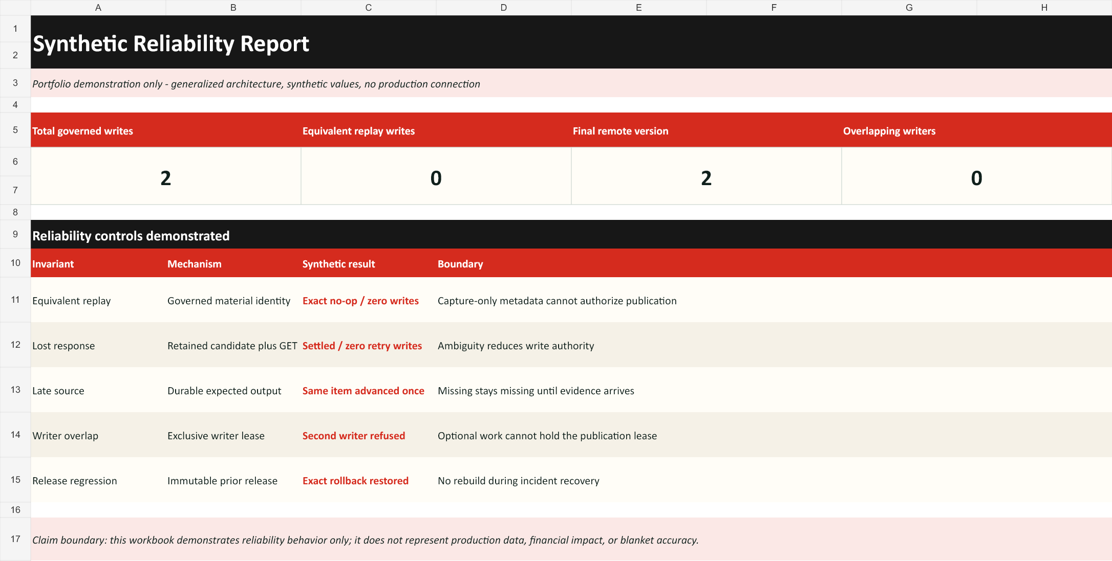
PRODUCT AND DATA CONTRACT
The workbook is an operational product - not an incidental export.
Rendered appearance and raw package state must agree before publication.
CERTIFICATION SURFACES
01
Two visible, purposeful sheets
02
Client-independent stored values
03
Formula and raw-package structure
04
Source lineage and material identity
05
Missing remains distinct from zero
06
Family semantics and visual layout
PEPPERBALL REPORTING PLATFORM
04
Notes:
Explain why raw package inspection matters: a recalculating spreadsheet client can make a visually plausible file appear correct even when required stored values are absent.
[Sources]
- public/synthetic-report-summary.png (synthetic artifact)
- docs/end-to-end-system.md
- docs/validation-methodology.md
[/Sources]

Slide 5
RECOVERY STATE MACHINE
Self-healing reduces authority as uncertainty increases.
The loop can repair eligible technical gaps, but it cannot invent facts or rewrite protected evidence.
OBSERVE
DECIDE
SETTLE
Expected versus actual
Classify and prepare
Write, read, or refuse
Independent accounting detects an identity that never existed.
Fair selection, source preparation, semantic identity, protected holds.
Conditional same-item write, GET-only settlement, no-op, or terminal closure.
ELIGIBLE: technical gaps and qualified late evidence
PROTECTED: unknown identity, missing business evidence, access conflicts, terminal outputs
PEPPERBALL REPORTING PLATFORM
05
Notes:
Use the horizontal line as the lifecycle. Stress that all recovery reuses the existing renderer, publisher, queue, and checkpoint store; there is no parallel self-healing writer.
[Sources]
- docs/reliability-state-machine.md
- docs/end-to-end-system.md
[/Sources]

Slide 6
FAIL-CLOSED DELIVERY
Security, uptime, and rollback are one release contract.
A release is acceptable only when identity, access, lineage, presentation, writer topology, and exact restoration all remain proven.
ACCESS
SHADOW
Least privilege
Zero-output validation
Unknown identity, permission, ACL, or secret state refuses mutation.
An immutable successor prepares and decides in production shape without proof writes.
HANDOFF
RESTORE
Exactly one writer
Exact predecessor
The current writer drains before the successor activates; overlap fails the release.
Material regression restores the certified inactive release instead of forcing output.
PEPPERBALL REPORTING PLATFORM
06
Notes:
Describe a failed-restored release as positive evidence for containment and rollback, not as a successful successor. The system preserved service and one-writer topology while refusing the regression.
[Sources]
- docs/security-and-governance.md
- docs/validation-methodology.md
[/Sources]

Slide 7
VERIFICATION AND OUTCOMES
Evidence closes the loop.
Claims remain bounded by the grade of proof: test, raw artifact, shadow, readback, failed-restored release, or natural schedule.
Focused and integration tests establish bounded rules. Raw workbook inspection validates the client-independent product. Output-suppressed shadows prove decisions without mutation. Exact remote readback certifies accepted state. Natural schedules prove the real cadence.
4
1
0
report families
active writer
retry PUTs
Shift drafts · daily · weekly · downtime
Serialized immutable releases
GET-only ambiguous settlement
PEPPERBALL REPORTING PLATFORM
07
Notes:
The four delivered report families are Shift Drafts, Daily Production, Weekly Production, and Weekly Downtime. The other numbers are architecture and protocol invariants: one active writer and zero retry PUTs after ambiguous accepted writes.
[Sources]
- docs/operational-use-and-impact.md
- docs/validation-methodology.md
- docs/claim-boundaries.md
[/Sources]

Slide 8
WHAT I WOULD CARRY FORWARD
Trustworthy automation knows when not to write.
Semantic identity over byte identity.
GET before replay.
Protect terminal evidence.
Make rollback observable.
Keep the assistant read-only; gate broader AI.
THOMAS RYAN
Forward Deployed Engineer Intern
May-August 2026
github.com/tonnyryam
linkedin.com/in/thomas-f-ryan
tommyryan.sf415@gmail.com
ALL RIGHTS RESERVED · SANITIZED PORTFOLIO CASE STUDY
08
Notes:
Close on the engineering principle: reliable automation is defined as much by refusal and evidence as by successful mutation. The functional Reporting Assistant already inherits identity, lineage, access, citation, and refusal boundaries; broader model-backed reasoning and advisory capability remain future work.
[Sources]
- docs/project-chronology.md
- docs/interview-kit.md
- docs/claim-boundaries.md
- CONTACT.md
[/Sources]

