Slide 1

Feed the cat
Platform for creating safe funding to help Ukraine

Slide 2
DEveloped by:
@Abionics and @get_username
Cats: @kletterlin
Github: github.com/tonred/FeedTheCat
Polygon contracts: 0xd4FA89528eeE80a6F5c0AEDE34d26e324F23c0E5
Website: feedthecat.org

Slide 3
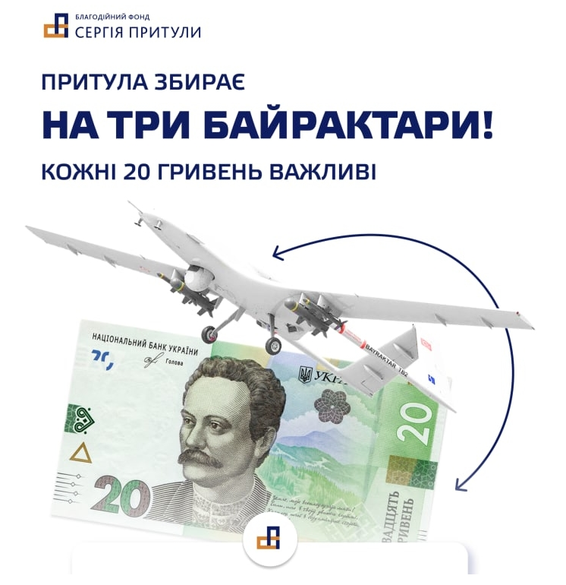
What problem is being solved and why
There were a lot of money fundings, starting from People's Bayraktar and ending with many local fundings for certain soldiers. But there is no one source with list of all fundings, where people can choose
Beside this, all such fundings must be properly checked to get rid of scammers and to avoid irrational purchases

Slide 4
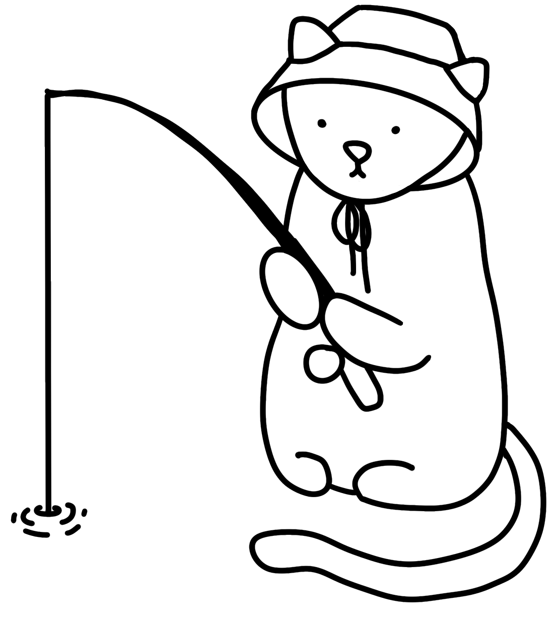
How problem is being solved
That’s why we decided to create Feed The Cat – a platform for creating safe funding to help Ukraine. Beside this, we motivate donators by rewarding them with NFTs, that have different requirements to achieve
Moreover, top donators will have an ability to help with validation of fundings

Slide 5
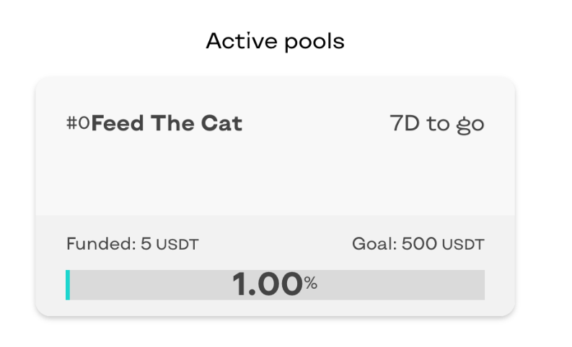
Funding
The main entity of the platform. Every funding is an independent contract with own vault
Anyone can create proposal and put it in DAO for voting.
DAO consists of trusted persons that verify all documents, and accept proposal if funding is really needed
Funding appears in list of active fundings

Slide 6
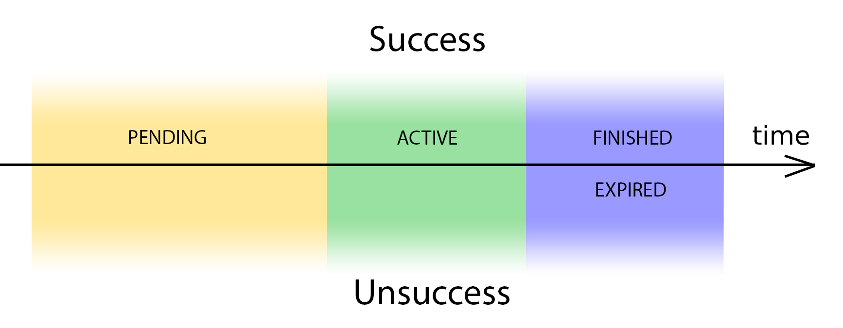
Flow
If funding collected target amount, the creator can withdraw tokens and add reports (as IPFS files)
If funding expired and target amount is not reached, donators can refund their tokens
States of funding:

Slide 7

Donates and rewards
In order to motivate people to donate, they will receive NFTs while they make a progress in donations. There global rewards that shared between all fundings, and local rewards for every funding. The workflow is next:
Donators can choose a favorite fundings from list and support them
As a reward, donators will receive NFTs
Reward NFTs can be staked in order to receive limited amount of DAO tokens. Using these tokens, top donators can help DAO members to validate fundings (in progress)

Slide 8
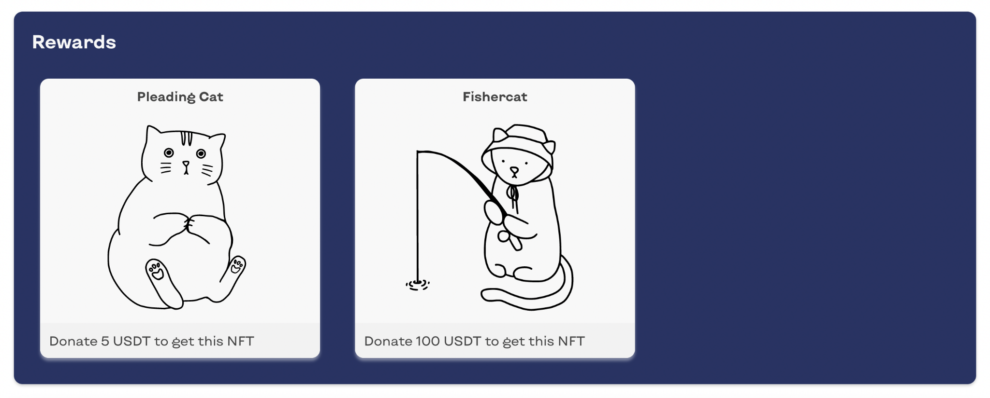
NFT
Global NFTs – exist for all fundings independently, represent summary progress of donator
Local NFTS – exist only for certain funding and refer only to it

Slide 9
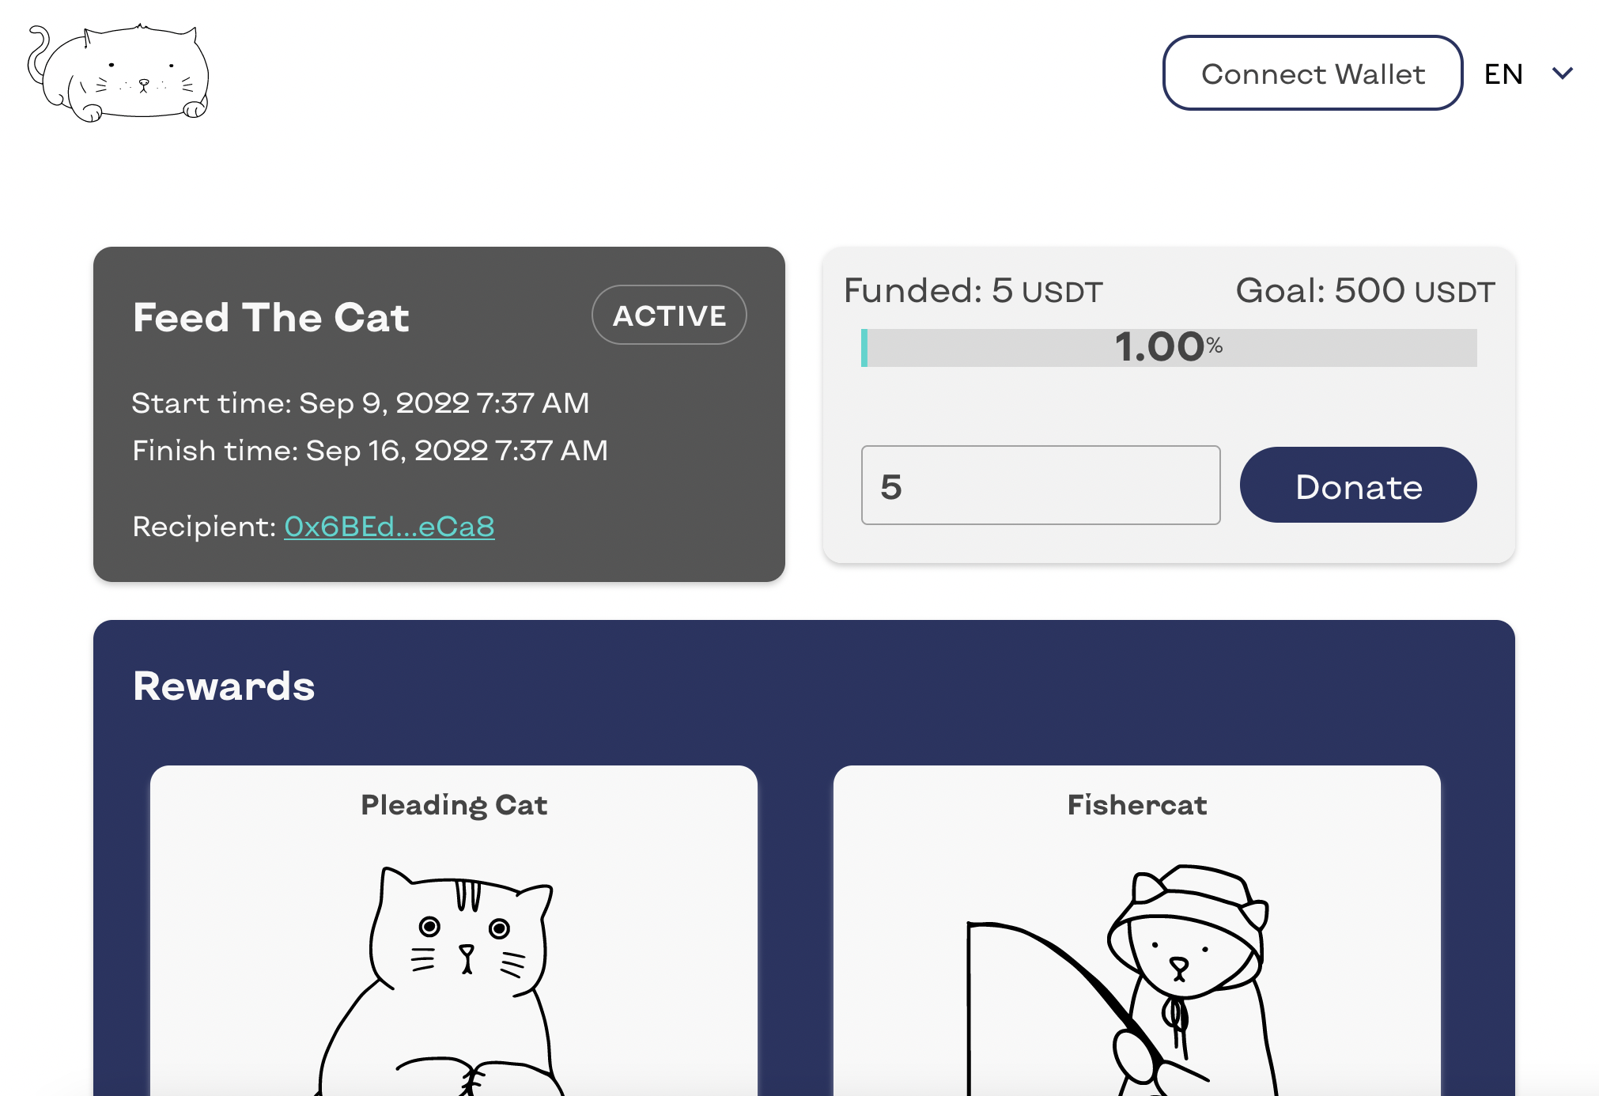
DAO (Aragon)
DAO consists of trusted persons that verify all documents, and accept proposal if funding is really needed. These persons have 90% of DAO tokens. Other 10% will distribute among top donators.

Slide 10
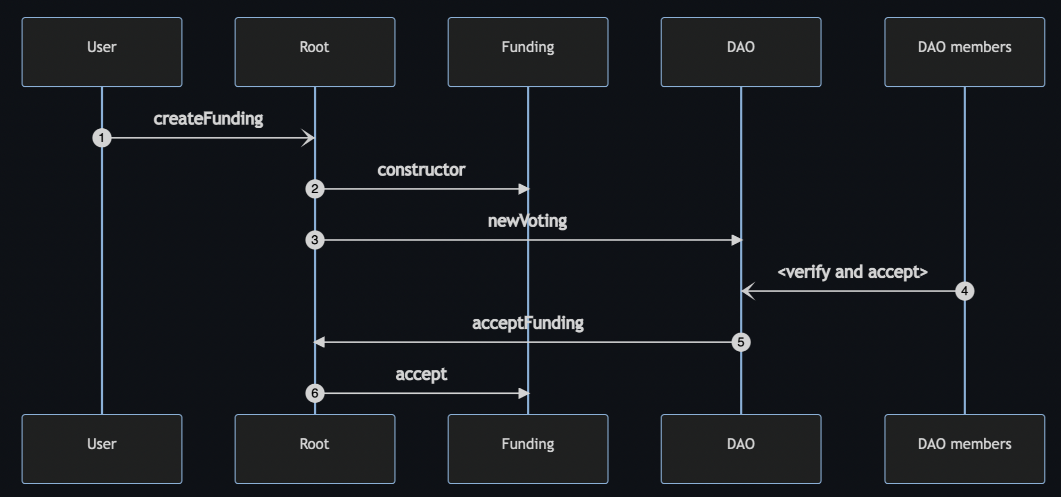
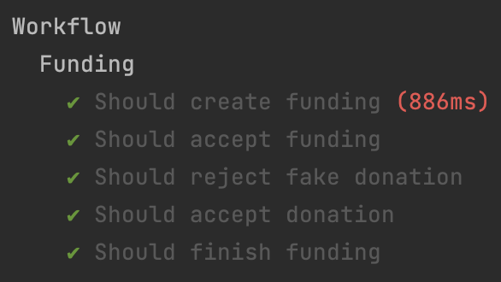
Tech things
Polygon blockchain(can be deployed to any other EVM compatible network)
Solidity for contracts with Hardhat as dev env
IPFS for storing NFT assets
Aragon as a DAO
React for frontend + web3
Contracts covered by tests

Slide 11

The END.
Don't forget to feed the cat

