Slide 1
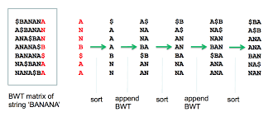
BWT genome indexing, Tony Robinson, Ulster university https://github.com/tonserrobo/BWT_HLS
Generated simplified C++ bwt/fm_index script from which to accelerate using AWS
Imported c++ source to vitis
Created hardware acc function for bwt, rotation & transform
Due to my lack of experience the project was stripped back to a bottom up approach, simply implementing a burrow wheelers transform (BWT) function in hardware.
Initially had difficulty developing an appropriate testbench
Dynamic memory allocation, structs, error handling and other c/c++ constructs –this needed fixed value at design time

