Slide 1
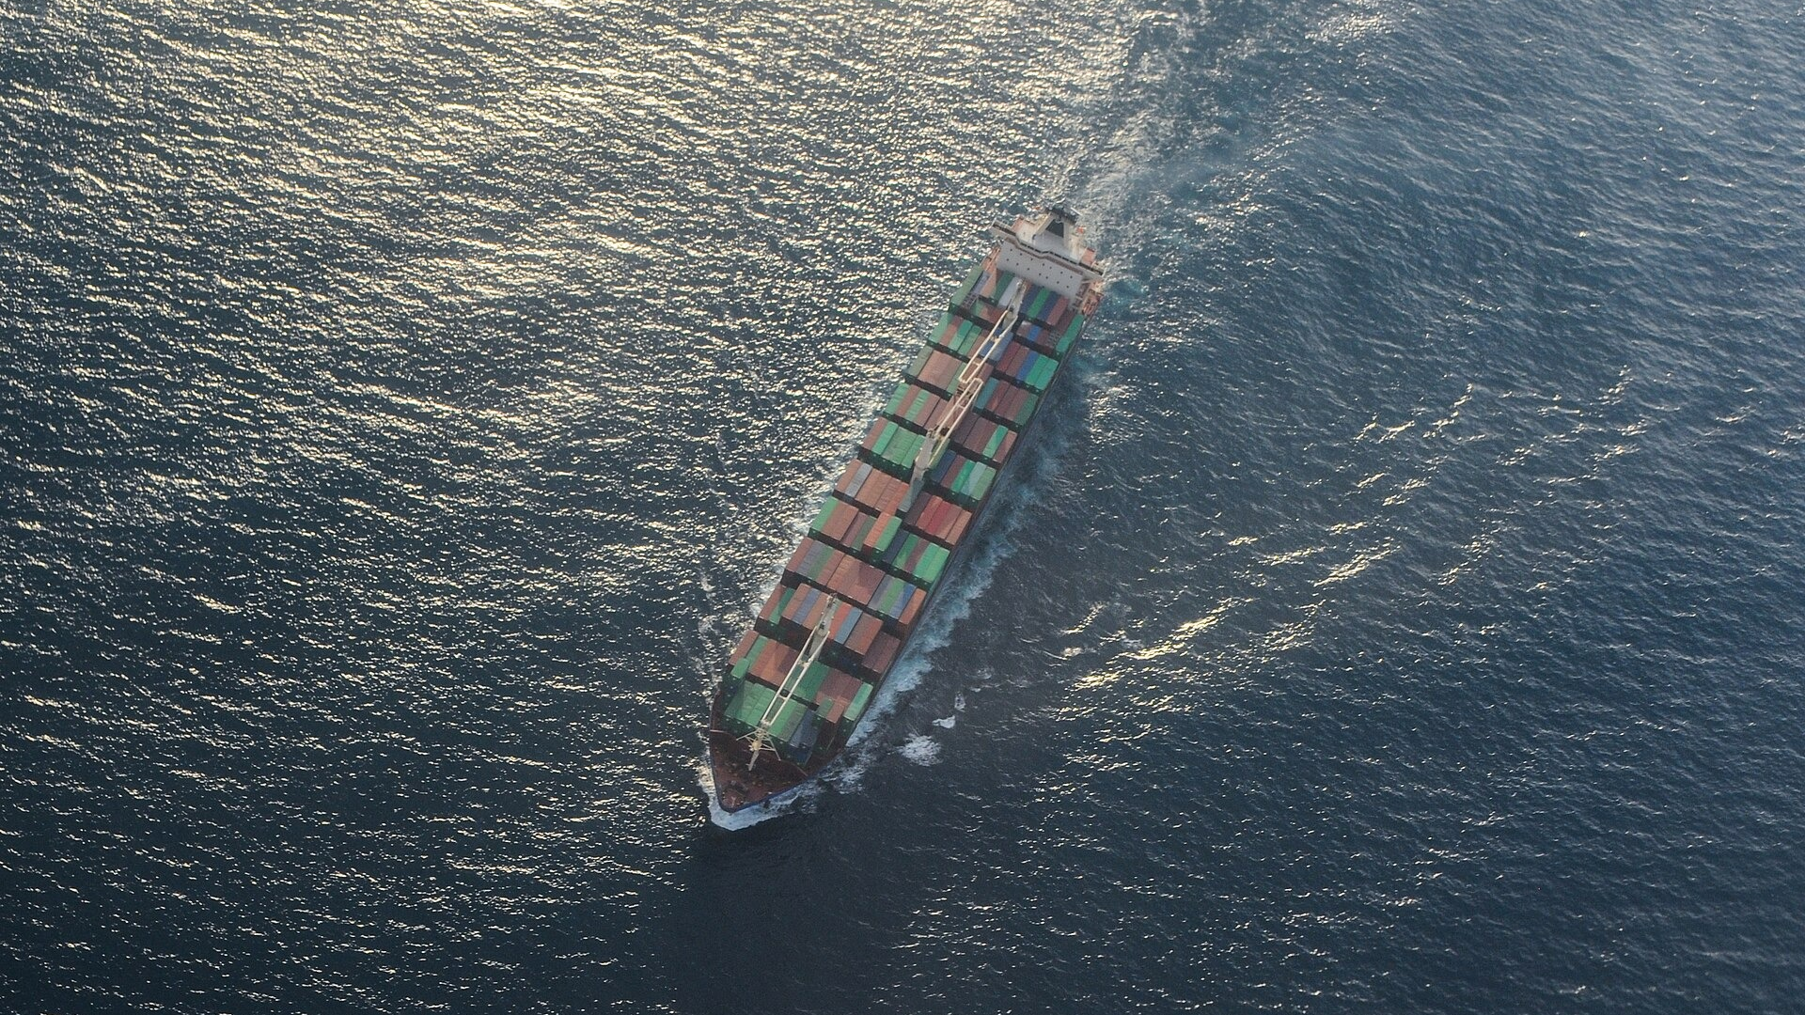
ICMIC 2026 · NTUST, Taipei · 19–21 August 2026
CONFROUTE
Confidence-Aware Routing for Resilient Maritime Edge AI
Anthony Uchenna Eneh · Love Allen Chijioke Ahakonye · Jae Min Lee · Dong-Seong Kim
Kumoh National Institute of Technology, Gumi, South Korea · NSLab Co. Ltd.
Notes:
Name, affiliation, one line: this is a paper about when an edge AI system on a ship should refuse to make a decision. 20 seconds, do not linger.

Slide 2
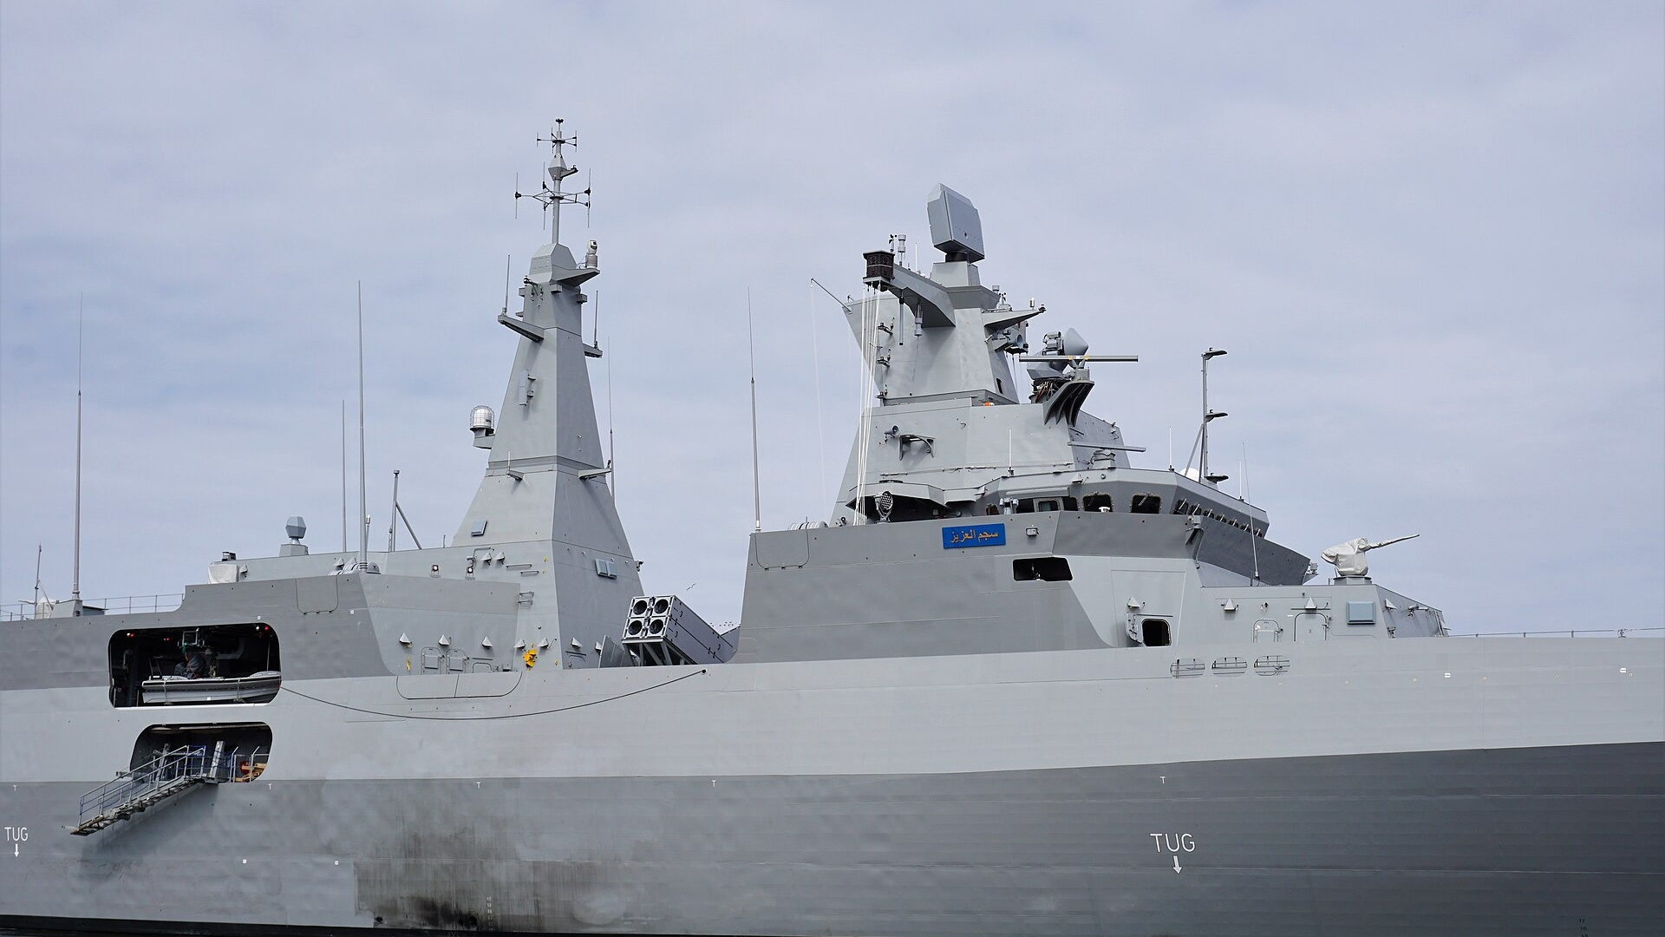
Ships now run AI on board.
Perception, monitoring, video triage, navigation support.
CONFROUTE | ICMIC 2026, NTUST Taipei
1
Notes:
Set the scene fast. Edge AI is already deployed at sea. Do not list applications, the slide does it. ~25 s.

Slide 3
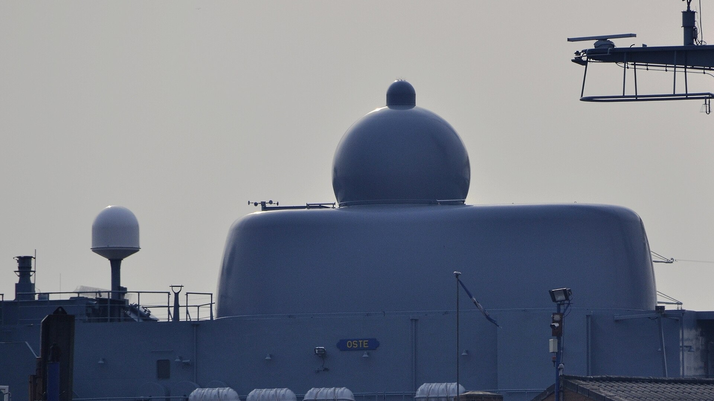
The link is not always there.
Satellite and ship-to-ship connectivity is intermittent by nature.
CONFROUTE | ICMIC 2026, NTUST Taipei
2
Notes:
Constraint one. Offloading is not a guaranteed escape hatch. ~25 s.

Slide 4

And the sea changes what the camera sees.
Sea state, illumination, haze, occlusion: the input drifts away from training.
CONFROUTE | ICMIC 2026, NTUST Taipei
3
Notes:
Constraint two, and the one this paper is really about. Point at the haze. ~25 s.

Slide 5
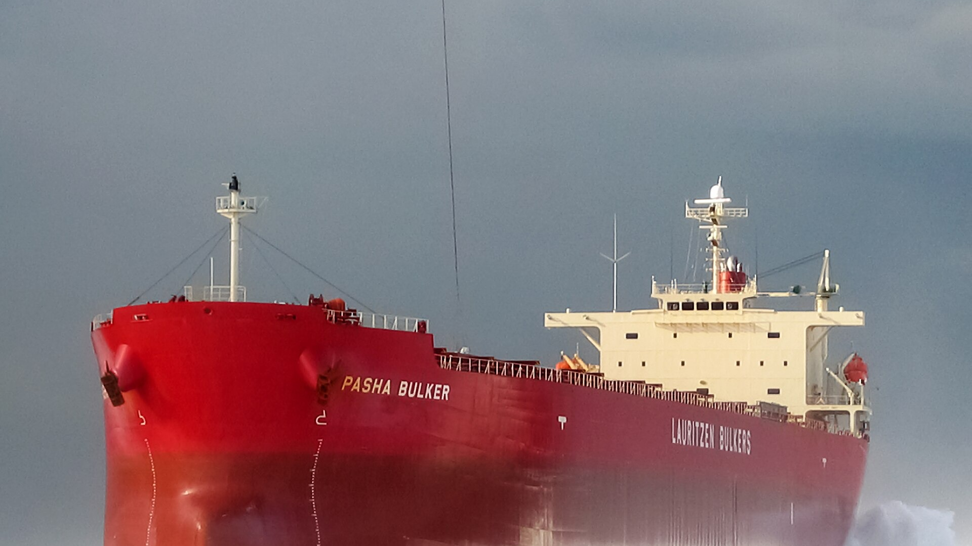
A wrong answer costs more than a slow one.
That inversion is what separates this from ordinary edge offloading.
CONFROUTE | ICMIC 2026, NTUST Taipei
4
Notes:
The key inversion. Latency-optimal is not safety-optimal. Say it plainly and pause. ~25 s.

Slide 6
Act now, ask for help, or refuse to answer?
Every task, on every node, under uncertainty.
CONFROUTE | ICMIC 2026, NTUST Taipei
5
Notes:
The question the paper answers. Let it sit for a beat. ~15 s.

Slide 7
Everyone assumes the model knows when it is unsure.
Confidence-threshold offloading is built entirely on that assumption.
CONFROUTE | ICMIC 2026, NTUST Taipei
6
Notes:
Prior maritime MEC work optimises latency against energy and treats confidence as a trustworthy gate. We tested it. ~25 s.

Slide 8
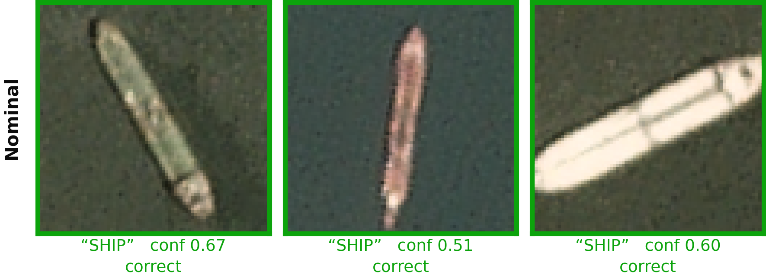
Clear water: the classifier finds every ship.
Three held-out ShipsNet chips, 80 × 80 PlanetScope imagery.
CONFROUTE | ICMIC 2026, NTUST Taipei
7
Notes:
Real chips from the dataset. All three correct. Note confidence is only 0.51 to 0.67: honestly unsure. ~30 s.

Slide 9
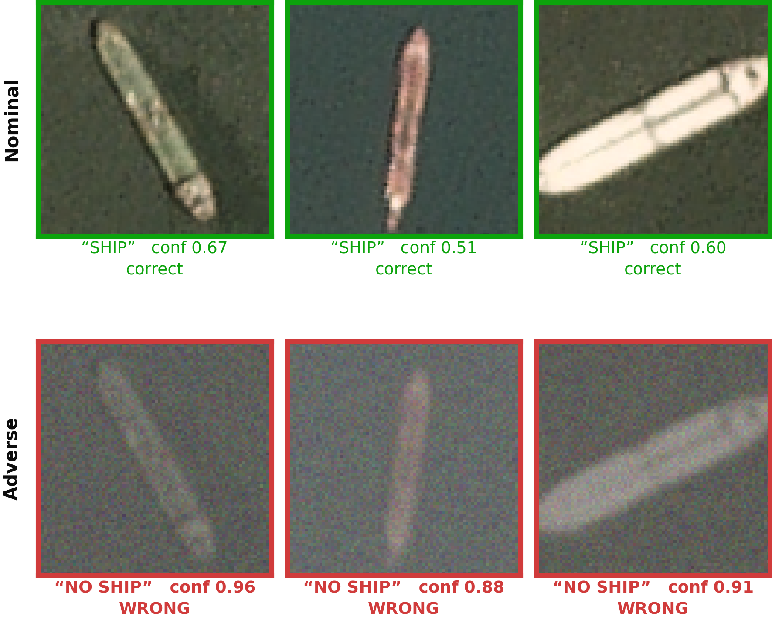
Add haze, and it stops seeing them.
Every chip still contains a ship. The model is now wrong on all three, and far more confident.
CONFROUTE | ICMIC 2026, NTUST Taipei
8
Notes:
THE slide. Same three vessels after the adverse transform. 0.67 correct becomes 0.96 WRONG. Slow down here. ~45 s.

Slide 10
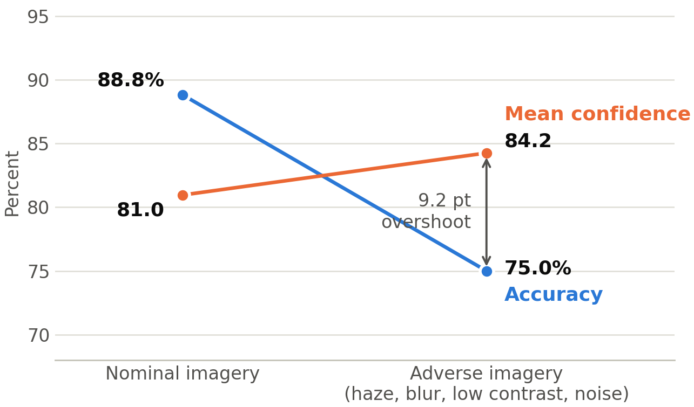
It is not three unlucky chips.
500 held-out images, nominal versus adverse.
Accuracy falls 13.8 points. Mean confidence rises 3.2 points.
CONFROUTE | ICMIC 2026, NTUST Taipei
9
Notes:
The population-level version of the previous slide. The lines cross. That crossing is the paper. ~40 s.

Slide 11
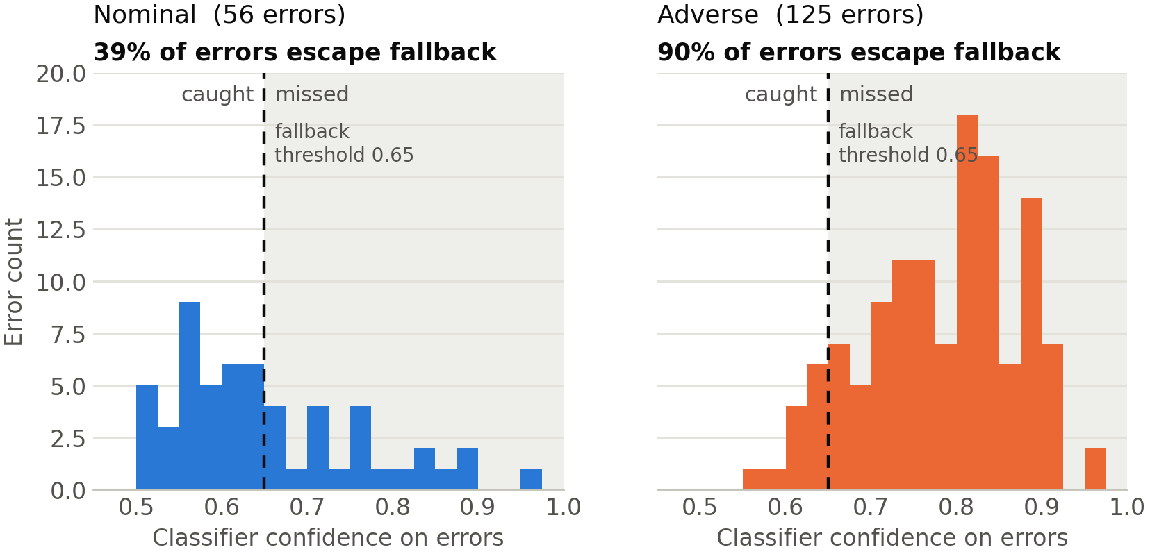
So a confidence gate cannot see the errors.
Under adverse conditions 90% of errors sit above the 0.65 threshold, invisible to it.
CONFROUTE | ICMIC 2026, NTUST Taipei
10
Notes:
Errors only, plotted against the fallback threshold. 39% escape under nominal, 90% under adverse. ~40 s.

Slide 12
A confidence gate fails exactly when you need it.
CONFROUTE | ICMIC 2026, NTUST Taipei
11
Notes:
One line, then move to the method. ~12 s.

Slide 13
CONFROUTE
Make refusal a first-class routing action, alongside compute and offload.
CONFROUTE | ICMIC 2026, NTUST Taipei
12
Notes:
Section break into the method. ~15 s.

Slide 14
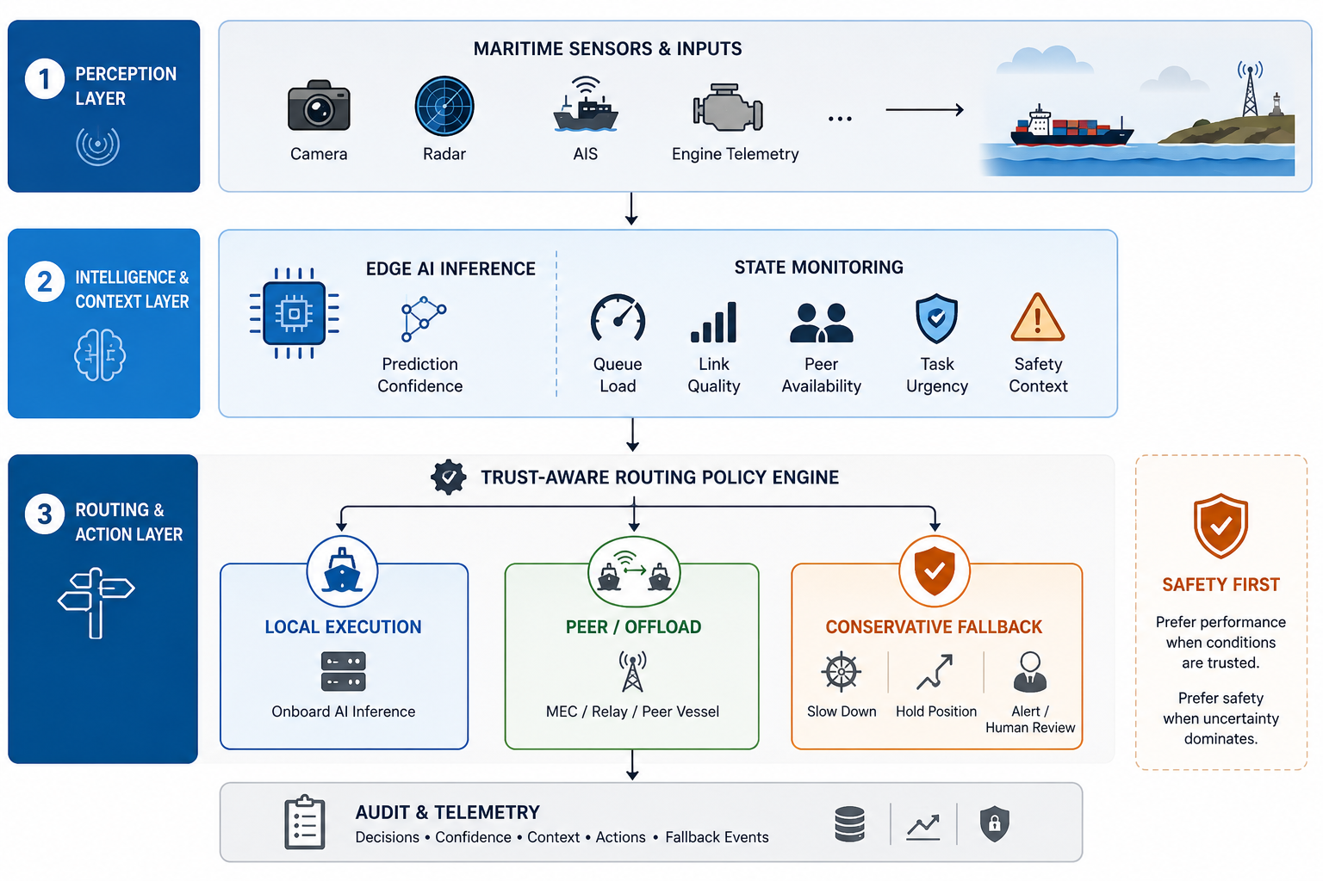
One layer, between the model and the actuator.
Consumes uncertainty without touching the model. Logs every decision for audit.
CONFROUTE | ICMIC 2026, NTUST Taipei
13
Notes:
Trace the three branches with the pointer. The router is post-scoring, pre-actuation, so it drops into an existing stack. ~40 s.

Slide 15
Three actions, one of them new.
LOCAL
OFFLOAD
FALLBACK
Run the model here.
Ask a peer or relay.
Refuse, and act safely.
Confident enough to act alone.
Link is usable, queue is loaded.
Uncertain and cut off.
Scores decide, guardrails override: no offload without a peer, no local execution on a safety-critical task below the confidence floor.
CONFROUTE | ICMIC 2026, NTUST Taipei
14
Notes:
Local when confident and the queue allows. Offload when the link is good and the queue is loaded. Fallback when uncertain AND cut off. ~35 s.

Slide 16
Fallback is an action, not an error code.
What the conservative branch means, per maritime application.
Collision avoidance
Reduce speed, sound horn, hold heading, alert the operator
Maritime surveillance
Flag the chip for review, defer the alert, request another pass
Engine anomaly
Report “inspection needed”, fall back to a limit-based alert
Waypoint decision
Hold position, revert to last safe heading, request human review
Conservative, auditable, and aligned with COLREGS/IMO practice: the ship does something safe and says why.
CONFROUTE | ICMIC 2026, NTUST Taipei
15
Notes:
Kills the objection that fallback means crash or do nothing. Read the collision-avoidance row aloud, then move on. ~35 s.

Slide 17
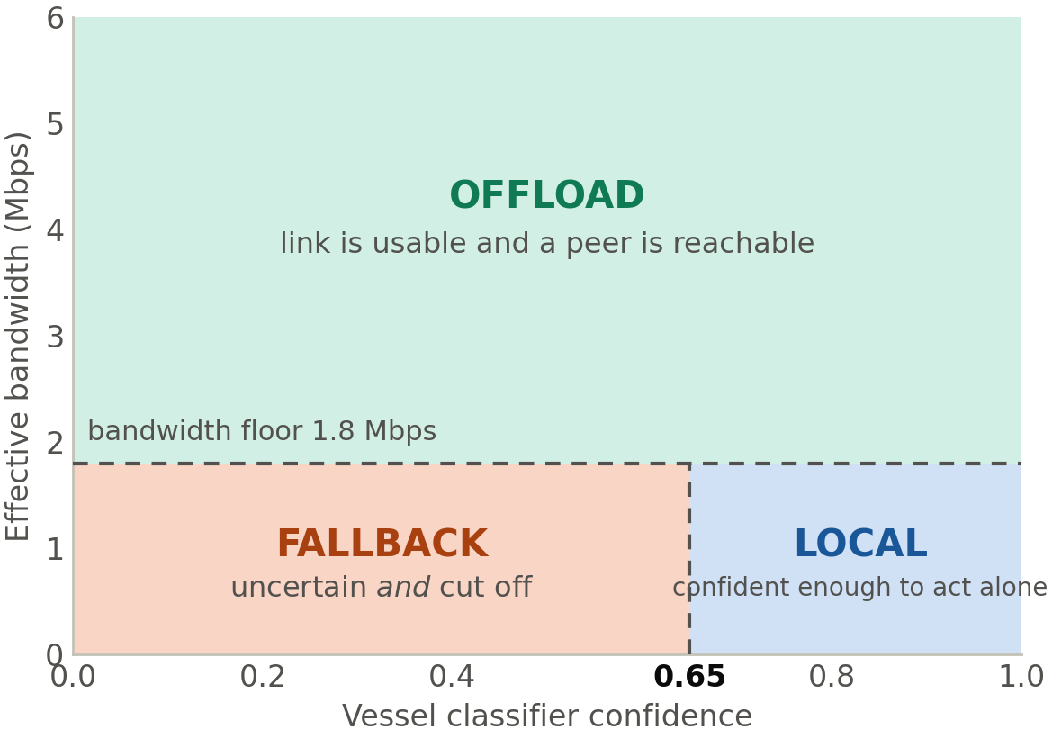
Refuse only when both signals fail.
Confidence below 0.65 and bandwidth below 1.8 Mbps.
If the link is healthy, the router would rather ask a better-resourced peer than refuse. That keeps fallback rare.
CONFROUTE | ICMIC 2026, NTUST Taipei
16
Notes:
Requiring both conditions is what stops the router hiding behind fallback. ~30 s.

Slide 18
37,500 routing decisions.
2,500 tasks × 5 policies × 3 link regimes.
4,000
ResNet-18
3
4
PlanetScope chips 80 × 80, ShipsNet
ImageNet-initialised 84.8% validation
link regimes stable / intermittent / degraded
baselines local, offload, confidence, load
Unsafe rate = routing-layer risk: safety-sensitive local errors, low-confidence local decisions, failed safety-sensitive offloads. It is not a count of physical incidents.
CONFROUTE | ICMIC 2026, NTUST Taipei
17
Notes:
ShipsNet, ResNet-18, three link regimes, four baselines. Say the unsafe-rate definition out loud: routing-layer risk, not physical incidents. ~35 s.

Slide 19
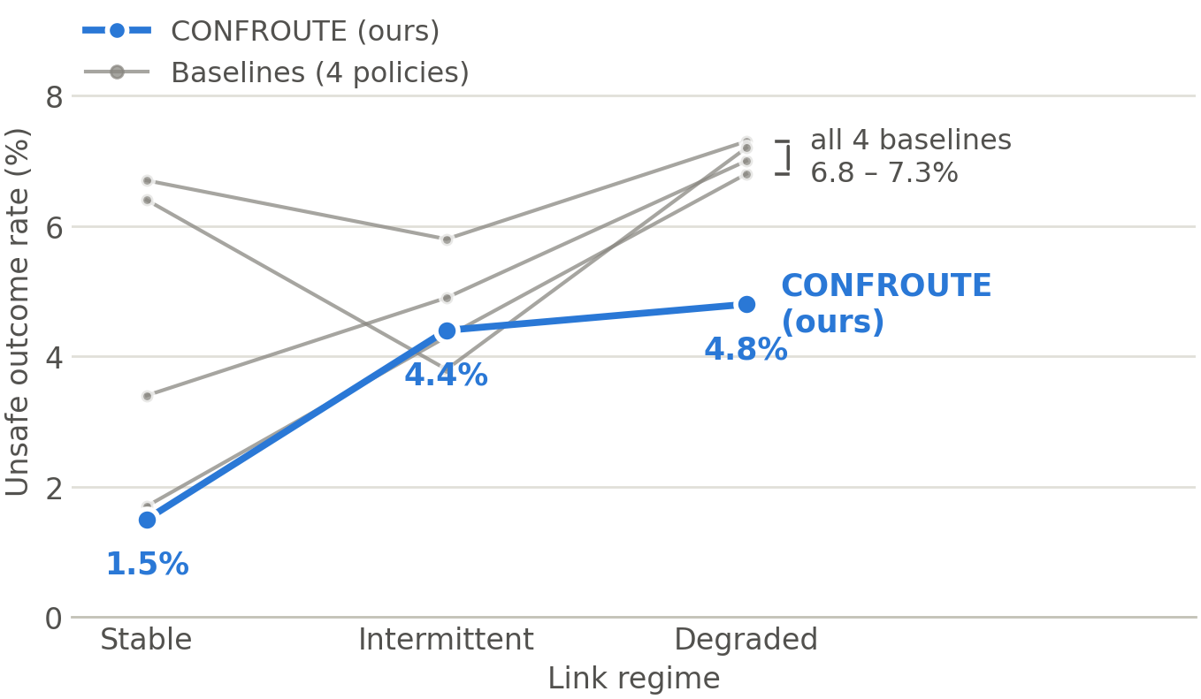
Every baseline converges at about 7%.
When the link goes, so does their escape hatch. CONFROUTE holds at 4.8%.
CONFROUTE | ICMIC 2026, NTUST Taipei
18
Notes:
The convergence is the story. Stable links flatter everything that offloads; degraded links expose the dependency. ~45 s.

Slide 20
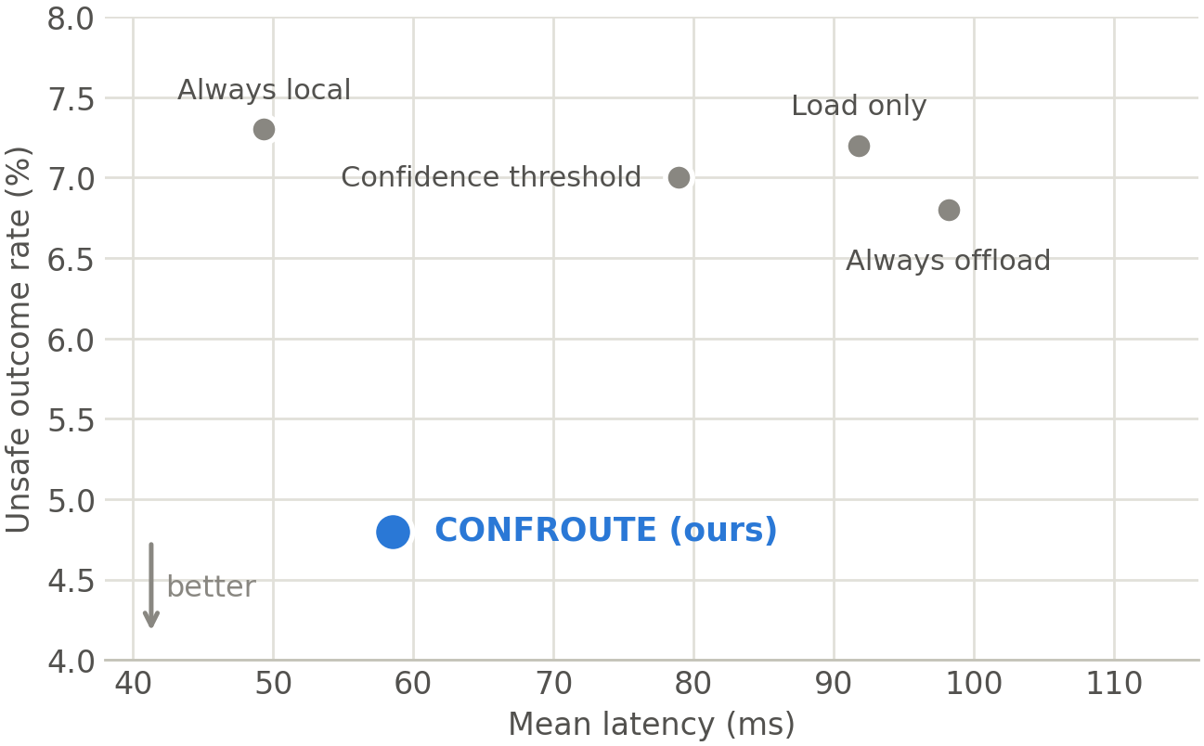
Degraded links: safer and faster.
Unsafe 6.8% → 4.8% and latency 98.2 → 58.5 ms against always-offload. A failed offload costs both.
CONFROUTE | ICMIC 2026, NTUST Taipei
19
Notes:
Normally safety costs latency. Not here, because attempting an offload that fails wastes time AND leaves the task unhandled. ~40 s.

Slide 21
Where we do not win: intermittent links.
The regime in which offloading still mostly works.
Policy
Latency (ms)
Unsafe rate
Fallback
Always local
49.4
5.8%
0.0%
Always offload
71.6
4.3%
0.0%
Confidence threshold
59.6
4.9%
0.0%
Load only
67.0
3.8%
0.0%
CONFROUTE (ours)
61.6
4.4%
2.6%
Load-only routing is safer here (3.8% vs 4.4%), at 5.4 ms more latency. Our case is the degraded regime, which is also the regime that actually threatens the vessel.
CONFROUTE | ICMIC 2026, NTUST Taipei
20
Notes:
Deliberate honesty, and it buys credibility. Load-only is safer here. Say why, then land the closing line. ~40 s.

Slide 22
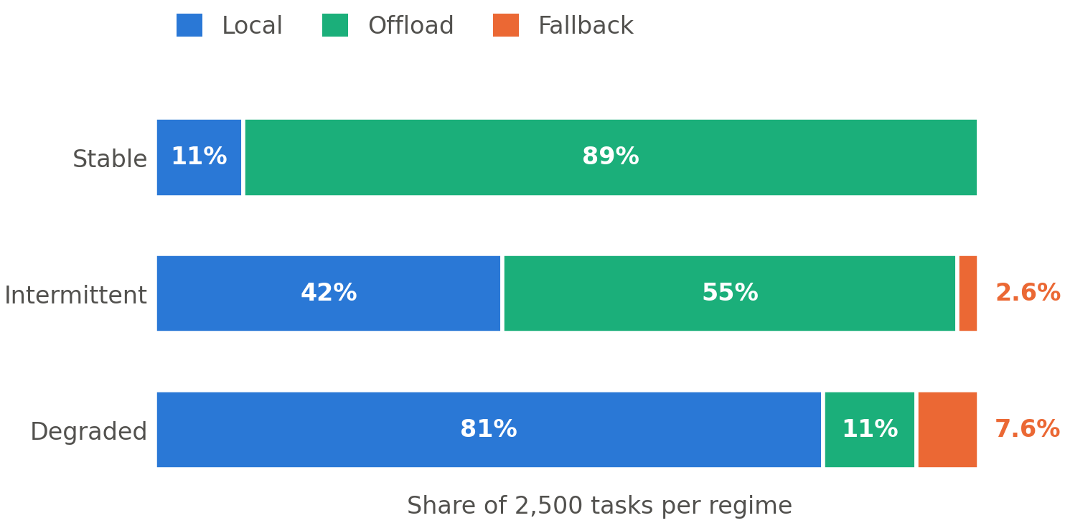
The router shifts with the link.
Offload collapses 89% → 11%. Fallback stays a bounded minority: the vessel keeps operating.
CONFROUTE | ICMIC 2026, NTUST Taipei
21
Notes:
Shows adaptation, and that fallback never runs away. ~30 s.

Slide 23
Both parts are load-bearing.
Unsafe outcome rate under degraded links.
Full CONFROUTE
4.8%
Without the fallback action
6.2%
p = 0.012
Without link-state awareness
5.9%
p = 0.037
CONFROUTE | ICMIC 2026, NTUST Taipei
22
Notes:
Removing fallback hurts more than removing link awareness. Having somewhere to put an undecidable task is the bigger effect. ~30 s.

Slide 24
The routing layer was never the bottleneck.
We improved it, and unsafe outcomes still occur at high confidence.
CONFROUTE | ICMIC 2026, NTUST Taipei
23
Notes:
Slow down. Let it sit before speaking. This is what you want the room to remember. ~25 s.

Slide 25
What we are not claiming.
Limitations
Where this goes
• Degradation is synthetic.
• Calibration first: conformal, OOD.
• One task family: satellite chips.
• Adaptive thresholds via bandits.
• Outcomes from a cost model.
• Peer-aware forwarding.
• Thresholds fixed and trace-tuned.
• Real traces, hardware-in-the-loop.
CONFROUTE | ICMIC 2026, NTUST Taipei
24
Notes:
State the limitations without apologising, then the forward path with calibration first. ~40 s.

Slide 26
Three things to take away.
1
Fallback deserves to be a routing action.
Under degraded links it cuts unsafe outcomes from 6.8% to 4.8% and saves 40 ms.
2
Confidence thresholds break exactly when needed.
Accuracy falls 13.8 points while confidence rises, and 90% of errors clear the gate.
3
Calibration is the reliability bottleneck.
Ahead of routing or scheduling. Safe autonomy at sea depends on knowing what the model does not know.
CONFROUTE | ICMIC 2026, NTUST Taipei
25
Notes:
Read the three headers only, then stop and invite questions. Do not add a new thought here. ~40 s.

Slide 27
Thank you. Questions?
Anthony Uchenna Eneh anthony@kumoh.ac.kr Kumoh National Institute of Technology, Gumi, South Korea
Notes:
Thank you, and take questions. Backup slides follow.

Slide 28
Backup

Slide 29
Backup: full results
Policy
Regime
Latency (ms)
Unsafe
Energy (J)
Always local
Stable
49.3
6.7%
0.50
Always offload
Stable
33.4
1.7%
0.60
Confidence threshold
Stable
46.5
3.4%
0.53
Load only
Stable
48.2
6.4%
0.51
CONFROUTE
Stable
33.5
1.5%
0.60
Always local
Intermittent
49.4
5.8%
0.50
Always offload
Intermittent
71.6
4.3%
0.59
Confidence threshold
Intermittent
59.6
4.9%
0.53
Load only
Intermittent
67.0
3.8%
0.58
CONFROUTE
Intermittent
61.6
4.4%
0.56
Always local
Degraded
49.3
7.3%
0.50
Always offload
Degraded
98.2
6.8%
0.56
Confidence threshold
Degraded
78.9
7.0%
0.55
Load only
Degraded
91.8
7.2%
0.56
CONFROUTE
Degraded
58.5
4.8%
0.50
CONFROUTE | ICMIC 2026, NTUST Taipei
27

Slide 30
Backup: confidence traces
Nominal 500 samples 88.8% accuracy mean confidence 0.810 std 0.140 Adverse 500 samples 75.0% accuracy mean confidence 0.842 std 0.085 The adverse transform is deterministic: reduced contrast and brightness, Gaussian blur, haze blending, sensor-like noise. Note the narrowing standard deviation: the model is not just wrong, it is uniformly confident. Mean confidence on incorrect predictions: 0.651 nominal, 0.782 adverse. Errors above the 0.65 threshold: 22 of 56 nominal, 113 of 125 adverse.
CONFROUTE | ICMIC 2026, NTUST Taipei
28

Slide 31
Image credits
Photographs from Wikimedia Commons, reused under the licence shown.
Aerial container ship (title, closing)
Wilfredor, CC BY-SA 3.0
Vessel in haze
Cavernia, CC BY-SA 4.0
Bulk carrier in heavy seas
Web107 / Georgfotoart, CC BY-SA 3.0
Shipborne radomes
High Contrast, CC BY 3.0 de
Frigate radar masts
Ein Dahmer, CC BY-SA 4.0
Satellite imagery and 80 × 80 chips: Ships in Satellite Imagery (ShipsNet), Planet Labs / Kaggle, CC BY-SA 4.0.
CONFROUTE | ICMIC 2026, NTUST Taipei
29

