Slide 1
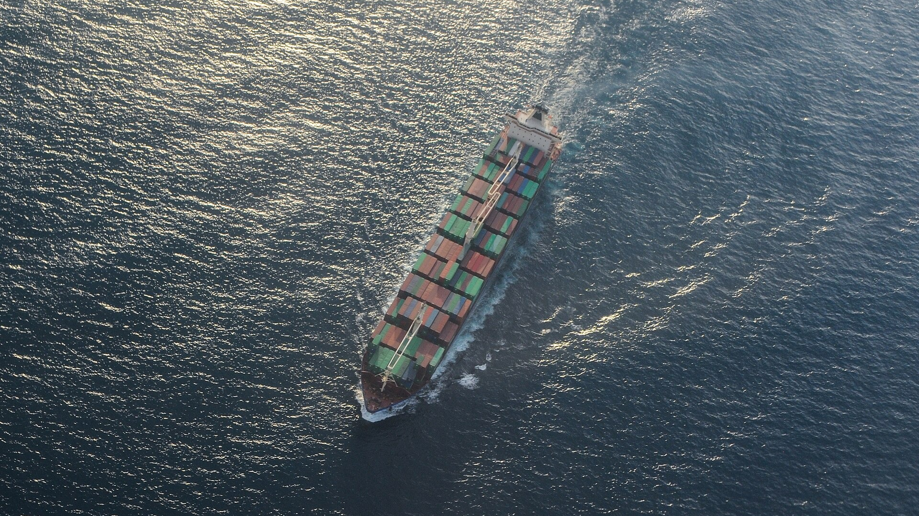
ICMIC 2026 · NTUST, Taipei · 19–21 August 2026
CONFROUTE
Confidence-Aware Routing for Resilient Maritime Edge AI
Anthony Uchenna Eneh · Love Allen Chijioke Ahakonye · Jae Min Lee · Dong-Seong Kim
Kumoh National Institute of Technology, Gumi, South Korea · NSLab Co. Ltd.
Notes:
Name, affiliation, one line: this is a paper about when an edge AI system on a ship should refuse to make a decision. 20 s, do not linger.

Slide 2
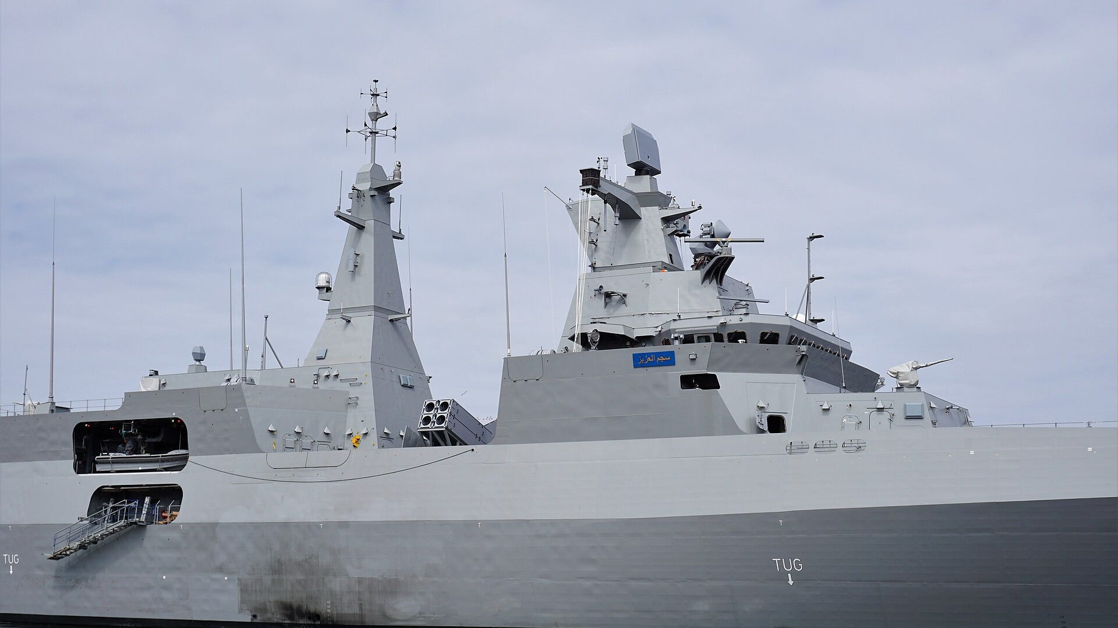
Ships now run AI on board.
Perception, monitoring, navigation support, on a satellite link that is intermittent by nature.
CONFROUTE | ICMIC 2026, NTUST Taipei
1
Notes:
Two facts, fast: the compute is already on the vessel, and the link that would let it ask for help is not guaranteed. Offloading is not an escape hatch. ~30 s.

Slide 3

And the sea changes what the camera sees.
Sea state, haze, illumination, occlusion: the input drifts away from training, and at sea a wrong answer costs more than a slow one.
CONFROUTE | ICMIC 2026, NTUST Taipei
2
Notes:
Point at the haze. Then land the inversion: latency-optimal is not safety-optimal, which is what separates this from ordinary MEC work. Say it plainly and pause. ~35 s.

Slide 4
Act now, ask for help, or refuse to answer?
Every task, on every node, under uncertainty. Confidence-threshold offloading assumes the model knows when it is unsure. We tested that.
CONFROUTE | ICMIC 2026, NTUST Taipei
3
Notes:
The question the paper answers, and the assumption the field is built on. Do not defend the assumption, you are about to break it. ~30 s.

Slide 5
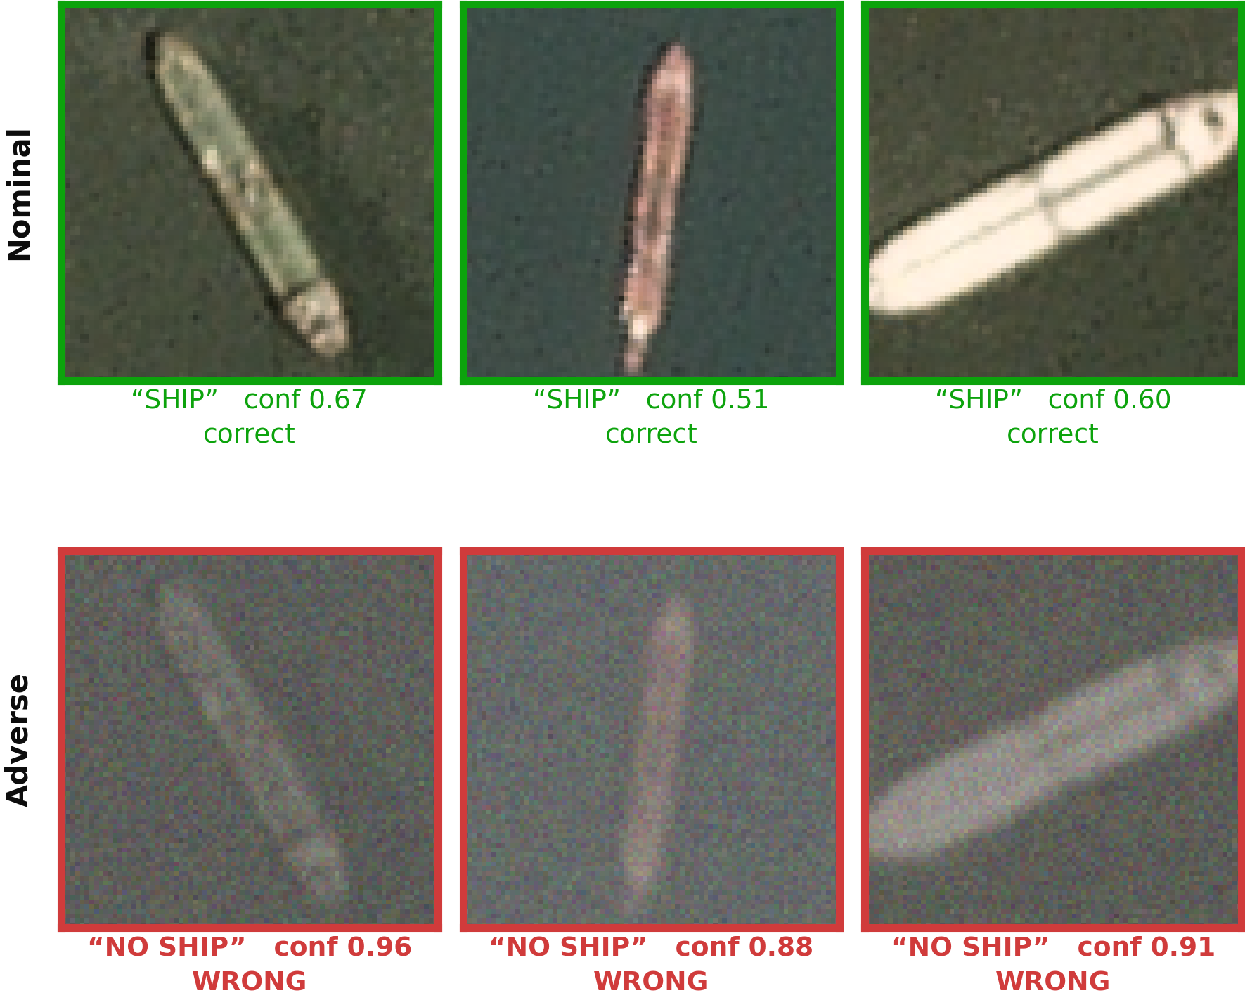
It finds every ship, until you add haze.
Three held-out ShipsNet chips, 80 × 80 PlanetScope imagery, before and after the adverse transform.
Every chip still contains a ship. The model is now wrong on all three, and far more confident.
CONFROUTE | ICMIC 2026, NTUST Taipei
4
Notes:
THE slide. Top row: all three correct, and confidence is only 0.51 to 0.67, honestly unsure. Bottom row: same three vessels, NO SHIP at 0.96, 0.88, 0.91. "It did not become uncertain. It became more certain, and wrong." Pause. ~1:10.

Slide 6
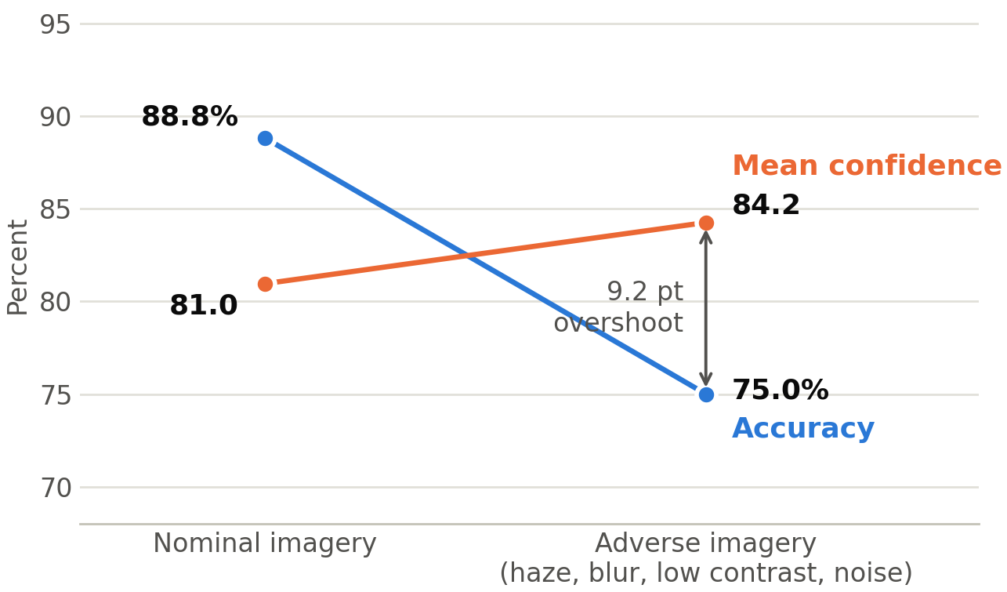
It is not three unlucky chips.
500 held-out images, nominal versus adverse.
Accuracy falls 13.8 points. Mean confidence rises 3.2 points.
CONFROUTE | ICMIC 2026, NTUST Taipei
5
Notes:
The population-level version of the previous slide. The lines cross. That crossing is the paper. Those three chips are 3 of 53 that behave this way. ~50 s.

Slide 7
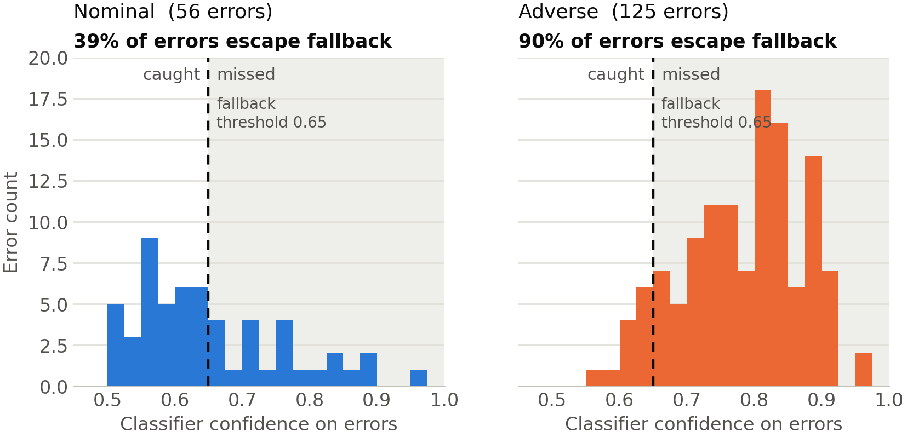
A confidence gate fails exactly when you need it.
Under adverse conditions 90% of errors sit above the 0.65 threshold, invisible to it. Under nominal conditions, 39%.
CONFROUTE | ICMIC 2026, NTUST Taipei
6
Notes:
Errors only, plotted against the fallback threshold. The gate is blind precisely in the regime that threatens the vessel. This is the hinge into the method. ~45 s.

Slide 8
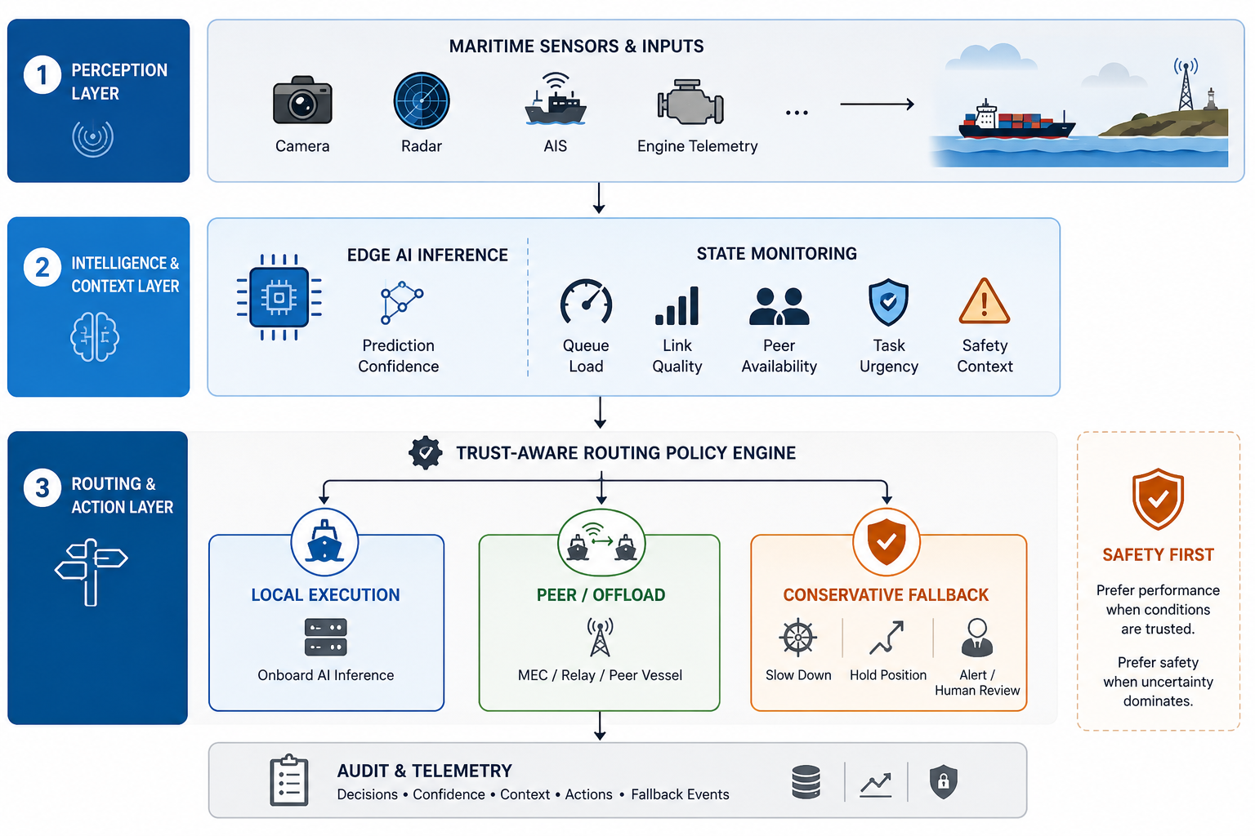
CONFROUTE: make refusal a routing action.
Post-scoring, pre-actuation: consumes uncertainty without touching the model, logs every decision.
CONFROUTE | ICMIC 2026, NTUST Taipei
7
Notes:
Trace the three branches with the pointer. Post-scoring, pre-actuation, so it drops into an existing stack. ~45 s.

Slide 9
Three actions, one of them new.
LOCAL
OFFLOAD
FALLBACK
Run the model here.
Ask a peer or relay.
Refuse, and act safely.
Confident enough to act alone.
Link is usable, queue is loaded.
Uncertain and cut off.
Scores decide, guardrails override: no offload without a peer, no local execution on a safety-critical task below the confidence floor.
CONFROUTE | ICMIC 2026, NTUST Taipei
8
Notes:
Local when confident and the queue allows. Offload when the link is good and the queue is loaded. Fallback when uncertain AND cut off. Land the guardrail line: the threshold controller is inspectable and certifiable. ~40 s.

Slide 10
Fallback is an action, not an error code.
What the conservative branch means, per maritime application.
Collision avoidance
Reduce speed, sound horn, hold heading, alert the operator
Maritime surveillance
Flag the chip for review, defer the alert, request another pass
Engine anomaly
Report “inspection needed”, fall back to a limit-based alert
Waypoint decision
Hold position, revert to last safe heading, request human review
Conservative, auditable, and aligned with COLREGS/IMO practice: the ship does something safe and says why.
CONFROUTE | ICMIC 2026, NTUST Taipei
9
Notes:
Kills the objection that fallback means crash or do nothing. Read the collision-avoidance row aloud, then move on. ~35 s.

Slide 11
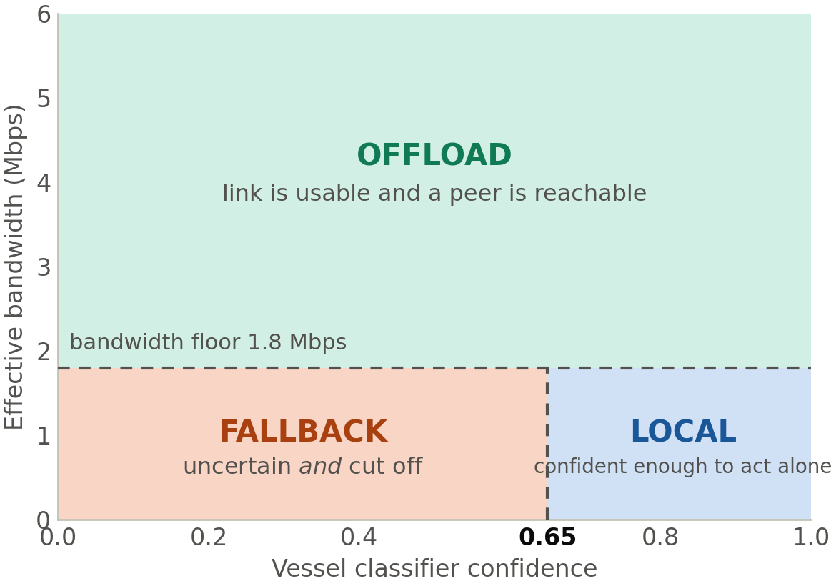
Refuse only when both signals fail.
Confidence below 0.65 and bandwidth below 1.8 Mbps.
If the link is healthy, the router would rather ask a better-resourced peer than refuse. That keeps fallback rare.
CONFROUTE | ICMIC 2026, NTUST Taipei
10
Notes:
Requiring both conditions is what stops the router hiding behind fallback. ~30 s.

Slide 12
37,500 routing decisions.
2,500 tasks × 5 policies × 3 link regimes.
4,000
ResNet-18
3
4
PlanetScope chips 80 × 80, ShipsNet
ImageNet-initialised 84.8% validation
link regimes stable / intermittent / degraded
baselines local, offload, confidence, load
Unsafe rate = routing-layer risk: safety-sensitive local errors, low-confidence local decisions, failed safety-sensitive offloads. It is not a count of physical incidents.
CONFROUTE | ICMIC 2026, NTUST Taipei
11
Notes:
ShipsNet, ResNet-18, three link regimes, four baselines. Say the unsafe-rate definition out loud: routing-layer risk, not physical incidents. ~35 s.

Slide 13
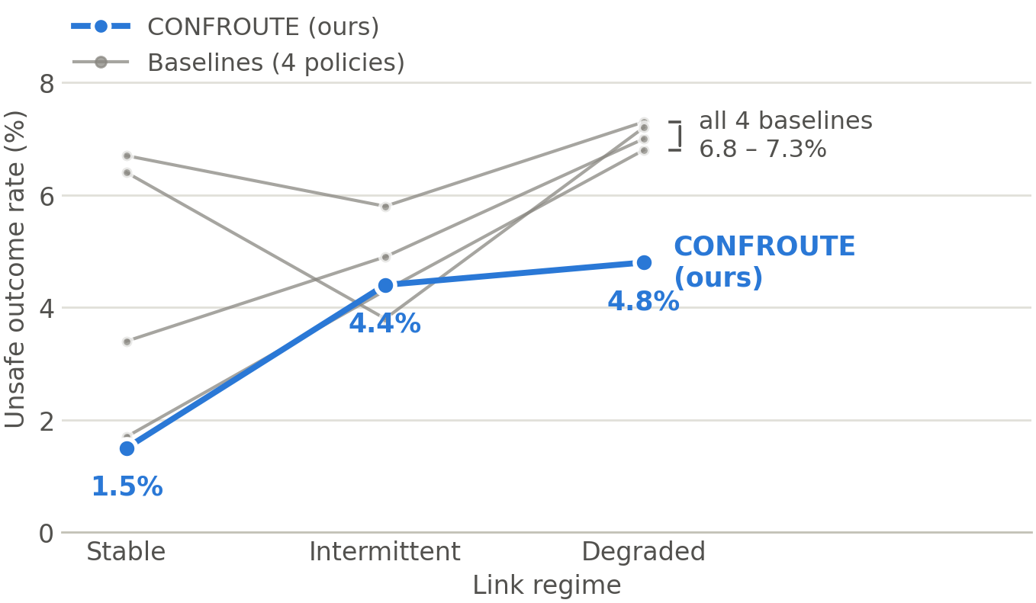
Every baseline converges at about 7%.
When the link goes, so does their escape hatch. CONFROUTE holds at 4.8%.
CONFROUTE | ICMIC 2026, NTUST Taipei
12
Notes:
The convergence is the story, not our line. Stable links flatter everything that offloads; degraded links expose the dependency. Then point at 4.8%. ~55 s.

Slide 14
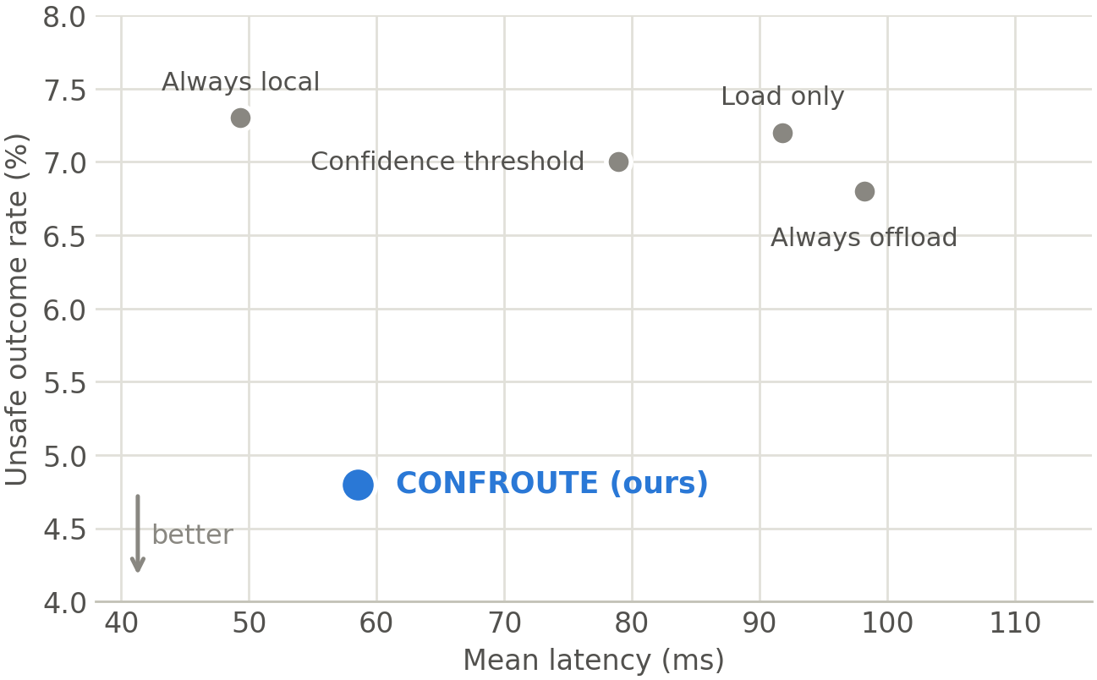
Degraded links: safer and faster.
Unsafe 6.8% → 4.8% and latency 98.2 → 58.5 ms against always-offload. A failed offload costs both.
CONFROUTE | ICMIC 2026, NTUST Taipei
13
Notes:
Normally safety costs latency. Not here, because attempting an offload that fails wastes time AND leaves the task unhandled. ~50 s.

Slide 15
Where we do not win: intermittent links.
The regime in which offloading still mostly works.
Policy
Latency (ms)
Unsafe rate
Fallback
Always local
49.4
5.8%
0.0%
Always offload
71.6
4.3%
0.0%
Confidence threshold
59.6
4.9%
0.0%
Load only
67.0
3.8%
0.0%
CONFROUTE (ours)
61.6
4.4%
2.6%
Load-only routing is safer here (3.8% vs 4.4%), at 5.4 ms more latency. Our case is the degraded regime, which is also the regime that actually threatens the vessel.
CONFROUTE | ICMIC 2026, NTUST Taipei
14
Notes:
Deliberate honesty, and it buys credibility. Load-only is safer here because offloading still works and removes local-error risk. Say why, then land the closing line. ~40 s.

Slide 16
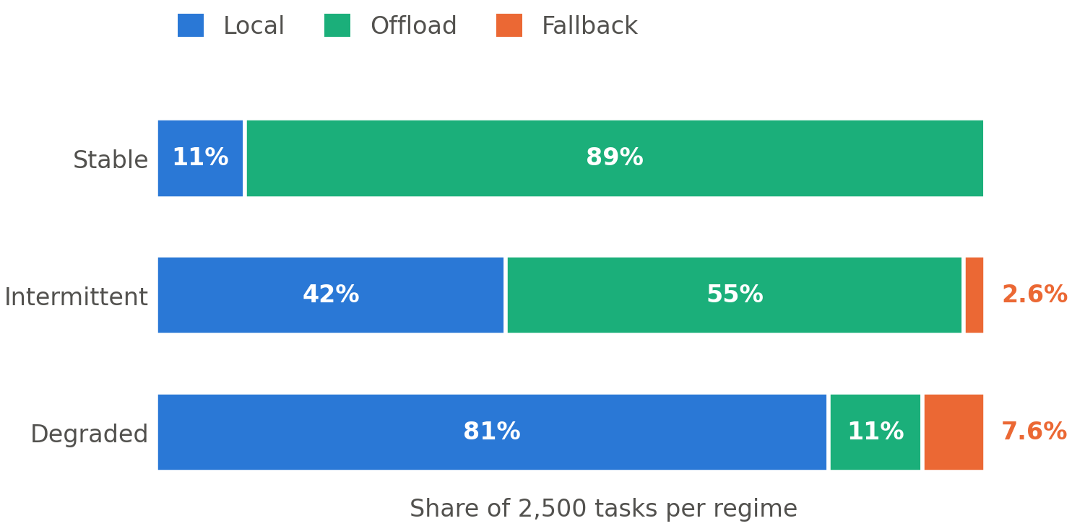
Both parts are load-bearing, and the router adapts.
Unsafe outcome rate under degraded links, and the action mix by regime.
Full CONFROUTE
4.8%
No fallback action
6.2%
p = 0.012
No link-state awareness
5.9%
p = 0.037
Fallback carries more of the benefit than link awareness does.
Offload collapses 89% → 11%. Fallback stays a bounded minority: the vessel keeps operating.
CONFROUTE | ICMIC 2026, NTUST Taipei
15
Notes:
Removing fallback hurts more than removing link awareness: having somewhere to put an undecidable task is the bigger effect. Then the chart: offload collapses 89% to 11% as the link degrades, and fallback stays a bounded minority. ~45 s.

Slide 17
The routing layer was never the bottleneck.
We improved it, and unsafe outcomes still occur at high confidence.
CONFROUTE | ICMIC 2026, NTUST Taipei
16
Notes:
Slow down. Let it sit before speaking. This is what you want the room to remember. ~30 s.

Slide 18
What we are not claiming.
Limitations
Where this goes
• Degradation is synthetic.
• Calibration first: conformal, OOD.
• One task family: satellite chips.
• Adaptive thresholds via bandits.
• Outcomes from a cost model.
• Peer-aware forwarding.
• Thresholds fixed and trace-tuned.
• Real traces, hardware-in-the-loop.
CONFROUTE | ICMIC 2026, NTUST Taipei
17
Notes:
State the limitations without apologising, then the forward path with calibration first. ~40 s.

Slide 19
Three things to take away.
1
Fallback deserves to be a routing action.
Under degraded links it cuts unsafe outcomes from 6.8% to 4.8% and saves 40 ms.
2
Confidence thresholds break exactly when needed.
Accuracy falls 13.8 points while confidence rises, and 90% of errors clear the gate.
3
Calibration is the reliability bottleneck.
Ahead of routing or scheduling. Safe autonomy at sea depends on knowing what the model does not know.
CONFROUTE | ICMIC 2026, NTUST Taipei
18
Notes:
Read the three headers only, then stop and invite questions. Do not add a new thought here. ~50 s.

Slide 20
Thank you. Questions?
Anthony Uchenna Eneh anthony@kumoh.ac.kr Kumoh National Institute of Technology, Gumi, South Korea
Photographs, Wikimedia Commons: Wilfredor (CC BY-SA 3.0); Cavernia (CC BY-SA 4.0); Ein Dahmer (CC BY-SA 4.0). Satellite imagery and 80 × 80 chips: Ships in Satellite Imagery (ShipsNet), Planet Labs / Kaggle, CC BY-SA 4.0.
Notes:
Thank you, and take questions. The full 31-slide deck has the backup material: full results table, confidence traces, per-image credits.

