Slide 1
HANDS-ON MLflow TRACE LAB
Combined Lab: Diagnose and Tune a Healthcare AI Agent
Find synthetic PHI, context confusion, and tool clash—then prove the fix
27 minutes • Deterministic by default • Fictional workshop data only
DATABRICKS | COMBINED LAB
1

Slide 2
COMBINED LAB
Your mission
• Determine where synthetic PHI first enters the agent and where it crosses protected boundaries.
• Explain why retrieval underperforms and why the ambiguous router selects the patient-record tool.
• Apply five controlled context remediations without training or replacing the model.
• Compare two real nested MLflow traces and prove the system changed—not merely the wording of one answer.
DATABRICKS | COMBINED LAB
2

Slide 3
BROKEN SCENARIO
One task, three competing signals
“What follow-up care is needed after discharge for this patient?”
CP-104 · ACTIVE
CM-220 · ACTIVE
PATIENT TOOL
Cardiology Discharge Policy Follow-up within 7 days
Care Management Standard Follow-up within 30 days
Ambiguous router output Follow-up within 30 days
No retrieved precedence rule identifies the controlling policy.
DATABRICKS | COMBINED LAB
3

Slide 4
DIAGNOSIS
This is context confusion—not a knowledge gap
• The model receives mutually inconsistent authoritative evidence, plus a tool output reinforcing 30 days.
• The broken prompt correctly prevents outside clinical knowledge from silently breaking the tie.
• A plausible answer cannot repair missing policy hierarchy or metadata upstream.
• The safe behavior is to expose the unresolved conflict and fix the context before inference.
DATABRICKS | COMBINED LAB
4

Slide 5
TRACE TRIAGE
Follow the first bad span
RETRIEVE
GUARD
ROUTER
MODEL
MEMORY
mixed policies + patient note
→
unsafe context passes through
→
overlapping tools patient tool wins
→
PHI + conflict reach inference
→
raw transcript is persisted
Intervene at the earliest safe boundary—not only at final-answer rendering.
DATABRICKS | COMBINED LAB
5

Slide 6
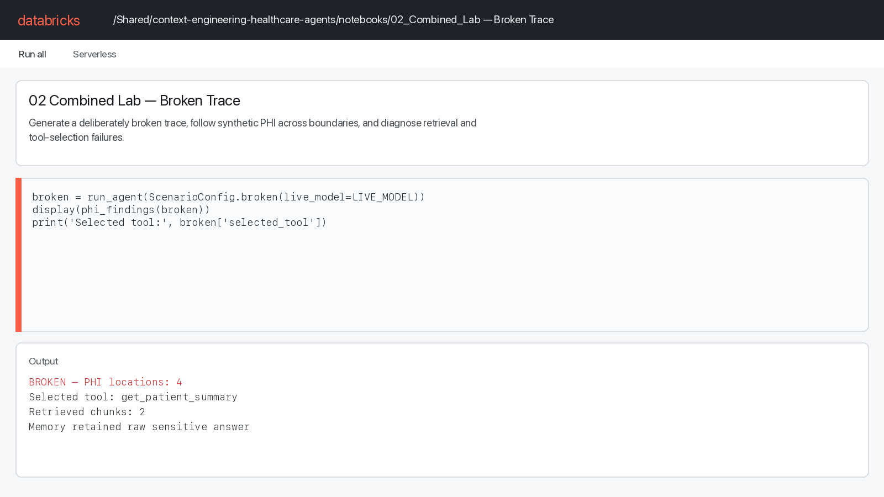
NOTEBOOK OUTPUT
The broken run makes the defects observable
Deterministic run: 4 synthetic-PHI locations; selected tool: get_patient_summary.
DATABRICKS | COMBINED LAB
6

Slide 7
REMEDIATION PROFILE
Five settings change the context lifecycle
JUST-IN-TIME
SMALL CHUNKS
DROP + REDACT
Task-specific retrieval timing is explicit in the trace.
Only approved policy chunks; exclude patient note and giant mixed chunk.
Unsafe documents are removed and synthetic PHI is redacted before inference.
PROGRESSIVE TOOLS
SAFE MEMORY
Expose only search_clinical_policy for this policy-only intent.
Persist an allowlisted, de-identified summary—not the raw transcript.
DATABRICKS | COMBINED LAB
7

Slide 8
WHAT IS REAL
Same agent workflow, safer configuration
• run_agent executes root agent, retriever, guard, router, tool, model, and memory functions instrumented with mlflow.trace.
• Embedded documents, tools, and synthetic values are controlled fixtures—not production Vector Search, EHR, or MCP integrations.
• LIVE_MODEL=True calls databricks-claude-sonnet-4-5 with deterministic fallback; False simulates only the generated answer.
• ScenarioConfig.fixed() activates safer branches; it does not train or repair a model.
DATABRICKS | COMBINED LAB
8

Slide 9
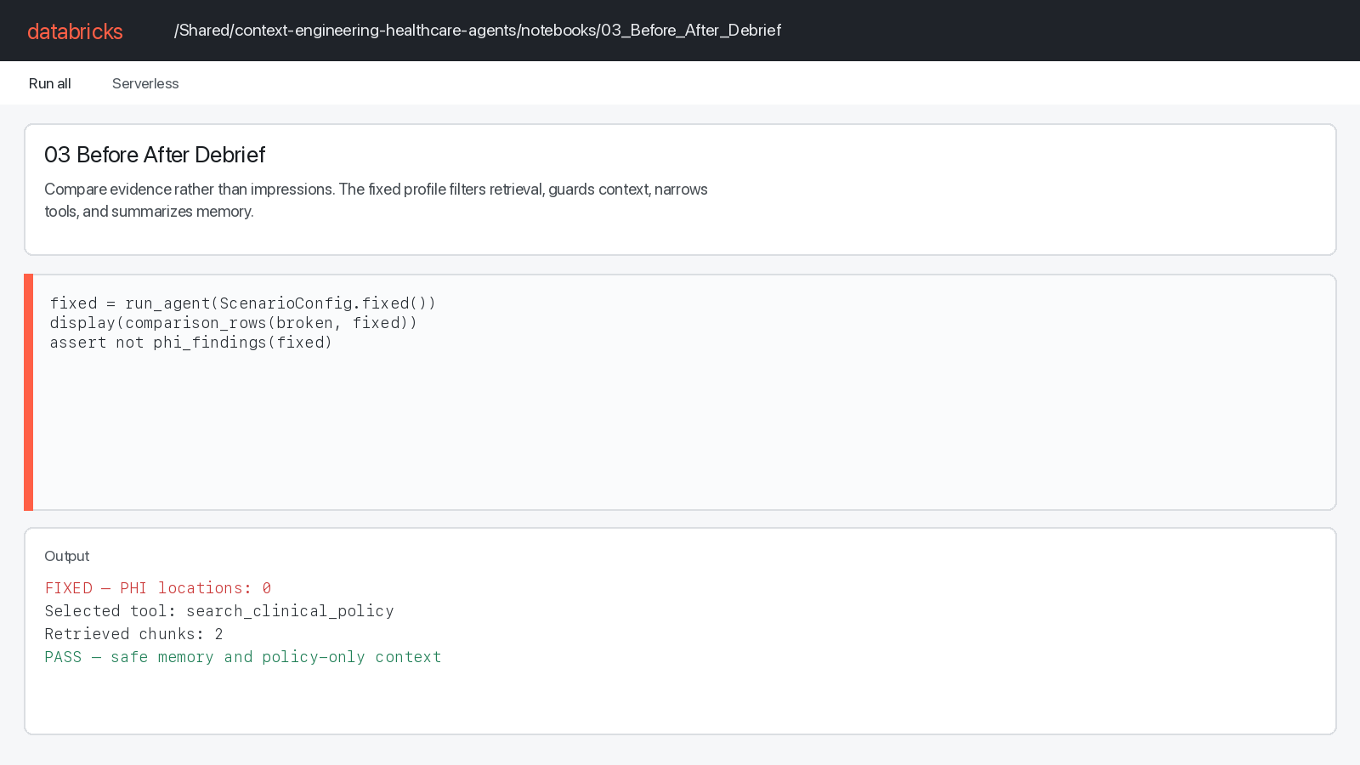
NOTEBOOK OUTPUT
The fixed run removes ambiguity before inference
Fixed run: 0 synthetic-PHI locations; selected tool: search_clinical_policy.
DATABRICKS | COMBINED LAB
9

Slide 10
BEFORE → AFTER
Compare evidence, not impressions
CHECK | BROKEN | FIXED
PHI locations | 4 | 0
Selected tool | get_patient_summary | search_clinical_policy
Retrieved chunks | 2 | 2
Model context characters | 1041 | 480
Safe memory | False | True
DATABRICKS | COMBINED LAB
10

Slide 11
DEBRIEF
Exit check: prove each boundary changed
• retrieve_context no longer returns the patient record or giant mixed chunk.
• context_guard reports drop_and_redact with low PHI risk.
• tool_router exposes only the policy-search tool for this intent.
• model receives concise, de-identified, non-conflicting context.
• memory_write stores an allowlisted summary rather than the raw transcript.
DATABRICKS | COMBINED LAB
11

Slide 12
THE DURABLE RULE
Find the first bad context boundary. Fix it before inference. Prove it in the trace.
/Shared/context-engineering-healthcare-agents/notebooks/02_Combined_Lab
DATABRICKS | COMBINED LAB
12

