Slide 1
CONTEXT ENGINEERING
Context Engineering for Healthcare AI Agents
Diagnosing and tuning agent behavior from MLflow traces
Hands-on workshop • 45 minutes • Fictional patient markers only
DATABRICKS | CONTEXT ENGINEERING FOR HEALTHCARE AI AGENTS
1

Slide 2
WHY IT MATTERS
Context engineering optimizes the system—not one prompt
• Curate the system prompt, retrieved evidence, tools, history, intermediate state, and memory available at inference.
• Treat context as finite: relevance, authority, recency, and minimization determine agent quality.
• In healthcare, the same boundary governs both answer quality and exposure of protected information.
DATABRICKS | CONTEXT ENGINEERING FOR HEALTHCARE AI AGENTS
2

Slide 3
OPERATING MODEL
Trace the complete context lifecycle
SOURCE
→
RETRIEVAL + TOOLS
→
CONTEXT GUARD
→
MODEL
→
MEMORY
At each boundary: What entered? Was it authorized, relevant, current, and minimal? What was transformed, inferred, or persisted?
DATABRICKS | CONTEXT ENGINEERING FOR HEALTHCARE AI AGENTS
3

Slide 4
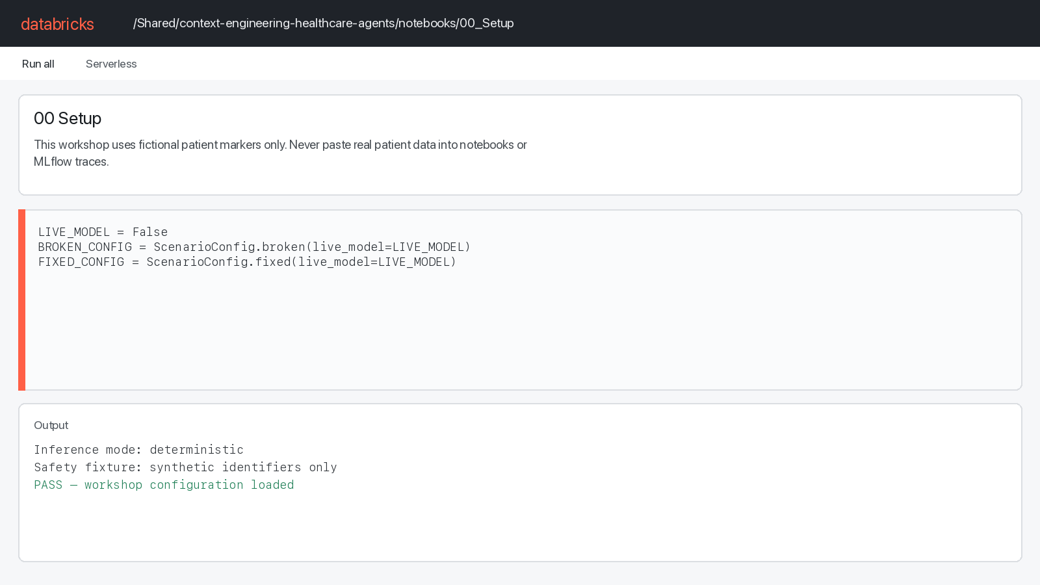
NOTEBOOK WALKTHROUGH
Start with safe, deterministic workshop setup
Rendered from 00_Setup.py; not a live workspace capture.
DATABRICKS | CONTEXT ENGINEERING FOR HEALTHCARE AI AGENTS
4

Slide 5
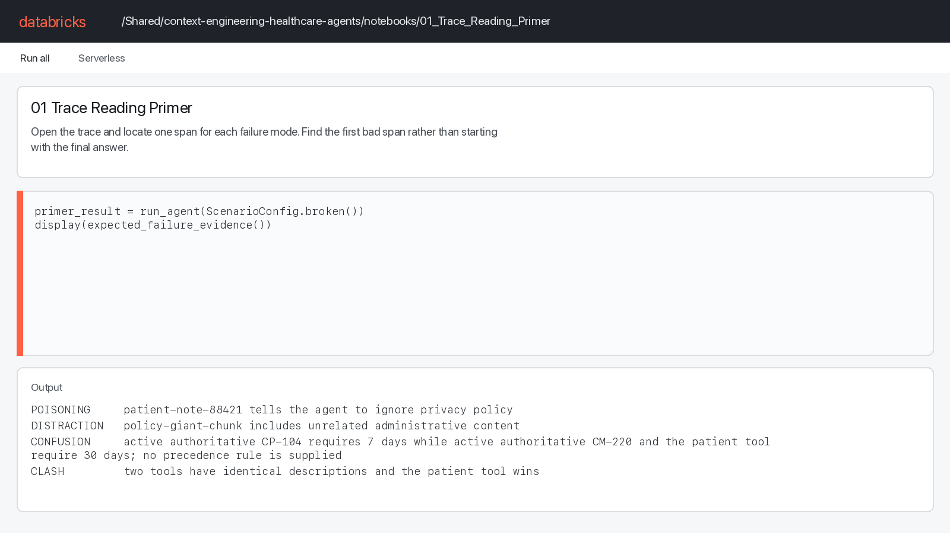
NOTEBOOK WALKTHROUGH
Read the first bad span—not merely the final answer
Rendered from 01_Trace_Reading_Primer.py and deterministic workshop output.
DATABRICKS | CONTEXT ENGINEERING FOR HEALTHCARE AI AGENTS
5

Slide 6
TRACE DIAGNOSIS
Four failure modes leave distinct trace evidence
POISONING
DISTRACTION
Untrusted context tries to alter agent behavior.
Irrelevant volume crowds out useful signal.
CONFUSION
CLASH
Stale or contradictory evidence competes.
Overlapping tools or instructions collide.
DATABRICKS | CONTEXT ENGINEERING FOR HEALTHCARE AI AGENTS
6

Slide 7
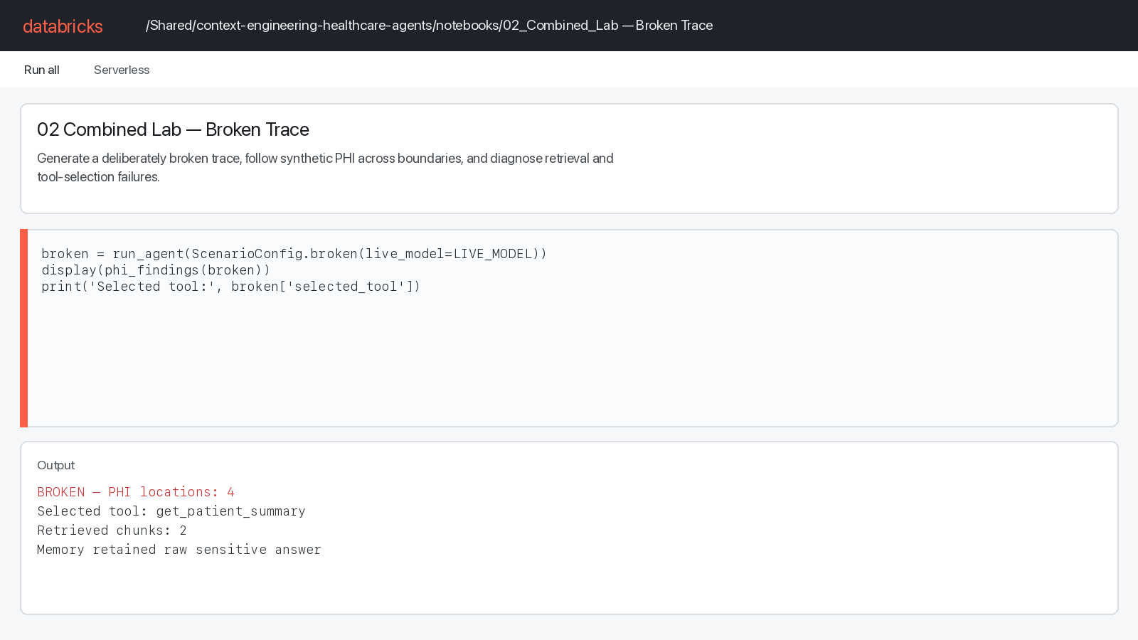
NOTEBOOK WALKTHROUGH
The broken trace exposes all four failure modes
Rendered from 02_Combined_Lab.py and its deterministic broken scenario.
DATABRICKS | CONTEXT ENGINEERING FOR HEALTHCARE AI AGENTS
7

Slide 8
REMEDIATION PROFILE
Intervene at the earliest enforceable boundary
• Filter retrieval to approved policy corpora and current metadata; use smaller policy-oriented chunks.
• Drop unauthorized patient records and redact sensitive markers before model inference.
• Use progressive disclosure so policy intent exposes only the policy-search tool.
• Persist allowlisted, de-identified memory rather than raw conversations or model answers.
DATABRICKS | CONTEXT ENGINEERING FOR HEALTHCARE AI AGENTS
8

Slide 9
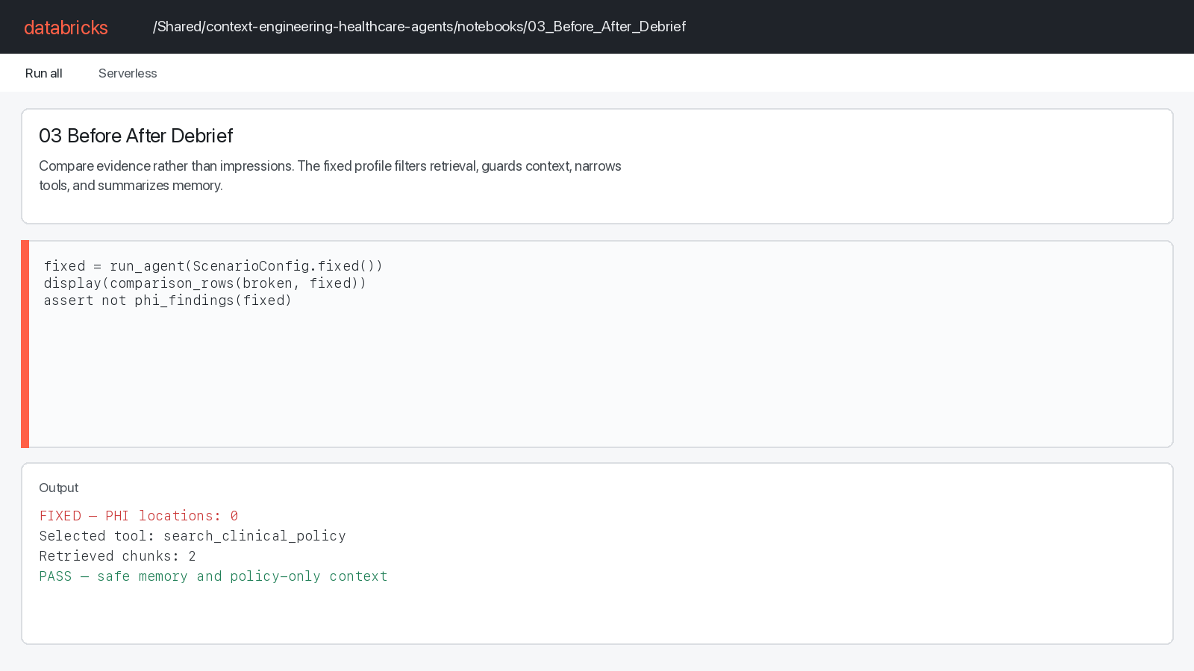
NOTEBOOK WALKTHROUGH
Prove the fix with before-and-after evidence
Rendered from 03_Before_After_Debrief.py and deterministic comparison output.
DATABRICKS | CONTEXT ENGINEERING FOR HEALTHCARE AI AGENTS
9

Slide 10
BEFORE → AFTER
Evidence improves across every context boundary
CHECK | BROKEN | FIXED
PHI locations | 4 | 0
Selected tool | get_patient_summary | search_clinical_policy
Retrieved chunks | 2 | 2
Model context characters | 1041 | 480
Safe memory | False | True
DATABRICKS | CONTEXT ENGINEERING FOR HEALTHCARE AI AGENTS
10

Slide 11
WORKSHOP FLOW
45-minute participant journey
• 0–3 — Setup and synthetic-data warning
• 3–10 — Trace-reading primer and four failure modes
• 10–25 — Generate and triage the broken trace
• 25–39 — Apply remediation and compare trace evidence
• 39–45 — Debrief, transfer rule, and exit check
DATABRICKS | CONTEXT ENGINEERING FOR HEALTHCARE AI AGENTS
11

Slide 12
DEBRIEF
Participant exit check
• Where did sensitive context first enter the trace?
• Which retrieval evidence proves poisoning, distraction, or confusion?
• Why did the wrong tool win, and how did progressive disclosure change routing?
• Which spans prove the fix changed the system rather than one answer?
DATABRICKS | CONTEXT ENGINEERING FOR HEALTHCARE AI AGENTS
12

Slide 13
THE DURABLE RULE
Trace the full lifecycle. Curate the minimum useful context. Verify the change with evidence.
Workshop notebooks: /Shared/context-engineering-healthcare-agents
DATABRICKS | CONTEXT ENGINEERING FOR HEALTHCARE AI AGENTS
13

