Slide 1
Big Data, Algorithms & Intelligent Systems
CS 435 Algorithms – Advanced Topics
Emdad Khan

Slide 2
What Is Big Data?
The amount of data has been exploding FAST!
2 Exa Bytes (2 ^18) per day!
This Large data set is called Big Data
providing both challenges and opportunities
Notes:
Suggest go back to Internet centric. You do not have enough in this presentation to position the company as a gadget interface
Pls use another slide master. The current background is very distracting.

Slide 3
Big Data Applications
High Level:
Processing, Viewing, Analyzing,..
Extracting Meaning
Summarization
Document Analysis, Drawing Inference
Common Areas:
Business Analytics, Meteorology, Economics, Biology, Bioinformatics, Astronomy, Medicine,….)
Popular Areas:
Intelligent Information Retrieval, Search, Q & A, Language Translation
Notes:
Suggest go back to Internet centric. You do not have enough in this presentation to position the company as a gadget interface
Pls use another slide master. The current background is very distracting.

Slide 4
Key Problems With Big Data
Searching, Transferring, Sharing
Analyzing, Processing, Viewing
Deriving Meaning / Semantics
Summarization
Discovering Knowledge
Drawing Inference, Making Predictions
More (including mining)
Notes:
Suggest go back to Internet centric. You do not have enough in this presentation to position the company as a gadget interface
Pls use another slide master. The current background is very distracting.

Slide 5
Key Problems With Big Data
Notes:
Suggest go back to Internet centric. You do not have enough in this presentation to position the company as a gadget interface
Pls use another slide master. The current background is very distracting.

Slide 6
Key Problems are Related to:
4 Vs, namely the following:
Volume
Velocity
Variety
Variability
A few other issues are security, privacy and usability.
Notes:
Suggest go back to Internet centric. You do not have enough in this presentation to position the company as a gadget interface
Pls use another slide master. The current background is very distracting.

Slide 7
Big Data Types
Unstructured
Texts on the Internet or other sources
Video
Images
Sound
Structured
Data in a Database
Unstructured Data Dominates with Wide Margin!
Notes:
Suggest go back to Internet centric. You do not have enough in this presentation to position the company as a gadget interface
Pls use another slide master. The current background is very distracting.

Slide 8
Issues Dealing with Unstructured Data
Semantic Meaning is needed
Context is very important
“John rides in a mustang” and “John rides on a
mustang”: (a) [2nd is riding on a horse] (b) O vrs. I might be a typo
World Knowledge is needed
Notes:
Suggest go back to Internet centric. You do not have enough in this presentation to position the company as a gadget interface
Pls use another slide master. The current background is very distracting.

Slide 9
Issues Dealing with Unstructured Data
Human brain can understand these instantly but computers cannot.
Keyword is not the answer.
Semantics using Predicate logic, Ontology and the like have issues – need to define semantics for almost everything!
Notes:
Suggest go back to Internet centric. You do not have enough in this presentation to position the company as a gadget interface
Pls use another slide master. The current background is very distracting.

Slide 10
Big Data – Key Ingredients
1. Infrastructure / frameworks / tools
[Map Reduce / Hadoop, Hive, Pig, Spark, Storm…]
2. Big Data Algorithms
3. Analytics (including emphasis on combining unstructured and structured data)
4. DB & Data Types (especially unstructured data and associated database e.g. NoSQL)
5. Natural Language Processing, AI, ML, UI
Notes:
Suggest go back to Internet centric. You do not have enough in this presentation to position the company as a gadget interface
Pls use another slide master. The current background is very distracting.

Slide 11
Some Current Applications - 1
Macy's Inc. and real-time pricing. The retailer adjusts pricing in near-real time for 73 million (!) items, based on demand and inventory, using technology from SAS Institute.

Slide 12
Current Applications -2
Wal-Mart Stores Inc. and search. The mega-retailer's latest search engine for Walmart.com includes semantic data. Polaris, a platform that was designed in-house, relies on text analysis, machine learning and even synonym mining to produce relevant search results. Wal-Mart says adding semantic search has improved online shoppers completing a purchase by 10% to 15%. "In Wal-Mart terms, that is billions of dollars," Laney said.

Slide 13
Current Applications - 3
Infinity Property & Casualty Corp. and dark data. Laney defines dark data as underutilized information assets that have been collected for single purpose and then archived. But given the right circumstances, that data can be mined for other reasons. Infinity, for example, realized it had years of adjusters' reports that could be analyzed and correlated to instances of fraud. It built an algorithm out of that project and used the data to reap $12 million in subrogation recoveries.

Slide 14
Applications - 4
PredPol Inc. and repurposing. The Los Angeles and Santa Cruz police departments, a team of educators and a company called PredPol have taken an algorithm used to predict earthquakes, tweaked it and started feeding it crime data. The software can predict where crimes are likely to occur down to 500 square feet. In LA, there's been a 33% reduction in burglaries and 21% reduction in violent crimes in areas where the software is being used.

Slide 15
Some Future Applications – Intelligent Internet, Intelligent Search, Question Answering, Summarization,…

Slide 16
The Progression of the Internet
Internet Sort of Started with Portal (like Yahoo)
Then Moved to Search (e.g. Yahoo, MSN, Google)
Then Moved to Transaction (eBay, Amazon)
Then to Social Networks (Facebook, Twitter)
What’s Next?
Notes:
Suggest go back to Internet centric. You do not have enough in this presentation to position the company as a gadget interface
Pls use another slide master. The current background is very distracting.

Slide 17
What’s Next?
We See a Clear Trend that the future Internet is going to be something that can provide
Very Specific
More Precise and Direct Information
In a Very Easy Way so that
Anyone including an Illiterate Person can Access and Use it at Ease
Notes:
Suggest go back to Internet centric. You do not have enough in this presentation to position the company as a gadget interface
Pls use another slide master. The current background is very distracting.

Slide 18
What’s Next?
This Means
Much Smaller set of Search Results Instead of Millions of Hits (Usually Under 100)
Answer (a Small set of Answers) to a Question
Summarization of Articles
Drawing Inference from set of Documents
More Including Specific Request, Smart Transactions
Using Natural Language Dialogues
Notes:
Suggest go back to Internet centric. You do not have enough in this presentation to position the company as a gadget interface
Pls use another slide master. The current background is very distracting.

Slide 19
The Next Generation Internet: Intelligent Internet (IINT)
Major Components
Big Data Handling Capability
Natural Language Capability
Intelligent Agent
Notes:
Suggest go back to Internet centric. You do not have enough in this presentation to position the company as a gadget interface
Pls use another slide master. The current background is very distracting.

Slide 20
Intelligent Internet (IINT): Architecture
Internet
W2
W3
Main Agent
(IA)
Sub Agent 1
Sub Agent 2
Agents of a Website, W1
Figure 1: Intelligent Internet (IINT) - showing a website with a main Intelligent Agent (IA) and 2 sub Agents. Sub Agents can perform functions like transactions or e-Learning etc. Such a website can have a Super Intelligent Agent (SIA) to handle more difficult tasks by collaborating with other websites. The Agents may reside on a different website(s).
Notes:
Suggest go back to Internet centric. You do not have enough in this presentation to position the company as a gadget interface
Pls use another slide master. The current background is very distracting.

Slide 21
Intelligent Internet (IINT): Key Algorithms
High Level Description as Each Can be a Separate Presentation
Delivering Requested Content
Calculating Some Functions – e.g. currency conversion
Performing Transactions – e.g. an e-Commerce application
Performing Teaching and Learning – e.g. an e-Learning application
Notes:
Suggest go back to Internet centric. You do not have enough in this presentation to position the company as a gadget interface
Pls use another slide master. The current background is very distracting.

Slide 22
Intelligent Internet (IINT): Key Algorithms
Performing Networking Type Activities
Intelligent Information Retrieval
Intelligent Search (Covered in the Demo)
General Q&A (Covered under Sample Application)
Summarization
Drawing Inference
Complex Content Manipulation
Notes:
Suggest go back to Internet centric. You do not have enough in this presentation to position the company as a gadget interface
Pls use another slide master. The current background is very distracting.

Slide 23
Some Applications - Search
Today’s Search
Uses String Match (# of words, IDF,….) – Millions of hits!
Example - "Auto body shops in San Francisco bay area", Google gave the following:
" About 1,200,000 results (0,45 seconds) ".
There are probably not 1.2M Auto body shops in the whole world! There are Key Issues!
Notes:
Suggest go back to Internet centric. You do not have enough in this presentation to position the company as a gadget interface
Pls use another slide master. The current background is very distracting.

Slide 24
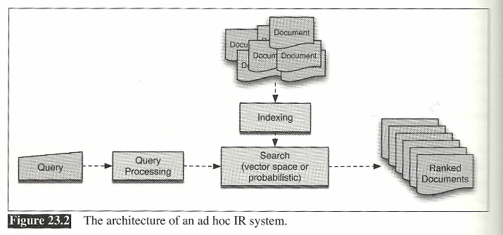
Applications: IR (Search) using Vector Space

Slide 25
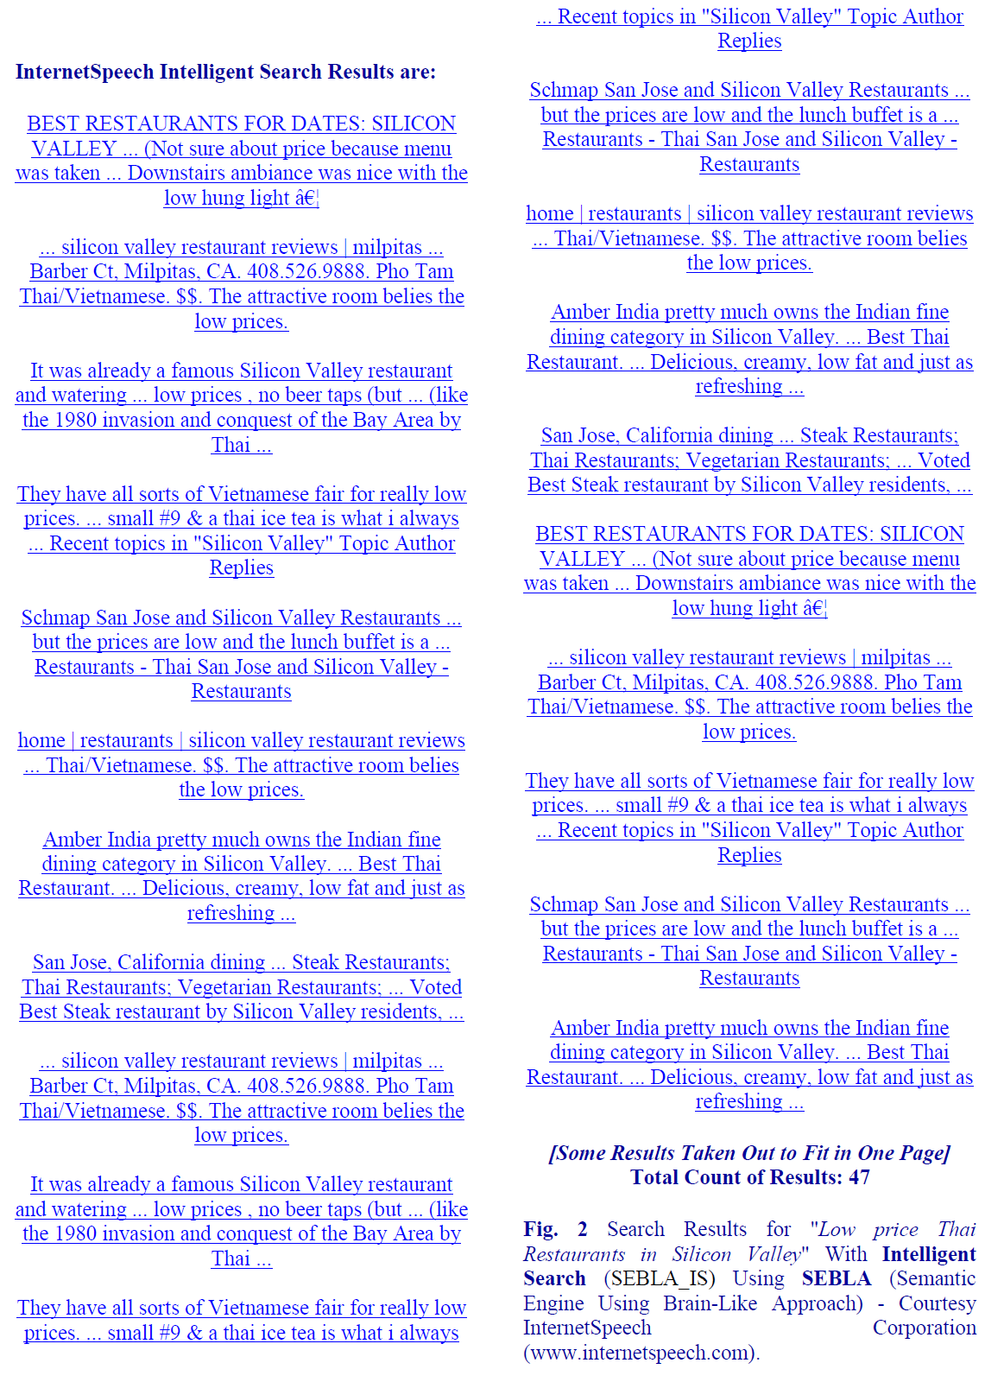
DEMO on Intelligent Search - Results
Notes:
Suggest go back to Internet centric. You do not have enough in this presentation to position the company as a gadget interface
Pls use another slide master. The current background is very distracting.

Slide 26
References / Further Reading
[1] E. Khan, "Next generation web - intelligent search, question answering, summarization and more", INTERNATIONAL JOURNAL of COMPUTERS AND COMMUNICATIONS, (NAUN & UNIVERSITY PRESS), Vol. 9, June 2015.
[2] E. Khan, " Intelligent Internet: Natural Language and Question & Answer based Interaction”, INTERNATIONAL JOURNAL of COMPUTERS AND
COMMUNICATIONS, (NAUN & UNIVERSITY PRESS) Oct. 2013.
[3] E. Khan, "Natural Language Processing, Big Data, Bioinformatics and Biology”, INTERNATIONAL JOURNAL OF BIOLOGY AND BIOMEDICAL ENGINEERING (NAUN & UNIVERSITY PRESS), June 2014.
[4] C. Eaton et al, “Understanding Big Data: Analytics for enterprise class Hadoop and Streaming Data”, http://public.dhe.ibm.com/common/ssi/ecm/en/iml14296usen/IML14296USEN.PDF
[5] P. Ryan et al, “The Problem of Analyzing Unstructured Data”, Grant Thoronton, 2009,
http://www.grantthornton.ie/db/Attachments/Publications/Forensic_&_inve/Grant%20Thornton%20-The%20problem%20of%20analysing%20unstructured%20data.pdf
[7] E. Khan, "Processing Big Data with Natural Semantics and Natural Language Understanding using Brain-Like Approach”, INTERNATIONAL JOURNAL
of COMPUTERS AND COMMUNICATIONS, (NAUN & UNIVERSITY PRESS) January 2014.
[8] E. Khan,: Natural Language Understanding Using Brain-Like Approach: Word Objects and Word Semantics Based Approaches help Sentence Level
Understanding, US Patent filed on July, 2011
[9] Khan, E., (2011): Internet For Everyone: Reshaping the Global Economy by Bridging the Digital Divide” published in Aug, 2011; 978-1-4620- 4251-7 (SC ISBN)
Notes:
Suggest go back to Internet centric. You do not have enough in this presentation to position the company as a gadget interface
Pls use another slide master. The current background is very distracting.

