Slide 1
Lesson 9
Binary Search Trees
: Solving Problems by Engaging the Field of Solutions
Binary search trees make it possible to store data in memory while preserving a specified order in a way that cannot be achieved as efficiently using any kind of a list. However, their worst case performance, which can potentially occur more often than desirable, reduces their efficiency to that of a linked list. One example of reducing or eliminating this worst case performance is through the introduction of a balance condition to ensure the tree never becomes skewed (for example, AVL trees and Red-Black trees).
Maharishi’s Science of Consciousness: Balance is the expression of the invincible quality of pure creative intelligence, which preserves the integrity of unboundedness even as it is expressed within boundaries.
Notes:
Radish-Sort

Slide 2
Review: Binary Search Trees
BST property:
key[leftSubtree(x)] ≤ key[x] ≤ key[rightSubtree(x)]
Example:
F
B
H
A
D
K

Slide 3
Inorder Tree Walk
What does the following code do?
  TreeWalk(x)
  TreeWalk(left[x]);
  print(x);
  TreeWalk(right[x]);
A: prints elements in sorted (increasing) order
This is called an inorder tree walk
  Preorder tree walk: print root, then left, then right
  Postorder tree walk: print left, then right, then root

Slide 4
Inorder Tree Walk
F
Example:
How long will a tree walk take?
Prove that inorder walk prints in monotonically increasing order
B
H
A
D
K

Slide 5
Operations on BSTs: Search
Given a key and a pointer to a node, returns an element with that key or NULL:
TreeSearch(x, k)
if (x = NULL or k = key[x])
return x;
if (k < key[x])
return TreeSearch(left[x], k);
else
return TreeSearch(right[x], k);

Slide 6
BST Search: Example
Search for D and C:
F
B
H
A
D
K

Slide 7
Operations on BSTs: Search
Here’s another function that does the same:
TreeSearch(x, k)
while (x != NULL and k != key[x])
if (k < key[x])
x = left[x];
else
x = right[x];
return x;
Which of these two functions is more efficient?

Slide 8
Operations of BSTs: Insert
Adds an element x to the tree so that the binary search tree property continues to hold
The basic algorithm
  Like the search procedure above
  Insert x in place of NULL
  Use a “trailing pointer” to keep track of where you came from (like inserting into singly linked list)

Slide 9
BST Insert: Example
Example: Insert C
F
B
H
A
D
K
C

Slide 10
BST Search/Insert: Running Time
What is the running time of TreeSearch() or TreeInsert()?
A: O(h), where h = height of tree
What is the height of a binary search tree?
A: worst case: h = O(n) when tree is just a linear string of left or right children
  We’ll keep all analysis in terms of h for now
  Later we’ll see how to maintain h = O(lg n)

Slide 11
Sorting With Binary Search Trees
Informal code for sorting array A of length n:
  BSTSort(A)
  for i=1 to n
  TreeInsert(A[i]);
  InorderTreeWalk(root);
Argue that this is Ω(n lg n)
What will be the running time in the
  Worst case?
  Average case? (hint: remind you of anything?)

Slide 12
Sorting With BSTs
for i=1 to n
TreeInsert(A[i]);
InorderTreeWalk(root);
Average case analysis
  It’s a form of quicksort!
3 1 8 2 6 7 5
3
1 2
8 6 7 5
1
8
2
6 7 5
2
6
5
7
5
7

Slide 13
Sorting with BSTs
Same partitions are done as with quicksort, but in a different order
  In previous example
    Everything was compared to 3 once
    Then those items < 3 were compared to 1 once
    Etc.
  Same comparisons as quicksort, different order!
    Example: consider inserting 5

Slide 14
Sorting with BSTs
Since run time is proportional to the number of comparisons, same time as quicksort: O(n lg n)
Which do you think is better, quicksort or BSTsort? Why?

Slide 15
Sorting with BSTs
Since run time is proportional to the number of comparisons, same time as quicksort: O(n lg n)
Which do you think is better, quicksort or BSTSort? Why?
A: quicksort
  Better constants
  Sorts in place
  Doesn’t need to build data structure

Slide 16
More BST Operations
BSTs are good for more than sorting. For example, can implement a priority queue
What operations must a priority queue have?
  Insert
  Minimum
  Extract-Min

Slide 17
BST Operations: Successor
For deletion, we will need a Successor() operation
Successor example – next slide
What is the successor of node 3? Node 15? Node 13?
What are the general rules for finding the successor of node x? (hint: two cases)

Slide 18
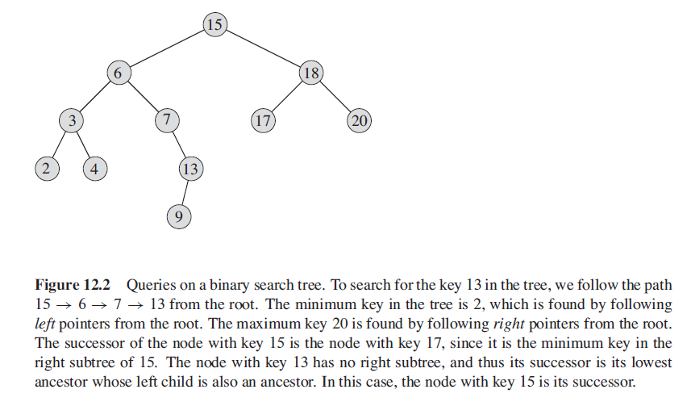
Successors - Example

Slide 19
BST Operations: Successor
Two cases:
  x has a right subtree: successor is minimum node in right subtree
  x has no right subtree: successor is first ancestor of x whose left child is also ancestor of x
    Intuition: As long as you move to the left up the tree, you’re visiting smaller nodes.
Predecessor: similar algorithm

Slide 20
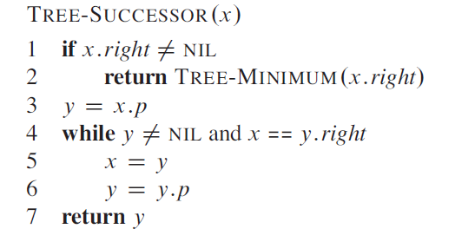
BST Operations: Successor

Slide 21
BST Operations: Predecessor
Predecessor:
Predecessor is the left subtree's right-most child or
The node with largest key that belongs to the tree and that is strictly less than x’s key.
So, In the previous Fig (3.2) ->
predecessor of 17 is 15 , predecessor of 6 is 4 and predecessor of 13 is 9.

Slide 22
BST Operations: Delete
Deletion is a bit tricky
3 cases:
  x has no children:
    Remove x
  x has one child:
    Splice out x
  x has two children:
    Swap x with successor y which has at most ONE CHILD
    Perform case 1 or 2 to delete it
F
B
H
A
D
K
Example: delete K
or H or B
C

Slide 23
BST Operations: Delete
Why will case 2 always go to case 0 or case 1?
A: because when x has 2 children, its successor is the minimum in its right subtree
Could we swap x with predecessor instead of successor?
A: yes. Would it be a good idea?
A: might be good to alternate

Slide 24
Main Point – BST
A Binary Search Tree can be used to maintain data in sorted order more efficiently than is possible using any kind of list. Average case running time for insertions and searchers is O(log n).
In a Binary Search Tree that does not incorporate procedures to maintain balance, insertions, deletions and searches all have a worst-case running time of Ω(n). By incorporating balance conditions, the worst case can be improved to O(log n).

Slide 25
Main Point – BST
Transcendental Consciousness is the field of perfect balance. All differences have Transcendental Consciousness as their common source.
Impulses Within The Transcendental Field. The sequential unfoldment that occurs within pure consciousness and that lies at the basis of creation proceeds in such a way that each new expression remains fully connected to its source. In this way, the balance between the competing emerging forces is maintained.
Wholeness Moving Within Itself. In Unity Consciousness, balance between inner and outer has reached such a state of completion that the two are recognized as alternative viewpoints of a single unified wholeness.

