Slide 1
Lesson 1: Solving Problems with Algorithms
Creation Emerging from the Collapse of Wholeness to a Point
Wholeness of the Lesson
Much of the power of modern software arises from the fact that it makes use of highly efficient algorithmic solutions to a variety of problems. These solutions represent the concentrated intelligence of great thinkers of the past half-century. Yet the range of problems for which such solutions are known is actually only a tiny speck in the landscape of abstract problems. Likewise, the full range of Nature’s computational power is too vast to be grasped by the intellect alone, yet harnessing even a little of that power is enough to produce powerful results.
Notes:
Quick-Sort

Slide 2
Algorithms As Concentrated Intelligence
An algorithm is a procedure or sequence of steps for computing outputs from given inputs
Algorithms can be implemented in programming languages like Java and C
We will study techniques for creating algorithms, measuring their efficiency, and refining their performance
In this lesson, we show that, as remarkable as the many feasible algorithms that have been found are, and as deep as the intelligence is that is behind such solutions, the truth is that the vast majority of “problems” that could be solved remains – and will always remain – completely beyond the reach of any kind of solution that could in principle be implemented on a computer.

Slide 3
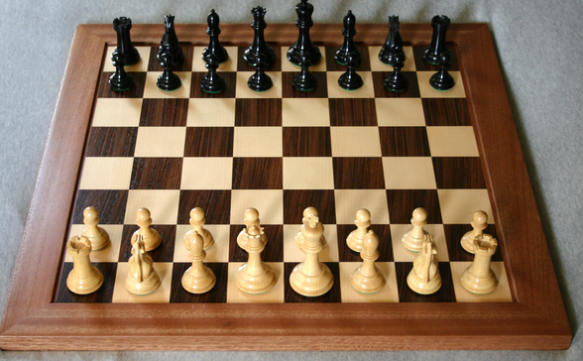
Examples of Problems
(GCD Problem) Given two positive integers m, n, is there a positive integer d that is a factor of both m and n and that is bigger than or equal to every integer d’ that is also a factor of m and n?
(Sorting Problem) Given a list of integers, is there a rearrangement of these integers in which they occur in ascending order?
(Subset Sum Problem) Given a set S of positive integers and a nonnegative integer k, is there a subset T of S so that the sum of the integers in T equals k?
(n x n Chess Problem) Given an arbitrary position of a generalized chess-game on an n×n chessboard, can White (Black) win from that position?
(Halting Problem) Given a Java program R and an input integer n, when R is executed with input n, does R terminate normally? (No runtime exceptions, no infinite loops.)

Slide 4
Solving P Problems
(GCD Problem) The Euclidean Algorithm computes the gcd of two positive integers m <= n. It requires fewer than n steps to output a result. We say it runs in O(n) time.
(SORTING Problem) Bubble Sort is an algorithm that accepts as input an array of n integers and outputs an array consisting of the same array elements, but in sorted order. It requires fewer than n² steps to output a result. We say it runs in O(n²) time.
Both Problems 1 and 2 have algorithms that run in polynomial time; this means that the number of steps of processing required is a polynomial function of the input size.
If a problem can be solved using an algorithm that runs in polynomial time, the problem is said to be a P Problem.
P Problems are said to have feasible solutions because an algorithm that runs in polynomial time can output its results in an acceptable length of time, typically.

Slide 5
NP and EXP Problems
(SUBSETSUM Problem) Every known algorithm to solve SubsetSum (with input array containing n elements) requires approximately 2^{n} steps of processing (“exponential time”) to output a result (in the worst case). However, it is still possible that someone will one day find an algorithm that solves SubsetSum in polynomial time.
(N X N CHESS Problem) Like SubsetSum, every known algorithmic solution requires exponential time in the worst case. However, it has also been shown that no algorithmic solution could ever be found that runs in polynomial time.
Both SubsetSum and n x n Chess are problems that belong to EXP. This means that each has an exponential time algorithm that solves it. The possibility remains that SubsetSum may also belong to the smaller class P, but this question remains unsolved. Read about the class EXP at http://en.wikipedia.org/wiki/EXPTIME
n x n Chess is a special type of problem in EXP, known as EXP-complete. For this lecture, it suffices to say that EXP-complete means that there is no way to devise an algorithm that solves it in polynomial time. See
http://www.ms.mff.cuni.cz/~truno7am/slozitostHer/chessExptime.pdf
When the only known solutions to a problem are exponential, the problem is said to have no known feasible solution.

Slide 6
NP and EXP Problems (continued)
The SubsetSum Problem is also an NP Problem: This means that there is an algorithm A and an integer k so that, given a solution T to a SubsetSum problem instance with input size n, A can verify that T is indeed a correct solution and does so in fewer than n^{k} steps (i.e. in polynomial time)
Sample Verification:
Start with a SubsetSum problem instance S = {s₁, s₂, . . ., s_{n}} and k, where s₁, …, s_{n} and k are all positive integers. Given also a solution T: A solution is a subset of S whose elements
add up to k.
Verification:
sum = 0;
for each j in T
sum += j
if(sum == k) return true;
else, return false;
n x n Chess is not known to belong to NP (but one day someone may prove that it does belong to NP). In general, every NP problem belongs to EXP, but whether NP = EXP is not known. See http://en.wikipedia.org/wiki/EXPTIME

Slide 7
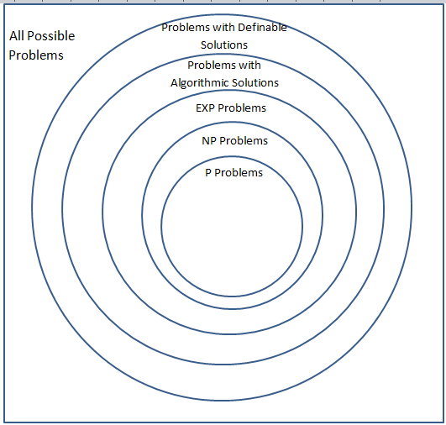
Classes of Problems

Slide 8
“Unsolvability” of the HALTING Problem
The Problem: Is there a Java program which accepts as input a normal Java program R and an integer n (which we represent as a BigInteger), and which outputs 1 (or “true”) if R terminates normally when run on n, or else outputs 0 (“false”) if R does not terminate normally.
[A “normal” Java program is one that has a public method that accepts a BigInteger argument and returns a BigInteger value]
Theorem: The Halting Problem is unsolvable.
Assumption: This is a theorem from Theory of Computation – to make sense of it, we must assume that our Java programs are running on an idealilzed computer that has no memory limits. The limitation on computation described here has nothing to do with the physical limitations of the computer hardware currently in use.

Slide 9
The HALTING Problem (already shown)
The Problem: Given a Java program R (having a main method), when R is executed, does R terminate normally?
It is known that there is no algorithm that could possibly solve the Halting Problem. Although it is possible to define a solution, there is no procedure that could actually compute a solution.

Slide 10
Unsolvability of the Halting Problem
Begin with an observation: Every Java program may be encoded as a positive integer in such a way that, from the integer code, the program can be reconstituted.

Slide 11
Unsolvability 2
Encoding Java programs
Assume < 512 distinct characters are ever used in a Java program, so each character can be represented by a bit string of length 9
Encode a program by eliminating white space, start with ‘1’, and concatenate the encoded characters one-by-one

Slide 12
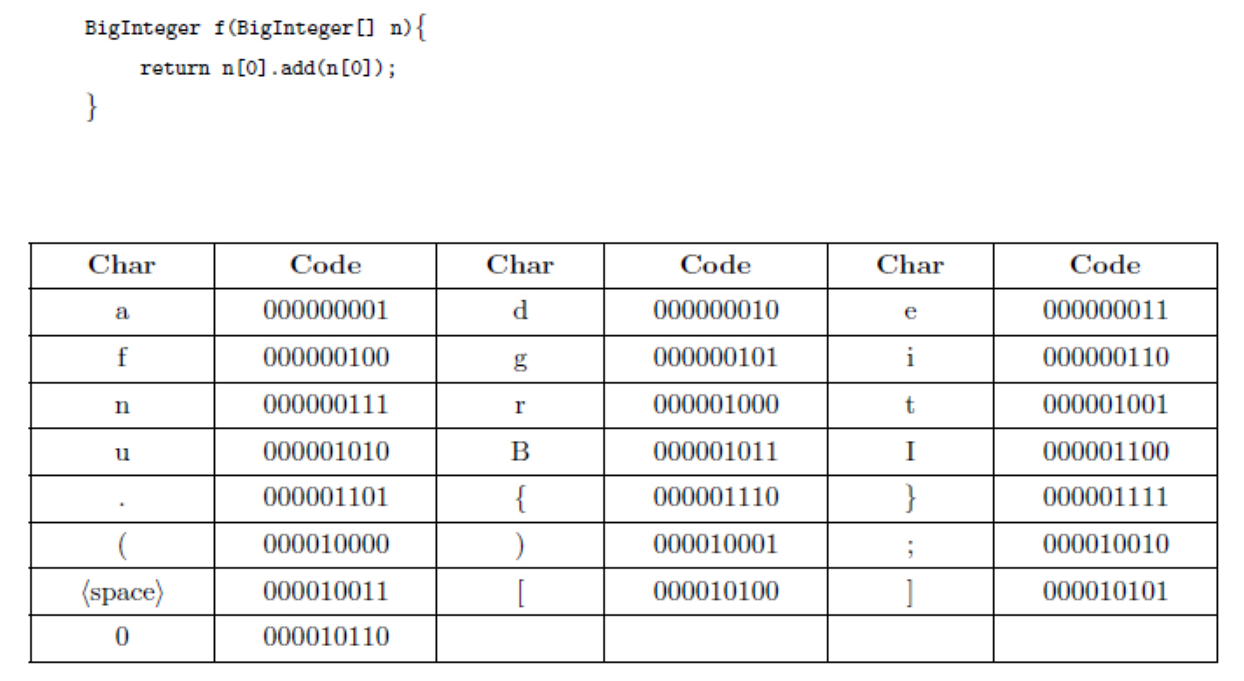
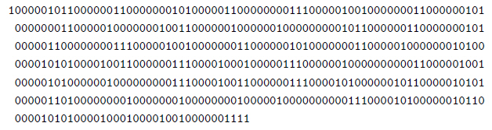

Slide 13
Unsolvability 3
With this encoding, we can state the Halting Problem in terms of a function H:
H(e,n) = 1 if the program
encoded by e halts when run
on input n; else H(e,n) = 0.
The Halting Problem is: What are the output values of H for all inputs e, n?
A solution for the Halting Problem is definable since we can specify a function H that solves it.
The important question is: Is there an algorithm A that computes the values of H (so that, on input e, n, A outpus H(e,n))? The Halting Problem is said to be unsolvable because no such algorithm exists.

Slide 14
Unsolvability 4
Suppose H is computable. Define another function G as follows:
G(e) = 1 if H(e,e) = 0
G(e) is undefined if H(e,e) = 1
If H is computable, so is G: Let P be a program that computes values of H. Create a program Q that computes G like this: On input e, Q runs P on e. If P outputs 0, Q outputs 1 and halts. If P outputs 1, Q goes into an infinite loop. This shows G is computable.

Slide 15
Unsolvability 5
Use computability of G to obtain a contradiction. Suppose u is the integer that encodes the program Q. We run Q on input u and ask: Does Q halt on input u?
Suppose Q does eventually halt on input u; then it outputs 1 on this input. By definition H(u,u) = 0. But this means that Q when run on input u, does not halt. Impossible.
Suppose Q does not halt on input u. Then
H(u,u) =1, which means that when Q is run on input u, it does halt. Impossible
This shows that the assumption that H is computable leads to absurd conclusions. Therefore, H is not computable.

Slide 16
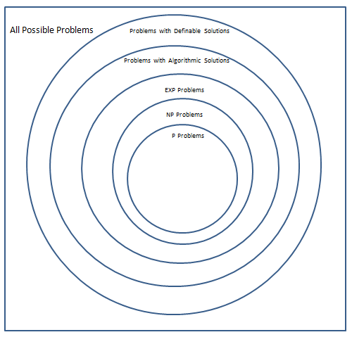
Classes of Problems

Slide 17
The Full Range of “Problems”
The Halting Problem has a definable solution because there is a definable function H that answers all questions about whether a given Java program terminates on a given input
Likewise, the abstract notion of “problem” is related to the concept of a function. Speaking generally, every definable function corresponds to (and is a definable solution for) a “problem”.
More generally, every function from f: N -> N (whether or not definable) specifies a problem. But most such functions are not definable – therefore, most “problems” cannot even be formulated precisely in the language of mathematics.

Slide 18
Main Point
It has turned out that the problems that are most needed to be solved for the purpose of developing modern-day software projects happen to lie in the very specialized class of P Problems – problems that have feasible solutions. For these problems, the creativity and intelligence of the industry has been concentrated to a point; the algorithms that have been developed for these are extremely fast and highly optimized. At the same time, this tiny point value reveals how vast is the range of problems that cannot be solved in a feasible way. These points illustrate that creative expression arises in the collapse of unboundedness to a point, and also that unboundedness itself is beyond the grasp of the intellect.

Slide 19
Connecting the Parts of Knowledge With The Wholeness of Knowledge
COLLAPSE OF INFINITY TO A POINT; EXPANSION OF POINT TO INFINITY
The functions that are used and analyzed in practice in the development and analysis of software are the polynomial bounded functions.
The polynomial bounded functions form only a tiny speck in the expansive class of all number-theoretic functions N → N.

Slide 20
3. Transcendental Consciousness is the fully expanded field of consciousness, beyond even the most general notion of “function”.
4. Impulses Within The Transcendental Field. As pure consciousness becomes conscious of itself, it undergoes transformational dynamics, as knower, known, and process of knowing interact. The process of knowing is the first sprout of the notion of “function.”
5. Wholeness Moving Within Itself. In Unity Consciousness, the transformational dynamics of consciousness, at the basis of all of creation, are appreciated as the lively impulses of one’s own consciousness, one’s own being.

