Slide 1
Lesson 13 Algorithms For Weighted Graphs: Creative Intelligence Manifesting As Material Creation
Wholeness of the Lesson
Weighted graphs are graphs that have weights or costs associated with each edge. Two questions that often need to be answered when working with weighted graphs are (1) What is the least costly path between two given vertices of the graph? (2) What is the least costly subgraph of the given graph which includes all the vertices of the given graph? Dijkstra’s Shortest Path Algorithm provides an efficient solution to the first question; Kruskal’s Minimum Spanning Tree Algorithm provides an efficient solution to the second. Solutions to optimization problems of all kinds give expression to Nature’s tendency to achieve the most possible with the least expenditure of energy. Waking up to one’s own deeper values of intelligence has the effect of drawing Nature’s style of functioning into our thinking and action so that we automatically achieve goals with less effort.
0
8
A
4
2
8
7
2
1
3
B
C
D
5
3
9
8
2
E
F
5

Slide 2
Outline
Weighted graphs
Shortest path problem
Dijkstra’s algorithm
Minimum spanning tree problem
Kruskal’s Algorithm

Slide 3
Weighted Graphs
In a weighted graph, each edge has an associated numerical value, called the weight of the edge (wt: edges → numbers)
Edge weights may represent distances, costs, etc.
Example:
In a flight route graph, the weight of an edge represents the distance in miles between the endpoint airports
849
PVD
1843
ORD
142
SFO
802
LGA
1743
1205
337
1387
HNL
2555
1099
LAX
1233
DFW
1120
MIA

Slide 4
Shortest Path Problem
Given a connected weighted graph and two vertices s and x, we want to find a path of minimum total weight between s and x.
“Length” of a path is the sum of the weights of its edges.
Example:
Shortest path between Providence and Honolulu
Applications
Internet packet routing
Flight reservations
Driving directions
849
PVD
1843
ORD
142
SFO
802
LGA
1743
1205
337
1387
HNL
2555
1099
LAX
1233
DFW
1120
MIA

Slide 5
Dijkstra’s Algorithm: The Problem
The distance of a vertex v from a vertex s, denoted d(s,v), is the length of a shortest path between s and v
Question: Is it always true in a weighted graph that, for any two vertices v, w, d(v,w) = wt(v,w)? Prove or give a counterexample.
Dijkstra’s algorithm computes the distances of all the vertices from a given start vertex s
Assumptions:
the graph G = (V,E) is connected
the edges are undirected
the edge weights are nonnegative

Slide 6
Starting with weighted graph G = (V,E) and starting vertex s, we wish to compute, for each vertex v, the shortest distance from s to v in G.
We will store our computed value of the distance from s to any vertex v in a map A: A[v] = our computed value of distance from s to v
If our algorithm is right (which we will need to prove) then for each v in V, A[v] = d(s,v).

Slide 7
The Basic Idea
Basic Strategy: It is reasonable to attempt to compute distances first for vertices close to s, then for vertices farther away.
Step 1. We set A[s] = 0 (since d(s,s) = 0).
Step 2. Pick a vertex v adjacent to s so that (s,v) has the least weight among all edges incident to s.
It will turn out that for this v, a shortest path from s to v really is wt(s,v). We will set A[v] = wt(s,v).
However, it will not be true in general that for any other w adjacent to s, wt(s,w) is a shortest path from s to w

Slide 8
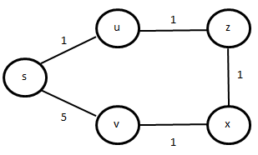
Example
Setting A[u] = wt(s,u) = 1 is correct
(s,u) has least weight among all pairs (s,t) where t adjacent to s
However, setting A[v] = 5 is not correct
A less costly path from s to v than s,v is s, u, z, x, v
The Logic: Why does Step 2 always work? (Pick a vertex u adjacent to s so that (s,u) has least weight among edges incident to s.) If p : s, w₁, w₂, …, w_{k} = u is any other path from s to u, then w₁ must itself be u (otherwise the first part of the path – s, w₁ – is already at least long as s, u)

Slide 9
Basic Idea, continued
Step 3. After an optimal vertex v adjacent to s has been chosen, there are two possible ways to extend further
For some other vertex w adjacent to s, wt(s,w) may turn out to be the shortest path length from s to w, OR
For some w adjacent to v, the path s, v, w is shortest possible from s to w.
Among these choices, the algorithm will pick the path that has minimal total weight

Slide 10
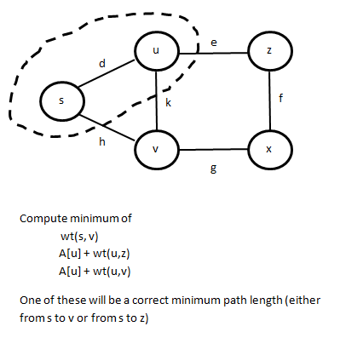
Example of Step 3
Why Step 3 Works
Case I. wt(s,v) is minimum
Any path from s to v begins either as s, u or s, v. By assumption s, v is no longer than s, u, v. The other possibility is s, u, z, x, v, but s, v is (by assumption) no longer than s, u, z.
Case II. A[u] + wt(u,v) is minimum
Case III. A[u] + wt(u,z) is minimum.
Cases II and III are similar. We prove it for Case III: We want to show that s, u, z is a shortest path to z. The other possible choices are s, u, v, x, z and s, v, x, z
Path s, u, v, x, z: length s,u,z ≤ length of s,u,v (by assumption)
Path s, v, x, z: length of s, u, z ≤ length s, v (by assumption)

Slide 11
Dijkstra’s Algorithm
We extend Steps 1, 2, 3 till every vertex has been reached
In general, we build a subset X of the set V of vertices, beginning with s and eventually including all of V. Associated with each vertex v in X will be a value A[v] representing the algorithm’s computation of the shortest path length from s to v
In each step, we add one new vertex w to X. We use a greedy strategy to select w : vertex w will be an endpoint of an edge (v,w) from X to w whose greedy length (= A[v] + wt(v,w) ) is the least possible among all edges having one end in X, the other outside of X.
Once a vertex w arrives in X, the storage map A will be updated so that A[w] stores the greedy length found for (v, w). It will be shown that once the value A[w] is computed, it is the correct shortest path length from s to w – namely, we show A[w] = d(s, w).

Slide 12
Dijkstra’s Algorithm
Input: A simple connected undirected weighted graph G with nonnegative edge weights, determined by a weight function wt (x,y), and a starting vertex s of G.
Output: Array A of shortest distances d(s,v) from s to v, for each v in V, so A[v] = d(s,v) for each v Aux Output: Array B with property that B[v] is a shortest path from s to v. The Algorithm:
A [s] ← 0. B [s] ← empty path (empty set) X ← {s} //Basis step
while X ≠ V do { POOL ← {(v,w) ∈ E | v ∈ X and w ∉ X} } //here, we have no control over how much of E is searched, leading to slow running time (v’,w’) ← search POOL for edge (v,w) for which greedy length A[v] + wt(v,w) is minimal add w’ to X A[w’] ← A[v’] + wt(v’,w’) B[w’] ← B[v’] U {(v’,w’)}
Consider an example.

Slide 13
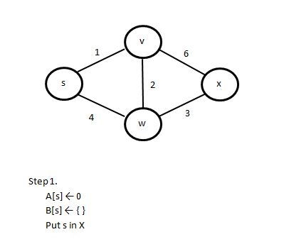
Worked Example: Step 1

Slide 14
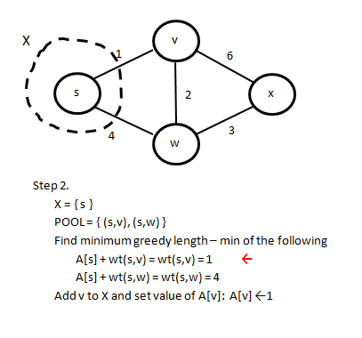
Worked Example: Step 2
Auxiliary Storage: B[v] = B[s] U {(s,v)} = {(s,v)}

Slide 15
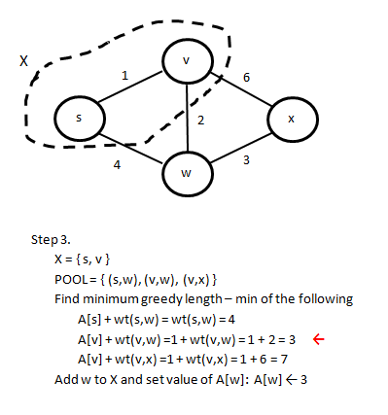
Worked Example: Step 3
Auxiliary Storage: B[w] = B[v] U {(v,w)} = {(s,v), (v,w)}

Slide 16
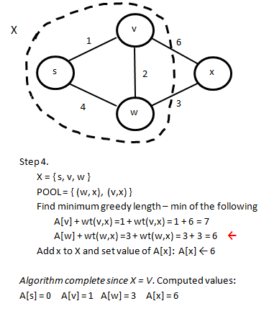
Worked Example: Step 4
Computeed values of array B: B[s] = { }, B[v] = {(s,v)}, B[w] = {(s,v), (v,w)}, B[x] = {(s,v), (v,w), (w,x)}

Slide 17
Dijkstra - Exercises
Why is there a requirement that edges have non-negative weights? Why can’t we add a large positive constant to every edge (to eliminate negative edge weights) and compute shortest paths for the new graph using Dijkstra?

Slide 18
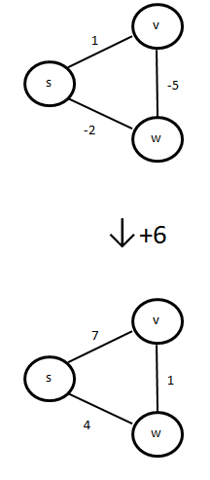
Dijkstra - Exercises
Why is there a requirement that edges have non-negative weights? Why can’t we add a large positive constant to every edge (to eliminate negative edge weights) and compute shortest paths for the new graph using Dijkstra?
d(s, w) = -4
s-v-w
d(s, w) = 4
s-w

Slide 19
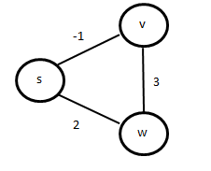
Exercises, continued
Does Dijkstra’s Algorithm sometimes work correctly when there are negative edge weights? Consider this weighted graph.

Slide 20
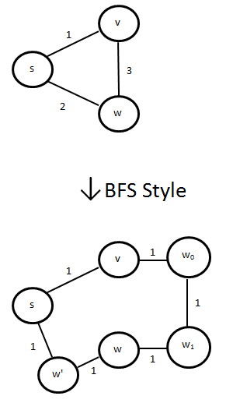
Exercises, continued
Why is Dijkstra’s approach to the shortest path problem better than simply using BFS, as described in the previous lesson?
[BFS approach: Making all edge weights = 1 is same as removing all weights. Perform BFS with start vertex s and compute distance to each vertex by returning its level in the BFS spanning tree. These computed values should be same as values found using Dijkstra]

Slide 21
Dijkstra – Correctness
Loop Invariant: I(i) is the following statement: (where i means iteration #i)
(1) |X| = i + 1
(2) A[v] = d(s,v) for all v ∈ X
Preconditions for loop:
X = {s}, A[s] = 0 (Basis Step)
Postconditions for loop:
X = V, A[v] = d(s,v) for all v ∈ V

Slide 22
Dijkstra – Correctness (2)
Verification of I(i) for all iterations i = 1 … n-1. We verified base case i = 1 in earlier slides. Induction Step: We assume I(i) is true, so |X|= i + 1 and A[v] = d(s,v) all v in X.
Iteration i+1 causes one more vertex to be added to X, so |X| = i + 2
During iteration i+1, algorithm locates (v’,w’) that has least greedy length among edges from X to V - X, and the algorithm sets A[w’] = A[v’]+d(v’,w’)
To complete the induction, it suffices to show A[w’] is shortest path length from s to w’,i.e., A[w’] = d(s,w’)

Slide 23
Dijkstra – Correctness (3)
Let q : s, …, y, z, …, w’ be a truly shortest path from s to w’, where z is first vertex in V - X encountered on the path q. Let L be the length of q. Let q₀ be the path s, …, y, z; we denote its length L₀. Notice that L₀ ≤ L (since no edge has negative weight). We will actually show that A[w’] ≤ L_{0,} and this will finish the induction step.
Notice that the sum of edge weights in q₀ from s to y is the true distance d(s,y) from s to y because q is a shortest path from s to w’ (if we could find a shorter path from s to y, we could also find a shorter path from s to w’). Therefore, by the induction hypothesis,
L₀ = length of q₀ = d(s,y) + wt(y,z) = A[y] + wt(y,z).
Recall from the previous slide that the algorithm so far has already defined A[w’] = A[v’] + wt(v’,w’) and that this is the smallest sum of the form A[u] + wt(u,w), for u in X and w not in X.
It follows that A[v’] + wt(v’,w’) ≤ A[y] + wt(y,z) and so A[w’] ≤ L_{0.} This completes the induction and proof of correctness.

Slide 24
Dijkstra – Running Time
Running time without optimizations can be computed by observing that a (potentially) exhaustive search of edges is made in each iteration, leading to a running time of O(mn).
This can be improved to O(m * log n) if an optimal data structure is used.
Idea: Since “mins” are needed in each iteration, serve them using a Priority Queue instead of doing an exhaustive search of edges.

Slide 25
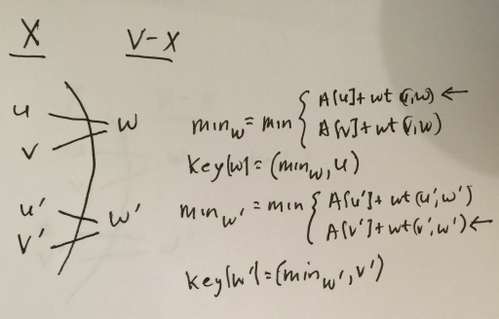
Dijkstra – Running Time (2)
We use a priority queue to store vertices still in V - X. The key key[w] to be used with each vertex w in V - X is defined by
key[w] = (min_{w,}v) where min_{w} is defined to be the minimum among all sums A[u] + wt(u,w), where u is in X and (u,w) is in E, and v is the value of u that yields a minimum, that is, min_{w} = A[v] + wt(v,w).

Slide 26
Dijkstra – Running Time (3)
In each iteration, the single step of locating (v’,w’) via an exhaustive search of edges is replaced by two steps:
removeMin to get the pair (key[w’],w’), where key[w’] includes both v’ and the sum A[v’]+wt(v’,w’).
update the heap

Slide 27
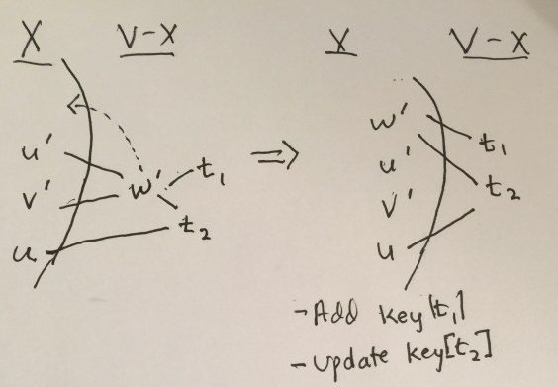
Dijkstra – Running Time (4)
Running time for handling the heap operations
(1) removeMin requires Θ(log n) (including downheap to restore heap)
(2) update the heap:
When w’ is moved to X, edges between w’ and other vertices in
V - X must be taken into account
There may be new keys for t ∈ V – X and (w’,t) in E – for each such t, new key given by:
key[t] = (A[w’] + wt(w’,t), w’)
[Running time to insert: O(log n)]
There may be a t ∈ V – X that already has a key, but key may need to be updated because of w’ – re-compute min among A[x] + wt(x,t) for which x in X. If update is needed, (key[t], t) must be removed, key[t] set to new value, and (key[t], t) re-inserted
[Running time: O(log n)]

Slide 28
Dijkstra – Running Time (5)
For each v in V: - O(log n): removeMin + downheap
- O(deg(v) * log(n)): add new keys when v moved into X - O(deg(v) * log(n)): update already existing keys because v moved to X
Summing over all v in V yields:
Since the graph is connected, n is O(m).
Running time is therefore
O(m log n)
This improves the O(mn) running time of the naïve algorithm.

Slide 29
Improved Dijkstra Correctness
The proof that this optimized version of Dijkstra’s algorithm is also correct is essentially identical to the proof for the naïve algorithm. The only point that needs to be observed is that, at each step of either algorithm, the edge (v’,w’) that is chosen has exactly the same properties whether it is obtained using the naïve or optimized approach; namely, (v’,w’) has the least greedy length among all pairs (v,w) for which v belongs to X and w lies outside of X. The only difference in the algorithms is how (v’, w’) is found, but it has the same essential characteristic in either case. And the discussion above demonstrates that the method for choosing (v’, w’) used by the optimized algorithm is correct (and performs better than the method used in the naïve algorithm). We conclude that the optimized Dijkstra algorithm is also correct.

Slide 30
Main Point
Dijkstra’s algorithm is an example of a shortest-path algorithm – an algorithm that efficiently (O(mlog n)) computes the shortest distance between two vertices in a graph.
Analogously, Nature itself is known to obey the law of least action – Nature does the least possible amount of work to proceed from one location or state to another. Nature’s way of achieving this makes use of computational dynamics that involve “no effort” and no steps.

Slide 31
Dijkstra’s Algorithm for Directed Graphs
Essentially the same algorithm can be used to find the shortest path from a starting vertex to any other vertex in a directed graph (as long as it is reachable).

Slide 32
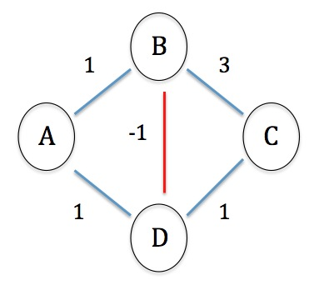
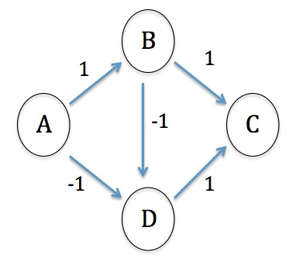
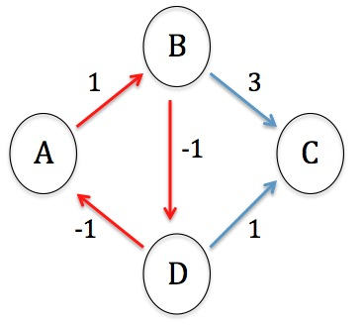
Computing Shortest Paths with Negative Edge Weights
Even if there is just one edge with a negative weight in an undirected graph, it is impossible to compute shortest paths between vertices.
This limitation can be removed by restricting attention to digraphs.
There is no shortest path because of the negative edge weight:
A-B-D-C A-B-D-B-D-C
A-B-D-B-D-B-D-C
In a directed graph, negative weight edges are not an inherent problem, with one exception . . .
Even in a directed graph, the presence of negative weight cycles makes it impossible to compute shortest paths.

Slide 33
A Dynamic Programming Approach for DAGs (Directed Acyclic Graphs)
Given a weighted DAG G = (V,E), a starting vertex s, and terminating vertex t, we observe something about the shortest path length d(s,t) from s to t:
Let in(t) = {w₁, w₂, . . ., w_{k}} be in-vertices for t (that is: for each i, (w_{i}, t) is an edge of G).
Every path from s to t must include a pair w_{i}, t at the end, for some i between 1 and k.
Therefore d(s,t) must be the minimum among all sums d(s,w_{i}) + wt(w_{i}, t), for 1 ≤ i ≤ k. Therefore, the problem of computing d(s,t) is reduced to computing distances d(s,w_{i}) involving fewer vertices (subproblems) and combining results by computing a minimum among sums d(s,w_{i}) + wt(w_{i}, t).
This observation leads to a dynamic programming solution.

Slide 34
First Try
For each v, plan to store (memoize) d(s,v) in an array D, so that D[v] = d(s,v) D[s] = 0
for v ∈ V – {s}
D[v] = ∞
for (w,v) ∈ E do
//want to read D[w] from storage
if D[w] + wt(w,v) < D[v] then
D[v] ← D[w] + wt(w,v)
Problem: No guarantee that D[w] has been computed when it is needed in the computation of D[v].

Slide 35
Second Try
A solution is to put vertices in an order that ensures D[w] has already been computed when it is needed during computation of D[v] (where (w,v) ∈ E): Try a topological sort, arranging V into <v₁, v₂, . . ., v_{n}> as a preprocessing step. Then in the algorithm:
D[s] = 0
for v ∈ V – {s}
D[v] = ∞
for (w,v) ∈ E do
//we can now read D[w] from storage
if D[w] + wt(w,v) < D[v] then
D[v] ← D[w] + wt(w,v)
We are now guaranteed that in looping through in-vertices w for v, w has been examined before v in the outer loop, since w → v implies w precedes v in the sequence <v₁, v₂, . . ., v_{n}> (because of the topological ordering of V)

Slide 36
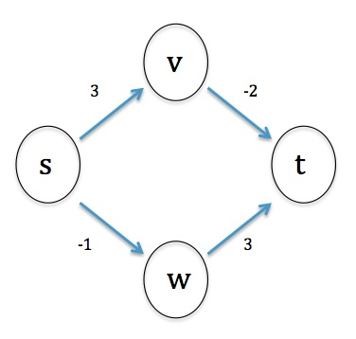
Example of Dynamic Programming Shortest Path Algorithm
Topological ordering of V: s < v < w < t
D[s] = 0
D[v] = min {D[x] + wt(x,v) | (x,v) ∈ E}
= D[s] + 3 = 3
D[w] = min{D[x] + wt(x,w) | (x,w) ∈ E}
= D[s] - 1= -1
D[t] = min {D[x] + wt(x,t) | (x,t) ∈ E}
= min{D[v] + -2, D[w] + 3}
= min {(3 – 2), (-1 + 3)}
= 1
Exercise: What happens if you try to compute the shortest directed path length from s to t using Dijkstra’s Algorithm?

Slide 37
Correctness
Suppose after running the algorithm there is some v for which D[v] is not the shortest length of a directed path from s to v. Assume v is the first in the topological ordering of V for which this failure occurs. Certainly v ≠ s.
Let p: s → . . . → w → v be a shortest path from s to v. Then p’: s → . . . → w is a shortest path from s to w, and, since vertices preceding v in the topological ordering have correct D values, D[w] stores the length d(s,w) of p’. Therefore, the shortest path length from s to v is d(s,w) + wt(w,v) = D[w] + wt(w,v).
When the algorithm executed and v was examined in the outer loop, one of the edges that was considered is (w,v), and the sum D[w] + wt(w,v) was tested as a candidate for D[v]. But since this is the smallest value, it would have been chosen during execution of the inner loop. Contradiction!

Slide 38
Running Time
Recall that topological sort can be done in O(n + m) time.
After that preprocessing step, the main algorithm runs in:
O(∑_{v} (1 + indeg(v))) = O(n) + O(m) = O(n + m)
time.
Therefore, total running time is O(n + m)

Slide 39
Further Improvements
Is there an efficient algorithm that computes the shortest path from a starting vertex s to a target t in a directed graph even if negative edge weights are allowed and even if the graph contains a directed cycle?
Answer: Yes, as long as there are no negative weight directed cycles. The Bellman-Ford algorithm is similar to the dynamic programming version given here, but works with any directed graph, including those with a directed cycle. Bellman-Ford runs in O(|V|*|E|) in O(n³) time. [Bellman-Ford is discussed in the book.]

Slide 40
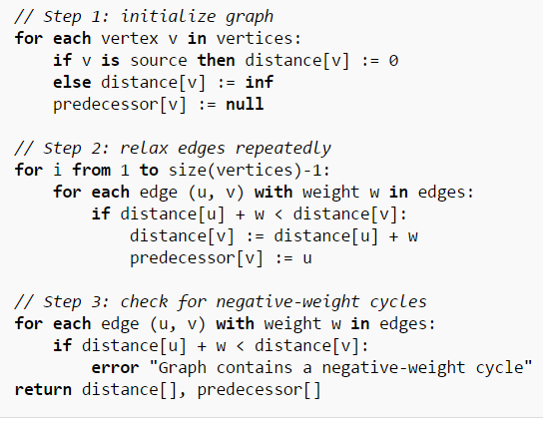
Optional: Bellman-Ford

Slide 41
Minimum Spanning Tree
Spanning subgraph
Subgraph of a graph G containing all the vertices of G
Spanning tree
Spanning subgraph that is itself a tree
Minimum spanning tree (MST)
Spanning tree of a weighted graph with minimum total edge weight
Applications
Computer network (minimize cost of cable)
Transportation networks (minimize cost of road construction)
ORD
10
1
PIT
DEN
6
7
9
3
DCA
4
STL
8
5
2
DFW
ATL

Slide 42
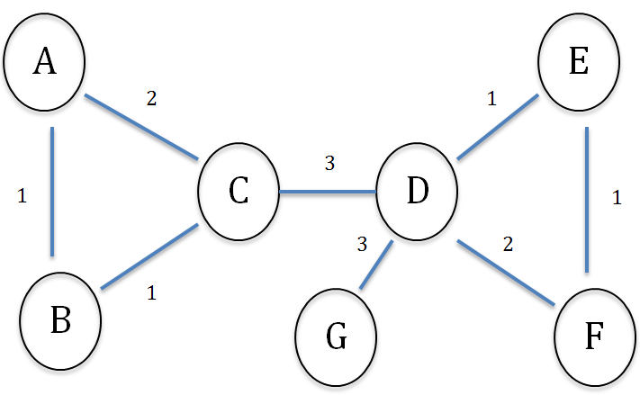
Kruskal's Greedy Strategy
Build a collection T of edges by doing the following: At each step, add an edge e to T of least weight subject to the constraint that adding e to T does not create a cycle in T. To answer questions about correctness and running time of this algorithm, we need to specify certain details.

Slide 43
Implementation Questions
How do we pick the next edge at each step?
How do we make sure that we do not add an edge to T that produces a cycle?

Slide 44
Solutions
We can arrange edges by sorting them by weight (in ascending order), and so we pick edges according to this sorted order.
We can ensure no cycles are created by building local minimum spanning trees around each vertex.

Slide 45
Kruskal's Algorithm
First step is to sort all edges by weight.
Second step involves creation of clusters
Every vertex is initially placed in a trivial cluster -- the cluster for a vertex v, denoted C(v), is simply {v}. A cluster represents a local minimum spanning tree.
When the next edge (u,v) is considered, C(u) and C(v) are compared -- if different, (u,v) is included as an edge in the final output tree, and C(u) and C(v) are merged.

Slide 46
Kruskal’s Algorithm
Input: A simple connected weighted graph G = (V, E) with n vertices and m edges Output: A minimum spanning tree T of G The Algorithm:
sort E in increasing order of edge weight
for each vertex v in G, define an elementary cluster C(v) (which will grow) by C (v) = {v}
T ← an empty tree //T will eventually become the minimum spanning tree
while T has fewer than n – 1 edges do
(u,v) ← next edge
C(v) ← cluster containing v
C(u) ← cluster containing u
if C(v) ≠ C(u) then add edge (u,v) to T merge C(u) and C(v) (and update other clusters as needed)
return T
Note: We represent T as a collection of edges; to make it a graph, include as its vertex set all endpoints of the edges in T.

Slide 47
Correctness
We need to verify the following Facts:
During execution, distinct clusters are always disjoint, and for each cluster C, if T[C] is the subgraph of T induced by C then T[C] is a tree. Moreover, G[C] is connected and T[C] is a spanning tree for G[C].
No cycle ever arises in T during execution of the algorithm
The main loop terminates (it is conceivable that after all edges have been examined, T still contains < n – 1 edges – this is shown to be impossible)
The set T that is returned is a spanning tree for G
The set T is a minimum spanning tree for G.

Slide 48
Verification of the Loop Invariant
To establish Facts 1 - 2, we establish the following loop invariant I(x,y) (for each edge (x,y) in E):
Distinct clusters are disjoint
For each cluster C, the subgraph T[C] is a spanning tree in G[C], and G[C] is connected
T contains no cycles
[NOTE: As the algorithm proceeds, we do not expect T itself to be a tree because it is composed of disconnected pieces. We will show that these pieces do assemble into a tree by the time the algorithm has completed.]
At the beginning of execution, when singleton clusters are first formed, (a) – (c) hold. We now assume (a) – (c) hold and consider the iteration in which the next edge (x,y) is examined, and show that (a) – (c) continue to hold. In the algorithm, if C(x) = C(y), the iteration ends and the state of the clusters and that of the set T are unchanged, so we assume C(x) ≠ C(y).
To establish that (a) – (c) hold, we make use of the following results, established in Labs for the course:

Slide 49
Background Facts
Suppose V₁, V₂, . . ., V_{k} are disjoint subsets of V and that V = V₁ U V₂ U . . . U V_{k}. Then there is an edge (x,y) in E such that for some i ≠ j, x ∈ V_{i} and y ∈ V_{j}.
Suppose S = (V_{S}, E_{S}) and T = (V_{T}, E_{T}) are subtrees of G with no vertices in common (in other words, V_{S} and V_{T} are disjoint). Then for any edge (x,y) in E for which x ∈ V_{S} and y ∈ V_{T}, the subgraph U = (V_{S} U V_{T}, E_{S} U E_{T} U {(x,y)}) is also a tree.
Suppose W is a subset of the set E of edges of G and |W| < n - 1. Consider the subgraph H of G formed from W by defining the edges of H to be W and defining the vertices of H to be the endpoints of those edges, and assume that H contains no cycle. Then there exists an edge (x,y) in G not in W so that the graph formed by W U {(x,y)} also contains no cycle.

Slide 50
Verifying the Loop Invariant (a)-(c)
For (a) [distinct clusters are disjoint], joining two clusters with an edge, forming a new larger cluster, does not change the fact that distinct clusters are disjoint.
For (b) [T[C] is a spanning tree, G[C] connected], adding the edge (x,y) to the union of the spanning trees T[C_{x}], T[C_{y}] results in another tree, T[C_{x}] U T[C_{y}] U {(x,y)}, by Background Fact B (previous slide). Let C = C_{x} U C_{y}. Then
T[C] = T[C_{x}] U T[C_{y}] U {(x,y)} is a tree. Since T[C] contains every vertex in G[C], T[C] is a spanning tree of G[C]
For (c) [no cycles], notice that the edges that compose T itself are formed as the union of the edges in the (disjoint) trees T[C_{v}], for v in V. Since none of these trees contains a cycle, T itself does not contain a cycle either.
This establishes the loop invariant and therefore Facts 1, 2.

Slide 51
Correctness – Fact 3, “while loop terminates”
We verify that the while loop in the algorithm eventually terminates:
Assume that after all edges have been examined, T still has < n-1 edges (this would be the situation when the while loop fails to terminate).
By Fact 2, T contains no cycle. By Background Fact C, since |T| < n – 1 and contains no cycle, there is an edge e in G so that T U {e} also contains no cycles and so that e ∉ T. But this situation is impossible: During the execution of Kruskal’s algorithm,
the edge e = (x,y) was examined at some point, because, if the while loop does not terminate, every edge would be examined eventually. When e was examined, Kruskal rejected e (since e was not in T after all edges had been examined); the only reason Kruskal has for rejecting is to avoid creation of a cycle in T. But, by the way e was chosen above, clearly e does not introduce a cycle, as Background Fact C shows. The reasoning shows that the assumption that the while loop never terminates is incorrect.

Slide 52
Correctness – Fact 4, “T is a spanning tree”
We verify Fact 4, that, after execution of Kruskal’s algorithm, T is a spanning tree.
We have already seen that T has no cycles and therefore (by the way the while loop is defined) T has n – 1 edges, where n is the number of vertices in G. By the lemma below, T must have n vertices. It follows that T is a spanning tree.
Lemma. If a graph H has n vertices and m edges and if m ≥ n, then H has a cycle.
Proof. If H is connected but has no cycle, it follows that m = n – 1. Since m ≥ n, it therefore follows that H has a cycle. If H is not connected, write H as a union of its connected components: H = H₁ U H₂ U . . . U H_{k}, where k > 1, where, for each i, H_{i} has n_{i} vertices and m_{i} edges. Since each H_{i} is a tree, m_{i} = n_{i} – 1. We have therefore
m = m₁ + . . . + m_{k} = (n₁-1) + . . . + (n_{k}-1) = n – k < n,
contradiction.

Slide 53
Correctness – Fact 5
To verify Fact 5 – that, after execution of Kruskal’s algorithm, T is a minimum spanning tree – we can establish the following points.
At each stage of the algorithm, for each cluster C, T[C] is not only a spanning tree for G[C], but is in fact a minimum spanning tree for G[C].
After the algorithm has finished, all clusters have merged into a single cluster, which must be equal to V, the set of all vertices of G.
From these two points, it follows that T = T[V] is a minimum spanning tree for G = G[V].
However, the final proof of correctness does not follow this path, though these conclusions are correct. We give an optional proof of correctness (upcoming slides), which also establish 1 and 2.

Slide 54
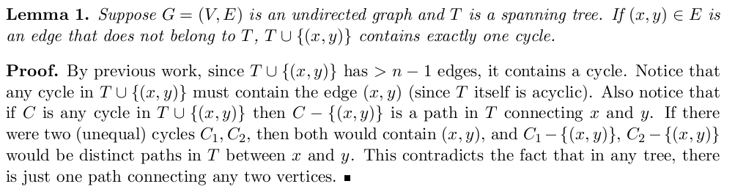
Optional: Proof of Fact 5

Slide 55
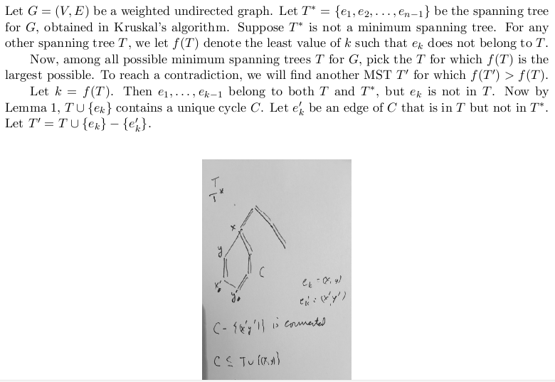
(continued)

Slide 56
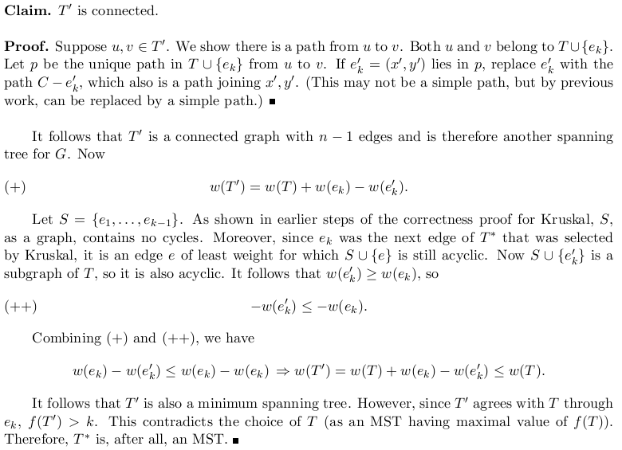
(continued)

Slide 57
Running Time of Kruskal: First Try
Computation
time to sort edges: O(mlog n)
Cost of while loop = O(mn) since loop potentially accesses every edge
comparison C(x) = C(y), with a hashtable implementation of sets, is O(n)
merging C(x), C(y) costs min{|C(x)|, |C(y)|}, which is O(n).
Cost of while loop can be improved with a good choice of data structure

Slide 58
DisjointSets Data Structure
Data structure for maintaining a partition of a set into disjoint subsets (data structure sometimes called Partition rather than DisjointSets)
General features
Data:
Universe U – the base set that is being partitioned (this set is never altered)
Collection C = {X₁, X₂, …, X_{n}} of subsets of the universe – the subsets are disjoint and their union is U (these subsets are modified when the data structure is used – size of C shrinks because of repeated union operations)
Operations:
find(x) – returns the subset X_{i} to which x belongs
union(A,B) – replaces the subsets A, B in C with A U B.

Slide 59
Example
Initial Structure:
U = {1, 2, 3, 4, 5}
X₁ = {1, 2}, X₂ = {3}, X₃ = {4, 5}
C = {X₁, X₂, X₃}
find Operation: find(2) = X₁ find(5) = X₃
union Operation: union(X₁, X₂) = X₁ U X₂ = {1,2,3} New value for C is {{1,2,3}, {4,5}}

Slide 60
Tree-Based Implementation of DisjointSets
The elements of each set X in the collection C are represented by nodes in a tree T_{X}; the set X itself is referenced by its root r_{X}.
find(x) returns the root of the tree to which x belongs
union(x,y) joins the tree that x belongs to to the tree that y belongs to by pointing root of one to the root of the other.

Slide 61
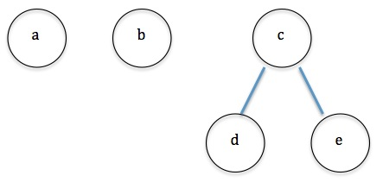
Example
U = {‘a’, ‘b’, ‘c’, ‘d’, ‘e’}
C = {{‘a’}, {‘b’}, {‘c’, ‘d’, ‘e’}}
Tree representations:
find(‘d’) returns ‘c’

Slide 62
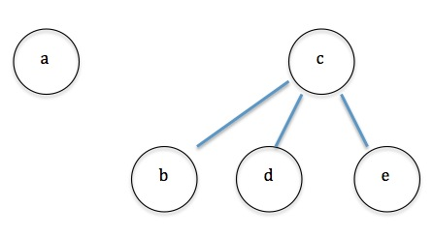
Example (cont)
union(‘b’, ‘c’) points root ‘b’ to root ‘c’ Now, find(‘b’) returns ‘c’

Slide 63
Code
//handle trees by keeping track of parents only
//whenever a character c is a root, its parent is set to be c itself
HashMap<Character, Character> parents = new HashMap<Character, Character>();
char[] universe;
//find returns the root of tree representing a subset
//worst case: find requires full depth of tree to locate root of representing tree
public char find(char element) {
char nextParent = parents.get(element);
if(nextParent == element) {
return element;
} else {
return find(nextParent);
}
}

Slide 64
Code
//union() accepts only tree roots (representing subsets) as arguments
//The method simply points the first root to the second
//In the worst case, resulting tree is taller than original two
public void union(char a_tree, char b_tree) {
parents.put(a_tree, b_tree);
}
To avoid building up trees that are too tall (and therefore imbalanced), an optimization can be used: Always point the shorter tree’s root to that of the taller.

Slide 65
Optimized Code
HashMap<Character, Character> parents = new HashMap<Character, Character>();
char[] universe;
//keep track of heights of trees
HashMap<Character, Integer> heights = new HashMap<Character, Integer>();
public void union(char a_tree, char b_tree) {
int height_a = heights.get(a_tree);
int height_b = heights.get(b_tree);
if(height_a < height_b) {
parents.put(a_tree, b_tree);
} else if(height_b < height_a) {
parents.put(b_tree, a_tree);
} else { //height_a == height_b
parents.put(a_tree, b_tree);
heights.put(b_tree, height_b + 1); //this is case in which height is increased
}
}
NOTE: With this optimization of union(), find() can be shown to run in O(log n) in the worst case. See https://en.wikipedia.org/wiki/Disjoint-set_data_structure

Slide 66
Optimized Running Time of Kruskal
Time to sort edges: O(mlog n)
Cost of while loop = O(mlog n)
loop potentially accesses every edge //O(m)
comparison C(x) = C(y) follows these steps: //locates roots of representing trees
r_{x} ← find(x) and r_{y} ← find(y) //O(log n)
check whether r_{x} = r_{y} //O(1)
merging C(x), C(y) is done by union() operation //O(1)
Total (optimized) running time for Kruskal: O(mlog n).

Slide 67
Connecting the Parts of Knowledge with the Wholeness of Knowledge
A Minimum Spanning Tree can be obtained from a weighted graph G = (V,E) by examining all possible subgraphs of G, and extracting from those that are trees having the smallest sum of edge weights. This procedure runs in Ω(2^{m}), where n = |E|.
Kruskal’s Algorithm is a highly efficient procedure (O(mlog n)) for finding an MST in a graph G. It proceeds by choosing edges with minimum possible weight subject to the constraint that selected edges do not introduce a cycle in the set T of edges obtained so far.

Slide 68
3.Transcendental Consciousness, the simplest form of awareness, is the source of effortless right action.
4.Impulses Within the Transcendental Field. Effortless, economical, mistake-free creation arises from the self-referral dynamics of the field of pure consciousness.
5.Wholeness Moving Within Itself. In Unity Consciousness, optimal solutions arise as an effortless unfoldment within one’s unbounded nature.

