Slide 1
Lesson 2: Introduction to Analysis of Algorithms: Discovering the Laws Governing Nature’s Computation
Input
Algorithm
Output
Wholeness of the Lesson
An algorithm is a procedure for performing a computation or deriving an output from a given set of inputs according to a specified rule. By representing algorithms in a neutral language, it is possible to determine, in mathematical terms, the efficiency of an algorithm and whether one algorithm typically performs better than another. Efficiency of computation is the hallmark of Nature’s self-referral performance. Contact with the home of all the laws of nature at the source of thought results in action that is maximally efficient and less prone to error.

Slide 2
Natural Things to Ask
How can we determine whether an algorithm is efficient ?
Correct ?
Given two algorithms that achieve the same goal, how can we decide which one is better? (E.g. sorting) Can our analysis be independent of a particular operating system or implementation in a language?
How can we express the steps of an algorithm without depending on a particular implementation?
Analysis of Algorithms

Slide 3
A Framework For Analysis of Algorithms
We will specify:
A simple neutral language for describing algorithms
A simple, general computational model in which algorithms execute
Procedures for measuring running time
A classification system that will allow us to categorize algorithms (a precise way of saying “fast”, “slow”, “medium”, etc)
Techniques for proving correctness of an algorithm
Analysis of Algorithms

Slide 4
Overview of the Lesson
Issues in Determining Running Time
Pseudo-code to Describe Algorithms
RAM Model and Counting Primitive Operations
Growth Rates and Limits at Infinity
Asymptotic Algorithm Analysis
The Sum of Two Problem
Running Time of Recursive Algorithms: The Master Formula
Proving Correctness: Iterative Algorithms
Proving Correctness: Recursive Algorithms

Slide 5

Issues in Determining Running Time
Most algorithms transform input objects into output objects.
The running time of an algorithm typically grows with the input size.
Average case time is often difficult to determine.
Often, we focus on the worst case running time.
  Easier to analyze
  Crucial to applications such as games, finance and robotics
Analysis of Algorithms

Slide 6

Direct Measurement
Write a program implementing the algorithm
Run the program with inputs of varying size and composition
Use a method like System.currentTimeMillis() to get an accurate measure of the actual running time
Optionally, plot the results
Analysis of Algorithms

Slide 7

Limitations of Direct Measurement
It is necessary to implement the algorithm, which may be difficult
Results may not be indicative of the running time on other inputs not included in the experiment.
In order to compare two algorithms, the same hardware and software environments must be used
Analysis of Algorithms

Slide 8

Theoretical Analysis
Uses a high-level description of the algorithm instead of an implementation
Characterizes running time as a function of the input size, n.
Takes into account all possible inputs
Allows us to evaluate the speed of an algorithm independent of the hardware/software environment
Analysis of Algorithms

Slide 9
Overview of the Lesson
Issues in Determining Running Time
Pseudo-code to Describe Algorithms
RAM Model and Counting Primitive Operations
Growth Rates and Limits at Infinity
Asymptotic Algorithm Analysis
The Sum of Two Problem
Running Time of Recursive Algorithms: The Master Formula
Proving Correctness: Iterative Algorithms
Proving Correctness: Recursive Algorithms

Slide 10
Pseudo-code to Describe Algorithms
Example: find max element of an array
High-level description of an algorithm
More structured than English prose
Less detailed than a program
Preferred notation for describing algorithms
Hides program design issues
Algorithm arrayMax(A, n)
Input array A of n integers
Output maximum element of A
currentMax ← A[0]
for i ← 1 to n − 1 do
if A[i] > currentMax then
currentMax ← A[i]
return currentMax
Analysis of Algorithms

Slide 11
Pseudocode Syntax
Control flow
  if … then … [else …]
  while … do …
  repeat … until …
  for … do …
  Indentation replaces braces
Method declaration
  Algorithm method (arg [, arg…])
  Input …
  Output …
Method call
  var.method (arg [, arg…])
Return value
  return expression
Expressions
  Assignment
  (like = in Java)
  Equality testing
  (like == in Java)
  n² Superscripts and other mathematical formatting allowed
Analysis of Algorithms

Slide 12
Exercise
Remove duplicates algorithm: Translate into pseudo-code:
Given a list L, return a list M of the distinct elements of L by doing the following:
For each n less than size of L, if L[n] is not yet in M, then add L[n] to M.
Analysis of Algorithms

Slide 13
Exercise
Remove duplicates algorithm: Translate into pseudo-code:
Given a list L, return a list M of the distinct elements of L by doing the following:
For each n less than size of L, if L[n] is not yet in M, then add L[n] to M.
Algorithm removeDups (L)
Input a list L
Output a list M containing the distinct elements of L
M ← new List
for i ← 0 to L.size() -1 do
if not M.contains (L[i]) then
M.add (L[i])
return M
Analysis of Algorithms

Slide 14
Main Point
For purposes of examining, analyzing, and comparing algorithms, a neutral algorithm language is used, independent of the particularities of programming languages, operating systems, and system hardware. Doing so makes it possible to study the inherent performance attributes of algorithms, which are present regardless of implementation details. This illustrates the SCI principle that more abstract levels of intelligence are more comprehensive and unifying.
Analysis of Algorithms

Slide 15
Overview of the Lesson
Issues in Determining Running Time
Pseudo-code to Describe Algorithms
RAM Model and Counting Primitive Operations
Growth Rates and Limits at Infinity
Asymptotic Algorithm Analysis
The Sum of Two Problem
Running Time of Recursive Algorithms: The Master Formula
Proving Correctness: Iterative Algorithms
Proving Correctness: Recursive Algorithms

Slide 16
The Random Access Machine (RAM) Model
A CPU
A potentially unbounded bank of memory cells, each of which can hold an arbitrary number or characters
2
1
0
Memory cells are numbered and accessing any cell in memory takes unit time.
Analysis of Algorithms

Slide 17

Primitive Operations
Basic computations performed by an algorithm
Identifiable in pseudocode
Largely independent of the programming language
Exact definition not important (we will see why later)
Assumed to take a constant amount of time in the RAM model
Analysis of Algorithms

Slide 18
Primitive Operations in This Course
  Performing an arithmetic operation (+, *, etc)
  Comparing two numbers
  Assigning a value to a variable
  Indexing into an array
  Calling a method
  Returning from a method
  Following an object reference
Analysis of Algorithms

Slide 19
Counting Primitive Operations
By inspecting the pseudocode, we can determine the maximum number of primitive operations executed by an algorithm, as a function of the input size
Algorithm arrayMax(A, n)
# operations
currentMax ← A[0] 2
m ← n − 1 2
for i ← 1 to m do 1 + n
if A[i] > currentMax then 2(n − 1)
currentMax ← A[i] 2(n − 1)
{ increment counter i } 2(n − 1)
return currentMax 1
Total 7n
Analysis of Algorithms

Slide 20

Estimating Running Time
Algorithm arrayMax executes 7n primitive operations in the worst case. Define:
  a = Time taken by the fastest primitive operation
  b = Time taken by the slowest primitive operation
Let T(n) be worst-case time of arrayMax. Then
a (7n) ≤ T(n) ≤ b(7n)
Hence, the running time T(n) is bounded by two linear functions
Analysis of Algorithms

Slide 21
Overview of the Lesson
Issues in Determining Running Time
Pseudo-code to Describe Algorithms
RAM Model and Counting Primitive Operations
Growth Rates and Limits at Infinity
Asymptotic Algorithm Analysis
The Sum of Two Problem
Running Time of Recursive Algorithms: The Master Formula
Proving Correctness: Iterative Algorithms
Proving Correctness: Recursive Algorithms

Slide 22

Growth Rate of Running Time
Changing the hardware / software environment
  Affects T(n) by a constant factor, but
  Does not alter the growth rate of T(n)
The linear growth rate of the running time T(n) is an intrinsic property of algorithm arrayMax
Analysis of Algorithms

Slide 23
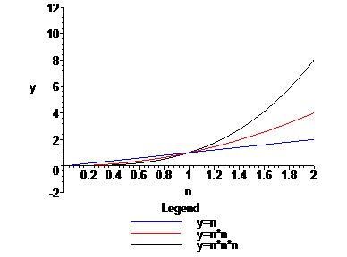
Growth Rates
Growth rates of functions:
  Linear ≈ n
  Quadratic ≈ n²
  Cubic ≈ n³
The graph of the cubic begins as the slowest but eventually overtakes the quadratic and linear graphs
Main factor for growth rates is the behavior as n gets large
Analysis of Algorithms

Slide 24
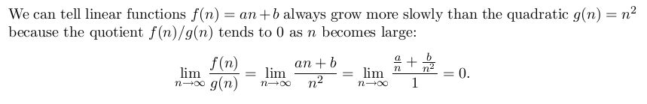

Detecting Growth Rates Using Limits
Example: Show that 5n + 3 grows more slowly than n²
Solution:
Analysis of Algorithms

Slide 25
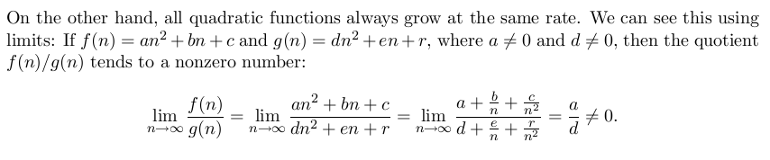

(continued)
Example: Show that 3n² + 7 grows at the same rate as 5n² – n.
Solution:
Analysis of Algorithms

Slide 26
Overview of the Lesson
Issues in Determining Running Time
Pseudo-code to Describe Algorithms
RAM Model and Counting Primitive Operations
Growth Rates and Limits at Infinity
Asymptotic Algorithm Analysis
The Sum of Two Problem
Running Time of Recursive Algorithms: The Master Formula
Proving Correctness: Iterative Algorithms
Proving Correctness: Recursive Algorithms

Slide 27


Theta, Little-oh, Little-omega
Suppose f(n) and g(n) are functions. Then
f(n) is o(g(n)) (“f(n) is little-oh of g(n)”) if
[f(n) grows much more slowly than g(n)]
f(n) is g(n)) (“f(n) is little-omega of g(n)”) if g(n) is o(f(n))
[f(n) grows much faster than g(n)]
f(n) is Θ(g(n)) (“f(n) is theta of g(n)”) if for some nonzero number r
[f(n) grows at the same rate as g(n)]
The classes of functions represented by o, and Θ are called complexity classes.
Note: It is theoretically possible that limits of this kind may not exist. This situation almost never arises in the context of determining running times of algorithms, and so we do not attempt to handle this special case in this course.
Analysis of Algorithms

Slide 28

Examples
5n + 3 is o(n²)
3n² + 7 is Θ(n²)
Analysis of Algorithms

Slide 29

Polynomial Theorem
When functions are polynomials (as in the examples) there is an easy formula for determining their complexity class
Degree of a polynomial. Suppose f(n) = a_{m}n^{m} + a_{m-1}n^{m-1} + . . . + a₁n + a₀. Then if a_{m} ≠ 0, f(n) is called a polynomial of degree m. We say the degree of f is m.
Polynomial Theorem. Suppose f(n) and g(n) are polynomials and degree of f is m, degree of g is t. Then
  if m = t, then f(n) is Θ(g(n))
  if m < t, then f(n) is o(g(n))
Analysis of Algorithms

Slide 30

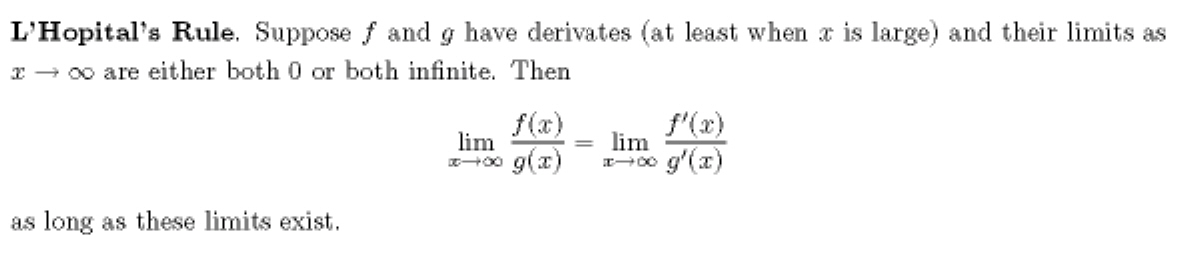
Standard Complexity Classes
The most common complexity classes used in analysis of algorithms are, in increasing order of growth rate:
Functions that belong to classes in the first row are known as polynomial time bounded.
Verification of the relationships between these classes sometimes requires the use of L’Hopital’s Rule
Analysis of Algorithms

Slide 31


Example using L’Hopital
Analysis of Algorithms

Slide 32

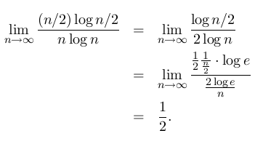
Example Using L’Hopital
Analysis of Algorithms

Slide 33
Overview of the Lesson
Issues in Determining Running Time
Pseudo-code to Describe Algorithms
RAM Model and Counting Primitive Operations
Growth Rates and Limits at Infinity
6. Big-oh (O) and big-omega ( )
Asymptotic Algorithm Analysis
The Sum of Two Problem
Running Time of Recursive Algorithms: The Master Formula
Proving Correctness: Iterative Algorithms
Proving Correctness: Recursive Algorithms

Slide 34

Big-oh and Big-omega
If f(n) grows no faster than g(n), we say f(n) is O(g(n)) (“big-oh”)
If f(n) grows at least as fast as g(n), we say f(n) is Ω(g(n)) (“big-omega”)
Limit criterion:
f(n) is O(g(n)) if
Then, f(n) is Ω(g(n)) if g(n) is O(f(n)).
Analysis of Algorithms

Slide 35
Examples
Both 2n + 1 and 3n² are O(n²)
Both 2n² – 1 and 4n³ are Ω(n²)
Analysis of Algorithms

Slide 36
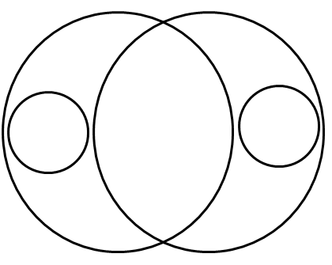



Relationships Between the Complexity Classes
Whenever f(n) is o(g(n)), f(n) is O(g(n).
No function is in both o
Analysis of Algorithms

Slide 37
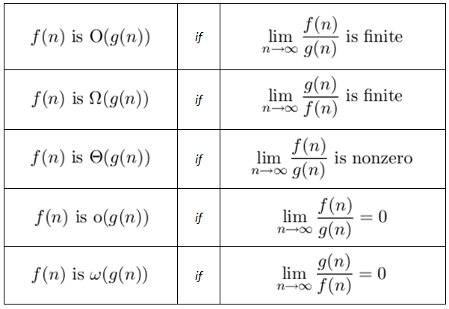
Summary of Criteria for Determining Complexity
Analysis of Algorithms

Slide 38
Overview of the Lesson
Issues in Determining Running Time
Pseudo-code to Describe Algorithms
RAM Model and Counting Primitive Operations
Growth Rates and Limits at Infinity
Asymptotic Algorithm Analysis
The Sum of Two Problem
Running Time of Recursive Algorithms: The Master Formula
Proving Correctness: Iterative Algorithms
Proving Correctness: Recursive Algorithms

Slide 39
Asymptotic Algorithm Analysis
The asymptotic analysis of an algorithm determines which complexity class the running time belongs to
To perform the (worst-case) asymptotic analysis
  We find the worst-case number of primitive operations executed as a function of the input size
  We express this function using big-Oh notation (or one of its variants)
Example:
  We determined that algorithm arrayMax executes at most 7n primitive operations
  Since 7n is O(n), we say that algorithm arrayMax “runs in O(n) time”. Or we could say arrayMax runs in Θ(n) time.
Analysis of Algorithms

Slide 40
Basic Rules For Computing Asymptotic Running Times
Rule-1: For Loops
The running time of a for loop is at most the running time of the statements inside the loop (including tests) times the number of iterations (see arrayMax)
Rule-2: Nested Loops
Analyze from inside out. The total running time of a statement inside a group of nested loops is the running time of the statement times the sizes of all the loops
for i ← 0 to n-1 do
for j ← 0 to n-1 do
k ← i + j
(Runs in Θ(n²) – often we say runs in O(n²) )
Analysis of Algorithms

Slide 41
(continued)
Rule-3: Consecutive Statements
Running times of consecutive statements should be added in order to compute running time of the whole
for i ← 0 to n-1 do
a[i] ← 0
for i ← 0 to n-1 do
for j ← 0 to i do
a[i] ← a[i] + i + j
(Running time is O(n) + O(n²), which is O(n²) )
Analysis of Algorithms

Slide 42
(continued)
Rule-4: If/Else
For the fragment
if condition then
S1
else
S2
the running time is never more than the running time of the condition plus the larger of the running times of S1 and S2.
Analysis of Algorithms

Slide 43
Overview of the Lesson
Issues in Determining Running Time
Pseudo-code to Describe Algorithms
RAM Model and Counting Primitive Operations
Growth Rates and Limits at Infinity
Asymptotic Algorithm Analysis
The Sum of Two Problem
Running Time of Recursive Algorithms: The Master Formula
Proving Correctness: Iterative Algorithms
Proving Correctness: Recursive Algorithms

Slide 44
Example:
The Sum of Two problem
The problem: Given an array A of distinct integers and another integer z, determine whether A contains two different numbers x, y so that x + y = z
Analysis of Algorithms

Slide 45
Sum of Two, Algorithm #1
Algorithm sumOfTwo_1(A, z)
Input: An array A of distinct integers, and
an integer z
Output: true if there are x, y in A
with x + y = z, else false
for i ← 0 to A.length do
for j ← 0 to i – 1 do
if A[i] + A[j] = z then
return true
return false
Analysis
Nested for-loops with inner variable dependent on outer variable:
The running time of sumOfTwo_1 is Θ(n²)
How to Improve?
Notice that the inner loop examines the same elements many times. Find a way to keep hold of these elements after they have been examined once.
Analysis of Algorithms

Slide 46
Sum of Two, Algorithm #2
Algorithm sumOfTwo_2(A, z)
Input: An array A of distinct integers,
and an integer z
Output: true if there are x, y in A
with x + y = z, else false
h ← new HashMap
for i ← 0 to A.length-1 do
if (A[i] + A[i] <> z) then
h.put(z – A[i], 0)
for j ← 0 to A.length - 1 do
if h.containsKey(A[j]) then
return true
return false;
Analysis
Note: As we will show in a later lesson, the operations “put” and “containsKey” on a properly defined hashtable have O(1) running times.
We have two successive for loops, each with running time O(n).
Therefore, the running time of sumOfTwo_2 is O(n)
Can we improve further?
Notice we can combine the steps of the two loops into just one loop
Analysis of Algorithms

Slide 47
Sum of Two, Algorithm #3
Algorithm sumOfTwo_3(A, z)
Input: An array A of distinct integers, and
an integer z
Output: true if there are x, y in A
with x + y = z, else false
h ← new HashMap
for i ← 0 to A.length -1 do
val ← A[i]
if (A[i] + A[i] <> z) then
if h.containsKey(z - val) then
return true
if not h.containsKey(val) then
h.put(val, 0)
return false;
Analysis
One for loop
Running time of sumOfTwo_3 is O(n)
Note: This is same asymptotic running time as sumOfTwo_2, but sumOfTwo_3 has a smaller constant (the main improvement is that A[i] is accessed only once per iteration)
Analysis of Algorithms

Slide 48
Main Point
One can improve the running time of a solution to the Sum of Two problem from O(n²) to O(n) by introducing a hashtable as a means to encapsulate "bookkeeping" operations. This technique is reminiscent of the Principle of the Second Element from SCI: To remove the darkness, struggling at the level of darkness is ineffective; instead, introduce a second element – namely, light. As soon as the light is introduced, the problem of darkness disappears.
Analysis of Algorithms

Slide 49
Overview of the Lesson
Issues in Determining Running Time
Pseudo-code to Describe Algorithms
RAM Model and Counting Primitive Operations
Growth Rates and Limits at Infinity
Asymptotic Algorithm Analysis
The Sum of Two Problem
Running Time of Recursive Algorithms: The Master Formula
Proving Correctness: Iterative Algorithms
Proving Correctness: Recursive Algorithms

Slide 50
Running Time of Recursive Algorithms
Problem: Given an array of integers in sorted order, is it possible to perform a search for an element in such a way that no more than half the elements of the array are examined? (Assume the array has 8 or more elements.)
Analysis of Algorithms

Slide 51
Binary Search
Algorithm search(A,x)
Input: An already sorted array A with n elements and search value x
Output: true or false
return binSearch(A, x, 0, A.length-1)
Algorithm binSearch(A, x, lower, upper)
Input: Already sorted array A of size n, value x to be
searched for in array section A[lower]..A[upper]
Output: true or false
if lower > upper then return false
mid ← (upper + lower)/2
if x = A[mid] then return true
if x < A[mid] then
return binSearch(A, x, lower, mid – 1)
else
return binSearch(A, x, mid + 1, upper)
_________________________________________________________________________
Analysis of Algorithms

Slide 52
(continued)
Algorithm binSearch(A, x, lower, upper)
Input: Already sorted array A of size n, value x to be
searched for in array section A[lower]..A[upper]
Output: true or false
if lower > upper then return false +1
mid ← (upper + lower)/2 +3
if x = A[mid] then return true +2
if x < A[mid] then +2
return binSearch(A, x, lower, mid – 1)
else
return binSearch(A, x, mid + 1, upper) +3 + T(n/2)
_________________________________________________________________________
For the worst case (x is above all elements of A and n a power of 2), running time is given by
the Recurrence Relation: (In this case, right half is always exactly half the size of the original.)
T(1) = 13; T(n) = 11 + T(n/2)
Analysis of Algorithms

Slide 53
(wait. How you got 13?)
binSearch(A, 12, 0, 0) // Let A[0] be 10
if lower > upper then return false +1 // false
mid ← (upper + lower)/2 +3 // mid = 0
if x = A[mid] then return true +2 // false
if x < A[mid] then +2 // false
return binSearch(A, x, lower, mid – 1)
else
return binSearch(A, 12, 1 , 0) +3 // method call
_________________________________________________________________________
binSearch(A, 12, 1, 0)
if lower > upper then return false +2 // true
Thus T(1) = 13
Analysis of Algorithms

Slide 54
The Divide and Conquer Algorithm Strategy
The binary search algorithm is an example of a “Divide And Conquer” algorithm, which is typical strategy when recursion is used.
The method:
  Divide the problem into subproblems (divide input array into left and right halves)
  Conquer the subproblems by solving them recursively (search recursively in whichever half could potentially contain target element)
  Combine the solutions to the subproblems into a solution to the problem (return value found or indicate not found)
Analysis of Algorithms

Slide 55
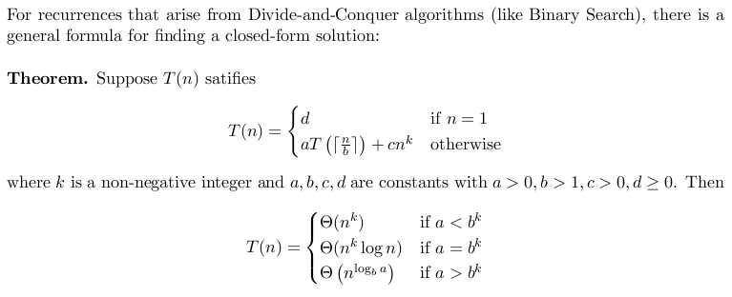
Running Time of Recursive Algorithms: The Master Formula
Analysis of Algorithms

Slide 56
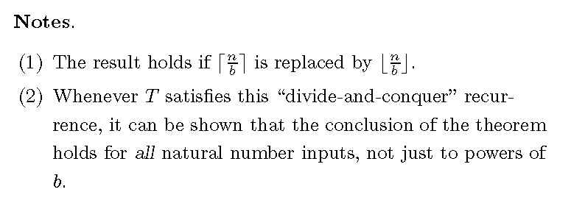
The Master Formula (continued)
Analysis of Algorithms

Slide 57
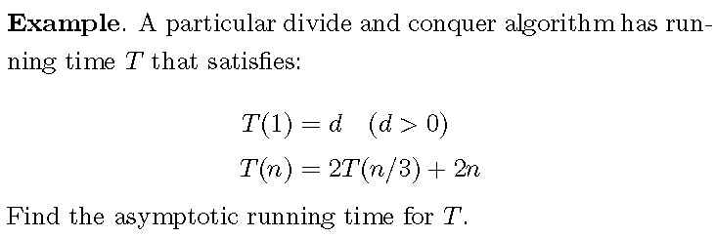
The Master Formula (continued)
Analysis of Algorithms

Slide 58
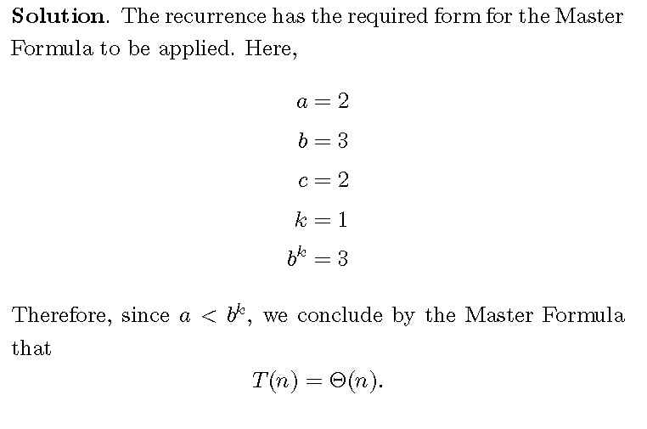
The Master Formula (continued)
Analysis of Algorithms

Slide 59
Main Point
Recurrence relations are used to analyze recursively defined algorithms. Just as recursion involves repeated self-calls by an algorithm, so the complexity function T(n) is defined in terms of itself in a recurrence relation. Recursion is a reflection of the self-referral dynamics at the basis of Nature’s functioning. Ultimately, there is just one field of existence; everything that happens therefore is just the dynamics of this one field interacting with itself. When individual awareness opens to this level of Nature’s functioning, great accomplishments become possible.
Analysis of Algorithms

Slide 60
Overview of the Lesson
Issues in Determining Running Time
Pseudo-code to Describe Algorithms
RAM Model and Counting Primitive Operations
Growth Rates and Limits at Infinity
Asymptotic Algorithm Analysis
The Sum of Two Problem
Running Time of Recursive Algorithms: The Master Formula
Proving Correctness: Iterative Algorithms
Proving Correctness: Recursive Algorithms

Slide 61
Proving Correctness:
Iterative Algorithms
In a careful demonstration of correctness, an algorithm is broken down into sections. Postconditions for one section become preconditions of next section. The proof of correctness will then show that within each section, under the assumption that preconditions hold for the section, the algorithm’s output for that section satisfies the postconditions.
In practice, for iterative algorithms, all that is necessary is to establish that the “goal” of each loop in the algorithm is achieved. This is done with the technique of loop invariants.
Analysis of Algorithms

Slide 62
Loop Invariants
Algorithm iterativeFactorial(n)
Input: A non-negative integer n
Output: n!
if (n = 0 || n = 1) then
return 1
accum ← 1
for i ← 1 to n do
accum ← accum * i
return accum
Definition of Loop Invariant: A loop invariant I(i) is a statement depending on the iterator i, which holds true at the completion of the ith pass through the loop, for each i.
Typically, showing that a statement I(i) is a loop invariant requires an argument by induction on i.
Example: A loop invariant here is:
I(i): accum = i!
Analysis of Algorithms

Slide 63
Proof of Correctness
Proof of correctness of iterativeFactorial:
We identify the loop invariant for the for loop as before: I(i): accum = i!
We verify by induction on i that I(k) holds at the end of the i = k pass, for 1 ≤ k ≤ n.
Base Case. After the iteration i = 1 completes, accum has value 1 = 1!.
Induction Step. Assuming I(k) holds (for k < n), show I(k+1) holds. Because I(k) is true, at the end of the i = k pass, accum = k!. Then, at the end of the i = k+1 pass, we have:
Algorithm iterativeFactorial(n)
Input: A non-negative integer n
Output: n!
if (n = 0 || n = 1) then
return 1
accum ← 1
for i ← 1 to n do
accum ← accum * i
return accum
accum = accum * i = accum * (k+1) = k! * (k+ 1) = k+1!
This shows that the loop invariant is true for all k for which
1 ≤ k ≤ n . In particular, the value stored in accum after the
k = n pass is n!, and this is the value that the algorithm returns. Therefore, iterativeFactorial correctly computes n! on input n.
Analysis of Algorithms

Slide 64
Overview of the Lesson
Issues in Determining Running Time
Pseudo-code to Describe Algorithms
RAM Model and Counting Primitive Operations
Growth Rates and Limits at Infinity
Asymptotic Algorithm Analysis
The Sum of Two Problem
Running Time of Recursive Algorithms: The Master Formula
Proving Correctness: Iterative Algorithms
Proving Correctness: Recursive Algorithms

Slide 65
Proving Correctness: Recursive Algorithms
The strategy for proving correctness of a recursive algorithm involves the following steps:
1. Verify that the recursion is valid: there should be a base case and recursive calls must eventually lead to the base case
2. Show that the values given by the base case are correct outputs for the function
3. Show that, if you assume the output value of the algorithm on input j is correct, for all j < n, then output value on input n is correct.
Analysis of Algorithms

Slide 66
Example of Correctness Proof for a Recursive Algorithm
Proof of Correctness
Valid Recursion Base case is “n= 0 or n=1”. Each self-call reduces input size by 1, so eventually base case is reached
Base The values 0! and 1! are correctly computed by the base case
Recursion Assuming recursiveFactorial(j) correctly computes j! whenever j < n, we must show output of recursiveFactorial(n) is correct. But output of recursiveFactorial(n) is
n * recursiveFactorial(n-1) = n!, as required.
Therefore, the algorithm correctly computes n! for every n.
Algorithm recursiveFactorial(n)
Input: A non-negative integer n
Output: n!
if (n = 0 || n = 1) then
return 1
return n * recursiveFactorial(n-1)
Analysis of Algorithms

Slide 67
Another Example: McCarthy’s 91
Algorithm mc91(n)
Input: A positive integer n
Output: 91 if n <= 101,
n-10 otherwise
if n > 100 then
return n - 10
return mc91(mc91(n+11))
Here, proof that this is a valid recursion is not obvious. It is necessary to prove the output is right in order to prove that the recursion is valid – not easy to separate these two validation points.
Optional Exercise: Prove mc91 is correct.
Analysis of Algorithms

Slide 68
Connecting the Parts of Knowledge
With The Wholeness of Knowledge
There are many techniques for analyzing the running time of a recursive algorithm. Most require special handling for special requirements (e.g. n not a power of 2, counting self-calls, verifying a guess).
The Master Formula combines all the intelligence required to handle analysis of a wide variety of recursive algorithms into a single simple formula, which, with minimal computation, produces the exact complexity class for algorithm at hand.
Analysis of Algorithms

Slide 69
3. Transcendental Consciousness is the field beyond diversity, beyond problems, and therefore is the field of solutions.
4. Impulses Within The Transcendental Field. Impulses within this field naturally form the blueprint for unfoldment of the highly complex universe. This blueprint is called Ved.
5. Wholeness Moving Within Itself. In Unity Consciousness, solutions to problems arise naturally as expressions of one’s own unbounded nature.
Analysis of Algorithms

