Slide 1
Lesson 4
Merge Sort: Collapsing Infinity To a Point
Wholeness of the Lesson
Merge Sort is a Divide and Conquer sorting algorithm which, by overcoming the limitations inherent in inversion-bound sorting algorithms, is able to sort lists in
O(n logn) time, even in the worst case. The Divide and Conquer strategy is an example of the simple principle of “Do Less and Accomplish More.’’ This technique makes it possible to break the inversion-bound barrier for sorting alrgorithms, to obtain very fast running times.
7 2 ⏐ 9 4 → 2 4 7 9
7 ⏐ 2 → 2 7
9 ⏐ 4 → 4 9
7 → 7
2 → 2
9 → 9
4 → 4
Merge Sort
Notes:
Merge Sort

Slide 2
MergeSort: A Divide-and-Conquer Algorithm
Recall: Divide-and conquer is a general algorithm design paradigm. MergeSort implements this design:
  Divide: divide the input data S in two disjoint subsets S₁ and S₂
  Conquer: solve the subproblems associated with S₁ and S₂
  Combine: combine the solutions for S₁ and S₂ into a solution for S
Merge-sort is a sorting algorithm based on the divide-and-conquer paradigm
Merge Sort

Slide 3
Merge Sort time complexity
Unlike Other sorts like Selection, Bubble and Insertion which has O(n²) time complexity
Merge sort has O(n log n) time complexity in worst case, which means Merge sort is much faster than other sorting algorithm we studied so far
Merge Sort

Slide 4
Merge-Sort
Merge-sort on an input sequence S with n integers consists of three steps:
  Divide: partition S into two sequences S₁ and S₂ of about n/2 elements each
  Conquer: recursively sort S₁ and S₂
  Combine: merge S₁ and S₂ into a single sorted sequence
Algorithm mergeSort(S)
Input sequence S with n
Output sequence S sorted
  if S.size() > 1 then
  (S₁, S₂) ← partition(S, n/2)
  mergeSort(S₁)
  mergeSort(S₂)
  S ← merge(S₁, S₂)
  return S
Merge Sort

Slide 5
Merging Two Sorted Sequences
The combine step of merge-sort consists of merging two sorted sequences A and B into a sorted sequence S containing the union of the elements of A and B
Merging two sorted arrays, each with n/2 elements takes O(n) time
Algorithm merge(A, B)
Input sorted sequences A and B with
n/2 integers each
Output sorted sequence S of A ∪ B
  S ← empty sequence
  while ¬A.isEmpty() ∧ ¬B.isEmpty() do
  if A.first() <= B.first() then
  S.insertLast(A.remove(A.first()))
  else
  S.insertLast(B.remove(B.first()))
  while ¬A.isEmpty() do
  S.insertLast(A.remove(A.first()))
  while ¬B.isEmpty() do
  S.insertLast(B.remove(B.first()))
  return S
Merge Sort

Slide 6
Execution Example
Partition
2 4 1 6⏐ 8 5 3 7 → 1
7 4 7 9
3 8 6 1 → 1 3 8 6
2 7
9 4 9
3 8 → 3 8
6 1 → 1 6
7 2→ 7
2 → 2
9 → 9
4 → 4
3 → 3
8 → 8
6 → 6
1 → 1
Merge Sort

Slide 7
Execution Example (cont.)
Recursive call, partition
2 4 1 6⏐ 8 5 3 7 9
2 4 ⏐ 1 6 2
3 8 6 1 → 1 3 8 6
7 2 → 2 7
9 4 → 4 9
3 8 → 3 8
6 1 → 1 6
7 → 7
2 → 2
9 → 9
4 → 4
3 → 3
8 → 8
6 → 6
1 → 1
Merge Sort

Slide 8
Execution Example (cont.)
Recursive call, partition
2 4 1 6⏐ 8 5 3 7 9
2 4 ⏐ 1 6 2 4 7 9
3 8 6 1 → 1 3 8 6
2 ⏐ 4 7
9 4 → 4 9
3 8 → 3 8
6 1 → 1 6
7 → 7
2 → 2
9 → 9
4 → 4
3 → 3
8 → 8
6 → 6
1 → 1
Merge Sort

Slide 9
Execution Example (cont.)
Recursive call, base case
2 4 1 6⏐ 8 5 3 7 9
2 4 ⏐ 1 6 2 9
3 8 6 1 → 1 3 8 6
2 ⏐ 4→ 2
9 4 → 4 9
3 8 → 3 8
6 1 → 1 6
2 → 2
2 → 2
9 → 9
4 → 4
3 → 3
8 → 8
6 → 6
1 → 1
Merge Sort

Slide 10
Execution Example (cont.)
Recursive call, base case
2 4 1 6⏐ 8 5 3 7 8 9
2 4 ⏐ 1 6
3 8 6 1 → 1 3 8 6
2 ⏐ 4→ 7
9 4 → 4 9
3 8 → 3 8
6 1 → 1 6
2 → 2
4 → 4
9 → 9
4 → 4
3 → 3
8 → 8
6 → 6
1 → 1
Merge Sort

Slide 11
Execution Example (cont.)
Merge
2 4 1 6⏐ 8 5 3 7 9
2 4 ⏐ 1 6 9
3 8 6 1 → 1 3 8 6
2 ⏐ 4 → 2 4
9 4 → 4 9
3 8 → 3 8
6 1 → 1 6
2 → 2
4 → 4
9 → 9
4 → 4
3 → 3
8 → 8
6 → 6
1 → 1
Merge Sort

Slide 12
Execution Example (cont.)
Recursive call, …, base case, merge
2 4 1 6⏐ 8 5 3 7
2 4 ⏐ 1 6 9
3 8 6 1 → 1 3 8 6
2 ⏐ 4 → 2 4
1 6 → 1 6
3 8 → 3 8
6 1 → 1 6
2 → 2
4 → 4
1 → 1
6 → 6
3 → 3
8 → 8
6 → 6
1 → 1
Merge Sort

Slide 13
Execution Example (cont.)
Merge
2 4 1 6⏐ 8 5 3 7 9
2 4 ⏐ 1 6 → 1 2 4 6
3 8 6 1 → 1 3 8 6
2 ⏐ 4 → 2 4
1 6 → 1 6
3 8 → 3 8
6 1 → 1 6
2 → 2
4 → 4
1 → 1
6 → 6
3 → 3
8 → 8
6 → 6
1 → 1
Merge Sort

Slide 14
Execution Example (cont.)
Recursive call, …, merge, merge
2 4 1 6⏐ 8 5 3 7 9
2 4 ⏐ 1 6 → 1 2 4 6
8 5 3 7 → 3 5 7 8
2 ⏐ 4 → 2 4
1 6 → 1 6
8 5 → 5 8
3 7 → 3 7
2 → 2
4 → 4
1 → 1
6 → 6
8 → 8
5 → 5
3 → 3
7 → 7
Merge Sort

Slide 15
Execution Example (cont.)
Merge
2 4 1 6⏐ 8 5 3 7 → 1 2 3 4 6 7 8 9
2 4 ⏐ 1 6 → 1 2 4 6
8 5 3 7 → 3 5 7 8
2 ⏐ 4 → 2 4
1 6 → 1 6
8 5 → 5 8
3 7 → 3 7
2 → 2
4 → 4
1 → 1
6 → 6
8 → 8
5 → 5
3 → 3
7 → 7
Merge Sort

Slide 16
Implementation of Merge
int[] theArray; //this array is populated with two sorted sections of ints
public void merge(int[] tempStorage,
int lowerPointer,
int upperPointer,
int upperBound) {
int j = 0; //tempStorage index
int lowerBound = lowerPointer;
//total number of elements to rearrange
int n = upperBound - lowerBound + 1;
//view the range [lowerBound,upperBound] as two arrays
//[lowerBound, mid], [mid+1,upperBound] to be merged
int mid = upperPointer -1;
while(lowerPointer <= mid && upperPointer <= upperBound){
if(theArray[lowerPointer] <= theArray[upperPointer]){
tempStorage[j++] = theArray[lowerPointer++];
}
else {
tempStorage[j++] = theArray[upperPointer++];
}
}
Merge Sort

Slide 17
Merge (continued)
//left array may still have elements
while(lowerPointer <= mid) {
tempStorage[j++] = theArray[lowerPointer++];
}
//right array may still have elements
while(upperPointer <= upperBound){
tempStorage[j++] = theArray[upperPointer++];
}
//replace the range [lowerBound,upperBound] in theArray with
//the range [0,n-1] just created in tempStorage
for(j=0; j<n; ++j) {
theArray[lowerBound+j] = tempStorage[j];
}
}
Merge Sort

Slide 18
Implementation of MergeSort, In-Place
class MergeSort {
int[] theArray;
//public sorter
public int[] sort(int[] input){
int n = input.length;
int[] tempStorage = new int[n];
theArray = input;
mergeSort(tempStorage,0,n-1);
return theArray;
}
Merge Sort

Slide 19
(continued)
void mergeSort(int[] temp, int lower, int upper) {
if(lower==upper){
return;
}
else {
int mid = (lower+upper)/2;
mergeSort(temp,lower,mid); mergeSort(temp,mid+1, upper);
merge(temp,lower,mid+1,upper);
}
}
}
Merge Sort

Slide 20
Trees
In computer science, a tree is an abstract model of a hierarchical structure
A tree consists of nodes with a parent-child relation
Applications:
  Organization charts
  File systems
  Programming environments
Computers”R”Us
Sales
Manufacturing
R&D
US
International
Laptops
Desktops
Europe
Asia
Canada
Merge Sort

Slide 21
Merge-Sort Tree
An execution of merge-sort may be depicted by a binary tree
  each node represents a recursive call of merge-sort and stores
    unsorted sequence before the execution and its partition
    sorted sequence at the end of the execution
  the root is the initial call
  the leaves are calls on subsequences of size 0 or 1
7 2 ⏐ 9 4 → 2 4 7 9
7 ⏐ 2 → 2 7
9 ⏐ 4 → 4 9
7 → 7
2 → 2
9 → 9
4 → 4
Merge Sort

Slide 22
Execution Example
Partition
7 2 9 4 ⏐ 3 8 6 1 → 1 2 3 4 6 7 8 9
7 2 9 4 → 2 4 7 9
3 8 6 1 → 1 3 8 6
7 2 → 2 7
9 4 → 4 9
3 8 → 3 8
6 1 → 1 6
7 → 7
2 → 2
9 → 9
4 → 4
3 → 3
8 → 8
6 → 6
1 → 1
Merge Sort

Slide 23
Execution Example (cont.)
Recursive call, partition
7 2 9 4 ⏐ 3 8 6 1 → 1 2 3 4 6 7 8 9
7 2 ⏐ 9 4 → 2 4 7 9
3 8 6 1 → 1 3 8 6
7 2 → 2 7
9 4 → 4 9
3 8 → 3 8
6 1 → 1 6
7 → 7
2 → 2
9 → 9
4 → 4
3 → 3
8 → 8
6 → 6
1 → 1
Merge Sort

Slide 24
Execution Example (cont.)
Recursive call, partition
7 2 9 4 ⏐ 3 8 6 1 → 1 2 3 4 6 7 8 9
7 2 ⏐ 9 4 → 2 4 7 9
3 8 6 1 → 1 3 8 6
7 ⏐ 2 → 2 7
9 4 → 4 9
3 8 → 3 8
6 1 → 1 6
7 → 7
2 → 2
9 → 9
4 → 4
3 → 3
8 → 8
6 → 6
1 → 1
Merge Sort

Slide 25
Execution Example (cont.)
Recursive call, base case
7 2 9 4 ⏐ 3 8 6 1 → 1 2 3 4 6 7 8 9
7 2 ⏐ 9 4 → 2 4 7 9
3 8 6 1 → 1 3 8 6
7 ⏐ 2 → 2 7
9 4 → 4 9
3 8 → 3 8
6 1 → 1 6
7 → 7
2 → 2
9 → 9
4 → 4
3 → 3
8 → 8
6 → 6
1 → 1
Merge Sort

Slide 26
Execution Example (cont.)
Recursive call, base case
7 2 9 4 ⏐ 3 8 6 1 → 1 2 3 4 6 7 8 9
7 2 ⏐ 9 4 → 2 4 7 9
3 8 6 1 → 1 3 8 6
7 ⏐ 2 → 2 7
9 4 → 4 9
3 8 → 3 8
6 1 → 1 6
7 → 7
2 → 2
9 → 9
4 → 4
3 → 3
8 → 8
6 → 6
1 → 1
Merge Sort

Slide 27
Execution Example (cont.)
Merge
7 2 9 4 ⏐ 3 8 6 1 → 1 2 3 4 6 7 8 9
7 2 ⏐ 9 4 → 2 4 7 9
3 8 6 1 → 1 3 8 6
7 ⏐ 2 → 2 7
9 4 → 4 9
3 8 → 3 8
6 1 → 1 6
7 → 7
2 → 2
9 → 9
4 → 4
3 → 3
8 → 8
6 → 6
1 → 1
Merge Sort

Slide 28
Execution Example (cont.)
Recursive call, …, base case, merge
7 2 9 4 ⏐ 3 8 6 1 → 1 2 3 4 6 7 8 9
7 2 ⏐ 9 4 → 2 4 7 9
3 8 6 1 → 1 3 8 6
7 ⏐ 2 → 2 7
9 4 → 4 9
3 8 → 3 8
6 1 → 1 6
7 → 7
2 → 2
9 → 9
4 → 4
3 → 3
8 → 8
6 → 6
1 → 1
Merge Sort

Slide 29
Execution Example (cont.)
Merge
7 2 9 4 ⏐ 3 8 6 1 → 1 2 3 4 6 7 8 9
7 2 ⏐ 9 4 → 2 4 7 9
3 8 6 1 → 1 3 8 6
7 ⏐ 2 → 2 7
9 4 → 4 9
3 8 → 3 8
6 1 → 1 6
7 → 7
2 → 2
9 → 9
4 → 4
3 → 3
8 → 8
6 → 6
1 → 1
Merge Sort

Slide 30
Execution Example (cont.)
Recursive call, …, merge, merge
7 2 9 4 ⏐ 3 8 6 1 → 1 2 3 4 6 7 8 9
7 2 ⏐ 9 4 → 2 4 7 9
3 8 6 1 → 1 3 6 8
7 ⏐ 2 → 2 7
9 4 → 4 9
3 8 → 3 8
6 1 → 1 6
7 → 7
2 → 2
9 → 9
4 → 4
3 → 3
8 → 8
6 → 6
1 → 1
Merge Sort

Slide 31
Execution Example (cont.)
Merge
7 2 9 4 ⏐ 3 8 6 1 → 1 2 3 4 6 7 8 9
7 2 ⏐ 9 4 → 2 4 7 9
3 8 6 1 → 1 3 6 8
7 ⏐ 2 → 2 7
9 4 → 4 9
3 8 → 3 8
6 1 → 1 6
7 → 7
2 → 2
9 → 9
4 → 4
3 → 3
8 → 8
6 → 6
1 → 1
Merge Sort

Slide 32
Tree Terminology
Root: node without parent (A)
Internal node: node with at least one child (A, B, C, F)
Leaf (or “external”) node is a node without children (E, I, J, K, G, H, D)
Ancestors of a node: parent, grandparent, grand-grandparent, etc. (ancestors of K: F, B, A)
Depth of a node: number of ancestors of the node (depth of K = 3)
Levels of a tree: Level n of a tree is the set of all nodes having depth n. (Level 1 of this tree is {B, C, D} )
Height of a tree: maximum depth of any node (height of tree = 3). Note: Num levels
= height + 1.
Descendant of a node: child, grandchild, grand-grandchild, etc. (descendants of B are E, F, I, J, K)
Subtree: tree consisting of a node and its descendants
A
subtree
B
C
D
E
F
G
H
I
J
K
Merge Sort

Slide 33
Alternate Analysis of Merge-Sort
The height h of the merge-sort tree is O(log n)
  at each recursive call we divide the sequence in half (approximately)
  The overall amount of work done at each level is O(n)
Thus, the total running time of merge-sort is O(n log n)
depth | #seqs | size
0 | 1 | n
1 | 2 | n/2
i | 2^{i} | n/2^{i}
… | … | …
Merge Sort

Slide 34
Main Point
By using a Divide and Conquer strategy, MergeSort overcomes the limitations that prevent inversion-bound sorting algorithms from performing faster than n². An essential characteristic of this strategy is the relationship of whole to part – wholes are successively collapsed and the collapsed values are combined to produce a new whole. This is different from the incremental approach of inversion-bound algorithms. We see here an application of the MVS principle of akshara: Creation arises in the collapse of the unbounded value of wholeness to a point.
Merge Sort

Slide 35
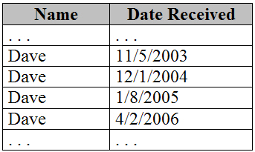
Handling Duplicates
Issue arises during the merge step – if element in left half equals element in right half, insert element in left half first
Stability
If you first sort by date (name secondary), then later by name (date secondary), you want dates related to a single name to remain sorted.
Merge Sort

Slide 36
Handling Duplicates (cont)
Definition. Suppose
S = <(k₀,e₀), (k₁,e₁),…,(k_{n},e_{n})>
is a list of pairs with keys k₀, k₁, …, k_{n}. A sorting algorithm is stable if, whenever it is the case that (k_{i}, e_{i}) precedes (k_{j}, e_{j}) before sorting (so that i < j) and k_{i} = k_{j}, then it continues to be true after sorting by keys that the pair (k_{i}, e_{i}) precedes (k_{j}, e_{j})
Stable sorting does not change
the order of duplicates
Merge Sort
Notes:
Relative order of occurrence of item set remains same.
Merge Sort

Slide 37
Stability of Sorting Algorithms
MergeSort is stable because of our strategy for handling duplicates during Merge
Merge Sort

Slide 38
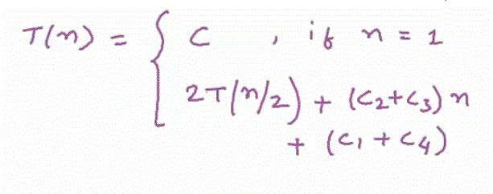
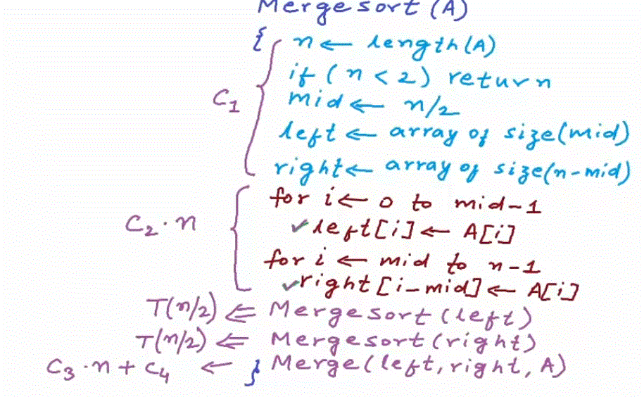
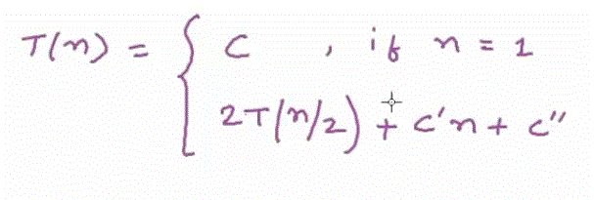
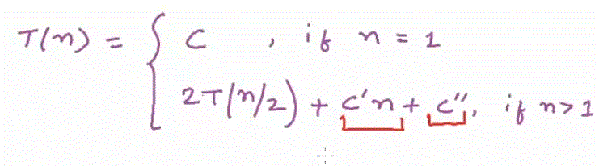
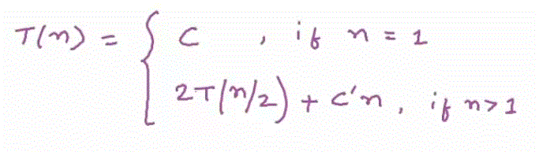
Time Complexity of Merge Sort
Merge Sort
Notes:
For C1 it represents the simple statements which do not involve any recursion or iterations
For C2 it simply assigns the items to arrays depend on size of array usually called n (Two loops in total will be going run n times)
If we saying T(n) is time cost for array of n, for two recursive calls it will be T(n/2) each
For merge function it will be C3.n+C4
C is some value of n which is base value/condition for algorithm
As we are interested in rate of growth of function for very high value on n so C” can be negligible here
Merge Sort

Slide 39
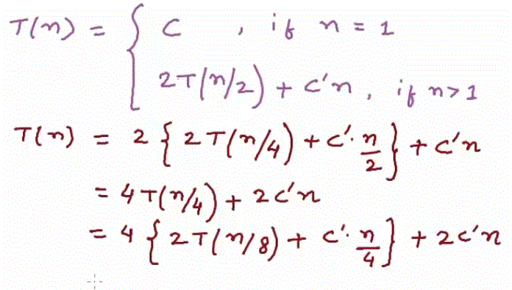
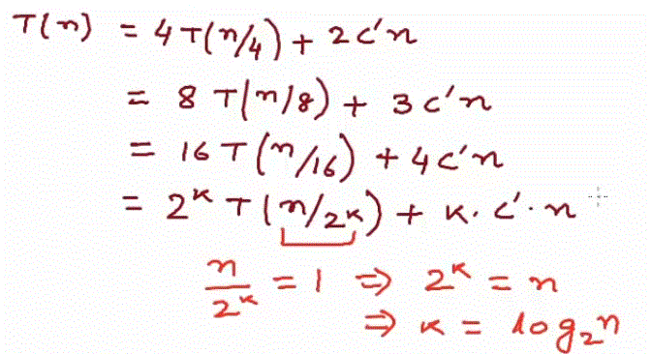
Time Complexity of Merge Sort
Merge Sort
Notes:
Merge Sort

Slide 40
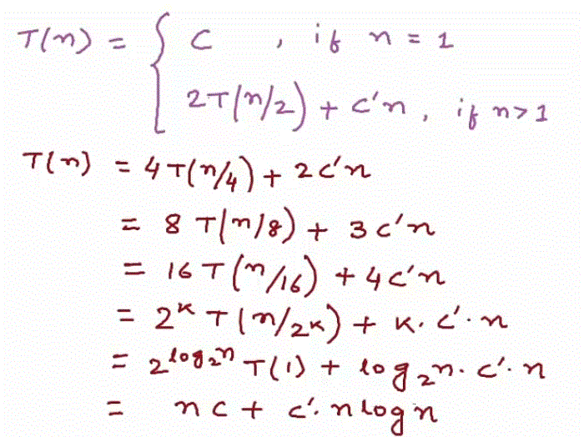
Time Complexity of Merge Sort
Merge Sort
Notes:
For very high value of n, we can neglect nc and c’
So we can represent T(n) =O (n log n)
Merge Sort

Slide 41
Main Point
Stability of a sorting algorithm requires maintenance of nonchange in the midst of change. This is an example in the world of sorting routines of the inner dynamics of outward success, as described in SCI: The more the inner quality of awareness remains established in silence, the more outer dynamism is supported for success and fulfillment.
Merge Sort

Slide 42
CONNECTING THE PARTS OF KNOWLEDGE
WITH THE WHOLENESS OF KNOWLEDGE
Merge Sort
1. Inversion-bound sorting algorithms typically examine each successive element in the input array and perform a further step to place this element in an already sorted area. The style of sorting involves a sequential unfoldment.
2. MergeSort proceeds by repeatedly collapsing the wholeness of the current input array into parts and then synthesizing the parts into a sorted whole. This approach yields a much faster sorting algorithm.
3. Transcendental Consciousness is the field of infinite correlation, where “an impulse anywhere is an impulse everywhere,” a field of “frictionless flow”.
4. Impulses within the Transcendental field. Established in the transcendental field, action reaches fulfillment with minimum effort. Yoga is “skill in action” – efficiency in action, “doing less, accomplishing more”, whereby little needs to be done to accomplish great goals.
5. Wholeness moving within itself. In Unity Consciousness, the field of action effortlessly unfolds as the play of one’s own Self, one’s own pure consciouness.
Merge Sort

