Slide 1
Lesson 5
QuickSort and QuickSelect: Enlivening Hidden Laws of Nature to Manage Change
Wholeness of the Lesson
Quick Sort, another Divide and Conquer sorting algorithm, typically sorts lists even faster than Merge Sort. QuickSort achieves even greater sorting efficiency by replacing the cruder merge step of MergeSort, which requires repeated access to temporary storage, with a subtler pre-processing partition step, which eliminates the need for temporary storage. This technique illustrates the principle that subtler levels of the mind and of the universe are more powerful; when these can be harnessed, more can be accomplished.
7 4 9 6 2 → 2 4 6 7 9
4 2 → 2 4
7 9 → 7 9
2 → 2
9 → 9
Quick-Sort
Notes:
Quick-Sort

Slide 2
Quick-Sort
Quick-sort is a sorting algorithm based on the divide-and-conquer paradigm. Consider first a randomized version:
  Divide: (Partition) pick a random element x (called pivot) and partition S into
    |L| elements less than x
    |E| elements equal x
    |G| elements greater than x
  Conquer: Sort L and G
  Combine: Join L, E and G
x
x
L
G
E
x
Quick-Sort

Slide 3
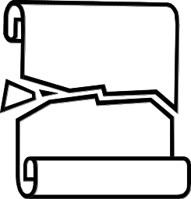
Partition
We partition an input sequence as follows:
  We remove, in turn, each element y from S and
  We insert y into L, E or G, depending on the result of the comparison with the pivot x
Each insertion and removal is at the beginning or at the end of a sequence. For a structure like a linked list, this takes
O(1) time, and so partition step takes O(n) time.
With a slight variation, the partition step for arrays is also O(n).
Algorithm partition(S, p)
Input sequence S, position p of pivot
Output subsequences L, E, G of the
elements of S less than, equal to,
or greater than the pivot, resp.
L, E, G ← empty sequences
  x ← S.removeElementAt(p)
  while !S.isEmpty()
  y ← S.removeFirst()
  if y < x
  L.insertLast(y)
  else if y = x
  E.insertLast(y)
  else { y > x }
  G.insertLast(y)
  return L, E, G
Quick-Sort

Slide 4
QuickSort in Pseudo-Code
Algorithm quickSort(S)
Input sequence S
Output S in sorted order
if(|S|=0 or |S|=1) then return S
p ← pickPivot()
(L,E,G) ← partition(S,p)
quickSort(L)
quickSort(G)
return L U E U G
Quick-Sort

Slide 5
Correctness of QuickSort
Valid Recursion: In each recursive call, input size is reduced by at least 1 element
Correct Base Case: When |S| = 0 or 1, S is correctly returned since it’s already sorted.
Correct In General: Observe that after the partition step, elements in L are to the left of elements in E and elements in E are to the left of elements in G
Assuming L and G have been sorted, the return value L U E U G is also correctly sorted.
Quick-Sort

Slide 6
Quick-Sort Tree
We can represent execution of quick-sort using a binary tree
  Each node represents a recursive call of quick-sort and stores
    Unsorted sequence before the execution and its pivot
    Sorted sequence at the end of the execution
  The root is the initial call
  The leaves are calls on subsequences of size 0 or 1
7 4 9 6 2 → 2 4 6 7 9
4 2 → 2 4
7 9 → 7 9
2 → 2
9 → 9
Quick-Sort

Slide 7
Execution Example
Pivot selection
7 2 9 4 3 7 6 1 → 1 2 3 4 6 7 8 9
7 2 9 4 → 2 4 7 9
3 8 6 1 → 1 3 8 6
2 → 2
9 4 → 4 9
3 → 3
8 → 8
9 → 9
4 → 4
Quick-Sort

Slide 8
Execution Example (cont.)
Partition, recursive call, pivot selection
7 2 9 4 3 7 6 1 → 1 2 3 4 6 7 8 9
2 4 3 1 → 2 4 7 9
3 8 6 1 → 1 3 8 6
2 → 2
9 4 → 4 9
3 → 3
8 → 8
9 → 9
4 → 4
Quick-Sort

Slide 9
Execution Example (cont.)
Partition, recursive call, base case
7 2 9 4 3 7 6 1 → → 1 2 3 4 6 7 8 9
2 4 3 1 →→ 2 4 7
3 8 6 1 → 1 3 8 6
1 → 1
9 4 → 4 9
3 → 3
8 → 8
9 → 9
4 → 4
Quick-Sort

Slide 10
Execution Example (cont.)
Recursive call, …, base case, join
7 2 9 4 3 7 6 1 → 1 2 3 4 6 7 8 9
2 4 3 1 → 1 2 3 4
3 8 6 1 → 1 3 8 6
1 → 1
4 3 → 3 4
3 → 3
8 → 8
9 → 9
4 → 4
Quick-Sort

Slide 11
Execution Example (cont.)
Recursive call, pivot selection
7 2 9 4 3 7 6 1 → 1 2 3 4 6 7 8 9
2 4 3 1 → 1 2 3 4
7 9 7 1 → 1 3 8 6
1 → 1
4 3 → 3 4
8 → 8
9 → 9
9 → 9
4 → 4
Quick-Sort

Slide 12
Execution Example (cont.)
Partition, …, recursive call, base case
7 2 9 4 3 7 6 1 → 1 2 3 4 6 7 8 9
2 4 3 1 → 1 2 3 4
7 9 7 1 → 1 3 8 6
1 → 1
4 3 → 3 4
8 → 8
9 → 9
9 → 9
4 → 4
Quick-Sort

Slide 13
Execution Example (cont.)
Join, join
7 2 9 4 3 7 6 1 → 1 2 3 4 6 7 7 9
2 4 3 1 → 1 2 3 4
7 9 7 → 17 7 9
1 → 1
4 3 → 3 4
8 → 8
9 → 9
9 → 9
4 → 4
Quick-Sort

Slide 14
Worst-case Running Time
The worst case for quick-sort occurs when the pivot selected is always the unique minimum (or maximum) element
In that case, one of L and G has size n − 1 and the other has size 0
The running time is proportional to the sum
n + (n − 1) + … + 2 + 1
Thus, the worst-case running time of quick-sort is Ω(n²)
depth | time
0 | n
1 | n − 1
… | …
n − 1 | 1
…
Quick-Sort

Slide 15
Expected Running Time
Consider a recursive call of quick-sort on an array of size n
  Good recursive call: the sizes of L and G are each less than 3n/4 (normal division)
  Bad recursive call: one of L and G has size greater than or equal to 3n/4
A recursive call is good with probability at least 1/2 [NOTE: alg is randomized]
  At least 1/2 of the possible pivots cause good recursive calls :
7 2 9 4 3 7 6 1 9
7 2 9 4 3 7 6 1
2 4 3 1
7 9 7 1 → 1
1
7 9 4 3 7 6
Good call
Bad call
1 2 3 4 5 6 7 8 9 10 11 12 13 14 15 16
Bad pivots
Good pivots
Bad pivots
Quick-Sort

Slide 16
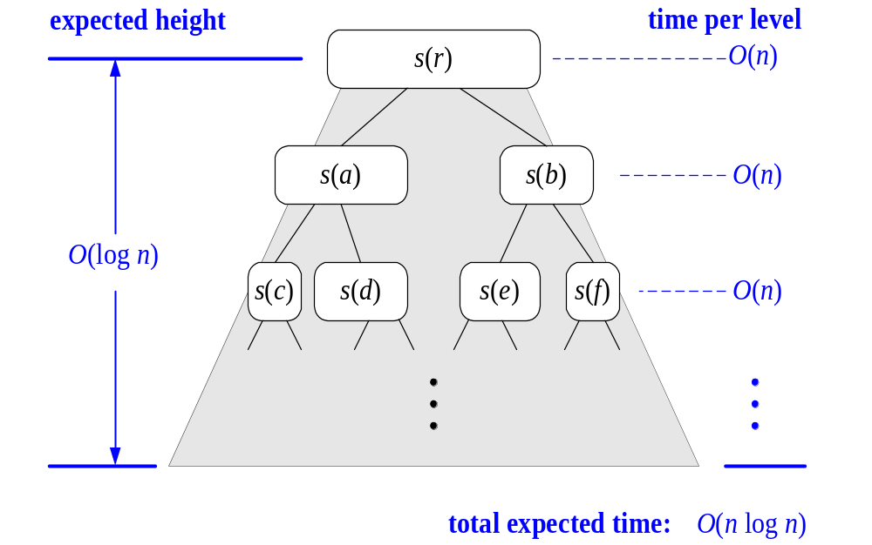
The “Good Case” Analysis
A good case occurs if every recursive call is good
The number of levels of recursion tree is equal to the length of the descending sequence
n, (3/4)n, (3/4)²n, . . ., 1, 0. By earlier observation, this length is ≤ 1 + log_{4/3}n, which is O(log n)
At each level of the recursion tree, total processing time is O(n)
Therefore, total running time in the good case is O(nlog n)
Note: For this analysis, we assume that the time it takes to locate the pivot is O(1) [for an array, this is realistic, but not for a linked list]
Quick-Sort

Slide 17
General Average Case Analysis
Good recursive calls don’t occur every time – but we know probability of a good recursive call is ½.
If all recursive calls are good, the number of levels in the tree is
m = 1+⎣log_{4/3}n⎦ (and the height is ⎣log_{4/3}n⎦). This implies that in general, recursion ends after m nested good recursive calls.
The expected number of levels in the recursion tree is the expected number of nested recursive calls required to obtain m good recursive calls
“What is expected number of levels to get m nested recursive calls?” is like “What is expected number of flips to get m heads?” In both cases, answer is 2m. In our case, m is O(log n), so 2m is also
O(log n).
Therefore, in the recursion tree, since there are O(n) processing steps at each level, and since expected number of levels is O(log n), we conclude that average case running time is O(nlog n).
Quick-Sort

Slide 18
Overview Of Avg Case Analysis
n
<3n/4
<3n/4
< 9n/16
< 9n/16
Any branch of recursive calls in which each successive recursive call cuts input size by a factor of <¾ each time must have height log_{b} n where b = 4/3. Call a recursive call that cuts input size by a factor of <¾ a “good recursive call”
Think of “success” as “a good recursive call occurs”. Probability of “success” is at least ½
Let m = 1+log_{b} n. On any path from root to leaf, expected number of recursive calls to get m good recursive calls is like expected number E of coin flips to get m heads:
E = 2m, and 2m is O(log n). Such a path will therefore visit one node in each level. Therefore, expected number of levels in the recursion tree is O(log n).
Running time at each level is O(n) => average case running time is O(nlog n).
Quick-Sort

Slide 19
Main Point
In average case analysis of QuickSort, it is observed that the actual number of recursive calls required to complete sorting does not deviate much from the number of good recursive calls that occur in the process. In a sense, the good recursive calls cause the process as a whole to unfold as efficiently as possible, and the fact that they occur so frequently follows from laws governing random behavior. In a similar way, when the home of natural law is enlivened in individual awareness, Maharishi explains that it is “more difficult to make mistakes” – life is spontaneously lived in a way that does not create harm or problems.
Quick-Sort

Slide 20

An Implementation:
In-Place QuickSort
Quick-sort usually implemented to run in-place
In the partition step, we use swap operations to rearrange the elements of the input sequence so that the current subarray has elements less than or equal to the pivot on the left side, and elements greater than or equal to pivot on right side.
Duplicates of the pivot end up being evenly distributed on either side of the pivot
This refinement slightly improves the algorithm described earlier, but makes average case analysis a bit more complicated in the case in which there are duplicates
Algorithm inPlaceQuickSort(S, l, r)
Input array S, positions l and r
Output array S with the
elements from positions l to r
rearranged in increasing order
if l > r
  return
  k ← a random integer between l and r
  swap(k,r) //place pivot at the right
  x ← S.elemAtPos(r) //the pivot
  i ← inPlacePartition(x) //new pos of piv
  swap(r,i) //place pivot in proper location
  inPlaceQuickSort(S, l, i − 1)
  inPlaceQuickSort(S, i + 1, r)
Quick-Sort

Slide 21
In-Place Partitioning
1. Move pivot to the far right (pos = r)
2. Begin with pointers i, j with i at pos l and j at pos r – 1 (for readability, we let l = 0 in this discussion).
3. Move i to the right past all values < pivot
4. Move j to the left past all values > pivot
5. If stuck (neither i nor j can move further), then swap the values at i, j, and repeat 3, 4, allowing i to move one to the right and j to the left
6. After this step, if j has crossed i (moved to the left of i), or i has crossed j (moved to the right of j), then stop
7. After stopping, swap positions of pivot and value at position i.
Quick-Sort

Slide 22


Partition Example
Randomly (or via median of 3) pick pivot -- say it's 6. Swap with rightmost element.
i now moves right as long as it points to values < 6
Quick-Sort

Slide 23


Partition Example continued
i is stuck at 8. Now j moves to the left as long as it points to a number > 6
j is now stuck at 2; since i is also stuck, swap 2 and 8. Increment i and decrement j.
Quick-Sort

Slide 24

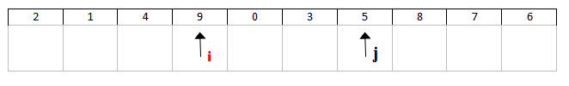
Partition Example continued
Now i moves to the right as long as value is < 6
i is now stuck at 9 and j is stuck at 5
Quick-Sort

Slide 25


Partition Example continued
Since i and j are stuck, swap 5 and 9, increment i, decrement j
Quick-Sort

Slide 26
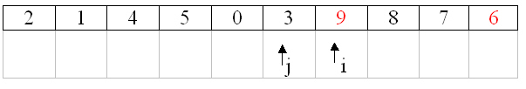

Partition Example continued
i moves to the right as long as value < 6
i is now stuck at 9 and j is stuck at 3. Since i crossed j, the process stops, and 9, 6 are swapped to place pivot in final position
Quick-Sort

Slide 27
Partition Example continued
Now elements < pivot 6 are to the left of 6 and elements > pivot 6 are to the right of 6
----------------------------------------------------------
Note: in case both i and j encounter values equal to the pivot, after a swap, they will still be pointing to a value equal to a pivot. For this reason, the rule says: "After a swap, i is automatically moved ahead 1 step and j is moved back"
Quick-Sort

Slide 28
Handling Duplicates And Non-Stability of QuickSort
In the partition algorithm, if the left pointer encounters a value equal to the pivot, it halts; and the right pointer behaves in the same way. This strategy has the effect of evenly distributing duplicates into the left and right halves of the partition.
Quick-Sort

Slide 29
(continued)
However, this strategy also makes QuickSort a non-stable sorting algorithm.
Example: Consider sorting by numeric key the following sequence: (1,a), (1,b), (1,c), (1,d). Assume the pivot always happens to be value at the far right. Using the algorithm, one discovers that after the first partition step, the array looks like this:
[(1,c), (1,b) | (1,d) | (1,a)]
For the rest of the sort, (1,a) will always remain to the right of (1,b) and (1,c). Therefore, positions of duplicates are modified by QuickSort. Therefore, QuickSort it is not stable.
Quick-Sort

Slide 30
Other Choices of Pivot
Choosing pivot at random. Usually a good choice. Repeated calls to random number generator could slow it down a little.
Choosing first or last element as pivot. This is a dangerous approach: using first element as pivot when data is already sorted leads to worst case. If data is known to be random (or is randomized), this is a good choice.
Median of Three. Many consider this the best alternative. If i = lower pos, u = upper pos, pick the median of elements at positions i, u, and └(i+u)/2┘ .
Quick-Sort

Slide 31

Example of Median of Three
Input Array a
Position └(9+0)/2┘ is position 4
a[0] = 8, a[4] = 6, a[9] = 3
=> median of 8,6,3 is 6
Therefore, for this call of the function, use 6 as the
pivot
Quick-Sort

Slide 32
Implementing QuickSort
Sentinels. The partitioning algorithm can lead to array accesses to the left of 0th element, and to the right of the last element. (Example: Start with A = [1,2,3,4] and assume pivot is 1. Then pointer j moves to the left of leftmost element.) A convenient way to avoid ArrayIndexOutOfBoundsExceptions is to insert the input array of length n into an auxiliary array of length n+2, where position 0 contains absolute min value and position n+1 contains absolute max value. When sorting is complete, extract elements at positions 1..n and return.
Small elements. As in MergeSort, QuickSort is often implemented so that whenever the input to a recursive call involves only a small number of elements (say 20 or fewer), the work of sorting is handed off to an InsertionSort routine
Demo. An implementation of QuickSort has been provided for you.
Quick-Sort

Slide 33
Likelihood of Worst Case
Using a probabilistic technique, one can show that the average-case O(nlog n) running time of QuickSort is extremely likely to occur. Precisely:
The probability that QuickSort, running on an array of length n, has a worst-case running time is < 1/n².
Quick-Sort

Slide 34
Comparison With MergeSort
MergeSort’s O(nlog n) worst-case running time makes it reliable, but in practice QuickSort is faster
Reason for QuickSort’s faster speed: MergeSort makes many copies of portions of array, increasing overhead.
Perspective on QuickSort’s worst-case: In order for the expected number of worst case runs of QuickSort to be 1, in sorting arrays of length 1 million, one would need to perform 1 trillion trials.
MergeSort’s style of writing to memory can be adapted to efficiently handle extremely large sorting jobs, where all data cannot fit into memory (so repeated disk reads are necessary)
Quick-Sort

Slide 35
Summary of Sorting Algorithms
Algorithm | Time | Notes
selection-sort | Θ(n²) | in-place slow (good for small inputs)
insertion-sort | Θ(n²) | in-place slow (good for small inputs)
bubble-sort | Θ(n²) | should never be used
quick-sort | O(n log n) expected | in-place, randomized fastest (good for large inputs) but… not stable
merge-sort | O(n log n) | in-place, stable fast (good for huge inputs)
Quick-Sort

Slide 36

The Selection Problem
Given an integer k and n elements x₁, x₂, …, x_{n}, taken from a total order, find the k-th smallest element in this set.
Of course, we can sort the set in O(n log n) time and then index the k-th element.
Can we solve the selection problem faster?
k=3
7 4 9 6 2 → 2 4 6 7 9
Quick-Sort

Slide 37
Quick-Select
Quick-select is a randomized selection algorithm for finding the kth smallest element in a list:
  Pick Pivot: pick a random element x (called pivot) and partition S into
    L - elements less than x
    E - elements equal x
    G - elements greater than x
  Search: depending on k, either answer is in E, or we need to recurse in either L or G
x
x
L
G
E
k < |L|
k > |L|+|E|
k’ = k - |L| - |E|
|L| < k < |L|+|E|
(done)
Quick-Sort

Slide 38
QuickSelect Pseudo-Code
Algorithm QuickSelect(S,k)
Input sequence S, rank k
Output kth smallest element of S
p ← pickPivot()
(L,E,G) ← partition(S,p)
if |L| < k ≤ |L| + |E| then
return any element of E
else if k ≤ |L| then
return QuickSelect(L, k)
else {k > |L| + |E|}
return QuickSelect(G, k – |L| – |E|)
Quick-Sort

Slide 39
Partition – same as QuickSort
We partition an input sequence as in the quick-sort algorithm:
  We remove, in turn, each element y from S and
  We insert y into L, E or G, depending on the result of the comparison with the pivot x
Each insertion and removal is at the beginning or at the end of a sequence, and hence takes O(1) time
Thus, the partition step of quick-select takes O(n) time
As before, an in-place version can be formulated, and arrays can be used.
Algorithm partition(S, p)
Input sequence S, position p of pivot
Output subsequences L, E, G of the
elements of S less than, equal to,
or greater than the pivot, resp.
L, E, G ← empty sequences
  x ← S.elementAt(p)
  while ¬S.isEmpty()
  y ← S.remove(S.first())
  if y < x
  L.insertLast(y)
  else if y = x
  E.insertLast(y)
  else { y > x }
  G.insertLast(y)
  return L, E, G
Quick-Sort

Slide 40
Quick-Select Visualization
An execution of quick-select can be visualized by a recursion path
  Each node represents a recursive call of quick-select, and stores k and the remaining sequence
k=5, S=(7 4 9 3 2 6 5 1 8)
k=2, S=(7 4 9 6 5 8)
k=2, S=(7 4 6 5)
k=1, S=(7 6 5)
5
Quick-Sort

Slide 41
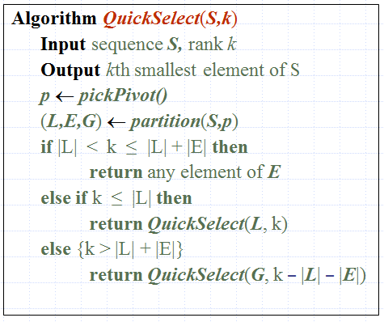
QuickSelect Example
Problem: Find the 5th smallest element in the array
[2,5,6,8,3,7,1,1,14]
We use QuickSelect with random pivots.
Quick-Sort

Slide 42
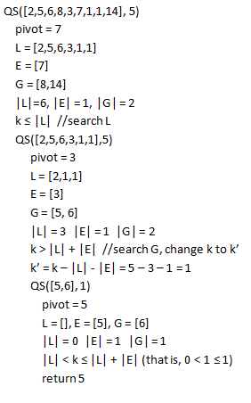
QuickSelect Example
Problem: Find the 5th smallest element in the array
[2,5,6,8,3,7,1,1,14]
We use QuickSelect with random pivots.
Quick-Sort

Slide 43
Worst-case Running Time
A worst case for QuickSelect occurs when the input array is sorted, k = 1, and the pivot is always chosen to be the rightmost element
In this case, the subsequence L always has size just one less than previous input and so T(n) is proportional to
1 + 2 + 3 + … + n
which is Θ(n²)
FACT: There is a variation of QuickSelect that runs in O(n) in the worst case, but the constants prevent the algorithm from being efficient in practice
Quick-Sort

Slide 44
Expected Running Time
Consider a recursive call of quick-select on a sequence of size s
  Good recursive call: the sizes of L and G are each less than 3s/4
  Bad recursive call: one of L and G has size greater than or equal to 3s/4
A call is good with probability 1/2
  1/2 of the possible pivots cause good calls:
7 2 9 4 3 7 6 1 9
7 2 9 4 3 7 6 1
2 4 3 1
7 9 7 1 → 1
1
7 9 4 3 7 6
Good call
Bad call
1 2 3 4 5 6 7 8 9 10 11 12 13 14 15 16
Bad pivots
Good pivots
Bad pivots
Quick-Sort

Slide 45
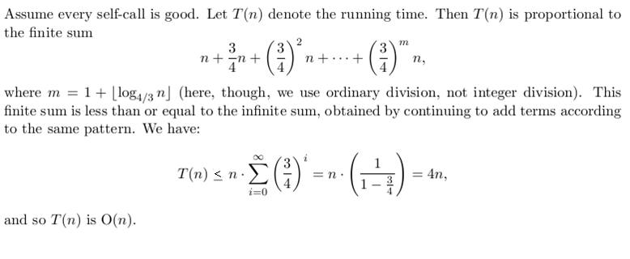
Good Case Analysis
Quick-Sort

Slide 46
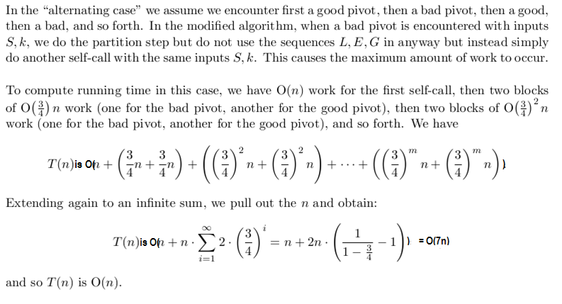
Alternating Analysis of QuickSelect
Algorithm ModifiedQuickSelect(S, k)
Input sequence S, rank k
Output kth smallest element of S
p ← pickPivot()
if p is a good pivot then //count as O(1)
(L, E, G) ← partition(S, p)
  if |L| < k ≤ |L| + |E| then
  return any element of E
  else if k ≤ |L| then
  return QuickSelect(L, k)
  else {k > |L| + |E|}
  return QuickSelect(G, k – |L| – |E|)
else {p is a bad pivot} //treat as wasted call
(L, E, G) ← partition(S, p)
  if |L| < k ≤ |L| + |E| then
  return any element of E
  else if k ≤ |L| then
  return QuickSelect(S, k)
  else {k > |L| + |E|}
  return QuickSelect(S, k)

Slide 47
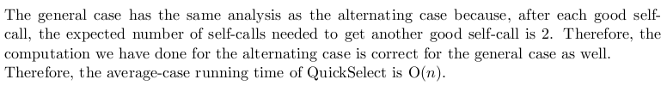
General Average-Case Analysis of QuickSelect
Quick-Sort

Slide 48
Alternative Analysis of QuickSelect
Good-case Analysis - All pivots are good.
T (n ) ≤ O(n) + T (3n /4)
Alternating Case - Alternate Bad pivots with Good pivots as in ModifiedQuickSelect.
T (n ) ≤ O(n) + O(n) + T (3n /4)
Alternating case accurately represents average case because expected number of recursive calls to get a good recursive call is 2.
Therefore:
T (n ) ≤ T (3n /4) + cn
Using Master Formula: a=1, b=4/3, c=c, k=1, b^{k}=4/3 yields
T (n ) is O(n ) in the average case.
Algorithm ModifiedQuickSelect(S, k)
Input sequence S, rank k
Output kth smallest element of S
p ← pickPivot()
if p is a good pivot then //count as O(1)
(L, E, G) ← partition(S, p)
  if |L| < k ≤ |L| + |E| then
  return any element of E
  else if k ≤ |L| then
  return QuickSelect(L, k)
  else {k > |L| + |E|}
  return QuickSelect(G, k – |L| – |E|)
else {p is a bad pivot} //treat as wasted call
(L, E, G) ← partition(S, p)
  if |L| < k ≤ |L| + |E| then
  return any element of E
  else if k ≤ |L| then
  return QuickSelect(S, k)
  else {k > |L| + |E|}
  return QuickSelect(S, k)

Slide 49
Connecting the Parts of Knowledge With the Wholeness of Knowledge
The naïve algorithm for finding the kth smallest element in a sequence of n elements requires Ω(n²) steps. A clever alternative is to sort the sequence first and then return the value at position k. This approach runs in Ω(nlog n)
Using a Divide and Conquer strategy, QuickSelect locates the kth smallest element in O(n) steps, on average.
Quick-Sort

Slide 50
3.Transcendental Consciousness is the field of all possibilities and the home of all knowledge. Contact with this field brings insight into new possibilities and opens awareness to expanded knowledge.
4.Impulses Within The Transcendental Field. The unmanifest foundation of the observable world is the lively recursive interaction within pure consciousness. Within this field, creation emerges in the collapse of unboundedness to a point, and expansion from point to infinity, with infinite frequency.
5. Wholeness Moving Within Itself. In Unity Consciousness, the unmanifest dynamics at the source of creation are appreciated as impulses of one’s own being.
Quick-Sort

