Slide 1
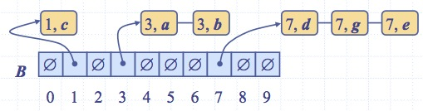
Lesson 6
Lower Bound on Comparison-Based Algorithms: Discovering the Range of Natural Law
Wholeness of the Lesson
Using the technique of decision trees, one establishes the following lower bound on comparison-based sorting algorithms: Every comparison-based sorting algorithm has at least one worst case for which running time is Ω(n log n). Bucket Sort and its relatives, under suitable conditions, run in linear time in the worst case, but are not comparison-based algorithms. Each level of existence has its own laws of nature. The laws of nature that operate at one level of existence may not apply to other levels of existence.
Bucket-Sort and Radix-Sort
Notes:
Radish-Sort

Slide 2
A Lower Bound on Comparison-Based Sorting Algorithms
All sorting algorithms discussed so far have used comparison as a central operation
So far, all sorting algorithms discussed have a worst-case running time of Ω(nlog n)
Using the technique of decision trees we can show that nlog n is the best that can be done for comparison-based sorting algorithms
Bucket-Sort and Radix-Sort

Slide 3
Sample Decision Tree
Every comparison-based sorting algorithm, applied to a given array, can be represented by a decision tree
To illustrate the technique, we use a simple but typical example: sorting a 3-element array of distinct values a,b,c.
Bucket-Sort and Radix-Sort

Slide 4
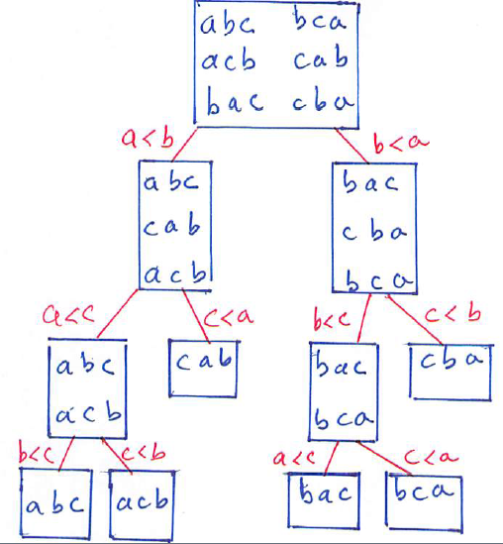
Decision Tree for Sorting 3 Elements
Bucket-Sort and Radix-Sort

Slide 5
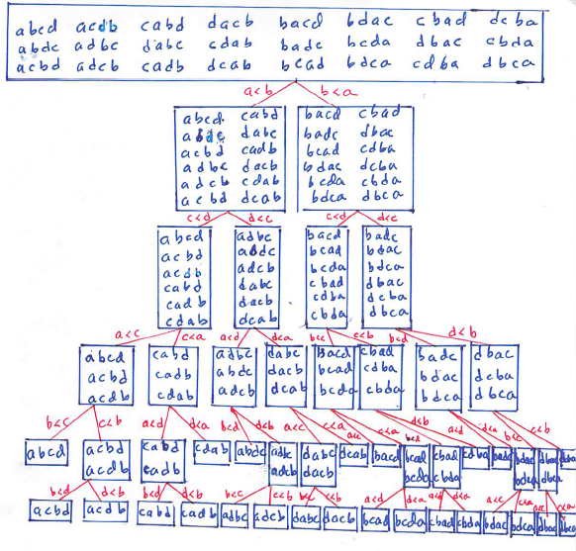
Decision Tree for Merge Sort on 4 Elements
Bucket-Sort and Radix-Sort

Slide 6
Anatomy of the Decision Tree
Each node of the tree represents all possible sorting outcomes that have not been eliminated by the comparisons done so far.
The labels on the links of the tree represent comparison steps as the algorithm runs. Different algorithms will perform some of the comparison steps in a different sequence.
A leaf in the decision tree represents a possible sorting outcome. The different paths to the leaves represent all possible ways three (or four in the MergeSort example) distinct items could be put in sorted order; therefore, the leaves represent all possible arrangements of three (or four) distinct elements.
Bucket-Sort and Radix-Sort

Slide 7
Strategy for Computing # Comparisons
Observation: The number of comparisons performed in order to arrive at an arrangement found in a leaf node equals the depth of that leaf node in the decision tree.
Therefore, to count # comparisons performed in the worst case, we determine the depth of the deepest node in the decision tree
Bucket-Sort and Radix-Sort
Notes:
Radish-Sort

Slide 8
Mathematical Observations
Suppose T is a binary tree with L leaves and height h.
Lemma 1. L ≤ 2^{h}. In particular, if d is the depth of the deepest leaf in a binary tree T, then T has at most 2^{d} leaves.
Use Lemma 1 to prove the next important fact:
Lemma 2. h ≥ ┌ log L┐. In particular, a binary tree T with L leaves has a leaf with depth d at least ┌log L┐.
Lemma 3. A decision tree T representing a comparison-based sorting algorithm for an n-element array has n! leaves. [Proof: Follows because leaves represent all possible permutations of the n elements of the array]
Bucket-Sort and Radix-Sort

Slide 9
Establishing the Lower Bound
Summary: Suppose we have a decision tree T for a sorting algorithm running on input of size n. Then T has n! leaves. So the height of T is at least ┌ log n!┐ so some leaf in T has depth at least ┌ log n!┐. Therefore, in the worst case, at least ┌ log n!┐ comparisons are performed, so running time is Ω(log n!). We determine the complexity class of log n!
Bucket-Sort and Radix-Sort

Slide 10
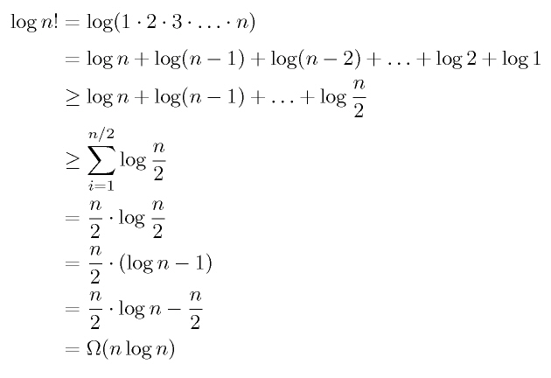
The Computation of log n!
Bucket-Sort and Radix-Sort

Slide 11
Proof of Lemma 1
Lemma 1. If the height of T is h and L is the number of leaves, then L ≤ 2^{h} .
A binary tree is completely filled if every nonempty level has the maximum possible size. In particular:
  every node that has a child has two children, AND
  for any k, if a node at level k has a child, then every node at level k has a child
Fact: Every completely filled binary tree of height h has 2^{h} leaves. (Proof by induction on height h.)
Proof of Lemma 1. Depth d of deepest leaf in T is the height of T. The completely filled binary tree of height d has 2^{d} leaves. Therefore, T must have ≤ 2^{d} leaves.
Bucket-Sort and Radix-Sort

Slide 12
Proof of Lemma 2
Lemma 2. A binary tree T with L leaves and height h satisfies h ≥ log L; in particular, h ≥┌log L┐
Proof: By Lemma 1, L ≤ 2^{h}. Applying log on both sides (recalling log is increasing) yields the first result. Since h is an integer, the second part also follows.
Bucket-Sort and Radix-Sort

Slide 13
Specialized Sorting: Bucket Sort
The Context: Suppose we have an array A of n distinct integers a₁, a₂, …, a_{n}, all lying in the range 0..m-1.
Sorting strategy:
  1. Create an array bucket[] of size m, entries initialized to 0. Create an output array B of size n
  2. Scan A. When a_{i} is encountered, increment the value
  bucket a_{i}
  3. Scan bucket[]. For each j < m for which bucket[j] > 0, copy a_{j} into next available slot in B.
Bucket-Sort and Radix-Sort

Slide 14
Analysis of Bucket Sort
Step 1 requires O(m+n)
Step 2 requires O(n)
Step 3 requires O(m)
** Therefore, BucketSort runs in O(m+n). When m is O(n),
BucketSort runs in O(n)
Example: When m is O(n), BucketSort runs in O(n). Example: Sort 1000 integers all lying in the range 0..1999.
Handling Duplicates (simple case): Same algorithm, except in loading array B at the end, if bucket[j] = k, insert k copies of a_{j} into B.
Bucket-Sort and Radix-Sort

Slide 15

Stability of Bucket-Sort
Given n integers a₁, a₂, …, a_{n} in the range [0, m-1], possibly with duplicates, and n matched objects o₁, o₂, …, o_{n}. We sort array A whose elements are pairs (a₁,o₁), (a₂,o₂),…,(a_{n},o_{n}).
To handle duplicates in this case, array bucket[] now consist of m lists rather than integers. Output array B will consist of pairs (a,o).
  Phase 1: Scan A. When (a_{i},o_{i}) is encountered, copy it to the end of the list in bucket B[a_{i}]
  Phase 2: For j = 0, …, m − 1, copy the items of bucket bucket[j] to the end of sequence B.
As before, running time is O(n+m). Notice the algorithm is stable because we always add newly scanned pairs to end of the list in the appropriate bucket
Algorithm bucketSort(A, m)
Input array A of (key, element)
items with keys in the range
[0, m − 1]
Output array B sorted by
increasing keys
bucket ← array of N empty lists
  for i ← 0 to n − 1
  (k, o) ← A[i]
  bucket[k].insertLast((k, o))
  for j ← 0 to m − 1
  while ¬bucket[j].isEmpty()
  (k, o) ← bucket[j].removeFirst()
  B.insertLast((k, o))
Bucket-Sort and Radix-Sort

Slide 16

Example
Key range [0, 9]
7, d
1, c
3, a
7, g
3, b
7, e
1, c
3, a
3, b
7, d
7, g
7, e
B
0
1
2
3
4
5
6
7
8
9
∅
∅
∅
∅
∅
∅
∅
1, c
3, a
3, b
7, d
7, g
7, e
Bucket-Sort and Radix-Sort

Slide 17

Expanding the Context
  Negative integers can be included if lower bound on these integers is known in advance. Similarly, integers in any range [a,b] can be sorted; worthwhile if b-a is
  O(n)
  If m is too big (i.e., not O(n)), BucketSort is not useful because scanning the bucket array is too costly
Bucket-Sort and Radix-Sort

Slide 18

Radix-Sort
Radix-sort is a generalization of BucketSort that uses multiple bucket arrays
Example: Sort 48, 1, 6, 23, 37, 19 ,21
BucketSort doesn’t work because range is too big – would run in
Ω(n²)
Bucket-Sort and Radix-Sort

Slide 19
Radix Sort Example
Strategy is to use 2 bucket arrays, each of size 7 (7 is the radix )
Based on observation that every k in [0,48] can be written:
k = 7q + r where 0 ≤ q < 7, 0 ≤ r < 7
Procedure:
  Pass #1: Scan initial array and place values in the “remainders” bucket r[] – put x in r[i] if x % 7 = i. (Need to assume bucket array consists of lists)
  Pass #2: Scan r[], reading from front of each list to back, and place values in the “quotients” bucket q[] – put x in q[i] if x/7 = i.
  Output: Scan q[], again reading lists front to back
Bucket-Sort and Radix-Sort

Slide 20
Radix Sort Example
Keys: 48 1 6 23 37 19 21
Key % 7
0 -> 21 1 -> 1 2 -> 23 -> 37
5 -> 19 6 -> 48 -> 6
Key / 7
0 -> 1 -> 6 2 -> 19 3 -> 21 -> 23
5 -> 37 6 -> 48
Sorted order
1 6 19 21 23 37 48
Bucket-Sort and Radix-Sort

Slide 21
Radix Sort Example
Keys: 48 = (6, 6) 1 = (0, 1) 6 = (0, 6) 23 = (3, 2)
37 = (5, 2) 19 = (2, 5) 21 = (3, 0) n = (s1, s0)
Primary Sort by s1
1 = (0, 1) 6 = (0, 6) 19 = (2, 5) 23 = (3, 2)
21 = (3, 0) 37 = (5, 2) 48 = (6, 6)
Secondary Sort by s0
1 = (0, 1) 6 = (0, 6) 19 = (2, 5) 21 = (3, 0)
23 = (3, 2) 37 = (5, 2) 48 = (6, 6)
Sorted order
1 6 19 21 23 37 48
Bucket-Sort and Radix-Sort

Slide 22
Analysis of RadixSort
Running time is O(d(n+m)) where
  d = # bucket arrays (in example d=2)
  n = size of initial array (example: 7)
  m = size of each bucket array (ex: 7)
RadixSort runs in O(n) whenever the number of bucket arrays is O(1), and size of each bucket array is O(n).
Bucket-Sort and Radix-Sort

Slide 23
Using 3 Bucket Arrays
Generalizing previous example, we observe that whenever k belongs to [0, 342] (note 342 = 7³ – 1), then we can write
k = 49q₁ + 7q₂ + r
where 0 ≤ q₁ < 7, 0 ≤ q₂ < 7, 0 ≤ r < 7.
Example: 340 = 49*6 + 7*6 + 4
Therefore to handle sorting approx 7 elements in the range [0, 342], create bucket arrays r[], q₁[], q₂[], and compute,for each x in input array, values x%7, (x/7)%7, x/49, respectively
Bucket-Sort and Radix-Sort

Slide 24
What Was That Lower Bound Again?
We established a lower bound of
Ω(nlog n) on comparison-based sorting algorithms. Do BucketSort and RadixSort disprove our earlier findings?
Resolution: Neither of these is comparison-based.
Bucket-Sort and Radix-Sort

Slide 25
Main Point
A decision-tree argument shows that comparison-based sorting algorithms can perform no better than Θ(nlog n). However, BucketSort is an example of a sorting algorithm that runs in O(n). This is possible only because BucketSort does not rely primarily on comparisons in order to perform sorting. This phenomenon illustrates two points from SCI. First, to solve a problem, often the best approach is to bring a new element to the situation (in this case, bucket arrays); this is the Principle of the Second Element. The second point is that different laws of nature are applicable at different levels of creation. Deeper levels are governed by more comprehensive and unified laws of nature.
Bucket-Sort and Radix-Sort

Slide 26
Connecting the Parts of Knowledge
With The Wholeness of Knowledge
Transcending The Lower Bound On Comparison-Based Algorithms
1. Comparison-based sorting algorithms can achieve a worst-case running time of Θ(n log n), but can do no better.
2. Under certain conditions on the input, Bucket Sort and Radix Sort can sort in
O(n) steps, even in the worst case. The n log n bound does not apply because these algorithms are not comparison-based.
3. Transcendental Consciousness is the field of all possibilities and of pure orderliness. Contact with this field brings to light new possibilities and leads to spontaneous orderliness in all aspects of life.
4. Impulses Within The Transcendental Field. The organizing power of pure knowledge is the lively expression of the Transcendent, giving rise to all expressions of intelligence.
5. Wholeness Moving Within Itself. In Unity Consciousness, the organizing dynamics at the source of creation are appreciated as an expression of one’s own Self.
Bucket-Sort and Radix-Sort

