Slide 1
Lesson 7
A Review of Data Structures:
Fully Developing the Container of Knowledge
Wholeness of the Lesson
An analysis of the average-case and worst-case running times of many familiar data structures (for instance, array lists, linked lists, stacks, queues, hashtables, binary search trees) highlights their strengths and potential weaknesses; clarifies which data structures should be used for different purposes; and points to aspects of their performance that could in principle be improved. Likewise, finer levels of intelligence are more expanded but at the same time more discriminating. For this reason, action that arises from a higher level of consciousness spontaneously computes the best path for success and fulfillment.
Data Structures
Notes:
Quick-Sort

Slide 2
Abstract Data Types
Definition: A set of objects together with a set of operations
Example: the Integer data type consists of a range of integers together with the operations of addition, multiplication, and many others
Data Structures

Slide 3
The LIST ADT
The set of objects is any ordered list A₁, A₂, …, A_{n}
Typical operations:
Other specialized operations are often considered, like findMin, findMax, contains.
Can be implemented in more than one way.
find(Object o) | returns position of first occurrence
findKth(int pos) | returns element based on index
insert(Object o, int pos) | inserts object into specified position
remove(Object o) | removes first occurrence of object
printList() | outputs all elements
makeEmpty() | empties the List
Data Structures

Slide 4
Array Implementation of LIST
In this implementation, an array is maintained internally in a List class and LIST operations are performed by internally carrying out array operations.
Advantage: Provides fastest (O(1)) implementation of findKth
Disadvantages:
insert and remove require copying an average of half the array elements (running time: O(n))
periodic array resizing may be necessary
Other running times:
makeEmpty, printList, find are all O(n)
Examples in Java: ArrayList and Vector are array-based implementations of LIST. Both implement the RandomAccess interface
Data Structures

Slide 5
Array Implementation of LIST
Disadvantages:
insert and remove require copying an average of half the array elements (running time: O(n))
Data Structures

Slide 6
LinkedList Implementation of LIST
The Need: Improve performance of insert, remove and avoid the cost of resizing incurred by the array implementation.
A LinkedList consists of Nodes. In addition to storing an Object, a Node contains a link to the next Node (which may be Null). In a doubly linked list, a Node also contains a reference to the previous node.
Data Structures

Slide 7
LinkedList Implementation of LIST
Operations
find requires traversing the Nodes via links, starting at the first Node.
insert requires traversing the Nodes to locate position and adjusting links
remove requires doing a find, and when the object is found, the previous object has to be located so that it can be linked to the next object
Data Structures

Slide 8
LinkedList Implementation of LIST
Running Times for LinkedList
find and findKth are O(n)
insert and remove are O(n), but are faster than in the array implementation because re-copying elements has been avoided
printList and makeEmpty are O(n)
Data Structures

Slide 9
When to use what
When the findKth operation is used more often than remove and insert, an array-based implementation is a good idea because it makes use of the random-access feature of the array.
If the main search operation requires iteration through the entire List, and insertions and/or deletions are frequent, a LinkedList is preferable since insertions/deletions are faster and the find operation is essentially the same for both implementations.
Data Structures

Slide 10
The STACK ADT
Definition: A STACK is a LIST in which insertions and deletions can occur relative to just one designated position (called the top of the stack).
Operations:
Pop | remove top of the stack (usually also returns this object)
Push | insert object as new top of stack
peek (or top) | view object at top of the stack without removing it
Data Structures

Slide 11
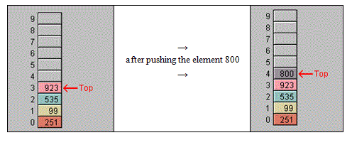
The STACK ADT
Model:
Running Times
All operations, under a reasonable implementation, run in constant time – that is, O(1).
Implementation
Stacks can be implemented using arrays (rightmost element is top) or linked lists.
Data Structures

Slide 12
Implementation of STACK in Java Libraries
The standard Java distribution comes with a Stack class, which is a subclass of Vector.
Vector is an array-based implementation of LIST. Therefore, for implementations that require many more pushes than pops, a stack based on a Linked List should be used.
Data Structures

Slide 13
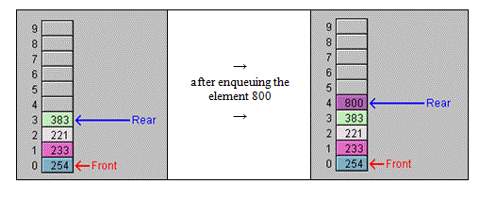
The QUEUE ADT
Model:
Data Structures

Slide 14
The QUEUE ADT
Definition. Like a STACK, a QUEUE is a specialized LIST in which insertions may occur only at a designated position (the back) and deletions may occur only at a designated position (the front).
Operations:
dequeue | remove the element at the front and return it
enqueue | insert object at the back
peek | view object at front of queue without removing it
Data Structures

Slide 15
The QUEUE ADT
Running Times
All operations, under a reasonable implementation, run in constant time.
Implementation of Queues
Queues can be implemented using an array or linked list. To avoid wasted space, in the array implementation, you can (using pointers) link last array slot to the first to provide a “circular array”.
Data Structures

Slide 16
MAIN POINTS
Array Lists provide O(1) performance for lookup by index because of random access provided by the background array, but perform insertions and deletions in Θ(n) time, with extra overhead because of the need to break the underlying array into pieces. Linked lists improve the performance of insertion and deletion steps to O(1), though locating the insertion point still requires Θ(n) time. On the other hand, linked lists, lacking random access, perform reads of all kinds in Θ(n) time. Stacks and queues achieve O(1) performance of their main operations, which involve either reading / removing the top element or inserting a new element either at the top or the end. Stacks and queues achieve their high level of efficiency by concentrating on a single point of input (top of stack or end of queue) and a single point of output (top of stack or front of queue).
Science of Consciousness: Wholeness contains within it diverse – even contradictory – values. These opposite values that are integrated within wholeness make wholeness a field of all possibilities. Experience of this wholeness value brings into our lives the ability to handle and make good use of opposite values.
Stacks and queues make use of the principle from Maharishi Vedic Science that the dynamism of creation arises in the concentration of dyamic intelligence to a point value ("collapse of infinity to a point”).
Data Structures

Slide 17
The HASHTABLE ADT
A Hashtable is a generalization of an array in which any object can be used as a key, not just just integers. A Hashtable has two main components - keys and values, and keys are used to look up corresponding values.
Operations:
get | returns the value to which the specified key is mapped, or null if this map contains no mapping for the key.
put | maps the specified key to the specified value in this hashtable.
remove | removes the key (and its corresponding value) from this hashtable.
Data Structures

Slide 18
Hashing Strategy
In a Hashtable, values lying in a large range are compressed into a (typically) much smaller range consisting of array indices.
This transformation is accomplished in two Steps:
  create a hashcode for each key – typically, this is a big integer
  create a hash value for each hashcode – the hash value is an index in the underlying table for the Hashtable.
Data Structures

Slide 19
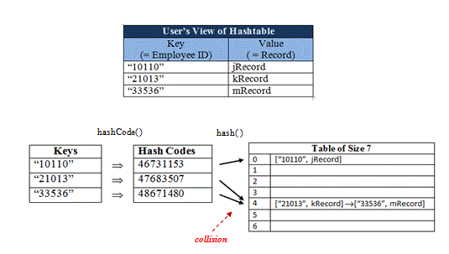
Hashing Strategy
Data Structures

Slide 20
Running Times for HashMap – The Worst Case
The worst case for a hashtable occurs when all keys are mapped to the same hash value – in that case, all values are stacked up (typically in a list) in a single slot. This results in Θ(n) performance for find, insert, and remove operations.
Example: Here, for typical hashtable implementations, all instances of WeakHashCode that are used as keys in a hashtable will be stacked up in slot #7 of the underlying hashtable table.
Data Structures

Slide 21
Handling Collisions
When the hash value function h maps two hashCodes to the same slot, we have a collision. When there are too many collisions, the hash table is said to be skewed. In the worst case, all hashCodes are mapped to the same slot. In order for hashtable operations to be O(1), collisions have to be handled well.
Separate Chaining. Separate chaining provides a way to handle collisions by placing in a list all key/value pairs for which the hash values associated with the key are equal:
Data Structures

Slide 22
Handling Collisions
Need for Mixing. To prevent the table from becoming skewed, keys need to be mapped to table slots so that each table slot stores approximately the same number of values as any other. This is achieved by “mixing up” data in the keys so that the possible array indices are all (approximately) equally likely to occur.
Data Structures

Slide 23
Summary on Hashtables
It is accurate to assert that the hashtable operations get, put, remove, containsKey perform in O(1) time on average, under the following assumptions:
  Both hashCode and hash functions perform in O(1). This will be the case if keys are typical (numeric objects, Strings of bounded length, objects whose instance variables are not too complex)
  The number m of elements in the table is O(n), where n is the table size
  The input data is sufficiently random
Data Structures

Slide 24
MAIN POINTS
Hashtables are a generalization of the concept of an array. They support (nearly) random access of table elements by looking up with a (possibly) non-integer key, and therefore their main operations have an average-case running time of O(1). Hashtables illustrate the principle of Do less and accomplish more by providing extremely fast implementation of the main List operations.
Data Structures

Slide 25
Binary Search Trees
Question: What is the best data structure to keep data in sorted order in memory?
How hard is it to implement this strategy: maintain sorted order to optimize searches?
If we are using an ArrayList, then maintaining the list in sorted order is expensive because each time we add a new element, it must be inserted into the correct spot, and this requires array copy routines
Exercise: What is the average-case running time to insert a new element?
Data Structures

Slide 26
Binary Search Trees
If we are using a LinkedList, it is easy to maintain sorted order since insertions are efficient, but searches are not very efficient.
Exercise: What is the worst-case running time to carry out BinarySearch in a LinkedList?
The Need. We need a data structure that performs insertions efficiently in order to maintain sorted order (like a linked list) but that also performs finds efficiently (as in an array list where binary search is highly efficient)
Data Structures

Slide 27
A Solution: Binary Search Trees
A binary tree is a generalization of a linked list. It has a root node. And each node has a reference to a left and right child node (though some references may be null).
A binary search tree (BST) is a binary tree in which the BST Rule is satisfied:
BST Rule:
At each node N, every value in the left subtree of N is less than the value at N, and every value in the right subtree of N is greater than the value at N.
Data Structures

Slide 28
A Solution: Binary Search Trees
The fundamental operations on a BST are:
  public boolean find(Integer val)
  public void insert(Integer val)
  public boolean remove(Integer val)
  public void print()
When implemented properly, BSTs perform insertions and deletions faster than can be done on Linked Lists and performs any find with as much efficiency as BinarySearch on a sorted array.
Data Structures

Slide 29
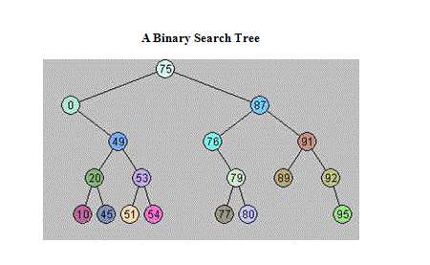
A Solution: Binary Search Trees
In addition, because of the BST Rule, the BST keeps all data in sorted order, and the algorithm for displaying all data in its sorted order is very efficient.
Data Structures

Slide 30
A Solution: Binary Search Trees
Algorithm for insertion of Integer x [an iterative implementation is given below]
1. If the root (of the tree being examined) is null, create a new root having value x
2. Else:-
i) if x is less than the value in the root, examine the left subtree of the root
ii) - if x is bigger than the value in the root, examine the right subtree
Data Structures

Slide 31
A Solution: Binary Search Trees
3-Repeat steps 1, 2 until the condition in (1) is true and a new Node is added that stores x.
Exercise: Insert the following into an initially empty BST: 1,8,2,3,9,5,4
Data Structures

Slide 32
A Solution: Binary Search Trees
Recursive algorithm for finding an Integer x
Finds and insertions can be done recursively. The recursive find operation for BSTs is in reality the binary search algorithm in the context of BSTs.
1.If the root (of the tree being examined) is null, return false
2.If the value in the root equals x, return true
i) If x is less than the value in the root, return the result of searching the left subtree
ii) If x is greater than the value in the root, return the result of searching the right subtree
Data Structures

Slide 33
A Solution: Binary Search Trees
Recursive print algorithm – outputs values in every node in sorted order
  If the root is null, return
  Print the left subtree of the root, in sorted order
  Print the root
  Print the right subtree of the root, in sorted order
The path in which nodes are visited for this print algorithm is called an in-order traversal. The sequence of visited nodes starts at the far left and follows the only path possible so that nodes with smaller values are always visited before nodes with larger values.
Data Structures

Slide 34
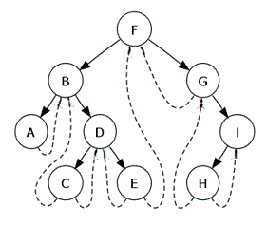
A Solution: Binary Search Trees
Data Structures

Slide 35
A Solution: Binary Search Trees
Algorithm to remove Integer x
Case I: Node to remove is a leaf node Find it and set to null
Case II: Node to remove has one child Create new link from parent to child, and set node to be removed to null
Case III: Node to remove has two children
Find smallest node in right subtree – say it stores an Integer y. This node has at
most one child
Replace x with y in node to be removed
Delete node that used to store y – this is done as in Case I or Case II
Data Structures

Slide 36
Analysis of Performance of BSTs
The running time of insertion, deletion, and search are all proportional to the time it takes to arrive at the node of interest. If d is the depth of this node, it therefore follows that performance of these operations is always O(d).
The question remains: How big is d? In the worst case, d is Θ(n), where n is the number of nodes in the tree. In good cases, when the tree is sufficiently balanced, d is Θ(log n). In fact, average-case analysis shows that d is Θ(log n)..
To improve the worst-case running time for BST operations, much research has been done on how to ensure that a binary tree, while it is growing, remains balanced, so that even in the worst case, the operations run in O(log n). We introduce several variations at the end of this lesson. The next lesson focuses on the most widely used variant: red-black trees.
Data Structures

Slide 37
Handling Duplicates in a BST
Running times of find, insert, and delete given above, and their implementations, make the assumption that there are no duplicate values.
To handle duplicate values, store in each Node a List (instead of a value); then when a value is added to a Node, it is instead added to the List.
Example: Suppose we are storing Employees in a BST, ordered by Name. Our BST will be created so that the value in each node is a List<Employee> instance. Then, after insertions, all Employees with the same name will be found in a single List located in a single Node.
Data Structures

Slide 38
Introduction to Balanced BSTs: AVL Trees
In order to avoid worst case scenarios for BSTs, several kinds of balanced BSTs have been devised. Typically, these work by formulating a balance condition that ensures that, as long as the condition is satisfied, the BST (having n nodes) must have height O(log n). The balance condition is forced to be true by performing balancing steps after every insertion and deletion.
One of the first kinds of balanced BSTs was the AVL Tree (A.V. L. are the first letters of the last names of the three guys who invented it).
The AVL Balance Condition: For any node x, the difference between the height of the left subtree at x and the right subtree at x is at most 1. (We adopt the convention that the height of a tree having 0 nodes– i.e. a null root -- is –1)
Data Structures

Slide 39
Introduction to Balanced BSTs: AVL Trees
AVL Tree Height Theorem. Every AVL tree having n nodes has height O(log n). Therefore, insertion, deletions, and searches all run in O(log n), even in the worst case.
The proof is based entirely on the AVL Balance Condition. Using this condition, one shows by induction on height that if an AVL tree has height h and has n nodes, then n ≥ F_{h+1}, where F is the Fibonacci sequence. Since F grows exponentially, it follows from this inequality that h is O(log n).
Data Structures

Slide 40
Main Point
AVL trees are binary search trees in which remain balanced after insertions and deletions by preserving the AVL balance condition. The balance condition is: For every node in the tree, the height of the left and right subtrees can differ by at most 1. The balance con-dition is maintained, after insertions and deletions, by strategic use of single and double rotations. Worst-case running time for insert, remove, find is O(log n). The balance condition illustrates the principle that boundaries can serve to give expression to boundless intelligence rather than simply limiting that intelligence.
三十幅共一轂: 當其無有車之用。 埏埴以為器, 當其無有器之用。 鑿戶牖以為室, 當其無有室之用。 故有之以為利, 無之以為用。 | Thirty spokes share the wheel’s hub; It is the center hole that makes it useful. Shape clay into a vessel; It is the space within that makes it useful Cut doors and windows for a room; It is the holes which make it useful. Therefore, profit comes from what is there; Usefulness comes from what is not there. Daodejing 11
Data Structures

Slide 41
Red-Black Trees
1.Red-black trees are a more recent (and more efficient) alternative to AVL trees, though the balance condition is slightly more complicated.
2.A BST is red-black if it has the following 4 properties:
  A. Every node is colored either red or black
  B. The root is colored black.
  C. If a node is red, its children are black.
  D. For each node n, every path from n to a NULL reference has the same number of black nodes.
Theorem. Every red-black tree having n nodes has height O(log n). Therefore, insertion, deletions, and searches all run in O(log n), even in the worst case.
Data Structures

Slide 42
CONNECTING THE PARTS OF KNOWLEDGE
TO THE WHOLENESS OF KNOWLEDGE
A Binary Search Tree can be used to maintain data in sorted order more efficiently than is possible using any kind of list. Average case running time for insertions and searchers is O(log n).
In a Binary Search Tree that does not incorporate procedures to maintain balance, insertions, deletions and searches all have a worst-case running time of Ω(n). By incorporating balance conditions, the worst case can be improved to O(log n).
Transcendental Consciousness is the field of perfect balance. All differences have Transcendental Consciousness as their common source.
Impulses Within The Transcendental Field. The sequential unfoldment that occurs within pure consciousness and that lies at the basis of creation proceeds in such a way that each new expression remains fully connected to its source. In this way, the balance between the competing emerging forces is maintained.
Data Structures

Slide 43
CONNECTING THE PARTS OF KNOWLEDGE
TO THE WHOLENESS OF KNOWLEDGE
Wholeness Moving Within Itself. In Unity Consciousness, balance between inner and outer has reached such a state of completion that the two are recognized as alternative viewpoints of a single unified wholeness.
Data Structures

