Slide 1
Lesson 8
Red-Black Trees
The Principle of the Second Element

Slide 2
Red-Black Tree
Wholeness of the Lesson
Red-black trees provide a solution to the problem of unacceptably slow worst case performance of binary search trees. This is accomplished by introducing a new element: nodes of the tree are colored red or black, adhering to the balance condition for red-black trees. The balance condition is maintained during insertions and deletions and doing so introduces only slight overhead.

Slide 3
Red-Black Tree
Science of Consciousness: Red-black trees, as an example of BSTs with a balance condition, exhibit the Principle of the Second Element for solving the problem of skewed BSTs.

Slide 4
The Goal
Improve the worst case performance of BST’s by introducing a balancing condition that
  can be maintained after each insertion and deletion
  guarantees that height of the tree is always O(log n), where n is the number of nodes in the tree.
Achieving this objective implies that all insertions, deletions and selections have a worst-case running time of O(log n)

Slide 5
Overview of the lesson
Specify the balance condition that defines a red-black tree.
Verify that the height of any red-black tree is O(log n).
Verify that insertion, deletion and selection have worst-case running time of O(log n)
Work through insertion algorithm for red-black tree.
Application: Ordered dictionary

Slide 6
Binary Search Trees
Binary Search Trees (BSTs) are an important data structure for dynamic sets
In addition to data, elements have:
  key: an identifying field inducing a total ordering
  left: pointer to a left child (may be NULL)
  right: pointer to a right child (may be NULL)
  p: pointer to a parent node (NULL for root)

Slide 7
Red-Black Tree terminology and conventions
We always think of red-black trees as terminating with a NULL reference.
  This convention will be important when we compute the height of red-black trees.
  Sometimes the NULL nodes are not shown.

Slide 8
Tree terminology and conventions
External nodes are NULL references; internal nodes are non-NULL nodes; if we refer to a “node” without specifying external or internal, we mean “internal node”.

Slide 9
Tree terminology and conventions
In the present context, a “leaf node” is an internal node that has only NULL children.
In the present context a “leaf” is an external node (NULL pointer).

Slide 10
Tree terminology and conventions
The height of an empty tree is -1.
The height of a node x is the length of the longest path from x to a leaf node.

Slide 11
Red-Black Properties
The red-black properties:
  1. Every node is either red or black
  2. Every leaf (NULL reference) is black
    Note: this means every “real” node has 2 children
  3. If a node is red, both children are black
    Note: can’t have 2 consecutive reds on a path
  Every path from node to descendent leaf contains the same number of black nodes
    This number is called black-height of x ( bh(x) ).
    bh(NULL) is 0.
  5. The root is always black

Slide 12
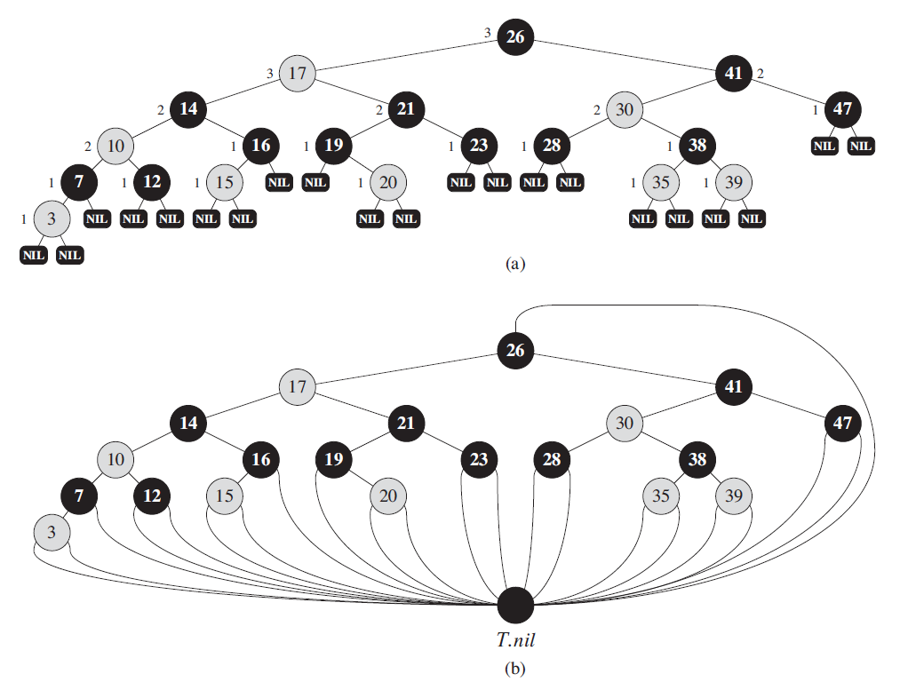
Red-Black Tree Example

Slide 13
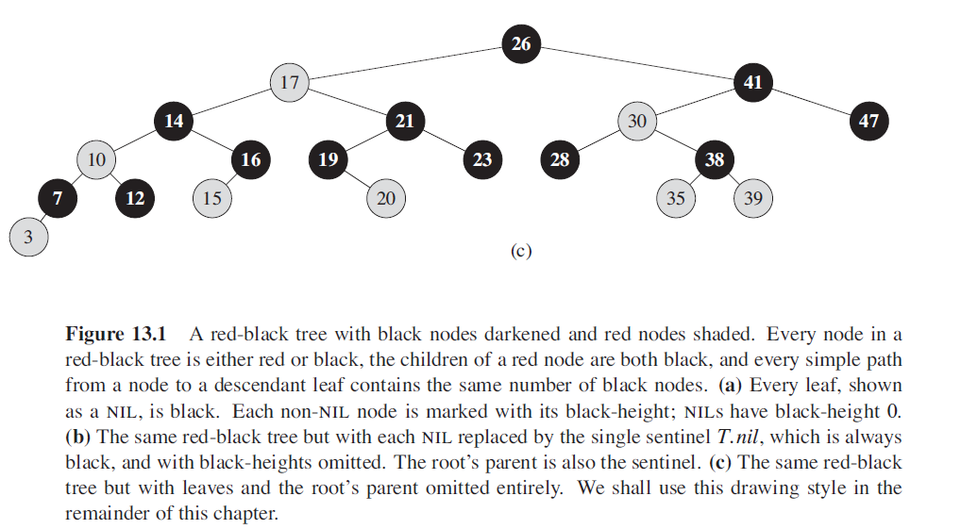
Red-Black Tree Example

Slide 14
Main Point 1
Red-black trees are binary search trees whose nodes are colored black or red in such a way that the balance condition for red-black trees is maintained:
the root is colored black;
if a node is red, its children are black;
for each node N, the lengths of all paths starting at N and extending to a NULL reference are the same.

Slide 15
Main Point 1
Science of Consciousness: Introducing auxiliary data (red/black color) and a corresponding balance condition is an example of the Principle of the Second Element from SCI, by which one arrives at a solution to a problem by introducing a new element outside the usual context of the problem.

Slide 16
Height of Red-Black Trees
What is the minimum black-height of a node with height h?
A: a height-h node has black-height ≥ h/2
Theorem: A red-black tree with n internal nodes has height h ≤ 2 log(n + 1)
How do you suppose we’ll prove this?

Slide 17
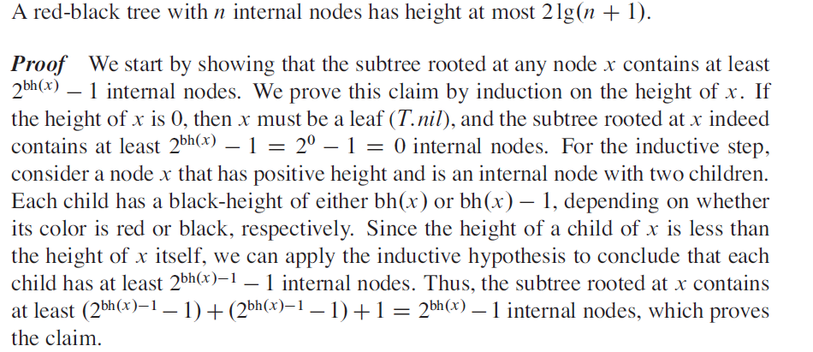

Red-Black Properties: Some Proof

Slide 18
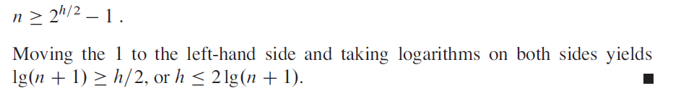
Red-Black Properties
The Black Height must be at least h/2. Hence,

Slide 19
Main Point 2
Because of their balance condition, red-black trees always have height O(log n), so their primary operations all have running times that are O(log n).

Slide 20
Main Point 2
Science of Consciousness: “Far away indeed from the balanced intellect is action devoid of greatness.” (Gita, II.49) The “balanced intellect” – a state of life in perfect balance in which each area of life from most expressed to most subtle and refined is given due attention – arises from regular contact with the Self, the field of pure consciousness, and from bringing this unbounded value of awareness to the domain of daily living.

Slide 21
Left Rotation
Let X be the parent and Y be the right child.
TO DO:
1. Make X Left Child of Y
2. Make “previous Left Child of Y,
as the Right Child of X

Slide 22
Left Rotation
LEFT-ROTATE(T, x)
x y
y x
yl yl

Slide 23
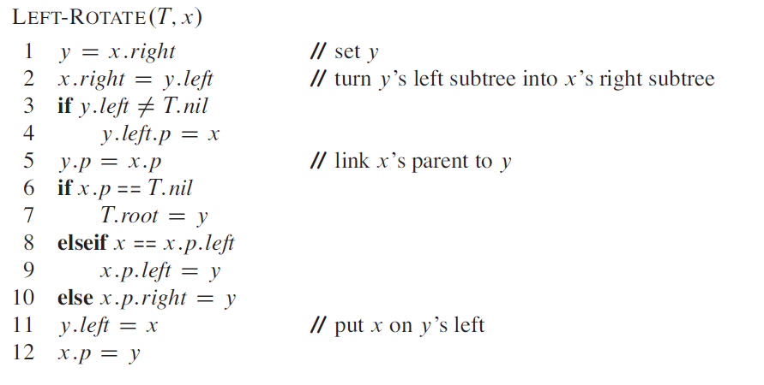
More on Rotation

Slide 24
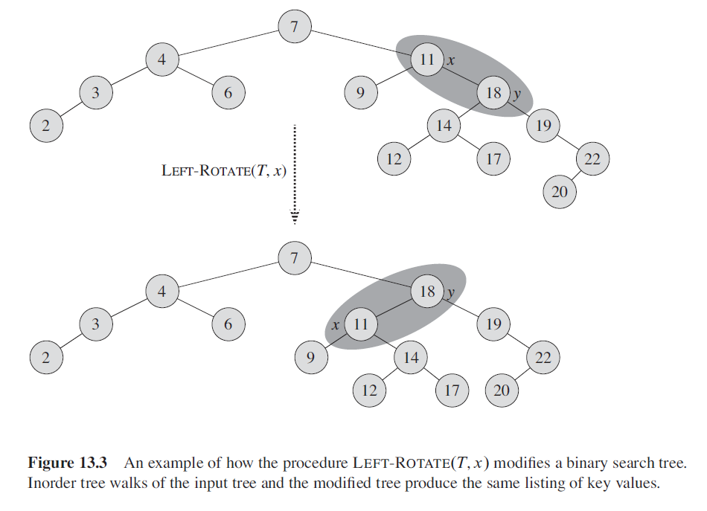
More on Rotation

Slide 25
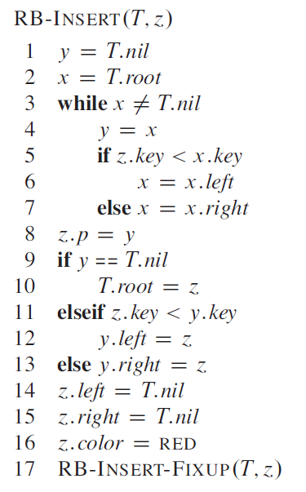
RB Insert

Slide 26
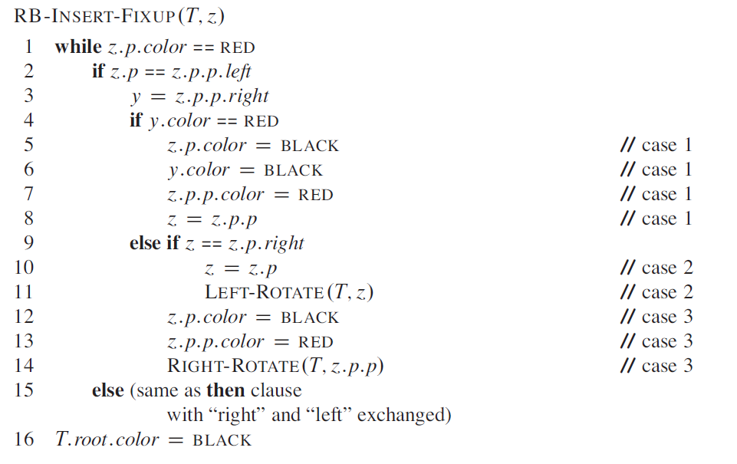
RB Insert
Note: There should be an “else” after Case 2. The book has it wrong

Slide 27
Three cases
Z is the node that is RED, Z’s Parent is also RED.
What follows is when parent is a left child of the grand parent.
Interchange left and right if parent is a right child.
Case 1: Z has a RED uncle.
Change Parent, Uncle to BLACK
Change Grand Parent to RED
Z <- Z.Parent.Parent

Slide 28
Three cases
Case 2: Z has a no RED uncle and Z is RIGHT child.
Z <- Z.Parent
LEFT ROTATION(T, Z)
Case 3: Z has a no RED uncle and Z is LEFT child.
Change Color of Parent, Grand Parent
RIGHT ROTATION(T, Z.Parent.Parent)
At the end, assign BLACK color to Root.

Slide 29
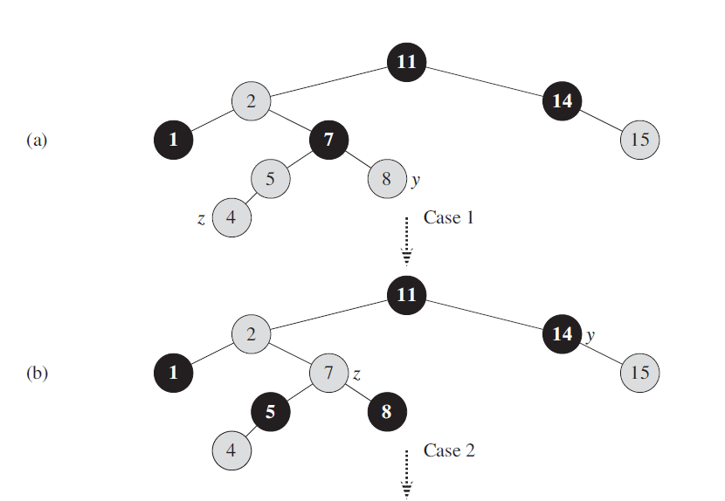
RB Insert

Slide 30
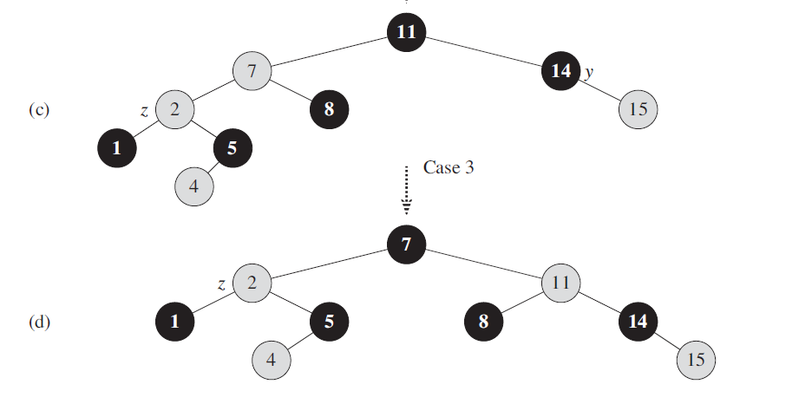
RB Insert

Slide 31
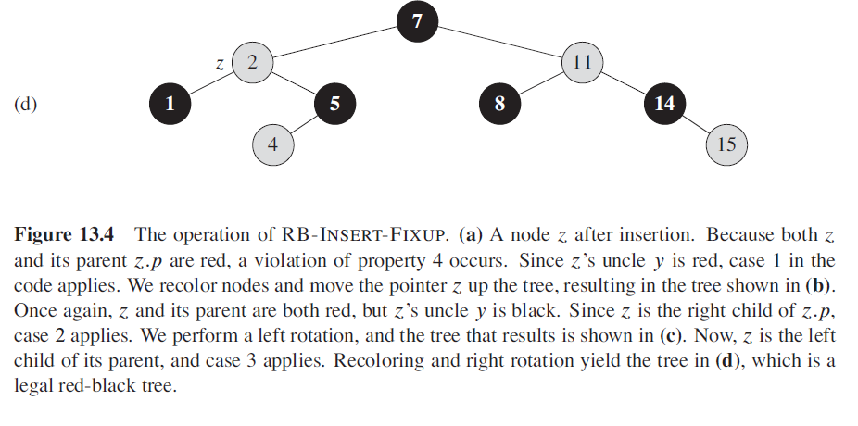
RB Insert

Slide 32
Red-Black Insertion
Code – No Case

Slide 33
Red-Black Insertion
Code – Case 3
[Right Rotate]
z

Slide 34
Red-Black Insertion
Code – Case 3
Change color:
Patent, GreandParent
Right-Rotate(T, z.p.p)

Slide 35
Red-Black Insertion
Code – Case 1 : Has a red uncle
(Just color change)
y
z

Slide 36
Red-Black Insertion
Code – Case 1 TO DO
(P : Black, Uncle: Black
Grand Parent: Red)
Make root Black
y
z

Slide 37
Red-Black Trees: Key Comments
So, the trick is to use Red and Back labels to nodes and use appropriate rules to manipulate nodes in such a way that makes the tree balanced after inserting a new value.

Slide 38
RB Trees: Worst-Case Time
We’ve proved that a red-black tree has
O(lg n) height
Corollary: These operations take O(log n) time:
  Minimum(), Maximum(), Successor(), Predecessor(), Search()
Insert() and Delete():
  Will also take O(log n) time
  But will need special care since they modify tree

Slide 39
Using a Red-Black Tree as a Dictionary
  A dictionary is a collection of pairs (k, e), which we consider to be key/value pairs. The purpose of a dictionary is to make it possible to look up values by key.
  The Dictionary ADT supports these operations:
    get(k) returns value (or e).
    put(k, e) insert the pair into dictionary.
    remove(k) remove any key/value pair whose key is k.
    containsKey(k) returns true if k occurs as a key in the dictionary.

Slide 40
Dictionary Implementations
  List. Key/value pairs can be inserted into any kind of list. Insertion can be done by adding to the end of the list in O(1) time. However, lookups and deletes require O(n) time.
  Hashtable. O(1) average case time for insert, lookup and delete operations. However, hashtables do not store keys in any particular order.

Slide 41
Dictionary Implementations
  Red-Black Trees. When keys have a natural ordering (like integers or strings), key/value pairs can be stored in the nodes of a red-black tree and ordered by keys. Red-black tree has O(log n) worst case time for insert, lookup and delete.

Slide 42
Ordered Dictionary
  An ordered dictionary is a dictionary that maintains its data in sorted order.
  Red-black tree is an example of ordered dictionary
  The price paid for maintaining the order is
    O(log n) vs. O(1) (Hashtable).
  Java’s implementation of an ordered dictionary is TreeMap.

Slide 43
Main Point 3
The integrity of red-black trees is preserved after tree operations (insertions and deletions) are performed by maintaining the balance condition after execution of each operation. This maintenance does not increase the cost of operations because it requires only constant time, involving local color changes, color flips, and rotations.

Slide 44
Main Point 3
Science of Consciousness: The ability to maintain its fundamental character in the face of change is the expression of the invincible quality of pure consciousness. Pure consciousness, in giving rise to diversity, maintains its unbounded and immortal status. In society, this invincible quality is seen when a small percentage of a population engages in group practice of the TM and TM-Sidhi Programs – the inherent harmony of the society is enlivened to the extent that it “averts the birth of an enemy.”

Slide 45
Connecting the Parts of Knowledge With the Wholeness of Knowledge
RED-BLACK TREES
In order to keep the benefits of a BST but eliminate the possibility of a worst case running time of Ω(n), different types of balance conditions have emerged, resulting in AVL trees and others.
Among enhanced BSTs with a balance condition, red-black trees are the most efficient. They outperform AVL trees by eliminating the need, in the worst case, to traverse the full height of the tree more than once.

Slide 46
Connecting the Parts of Knowledge With the Wholeness of Knowledge
Transcendental Consciousness is the home of all the laws of nature. Enlivenment of this field brings support of nature’s almighty power to the field of action.
Impulses Within The Transcendental Field. Within its unmanifest nature, pure consciousness, as a field of all possibilities, is capable of accomplishing anything, and sets forth a blueprint for manifesting the entire universe.

Slide 47
Connecting the Parts of Knowledge With the Wholeness of Knowledge
Wholeness Moving Within Itself. In Unity Consciousness, the transformational dynamics of consciousness, at the basis of all of creation, are appreciated as the lively impulses of one’s own consciousness, one’s own being.

