Slide 1
Some Review Problems

Slide 2
Data Structures
Give one advantage of a Linked List, as compared to
an array.
Ans. Linked List has much faster Insert and Remove operations than an Array – O(1) for Linked List and O(n) for Arrays.
Another one – Linked List allows more flexible memory management than an Array. It does not require large contiguous memory blocks, and needs no preallocation.

Slide 3
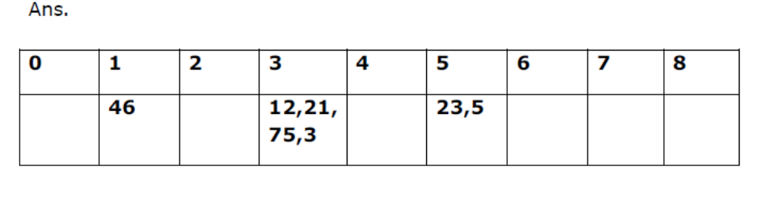
Data Structures – Hashing 1
Insert the following sequence of numbers 23, 46, 12, 21, 75, 5, 3
into a hash table of size 9 using h(x) = x%9 as a hash function. % means
Mod. Use Chaining with Linked List to avoid collision.

Slide 4
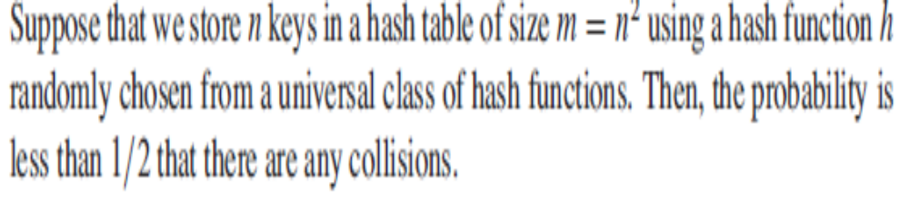
Data Structures – Hashing 2

Slide 5
Some Review Problems
Suppose that A and B , and that A ≤p B. Circle one answer for each statement below.
If A ∈NP-Complete and B is in NP then B ∈ NP-Complete.
True False
If B ∈ P then A ∈ P.
True (you cannot go down from NP hard to P) False
If B is NP-hard then A is NP-hard.
True False

Slide 6
Reduction -1

Slide 7
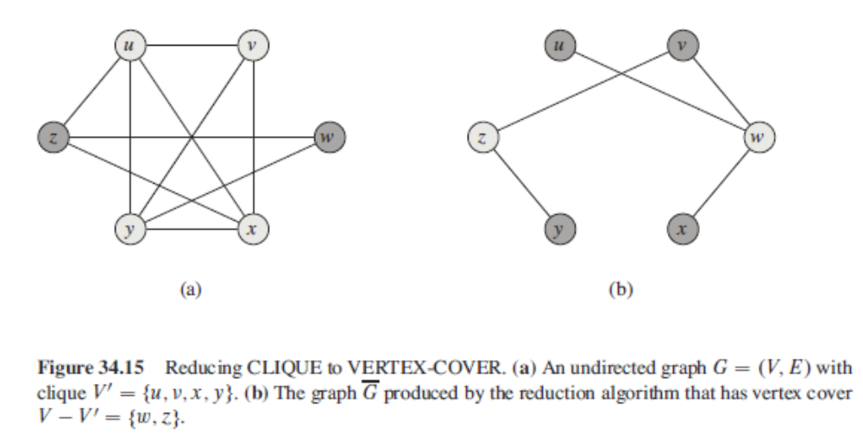
Clique → Vertex Cover
poly
NP-Completeness

Slide 8
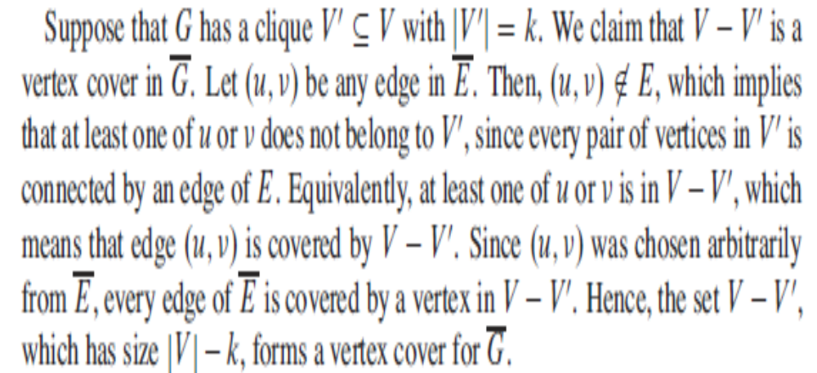
Clique → Vertex Cover
poly
NP-Completeness

