Slide 1
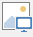
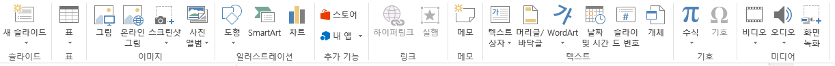



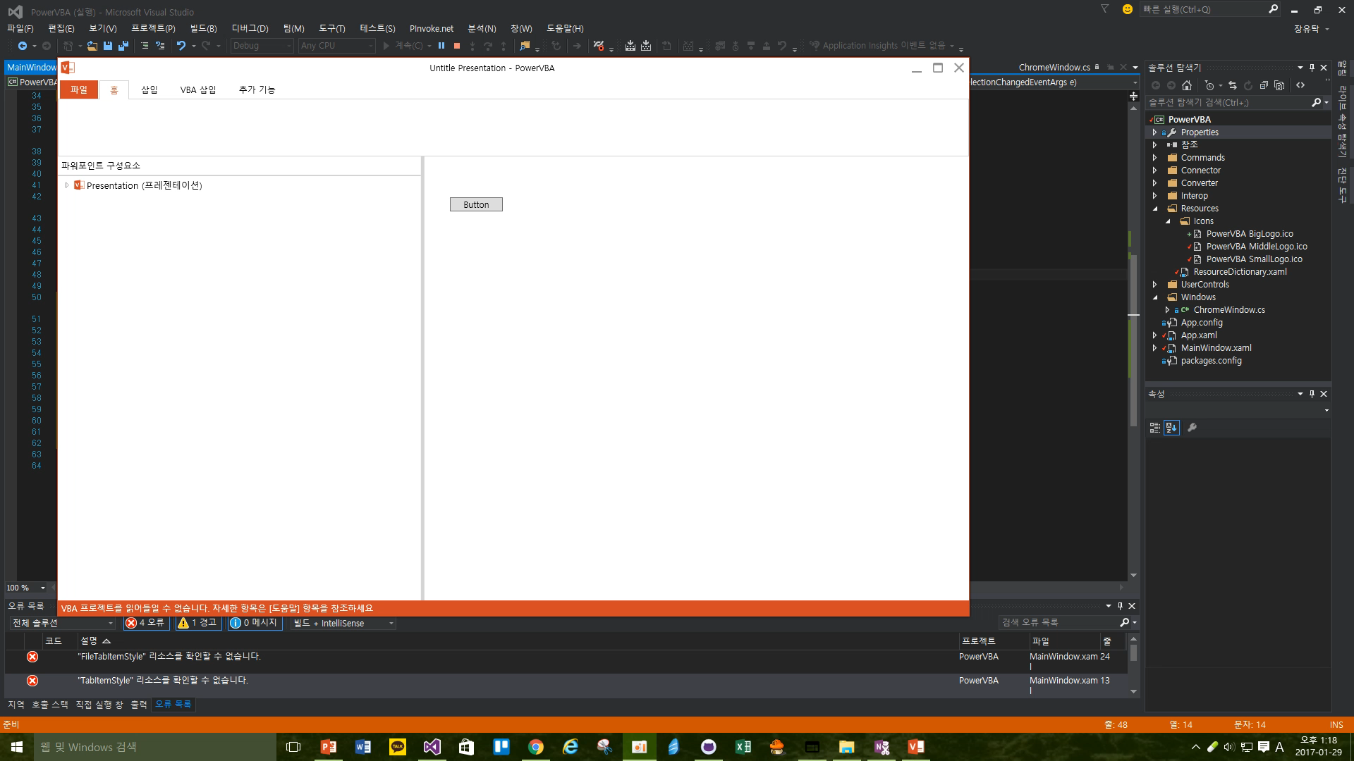
msoAutoShape = 1,
msoCallout = 2,
msoChart = 3,
msoComment = 4,
msoFreeform (자유형 – 쉐이프 포함) = 5,
msoGroup = 6,
msoEmbeddedOLEObject (텍스트 – 개체) = 7,
msoFormControl = 8,
msoLine = 9,
msoLinkedOLEObject = 10,
msoLinkedPicture = 11,
msoOLEControlObject (VBA Control) = 12,
msoPicture = 13,
msoPlaceholder (레이아웃 제목 or 부제 or 날짜 개채 틀) = 14,
msoTextEffect = 15,
msoMedia (동영상 + 소리) = 16,
msoTextBox(일반 텍스트 박스) = 17,
msoScriptAnchor = 18,
msoTable = 19,
msoCanvas = 20,
msoDiagram = 21,
msoInk = 22,
msoInkComment = 23,
msoSmartArt = 24,
msoSlicer = 25,
msoWebVideo = 26,
msoContentApp = 27
Slide
워드 아트

