Slide 1
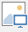
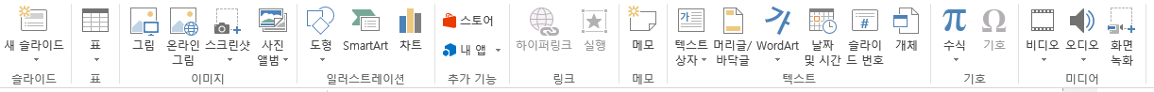

msoAutoShape = 1,
msoCallout = 2,
msoChart = 3,
msoComment = 4,
msoFreeform = 5,
msoGroup = 6,
msoEmbeddedOLEObject = 7,
msoFormControl = 8,
msoLine = 9,
msoLinkedOLEObject = 10,
msoLinkedPicture = 11,
msoOLEControlObject (VBA Control) = 12,
msoPicture = 13,
msoPlaceholder = 14,
msoTextEffect = 15,
msoMedia = 16,
msoTextBox(일반 텍스트 박스) = 17,
msoScriptAnchor = 18,
msoTable = 19,
msoCanvas = 20,
msoDiagram = 21,
msoInk = 22,
msoInkComment = 23,
msoSmartArt = 24,
msoSlicer = 25,
msoWebVideo = 26,
msoContentApp = 27
Slide

