Slide 1
Human Resources Analytics
Tool Used: Power BI
Submitted to: Ashish Rajput Sir(Mentor)
Submitted by: N. Shiva Sai

Slide 2
Project Overview
Analyze workforce composition, attrition, performance, satisfaction, and career growth using Power BI.

Slide 3
Business Objectives
1. Understand Workforce
2. Monitor Retention
3. Evaluate Performance
4. Analyze Career Growth
5. Identify Workforce Challenges

Slide 4
Dataset & Data Preparation
Sources: CSV, Excel, MySQL
Data Cleaning: Missing values, duplicates, datatype corrections, Power Query transformations.

Slide 5

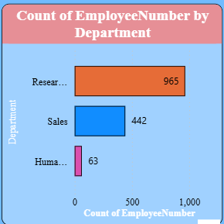
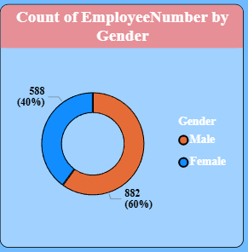
Objective 1: Understand the Current Workforce
The organization currently employs 1K+ employees.
Research & Development contains the largest share of employees.
The workforce shows a reasonable level of gender diversity with opportunities for further balance.

Slide 6
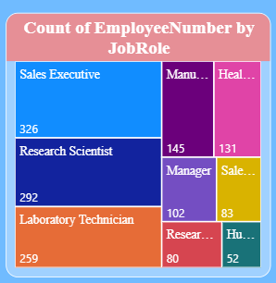
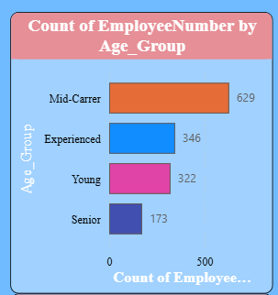
.
Continue…
These roles form the backbone of the organization's operations and growth.
Most employees are in their productive and experienced career stage.

Slide 7
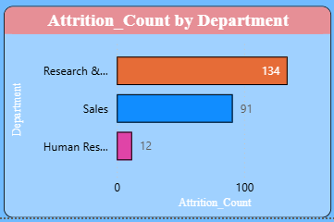
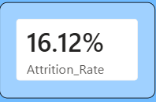
Objective 2: Monitor Employee Retention and Workforce
Stability
Employee turnover exists and requires attention to improve retention.
Despite being the largest department, R&D faces notable employee turnover challenges.

Slide 8
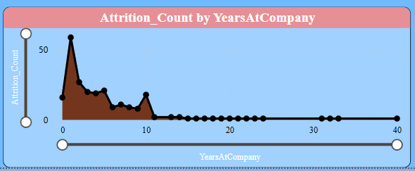
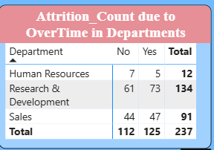
.
Continue…
New employees are more likely to leave, indicating a need for better retention strategies.
Excessive workload may be contributing to employee turnover.

Slide 9
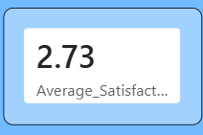
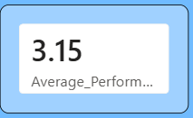
Objective 3: Evaluate Employee Performance and Workplace
Experience
There is room to improve employee engagement and workplace experience.
Employees are performing well and contributing positively to organizational goals.

Slide 10
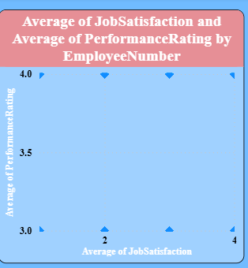
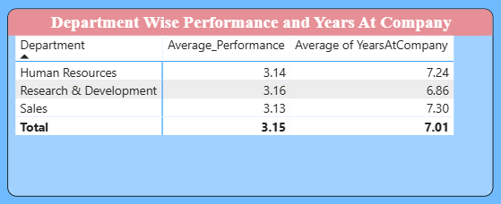
.
Continue…
Experience and organizational knowledge contribute to stronger performance.
Satisfied employees tend to be more productive and engaged.

Slide 11
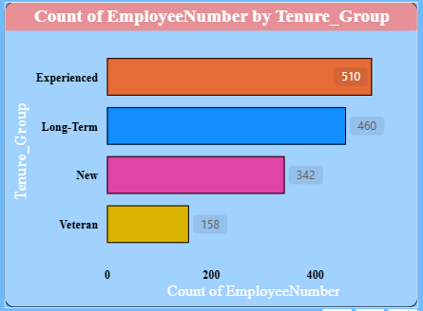
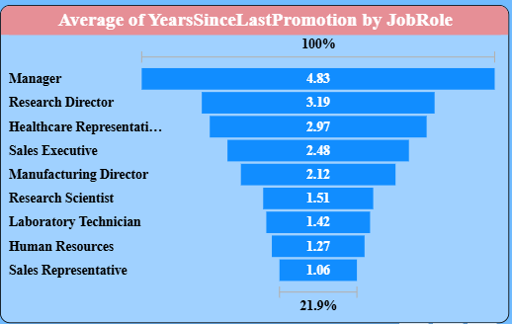
Objective 4: Analyze Employee Development and Career
Growth
The organization has a stable workforce with a balanced experience level.
Career growth appears to increase as employees gain more experience.

Slide 12
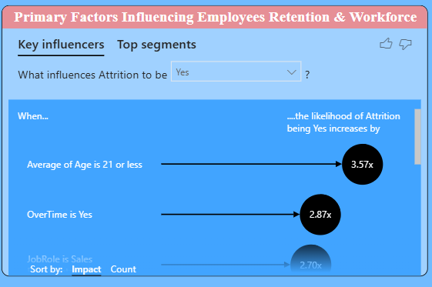
Objective 5:Identify Key Workforce Challenges AND
OPPORTUNITIES
Workload, employee happiness, and pay are key factors influencing retention.

Slide 13
LIMITATIONS & cHALLENGES
Data Quality Issues
Designing a One-Page Interactive Dashboard
Creating Meaningful KPIs and DAX Measures
Static Historical Data
Limited Dataset Scope

Slide 14
SUMMARY
Workforce Analysis
Employee Retention Insights
Performance and Engagement Assessment
Career Growth and Development Analysis
Strategic Business Recommendations

Slide 15
Conclusion & Recommendations
Improve engagement, reduce overtime, strengthen training, support career growth, and focus on high-risk employee groups.

