Slide 1
Money, role and functions
© 2015 Cengage Learning. All Rights Reserved. May not be copied, scanned, or duplicated, in whole or in part, except for use as permitted in a license distributed with a certain product or service or otherwise on a password-protected website for classroom use.

Slide 2
The Meaning of Money
Money
  Set of assets in an economy
  That people regularly use
  To buy goods and services from other people
The functions of money
  Medium of exchange
  Unit of account
  Store of value
© 2015 Cengage Learning. All Rights Reserved. May not be copied, scanned, or duplicated, in whole or in part, except for use as permitted in a license distributed with a certain product or service or otherwise on a password-protected website for classroom use.

Slide 3
The Meaning of Money
Medium of exchange
  Item that buyers give to sellers when they want to purchase goods and services
Unit of account
  Yardstick people use to post prices and record debts
© 2015 Cengage Learning. All Rights Reserved. May not be copied, scanned, or duplicated, in whole or in part, except for use as permitted in a license distributed with a certain product or service or otherwise on a password-protected website for classroom use.

Slide 4
The Meaning of Money
Store of value
  Item that people can use to transfer purchasing power
    From the present to the future
Liquidity
  Ease with which an asset can be converted into the economy’s medium of exchange
© 2015 Cengage Learning. All Rights Reserved. May not be copied, scanned, or duplicated, in whole or in part, except for use as permitted in a license distributed with a certain product or service or otherwise on a password-protected website for classroom use.

Slide 5
The Kinds of Money
Commodity money
  Money that takes the form of a commodity with intrinsic value
    Gold, cigarettes
Intrinsic value
  Item would have value even if it were not used as money
Gold standard - Gold as money
    Or paper money that is convertible into gold on demand
© 2015 Cengage Learning. All Rights Reserved. May not be copied, scanned, or duplicated, in whole or in part, except for use as permitted in a license distributed with a certain product or service or otherwise on a password-protected website for classroom use.

Slide 6
The Kinds of Money
Fiat money
  Money without intrinsic value
  Used as money because of government decree
  “This note is legal tender for all debts, public and private”
Fiat
  Order or decree
© 2015 Cengage Learning. All Rights Reserved. May not be copied, scanned, or duplicated, in whole or in part, except for use as permitted in a license distributed with a certain product or service or otherwise on a password-protected website for classroom use.

Slide 7
Money in the Economy
Money stock
  Quantity of money circulating in the economy
Currency
  Paper bills and coins in the hands of the public
Demand deposits
  Balances in bank accounts; depositors can access on demand by writing a check
© 2015 Cengage Learning. All Rights Reserved. May not be copied, scanned, or duplicated, in whole or in part, except for use as permitted in a license distributed with a certain product or service or otherwise on a password-protected website for classroom use.

Slide 8
Money in the U.S. Economy
Measures of money stock
  M1
    Demand deposits, Traveler’s checks
    Other checkable deposits, Currency
  M2
    Everything in M1
    Savings deposits, Small time deposits
    Money market mutual funds
    A few minor categories
© 2015 Cengage Learning. All Rights Reserved. May not be copied, scanned, or duplicated, in whole or in part, except for use as permitted in a license distributed with a certain product or service or otherwise on a password-protected website for classroom use.

Slide 9
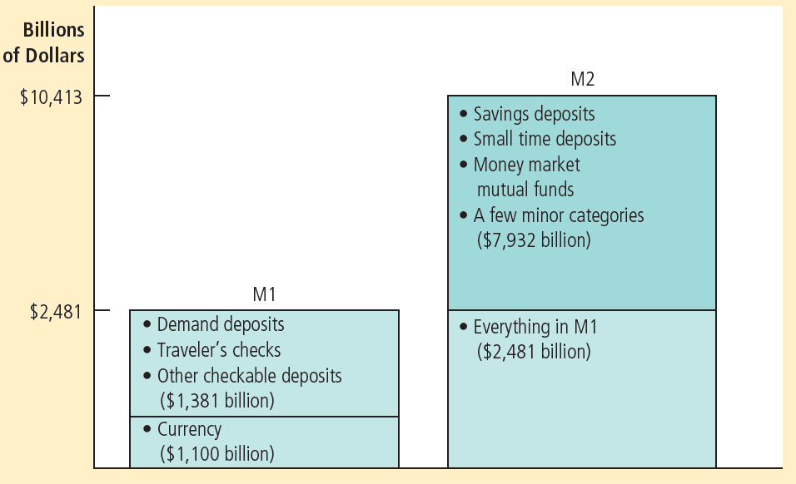
Figure 1
Two Measures of the Money Stock for the U.S. Economy
The two most widely followed measures of the money stock are M1 and M2. This figure shows the size of each measure in January 2013.
© 2015 Cengage Learning. All Rights Reserved. May not be copied, scanned, or duplicated, in whole or in part, except for use as permitted in a license distributed with a certain product or service or otherwise on a password-protected website for classroom use.

Slide 10
Central Banking
Central bank
  Institution designed to
    Oversee the banking system
    Regulate the quantity of money in the economy
© 2015 Cengage Learning. All Rights Reserved. May not be copied, scanned, or duplicated, in whole or in part, except for use as permitted in a license distributed with a certain product or service or otherwise on a password-protected website for classroom use.

Slide 11
Central Banking
A Central Bank’s Functions
  Regulate banks and ensure the health of the banking system
    Monitors each bank’s financial condition
    Facilitates interbank transactions
    Acts as a bank’s bank
    lender of last resort
© 2015 Cengage Learning. All Rights Reserved. May not be copied, scanned, or duplicated, in whole or in part, except for use as permitted in a license distributed with a certain product or service or otherwise on a password-protected website for classroom use.

Slide 12
Central Banking
A Central Bank’s Functions
  Control the money supply
    Quantity of money available in the economy
    Monetary policy
Money supply
  Quantity of money available in economy
Monetary policy
  Setting of the money supply
© 2015 Cengage Learning. All Rights Reserved. May not be copied, scanned, or duplicated, in whole or in part, except for use as permitted in a license distributed with a certain product or service or otherwise on a password-protected website for classroom use.

Slide 13
Central Banking
Central Bank’s primary tool: open-market operation
  Purchase & sale of government bonds
increase the money supply
  open-market purchase
decrease the money supply
  open-market sale
© 2015 Cengage Learning. All Rights Reserved. May not be copied, scanned, or duplicated, in whole or in part, except for use as permitted in a license distributed with a certain product or service or otherwise on a password-protected website for classroom use.

Slide 14

Banks and the Money Supply
Money
  Currency + Demand deposits
Behavior of banks
  Can influence the quantity of demand deposits in the economy (and the money supply)
“I’ve heard a lot about money, and now I’d like to try some.”
© 2015 Cengage Learning. All Rights Reserved. May not be copied, scanned, or duplicated, in whole or in part, except for use as permitted in a license distributed with a certain product or service or otherwise on a password-protected website for classroom use.

Slide 15
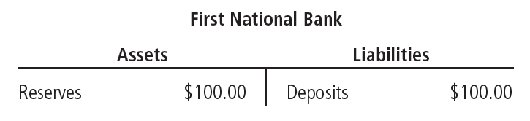
Banks and the Money Supply
Reserves
  Deposits that banks have received but have not loaned out
The simple case of 100% reserve banking
  All deposits are held as reserves
    Banks do not influence the supply of money
© 2015 Cengage Learning. All Rights Reserved. May not be copied, scanned, or duplicated, in whole or in part, except for use as permitted in a license distributed with a certain product or service or otherwise on a password-protected website for classroom use.

Slide 16
Fractional-Reserve Banking
Fractional-reserve banking
  Banks hold only a fraction of deposits as reserves
Reserve ratio
  Fraction of deposits that banks hold as reserves
Reserve requirement
  Minimum amount of reserves that banks must hold; set by Central Bank
© 2015 Cengage Learning. All Rights Reserved. May not be copied, scanned, or duplicated, in whole or in part, except for use as permitted in a license distributed with a certain product or service or otherwise on a password-protected website for classroom use.

Slide 17
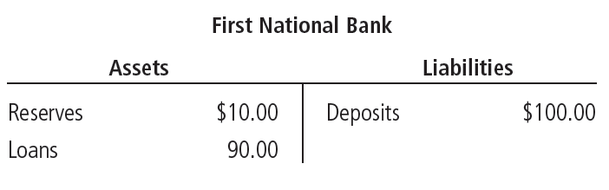
Fractional-Reserve Banking
Excess reserve
  Banks may hold reserves above the legal minimum
Example: First National Bank
  Reserve ratio 10%
© 2015 Cengage Learning. All Rights Reserved. May not be copied, scanned, or duplicated, in whole or in part, except for use as permitted in a license distributed with a certain product or service or otherwise on a password-protected website for classroom use.

Slide 18
Fractional-Reserve Banking
Banks hold only a fraction of deposits in reserve
  Banks create money
    Assets
    Liabilities
  Increase in money supply
  Does not create wealth
© 2015 Cengage Learning. All Rights Reserved. May not be copied, scanned, or duplicated, in whole or in part, except for use as permitted in a license distributed with a certain product or service or otherwise on a password-protected website for classroom use.

Slide 19
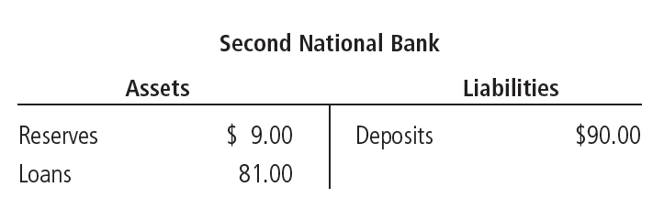
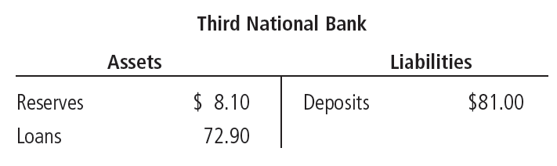
The Money Multiplier
© 2015 Cengage Learning. All Rights Reserved. May not be copied, scanned, or duplicated, in whole or in part, except for use as permitted in a license distributed with a certain product or service or otherwise on a password-protected website for classroom use.

Slide 20
The Money Multiplier
The money multiplier
  Original deposit = $100.00
  First National lending = $ 90.00 [= .9 × $100.00]
  Second National lending = $ 81.00 [= .9 × $90.00]
  Third National lending = $ 72.90 [= .9 × $81.00]
  …
  Total money supply = $1,000.00
© 2015 Cengage Learning. All Rights Reserved. May not be copied, scanned, or duplicated, in whole or in part, except for use as permitted in a license distributed with a certain product or service or otherwise on a password-protected website for classroom use.

Slide 21
The Money Multiplier
The money multiplier
  Amount of money the banking system generates with each dollar of reserves
  Reciprocal of the reserve ratio = 1/R
The higher the reserve ratio
  The smaller the money multiplier
© 2015 Cengage Learning. All Rights Reserved. May not be copied, scanned, or duplicated, in whole or in part, except for use as permitted in a license distributed with a certain product or service or otherwise on a password-protected website for classroom use.

Slide 22
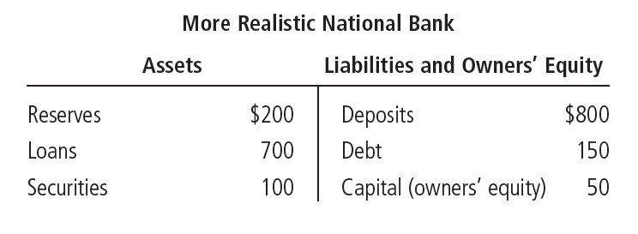
Banks and Leverage
Bank capital
  Resources a bank’s owners have put into the institution
  Used to generate profit
© 2015 Cengage Learning. All Rights Reserved. May not be copied, scanned, or duplicated, in whole or in part, except for use as permitted in a license distributed with a certain product or service or otherwise on a password-protected website for classroom use.

Slide 23
Banks and Leverage
Leverage
  Use of borrowed money to supplement existing funds for purposes of investment
Leverage ratio
  Ratio of assets to bank capital
Capital requirement
  Government regulation specifying a minimum amount of bank capital
© 2015 Cengage Learning. All Rights Reserved. May not be copied, scanned, or duplicated, in whole or in part, except for use as permitted in a license distributed with a certain product or service or otherwise on a password-protected website for classroom use.

Slide 24
Banks and Leverage
If bank’s assets rise in value by 5%
  Because some of the securities the bank was holding rose in price
  $1,000 of assets would now be worth $1,050
  Bank capital rises from $50 to $100
  So, for a leverage rate of 20
    A 5% increase in the value of assets
    Increases the owners’ equity by 100%
© 2015 Cengage Learning. All Rights Reserved. May not be copied, scanned, or duplicated, in whole or in part, except for use as permitted in a license distributed with a certain product or service or otherwise on a password-protected website for classroom use.

Slide 25
Banks and Leverage
If bank’s assets are reduced in value by 5%
  Because some people who borrowed from the bank default on their loans
  $1,000 of assets would be worth $950
  Value of the owners’ equity falls to zero
  So, for a leverage ratio of 20
    A 5% fall in the value of the bank assets
    Leads to a 100% fall in bank capital
© 2015 Cengage Learning. All Rights Reserved. May not be copied, scanned, or duplicated, in whole or in part, except for use as permitted in a license distributed with a certain product or service or otherwise on a password-protected website for classroom use.

Slide 26
Banks and Leverage
If bank’s assets are reduced in value by more than 5%
  Because some people who borrowed from the bank default on their loans
  For a leverage ratio of 20
    The bank’s assets would fall below its liabilities
    The bank would be insolvent
      Unable to pay off its debt holders and depositors in full
© 2015 Cengage Learning. All Rights Reserved. May not be copied, scanned, or duplicated, in whole or in part, except for use as permitted in a license distributed with a certain product or service or otherwise on a password-protected website for classroom use.

Slide 27
Financial Crisis of 2008–2009
Many banks in 2008 and 2009
  Incurred sizable losses on some of their assets
    Mortgage loans and securities backed by mortgage loans
  Shortage of capital induced the banks to reduce lending
    Credit crunch
    Contributed to a severe downturn in economic activity
© 2015 Cengage Learning. All Rights Reserved. May not be copied, scanned, or duplicated, in whole or in part, except for use as permitted in a license distributed with a certain product or service or otherwise on a password-protected website for classroom use.

Slide 28
Financial Crisis of 2008–2009
U.S. Treasury and the Fed
  Put many billions of dollars of public funds into the banking system
    To increase the amount of bank capital
  Temporarily made the U.S. taxpayer a part owner of many banks
  Goal: to recapitalize the banking system
    So that bank lending could return to a more normal level - occurred by late 2009
© 2015 Cengage Learning. All Rights Reserved. May not be copied, scanned, or duplicated, in whole or in part, except for use as permitted in a license distributed with a certain product or service or otherwise on a password-protected website for classroom use.

Slide 29
Fed’s Tools of Monetary Control
Influences the quantity of reserves
  Open-market operations
  Fed lending to banks
Influences the reserve ratio
  Reserve requirements
  Paying interest on reserves
© 2015 Cengage Learning. All Rights Reserved. May not be copied, scanned, or duplicated, in whole or in part, except for use as permitted in a license distributed with a certain product or service or otherwise on a password-protected website for classroom use.

Slide 30
Fed’s Tools of Monetary Control
Open-market operations
  Purchase and sale of U.S. government bonds by the Fed
  To increase the money supply
    The Fed buys U.S. government bonds
  To reduce the money supply
    The Fed sells U.S. government bonds
  Easy to conduct
  Used more often
© 2015 Cengage Learning. All Rights Reserved. May not be copied, scanned, or duplicated, in whole or in part, except for use as permitted in a license distributed with a certain product or service or otherwise on a password-protected website for classroom use.

Slide 31
Fed’s Tools of Monetary Control
Fed lending to banks
  To increase the money supply
  Discount window
    At the discount rate
  Term Auction Facility
    To the highest bidder
© 2015 Cengage Learning. All Rights Reserved. May not be copied, scanned, or duplicated, in whole or in part, except for use as permitted in a license distributed with a certain product or service or otherwise on a password-protected website for classroom use.

Slide 32
Fed’s Tools of Monetary Control
The discount rate
  Interest rate on the loans that the Fed makes to banks
  Higher discount rate
    Reduce the money supply
  Smaller discount rate
    Increase the money supply
© 2015 Cengage Learning. All Rights Reserved. May not be copied, scanned, or duplicated, in whole or in part, except for use as permitted in a license distributed with a certain product or service or otherwise on a password-protected website for classroom use.

Slide 33
Fed’s Tools of Monetary Control
Term Auction Facility
  The Fed sets a quantity of funds it wants to lend to banks
  Eligible banks bid to borrow those funds
  Loans go to the highest eligible bidders
    Acceptable collateral
    Pay the highest interest rate
© 2015 Cengage Learning. All Rights Reserved. May not be copied, scanned, or duplicated, in whole or in part, except for use as permitted in a license distributed with a certain product or service or otherwise on a password-protected website for classroom use.

Slide 34
Fed’s Tools of Monetary Control
Reserve requirements
  Minimum amount of reserves that banks must hold against deposits
    An increase in reserve requirement
      Decrease the money supply
    A decrease in reserve requirement
      Increase the money supply
  Used rarely – disrupt business of banking
  Less effective in recent years
    Many banks hold excess reserves
© 2015 Cengage Learning. All Rights Reserved. May not be copied, scanned, or duplicated, in whole or in part, except for use as permitted in a license distributed with a certain product or service or otherwise on a password-protected website for classroom use.

Slide 35
Fed’s Tools of Monetary Control
Paying interest on reserves
  Since October 2008
  The higher the interest rate on reserves
    The more reserves banks will choose to hold
  An increase in the interest rate on reserves
    Increase the reserve ratio
    Lower the money multiplier
    Lower the money supply
© 2015 Cengage Learning. All Rights Reserved. May not be copied, scanned, or duplicated, in whole or in part, except for use as permitted in a license distributed with a certain product or service or otherwise on a password-protected website for classroom use.

Slide 36
Problems
The Fed’s control of the money supply
  Not precise
The Fed does not control:
  The amount of money that households choose to hold as deposits in banks
  The amount that bankers choose to lend
© 2015 Cengage Learning. All Rights Reserved. May not be copied, scanned, or duplicated, in whole or in part, except for use as permitted in a license distributed with a certain product or service or otherwise on a password-protected website for classroom use.

Slide 37
Bank runs and the money supply
Bank runs
  Depositors suspect that a bank may go bankrupt
    “Run” to the bank to withdraw their deposits
  Problem for banks under fractional-reserve banking
    Cannot satisfy withdrawal requests from all depositors
© 2015 Cengage Learning. All Rights Reserved. May not be copied, scanned, or duplicated, in whole or in part, except for use as permitted in a license distributed with a certain product or service or otherwise on a password-protected website for classroom use.

Slide 38
Bank runs and the money supply
When a bank run occurs
  The bank - is forced to close its doors
  Until some bank loans are repaid
  Or until some lender of last resort provides it with the currency it needs to satisfy depositors
  Complicate the control of the money supply
© 2015 Cengage Learning. All Rights Reserved. May not be copied, scanned, or duplicated, in whole or in part, except for use as permitted in a license distributed with a certain product or service or otherwise on a password-protected website for classroom use.

Slide 39
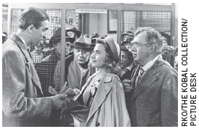
Bank runs and the money supply
Great Depression, early 1930s
  Wave of bank runs and bank closings
  Households and bankers - more cautious
  Households
    Withdrew their deposits from banks
A not-so-wonderful bank run
© 2015 Cengage Learning. All Rights Reserved. May not be copied, scanned, or duplicated, in whole or in part, except for use as permitted in a license distributed with a certain product or service or otherwise on a password-protected website for classroom use.

Slide 40
Bank runs and the money supply
Great Depression, early 1930s
  Bankers - responded to falling reserves
    Reducing bank loans,
    Increased their reserve ratios
    Smaller money multiplier
    Decrease in money supply
© 2015 Cengage Learning. All Rights Reserved. May not be copied, scanned, or duplicated, in whole or in part, except for use as permitted in a license distributed with a certain product or service or otherwise on a password-protected website for classroom use.

Slide 41
Bank runs and the money supply
Bank runs today
  Not a major problem for the U.S. banking system
The federal government
  Guarantees the safety of deposits at most banks
    Federal Deposit Insurance Corporation (FDIC)
© 2015 Cengage Learning. All Rights Reserved. May not be copied, scanned, or duplicated, in whole or in part, except for use as permitted in a license distributed with a certain product or service or otherwise on a password-protected website for classroom use.

Slide 42
Bank runs and the money supply
No bank runs today
  Depositors are confident
  FDIC will make good on the deposits
Government deposit insurance
  Cost:
    Bankers - little incentive to avoid bad risks
  Benefit:
    A more stable banking system
© 2015 Cengage Learning. All Rights Reserved. May not be copied, scanned, or duplicated, in whole or in part, except for use as permitted in a license distributed with a certain product or service or otherwise on a password-protected website for classroom use.

Slide 43
The Federal Funds Rate
The federal funds rate
  Interest rate at which banks make overnight loans to one another
    Lender – has excess reserves
    Borrower – needs reserves
  A change in federal funds rate
    Changes other interest rates
© 2015 Cengage Learning. All Rights Reserved. May not be copied, scanned, or duplicated, in whole or in part, except for use as permitted in a license distributed with a certain product or service or otherwise on a password-protected website for classroom use.

Slide 44
The Federal Funds Rate
The Fed: target the federal funds rate
  Open-market operations
    The Fed buys bonds
      Decrease in the federal funds rate
      Increase in money supply
    The Fed sells bonds
      Increase in the federal funds rate
      Decrease in money supply
© 2015 Cengage Learning. All Rights Reserved. May not be copied, scanned, or duplicated, in whole or in part, except for use as permitted in a license distributed with a certain product or service or otherwise on a password-protected website for classroom use.

