Slide 1
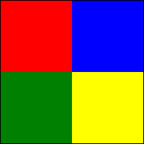
Cropped: 12.5% each side

Slide 2
Grayscale

Slide 3
Brightness+Contrast adjusted

