Slide 1




BERT FOR GITHUB REPOSITORY CLASSIFICATION
Leveraging contextual embeddings for automated software project categorization.
Student Project
NLP & Machine Learning
GitHub Analysis
Notes:
Welcome everyone. Today we're exploring BERT, a revolutionary model in Natural Language Processing. We'll see how we applied it to classify GitHub repositories based on their textual descriptions. Our focus is on how BERT brings efficiency, accuracy, and a deep contextual understanding to this task. We'll dive into the specifics of this project and its implications for understanding software projects.

Slide 2

NLP & TEXT UNDERSTANDING
BRIDGING THE GAP
THE POWER OF CONTEXT
What is NLP?
Beyond Isolation
Natural Language Processing enables computers to understand, interpret, and generate human language in a valuable way.
Traditional models treated words as independent units. Modern NLP captures the relationship between words.
The Challenge
Technical content like GitHub repositories requires deep semantic understanding, not just keyword matching.
Notes:
So, before we dive into BERT, let's ground ourselves in what NLP truly is. It's not just about reading words; it's about understanding the intent and meaning behind them. This matters greatly for GitHub projects, because a 'Python' project could be a library, a tool, or even a tutorial. Traditional models often missed this nuance, treating words in isolation. But modern NLP, and especially BERT, understands the full context. This deeper understanding is crucial for accurately categorizing technical content. Now, let's look at how BERT achieves this advanced understanding.

Slide 3


WHAT IS BERT?
Bidirectional Encoder Representations from Transformers
THE KEY INNOVATION
TRUE CONTEXT
Unlike traditional models that read text sequentially (left-to-right), BERT reads the entire sequence of words at once.
It captures the meaning of a word based on all of its surroundings—both to its left and its right—simultaneously.
CONTEXT
WORD
CONTEXT
Notes:
BERT truly changed the game in 2018. Its full name, Bidirectional Encoder Representations from Transformers, hints at its power. The 'bidirectional' part is key here. Unlike older models that read text only from left to right, BERT processes the entire sequence of words at once. This means it understands a word's meaning by looking at all its surroundings, both before and after it, simultaneously. This comprehensive view allows for a much richer contextual understanding. So, how does BERT actually achieve this bidirectional magic? Let's break down its architecture.

Slide 4




BERT ARCHITECTURE: THE ENGINE
TRANSFORMER ENCODER
SELF-ATTENTION
INPUT EMBEDDINGS
The core building block that processes input data in parallel, allowing for faster training and deeper understanding of complex patterns.
A mechanism that allows the model to weigh the importance of different words in a sentence when processing a specific token.
Combines Token, Position, and Segment embeddings to provide a rich numerical representation of the text and its structure.
PARALLEL PROCESSING
CONTEXTUAL WEIGHTING
MULTI-DIMENSIONAL DATA
Notes:
BERT is built on the powerful Transformer architecture. The core component is the Transformer Encoder, which processes input data in parallel. This allows for faster training and a deeper grasp of complex patterns. A critical part of this is the Self-Attention mechanism. It's like a spotlight, allowing the model to focus on the most relevant words in a sentence when trying to understand a specific word. Finally, BERT uses input embeddings that combine token, position, and segment information. This creates a rich numerical representation of the text. But how does BERT actually prepare this text for its engine? Let's explore that next.

Slide 5
INPUT REPRESENTATION
WORDPIECE TOKENIZATION
SPECIAL TOKENS
Sub-word Units
[CLS] Token
BERT breaks down complex or rare words into smaller meaningful pieces (e.g., "playing" → "play", "##ing").
Added at the start of every sequence. Its final hidden state is used for classification tasks.
Vocabulary Efficiency
[SEP] Token
This reduces the vocabulary size while effectively handling out-of-vocabulary words.
Used to separate two sentences or mark the end of a single sequence.
[CLS]
GitHub
repos
are
amaz
##ing
[SEP]
Notes:
BERT doesn't see words directly; it processes them as numerical representations. We use WordPiece tokenization, which breaks down complex or rare words into smaller, more meaningful sub-units. This helps manage vocabulary size and handles words it hasn't seen before. We also use special tokens like [CLS] at the start of every sequence. Its final output is particularly important for classification tasks. The [SEP] token helps separate sentences or mark the end of a sequence. This careful input representation is vital for BERT to effectively process and understand text. Now, let's see how BERT uses this processed input for classification.

Slide 6






HOW BERT PERFORMS CLASSIFICATION
CLASSIFICATION HEAD
SOFTMAX LAYER
PREDICTION
We extract the output of the [CLS] token, which acts as a summary of the entire input sequence.
A linear layer followed by Softmax converts raw scores into probabilities for each category.
The category with the highest probability is selected as the final classification label.
THE FINE-TUNING PROCESS
Instead of training from scratch, we take a pre-trained BERT model and update its weights slightly using our specific GitHub dataset to specialize it for repository classification.
Notes:
So, how do we actually get BERT to classify GitHub repositories? We don't change the core BERT model. Instead, we add a specific component on top, often called a "classification head." We take the special [CLS] token's output, which summarizes the entire input, and feed it into a linear layer. This layer, combined with a Softmax function, gives us probabilities for each category. We then pick the category with the highest probability as our prediction. This process is called fine-tuning; we adapt a pre-trained BERT to our specific task without starting from scratch. This makes the model highly effective for our classification needs.

Slide 7
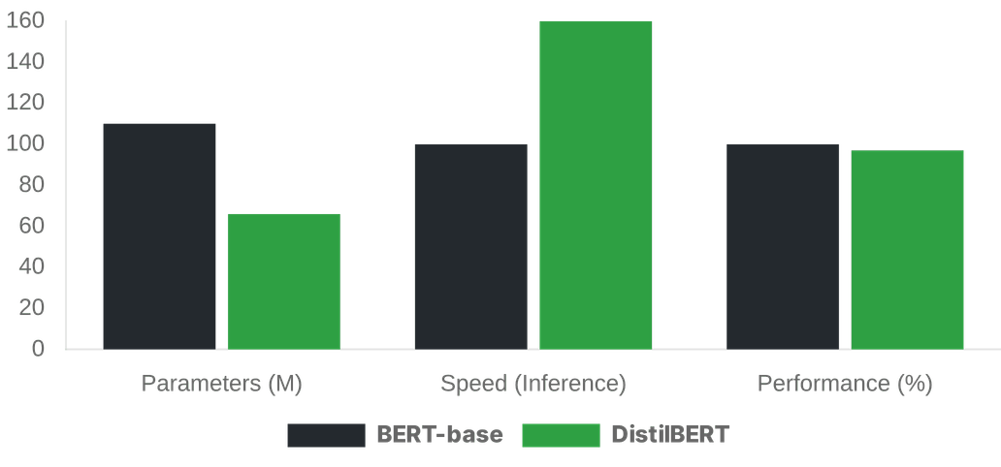
WHY DISTILBERT?
EFFICIENCY VS. POWER
THE TRADE-OFF
Knowledge Distillation
A "Teacher" BERT model trains a smaller "Student" DistilBERT, transferring its linguistic knowledge.
Performance Retention
Retains roughly 97% of BERT's performance while being significantly lighter.
Speed & Size
40% fewer parameters and 60% faster training/inference times compared to BERT-base.
Notes:
Now that we understand how BERT classifies, let's talk about why we chose DistilBERT for this project. It's all about balancing efficiency with performance. DistilBERT is a smaller, faster version of BERT. It learns from a larger "teacher" BERT model through a process called knowledge distillation. This means it retains about 97% of BERT's original performance. But here's the key: it has 40% fewer parameters and trains 60% faster. This trade-off was crucial for us, allowing us to achieve strong results within our project constraints. It gives us nearly the same power with much less computational cost.

Slide 8

DATA & TRAINING SETUP
DATA PREPARATION
TRAINING CONFIGURATION
Feature Engineering
Optimizer
AdamW
Merged repository descriptions with README content to provide the model with maximum semantic context.
Learning Rate
2e-5
Text Cleaning
Batch Size
16
Removed Markdown syntax, HTML tags, and non-ASCII characters to reduce noise in the input.
Epochs
4 (with Early Stopping)
Precision
FP16 (Mixed Precision)
Tokenization
Applied WordPiece tokenization with a fixed max length of 512 tokens.
Split
80% Train / 10% Val / 10% Test
Notes:
With our model choice made, let's look at how we prepared our data and set up the training. Data quality is paramount for any machine learning project. We combined the repository description with its README content to give DistilBERT the richest possible context. We also cleaned the text, removing things like Markdown and HTML tags to reduce noise. For training, we used standard practices like the AdamW optimizer and set a maximum token length of 512. We also employed early stopping to prevent overfitting and used mixed precision for faster GPU training. This meticulous setup ensures our model learns effectively and generalizes well to new data.

Slide 9





EVALUATION: BEYOND ACCURACY
METRIC SELECTION
MODEL PIPELINE
The Accuracy Trap
In imbalanced datasets, a model can achieve high accuracy by simply predicting the majority class, failing to identify smaller but important categories.
Raw Text (README)
Macro F1-Score
WordPiece Tokenizer
Calculates the F1-score for each class independently and then takes the average. This ensures that the model performs well across all repository types.
DistilBERT Model
Predicted Category
Notes:
When we talk about how well our model performs, we can't just look at accuracy. It's a common trap, especially with imbalanced datasets. We used Macro F1-score as our main metric because it gives a much clearer picture of true performance. This metric makes sure our model isn't just good at guessing the most common categories. It tells us if we're doing well across all repository types, even the smaller ones. So, after all that data processing and training, this is how we really knew if our model was working. Now, let's talk about some of the hurdles we faced and what we learned.

Slide 10



CHALLENGES & INSIGHTS
TECHNICAL HURDLES
KEY INSIGHTS
Text Truncation
GitHub READMEs often exceed 512 tokens. Deciding which parts to keep without losing context was critical.
"The model's ability to understand technical jargon allowed it to distinguish between 'Frameworks' and 'Libraries' even when the keywords were nearly identical."
Class Imbalance
Some categories (e.g., Web) had significantly more data than others (e.g., Security), affecting model bias.
SEMANTIC NUANCE CAPTURED
Notes:
Every project has its challenges, and ours was no different. One big hurdle was dealing with really long READMEs. We had to truncate them to 512 tokens, and deciding what to keep without losing important context was tough. We also dealt with class imbalance, where some categories had way more examples than others. But through these challenges, we gained some cool insights. We saw that the model could really understand technical jargon, even distinguishing between similar concepts like 'Frameworks' and 'Libraries.' This showed us the power of BERT's semantic understanding. These insights lead us to our main conclusions.

Slide 11


CONCLUSION & KEY TAKEAWAYS
CONTEXT IS KING
TRANSFER LEARNING
BERT's bidirectional nature allows for a deeper understanding of technical text compared to traditional keyword-based methods.
Pre-trained models like DistilBERT make state-of-the-art NLP accessible even with limited computational resources and smaller datasets.
EFFICIENCY MATTERS
FUTURE HORIZONS
DistilBERT provides the perfect balance between high accuracy and the speed required for real-world application pipelines.
Moving forward, integrating CodeBERT could allow for classification based on actual source code logic, not just documentation.
THANK YOU FOR YOUR ATTENTION
Notes:
So, what are the big takeaways from all this? First, context is king. BERT's ability to understand text bidirectionally is far superior to just matching keywords. Second, transfer learning is a game-changer. Using pre-trained models like DistilBERT makes advanced NLP accessible, even for projects with limited resources. And finally, efficiency matters. DistilBERT gave us that sweet spot of high accuracy and speed. Looking ahead, we're excited about exploring CodeBERT to classify based on actual code, not just documentation. Thank you.

