Slide 1
Comp4433 House Price Prediction Group Name:Ask Poe
LAI Ka Chung 22080062d
LI Chun Yin 21079842d

Slide 2
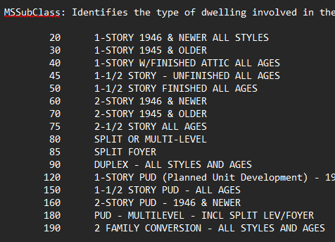
Preview of data
1460 samples representing a housing unit
81 features
43 object attributes
Ie MSSubClass
37 numerical attributes
3 float types

Slide 3
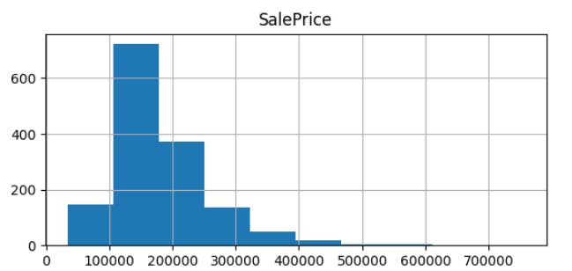
Review the target SalePrice
heavily right-skew
concentrated in low-price rangers
few expensive outliers

Slide 4
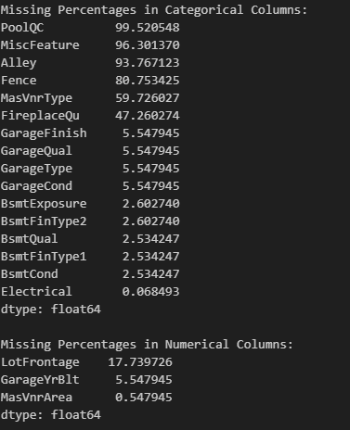
Missing data analysis
two type of missing value
structural missing values
that represents absence of features
PoolArea = NA (house has no pool)
Information missing values
data that should exist but is missing
LotFrontage
Six of them more than 40 % missing percentages
Dropping high correlation attribute

Slide 5
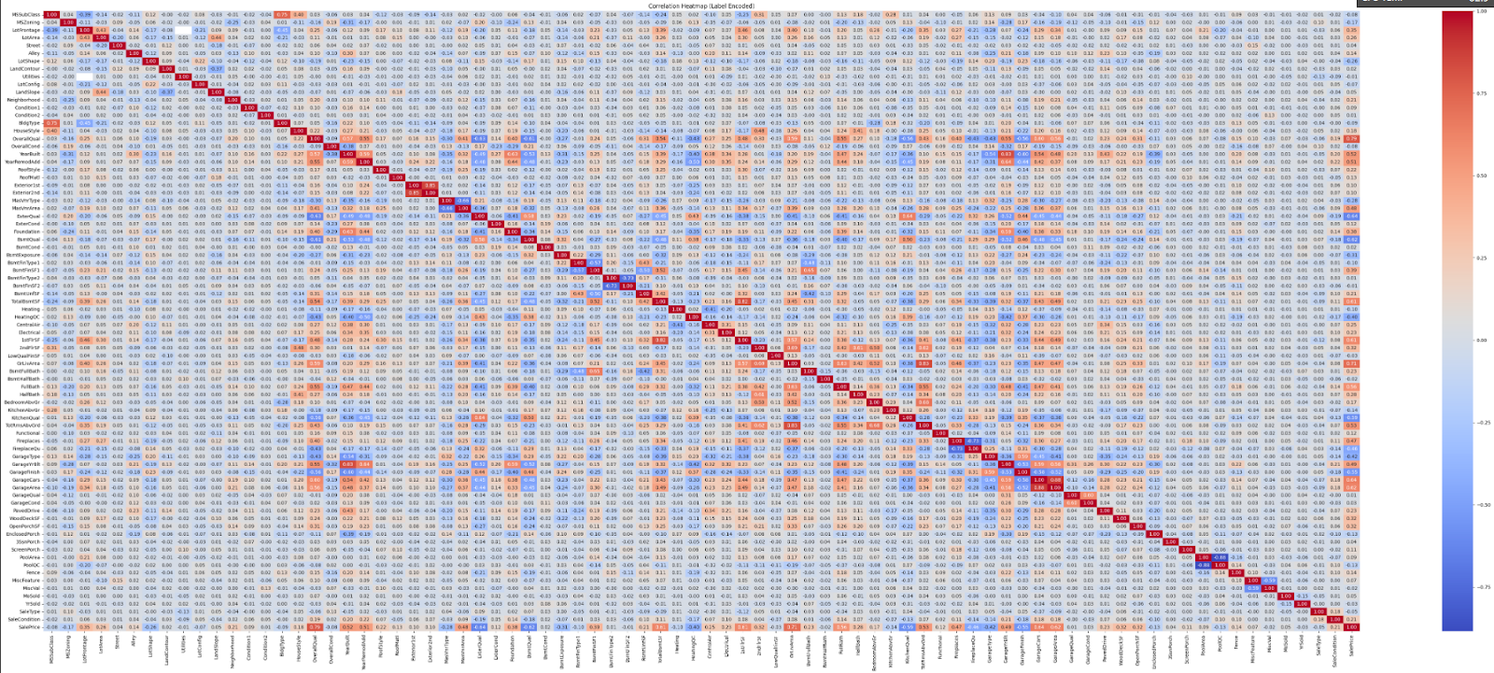
Correlation between variables

Slide 6
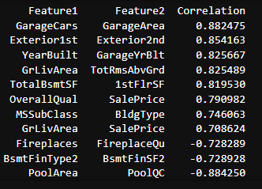
Here are pairs of features with a high correlation higher than 0.7
the relationship between variables
Locate attributes with information overlap

Slide 7
Feature engineering
Filling missing values
use 0 for numerical missing value
None for the categorical missing value
Use median instead of mean for numerical features to reduce the impact of outliers
Convert non-numeric predictors into strings
To prevent algorithm bias
remove the implied numeral ordering, convert YrSold and MoSold into strings
Avoid misidentified of dat
Eg 20 = “1-STORY 1946 & NEWER ALL STYLES,” 30 = “1-Story 1945 & Older
represent categories, not actual quantities
converted to a string.

Slide 8
Feature engineering
Apply label encoding
Categorical data
Converting categorical text data into numbers
For example, ExterQual, Ex =4, Gd =3, TA =2, Fa =1,Po = 0.
Log1p normalization for Sales Price
solve the problem of right skewness
Normalise
reduce the impact of outliers and improve the model's performance.
One-hot encoding
hardly use string data to analyze
urn them to boolean values(1 and 0 )
sacrificed the dimensionality of the data set to facilitate our analysis on SalePrice

Slide 9
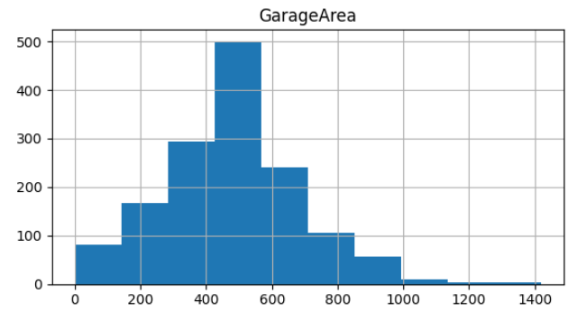
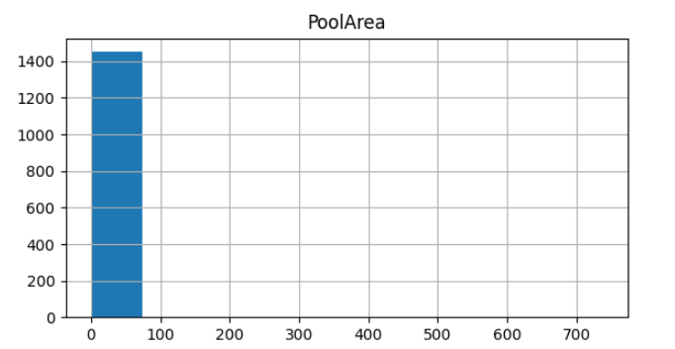
Feature engineering
Dropping attributes
Attributes dominated by one attribute value provide minimal information
attributes with values dominating 99% of the sample will be dropped

Slide 10
Feature engineering
Combining features
helps capture complex relationships
For example: features['BasementRatio'] = features['TotalBsmtSF'] / features['1stFlrSF’]
reveals hidden patterns and captures interaction effects
Simplify Features
Multiple condition variables can be simplified
The Neighborhood has over 20+ categories that can be divided into 3 different groups: high-end, medium-end, and Standard
Dropping high correlation attribute
Drop one side of high correlation pair
like GarageCars and GarageArea
keep GarageCars and drop GarageArea.

Slide 11
Result with Combining features with dropping or not dropping
Consider dropping the composition attribute if combined attribute
Information repetition
without dropping original features
with dropping original features

Slide 12
Result with Combining features with dropping or not dropping
Explanation of phenomenon
different requirements of customers which affect the price
features['TotalSF']=features['BsmtFinSF1'] + features['BsmtFinSF2']+ features ['BsmtUnfSF']+ features['1stFlrSF'] + features['2ndFlrSF']
some consumers may concern more on features['BsmtFinSF1’]
Combined feature only represent all numerical data
Udlying information not represented

Slide 13
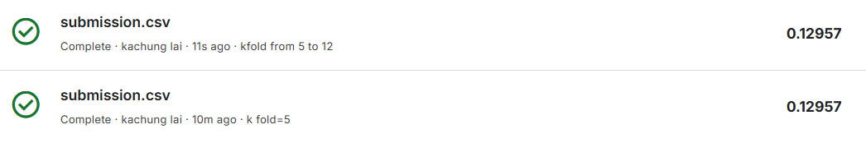


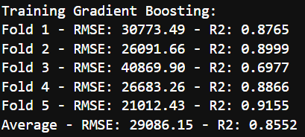
Model training
Cross-validation (K-fold)
Reduce overfitting
Produce more reliable prediction
More fold not equal to better performance but the time increase
To measure the performance of the model
Using RMSE(Root Mean Square Error) & R2 (R-squared)

Slide 14
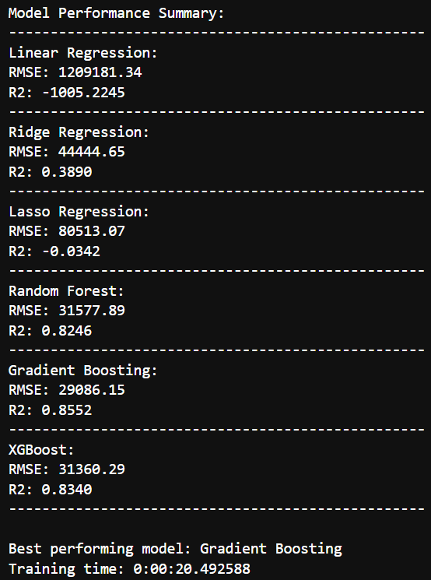
Model training
Compare 6 different training algorithm:
linear regression
Ridge Regression
Lasso Regression
Random Forest
Gradient Boosting
Xgboost
Gradient Boosting
High prediction accuracy
Especially in decision trees

Slide 15
Obstacle 1
Failure on dropping attribute\
Assumption 1 (before reading the data)
remove every sample with any NA attribute value
Avoid noise
90% of the sample will be removed
Assumption 2
delete all data with correlation below absolute (0.1)
Attribute Pool Quality was not dropped
Only 5 of the samples have pools
correlation against Sale Revenue is 0.13

Slide 16
Obstacle 2
Understanding the attribute
For combine features
Example
['Total_porch_sf'] = (features['OpenPorchSF'] + features['3SsnPorch'] + features['EnclosedPorch'] + features['ScreenPorch'] + features['WoodDeckSF’])
considered a type of porch
Not similar with Hong Kong

Slide 17
Conclusion
Which feature engineering effort is most useful in your competition work? Any reason behind?
Dropping dominated attributes
accuracy improved from 0.13364 to 0.12883
dominated attributes exhibited similar values regardless of the SalePrice
Noise
If you have submitted more than 1 entry, describe the case your team has obtained the best improvement (not absolute performance).
Data Preprocessing:
Missing Data Treatment:
Median for numeric values
Zero filling where appropriate
Mode for categorical data
String conversion for non-numeric predictors

Slide 18
Conclusion
Feature Engineering:
Target Variable Treatment:
Log1p normalization on Sales Price
Addressed skewness
Improved distribution normality
Categorical Processing:
One-hot encoding implementation
Outlier removal
Created combined features
Dropped original components
Feature Optimization:
Simplified feature set
Eliminated highly correlated attributes
Reduced multicollinearity

Slide 19
Conclusion
Final Model:
Gradient Boost Implementation
Optimal Balance Achieved:
Efficient training time
Reduced complexity
Minimal accuracy trade-off
Improved computational efficiency

