Slide 1
Write up
Credit: Tony Liu
Tutorial : 曾龍教授

Slide 2
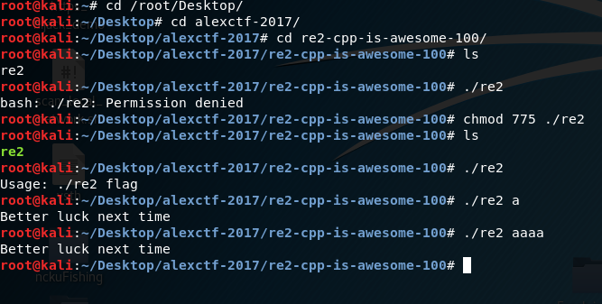
First look with re2
Chmod 775 to get permission
./re2 flag

Slide 3
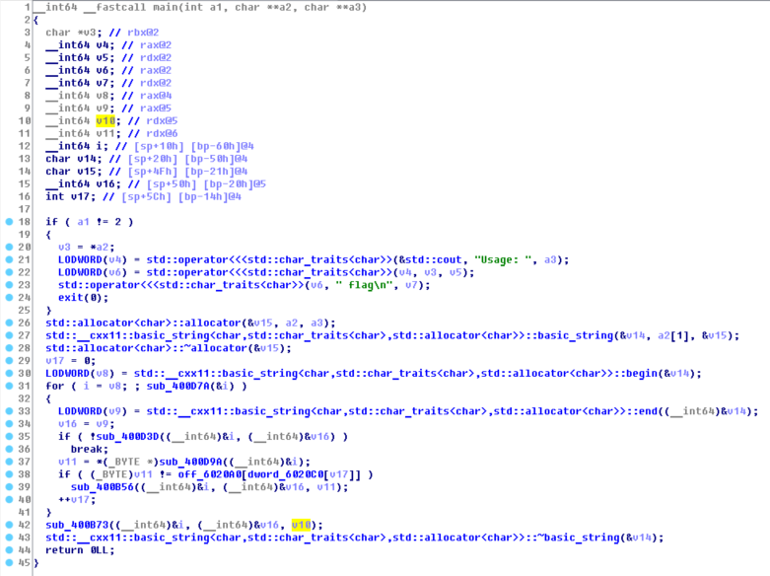
Decompile with IDA

Slide 4
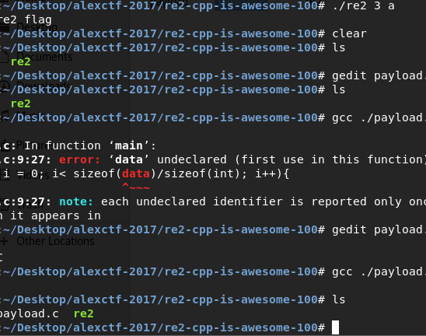

Slide 5

for (int i =0; i~~~; i++) plus +1

Slide 6
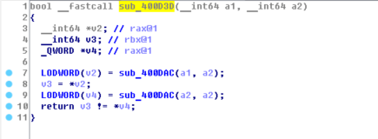
Compare a1 a2

Slide 7

Function : Fail

Slide 8
Key point : The answer is here off_6020A0 : string byte_6020c0 : int []

Slide 9
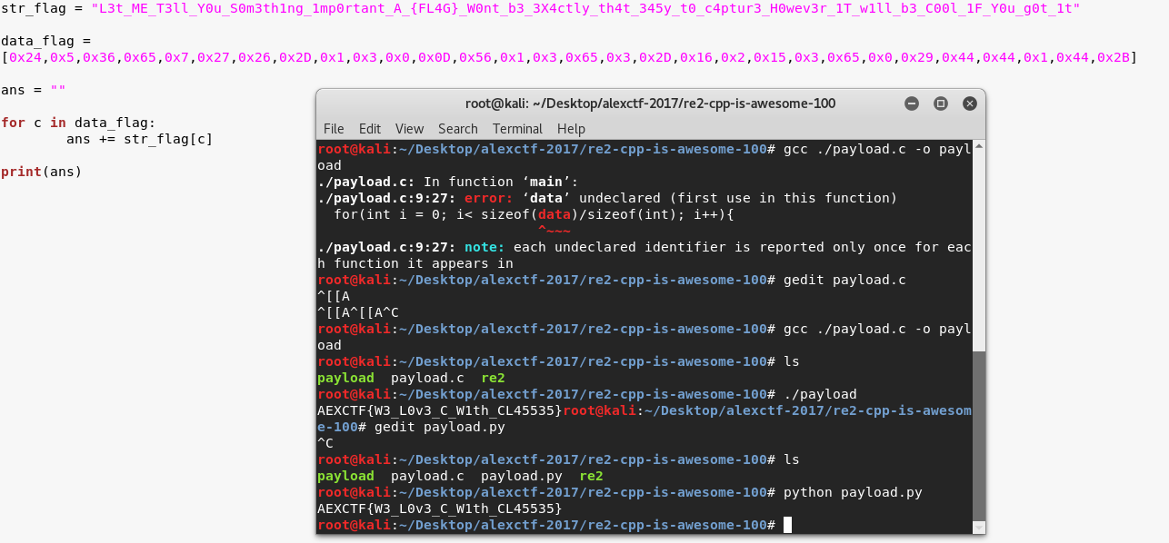
Payload with python

Slide 11

If ./re2 right_flag You will get this

Slide 12


Slide 13
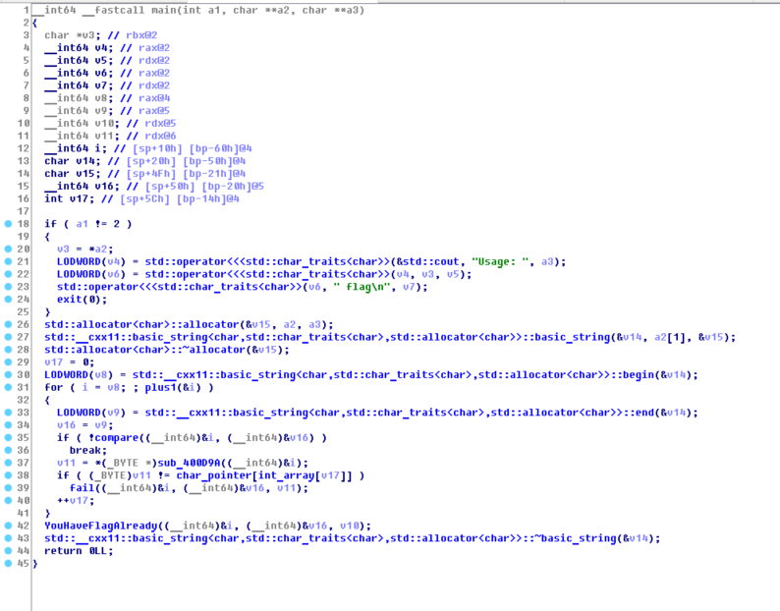
Flush up the IDA

