Slide 1
Lab 3 Data path of Single Cycle CPU

Slide 2
Notice
Lab 3 is group work
Please follow Group ID (https://docs.google.com/spreadsheets/d/1IMhhk1ihOGYk7AlbDCjnls3hSTRfpzcace4BsPSDNGQ/edit#gid=0)
We recommend you to find teammate
Lab 3 will have individual Demo (remote?)
Run your program in your computer
Run special test case in your computer (considering)
Code review
Ask questions
All of you need to submit to new e3, format: “GroupID_ID1_ID2.zip”
Deadline 2020/04/29
Notes:
https://docs.google.com/spreadsheets/d/1ZUCVMoT-TsYwq-XjuQmA8R_mjxXebLykivcohCnJsTE/edit?usp=sharing

Slide 3
If you have any problems about the specification,
Please contact TA as soon as possible
Contact:
何承澤 djjjimmyyy@gmail.com
Notes:
https://docs.google.com/spreadsheets/d/1ZUCVMoT-TsYwq-XjuQmA8R_mjxXebLykivcohCnJsTE/edit?usp=sharing

Slide 4
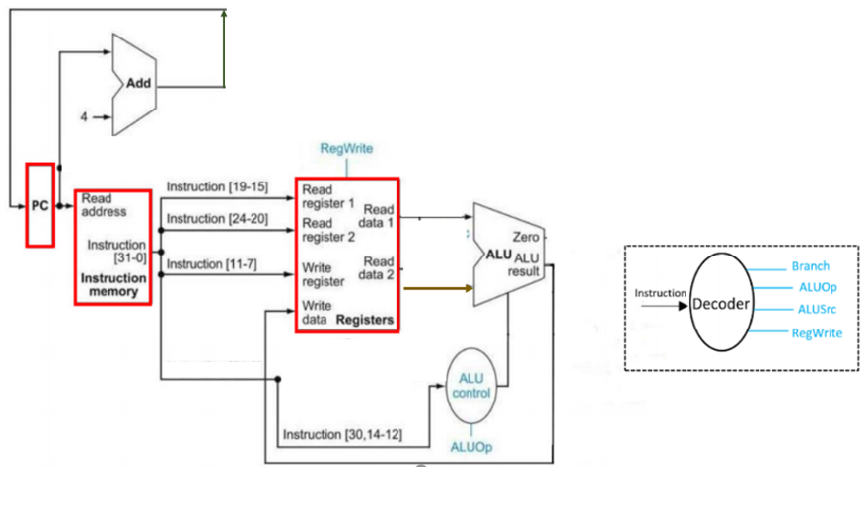
Overview of lab 3
Implement Datapath of Single Cycle CPU as below
Provided
Notes:
https://docs.google.com/spreadsheets/d/1ZUCVMoT-TsYwq-XjuQmA8R_mjxXebLykivcohCnJsTE/edit?usp=sharing

Slide 5
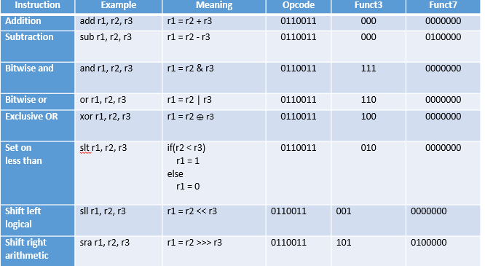
Basic Instruction set of lab3 (80%)
Notes:
https://

Slide 6
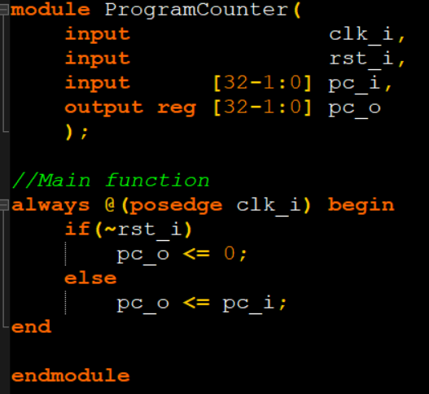
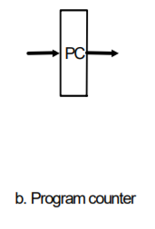
PC (TA offer)
Register use to store Program Counter value

Slide 7
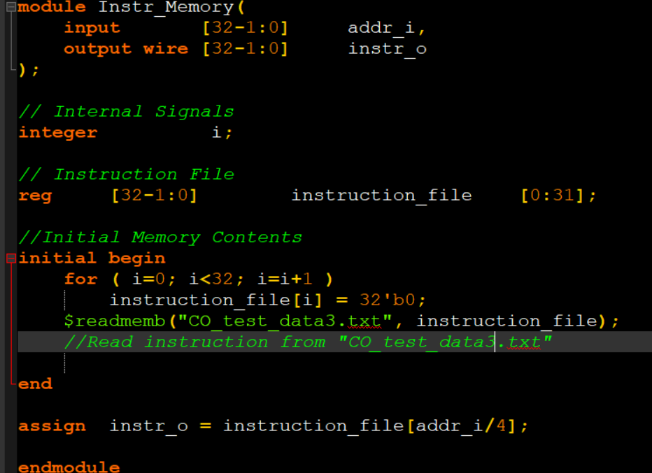
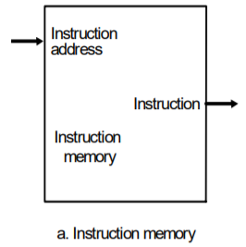
Instruction memory (TA offer)
Fetch instruction by using PC value

Slide 8
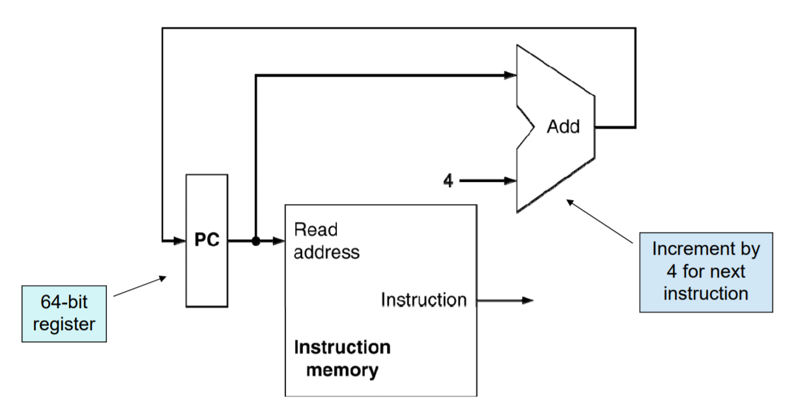
Instruction fetch

Slide 9
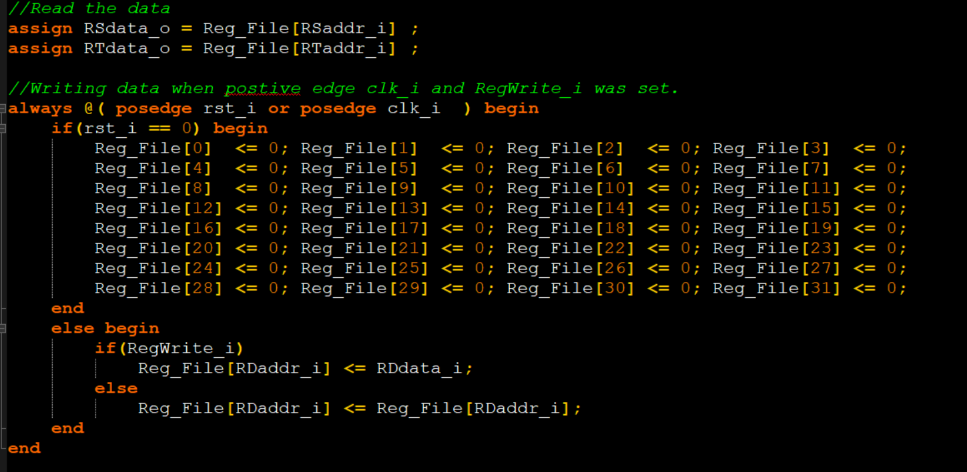
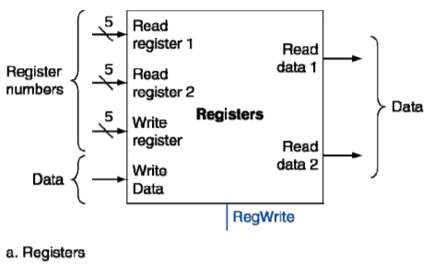

Register file(TA offer)

Slide 10
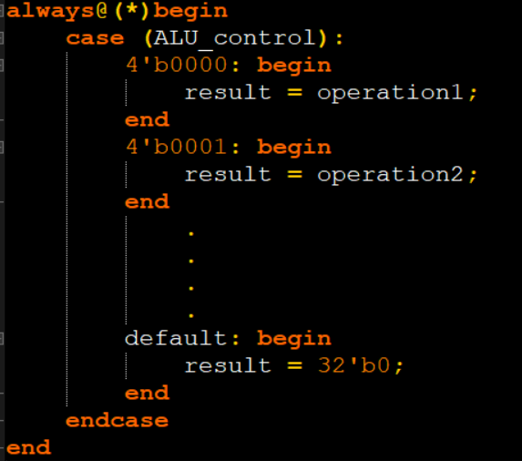
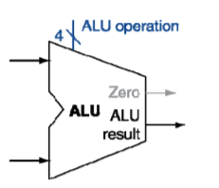
ALU
Extend ALU op design to support more instructions
You don’t need to bottom up build ALU form “ALU 1bit”
For instance:
same

Slide 11
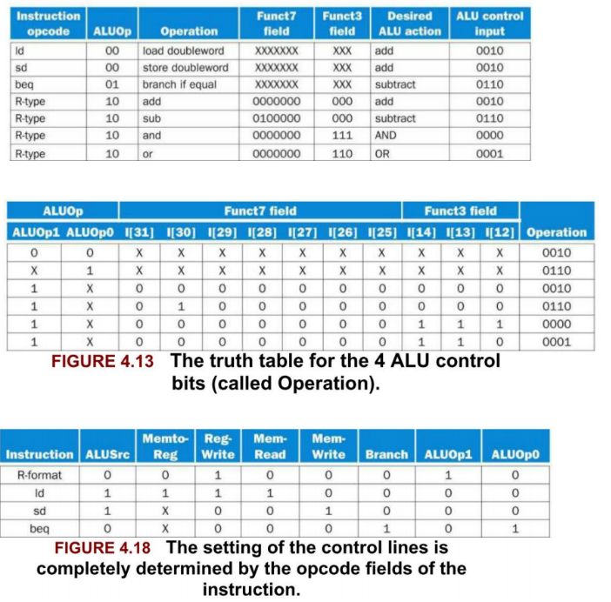
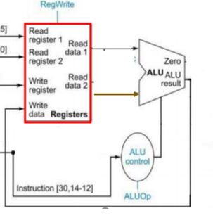
ALU_operation (ALU_control)
Value of ALU_operation (ALU_control) is assigned by “ALU_control”
More specific please follow
ALU_control unit

Slide 12
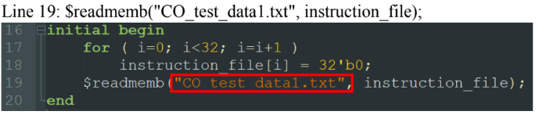
Testbench
10 test cases (CO_test_data1.txt ~ CO_test_data10.txt. , you can find details in testcase.txt)
Need to manual change by yourself
Edit line 19 in the file “Instr_Memory.v”
Notes:
https://

Slide 13
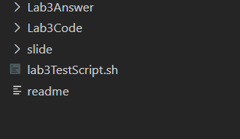
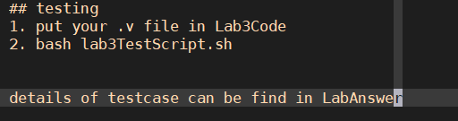
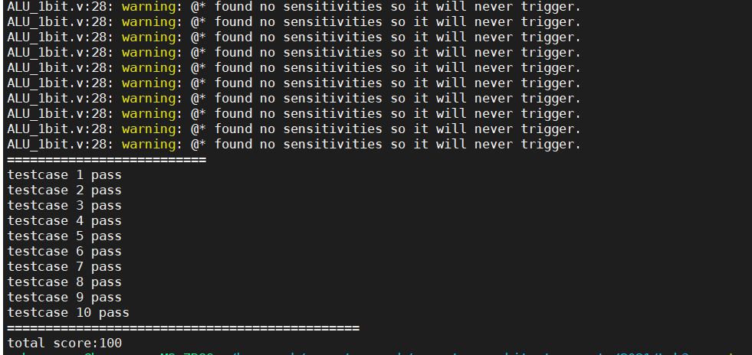
Testing
Testing environment : ubuntu 18.04

Slide 14
Submit format
GroupID_ID1_ID2.zip
GroupID_ID1_ID2/
Decoder.v , Simple_Single_CPU.v , alu.v , ALU_Ctrl.v,Adder.v

Slide 15
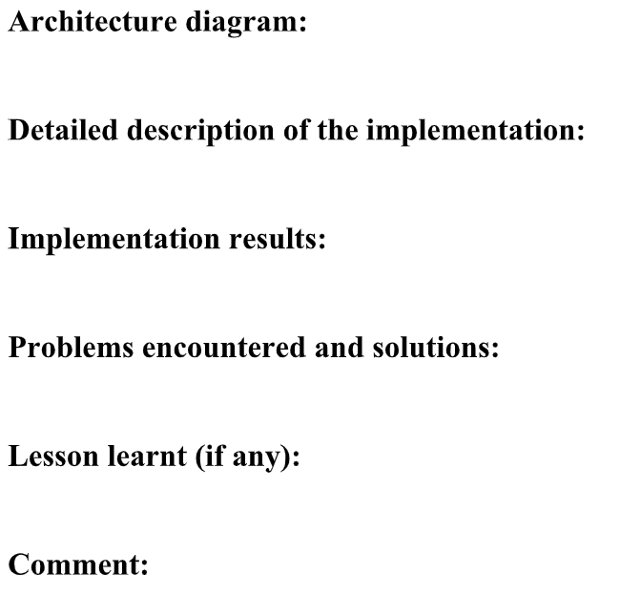
Report format
Can combine
Notes:
https://

