Slide 1
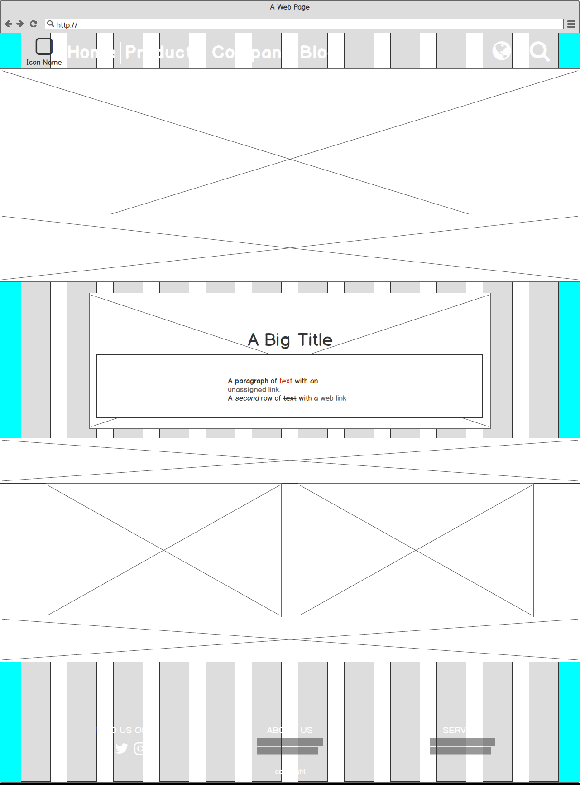

Slide 2
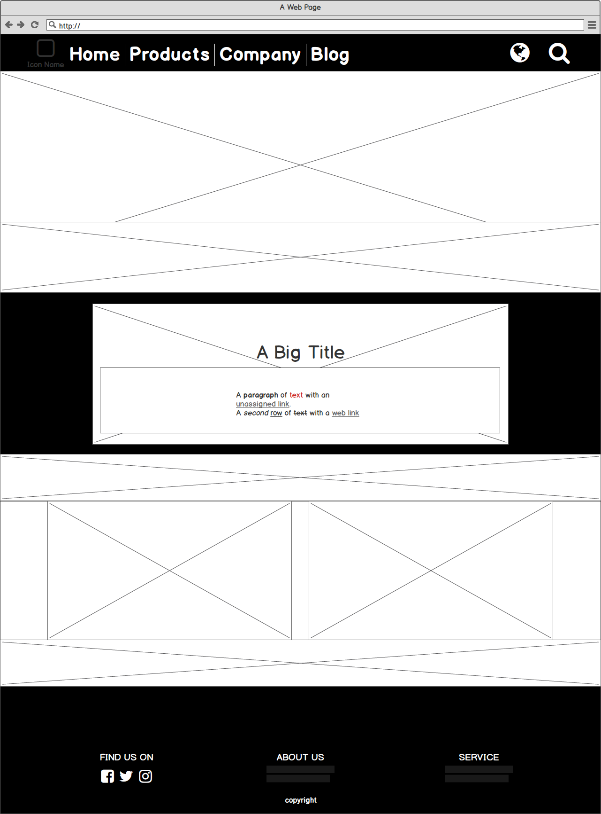

Slide 3
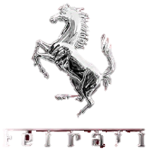
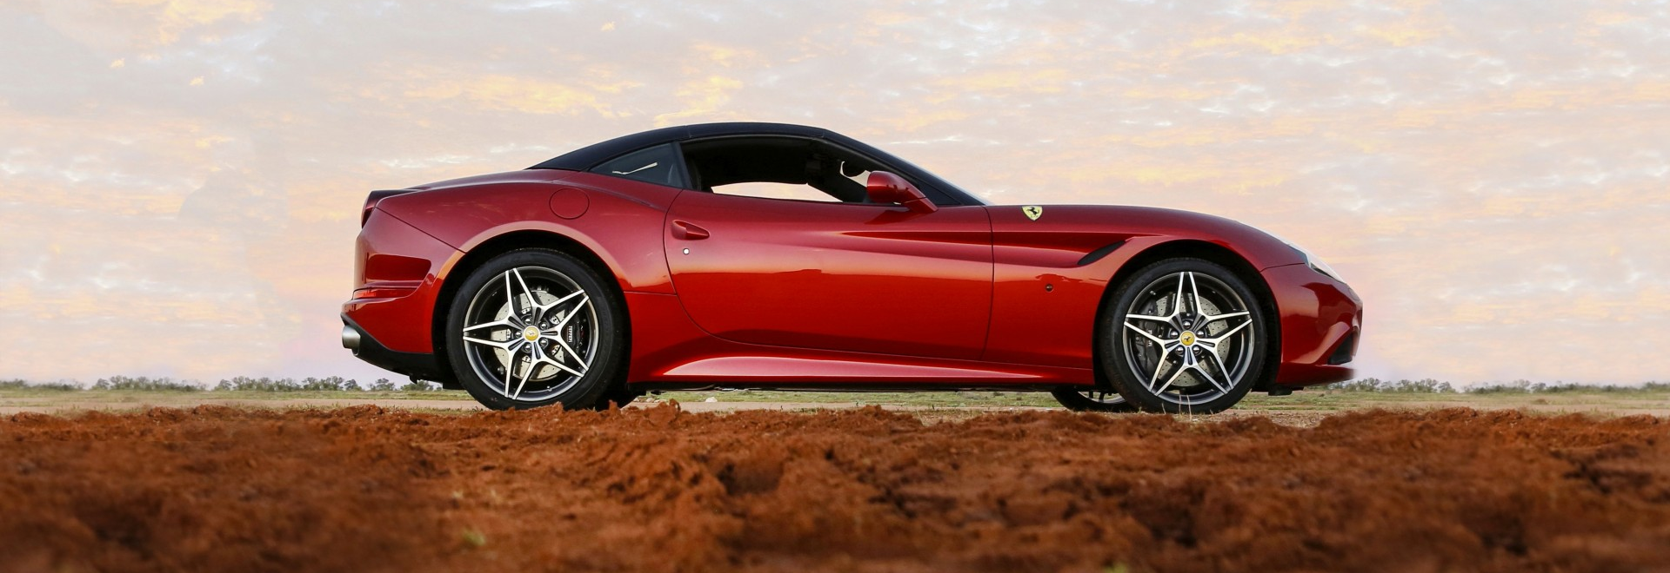

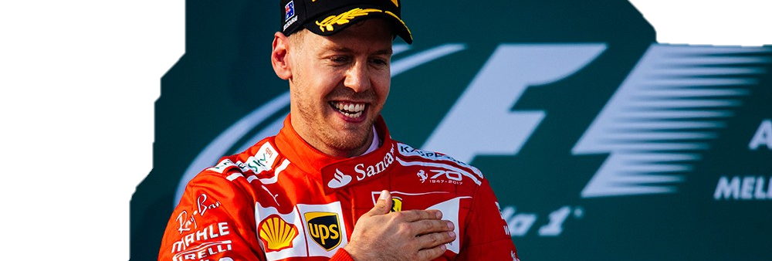

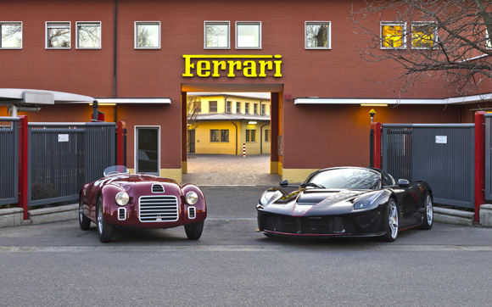
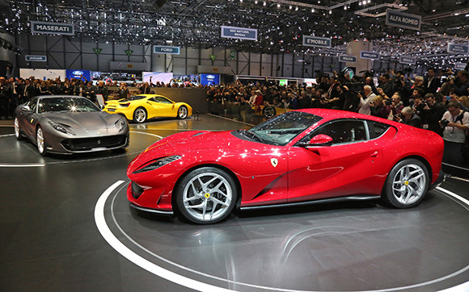

Australian Grand Prix –Vettel and Scuderia Ferrari on top in Australia
26 Mar 2017
Raikkonen fourth. A great job from the entire team
Melbourne – Ten years on from Kimi Raikkonen’s victory at Albert Park, Scuderia Ferrari has returned to winning ways in Melbourne, in the first race of the season. Sebastian Vettel crossed the finish line in first place after 57 laps, in a race whose key moment came on lap 23,….

Slide 4
1.logo
2.導覽列
3.語言&搜尋
4.封面圖
5.捷報
Australian Grand Prix –Vettel and Scuderia Ferrari on top in Australia
26 Mar 2017
Raikkonen fourth. A great job from the entire team
Melbourne – Ten years on from Kimi Raikkonen’s victory at Albert Park, Scuderia Ferrari has returned to winning ways in Melbourne, in the first race of the season. Sebastian Vettel crossed the finish line in first place after 57 laps, in a race whose key moment came on lap 23,….
6.其他資訊
7.聯絡資訊

Slide 5
此設計理念為重新設計他的官網
整體設計盡量下拉式來呈現
Australian Grand Prix –Vettel and Scuderia Ferrari on top in Australia
26 Mar 2017
Raikkonen fourth. A great job from the entire team
Melbourne – Ten years on from Kimi Raikkonen’s victory at Albert Park, Scuderia Ferrari has returned to winning ways in Melbourne, in the first race of the season. Sebastian Vettel crossed the finish line in first place after 57 laps, in a race whose key moment came on lap 23,….

