Slide 1
初階影像處理、嵌入式機器人視覺 及人機互動 (Introduction to Image Processing, Embedded Robot Vision and Human-Computer Interaction) Homework 1 Instructions (Python version)
TA:
Edward: thanhng1985@gmail.com
Charlie: p76074664@mail.ncku.edu.tw
Office Hour: 15:00~17:00, Mon. 20:00~22:00, Tue.
At CSIE 9F Robotics Lab.

Slide 2
Requirement
Python 3.6.5 (https://www.python.org/downloads/)
opencv-python (3.4.3.18)
pyqt5 (5.11.3)

Slide 3
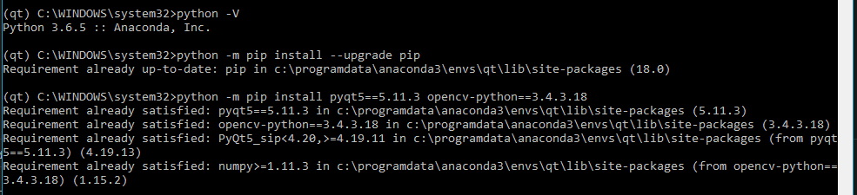
System Setup
Install Python 3.6.5
Run script below on your sell

Slide 4

Sample Code explanation
There are three files in Cv_Hw1_Python.zip, hw1.ui, hw1_ui.py, and hw1_example.py.
Modify MainWindow.py and add your code in callback function
Run your code simply by typing python hw1_example.py in your shell.

Slide 5
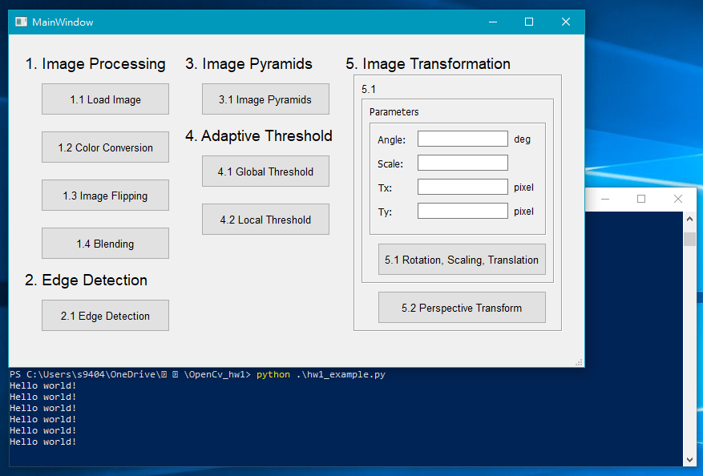
Example

