Slide 1
Story - 6 : What Is The State of Food Security and Nutrition in the US
CHUN SHING LEUNG

Slide 2
Do we suffer from malnutrition and starvation?
Is there a correlation between level of poverty and food insecurity?
what happens to the children as they mature into adults?

Slide 3
Food insecurity rate for low-income households was 6.5 times higher than that for mid/high-income households

Slide 4
17% (6.4 million) of households with children younger than 18 years old experience food insecurity

Slide 5
Children with food insecurity suffer from higher percentage of ACE

Slide 6
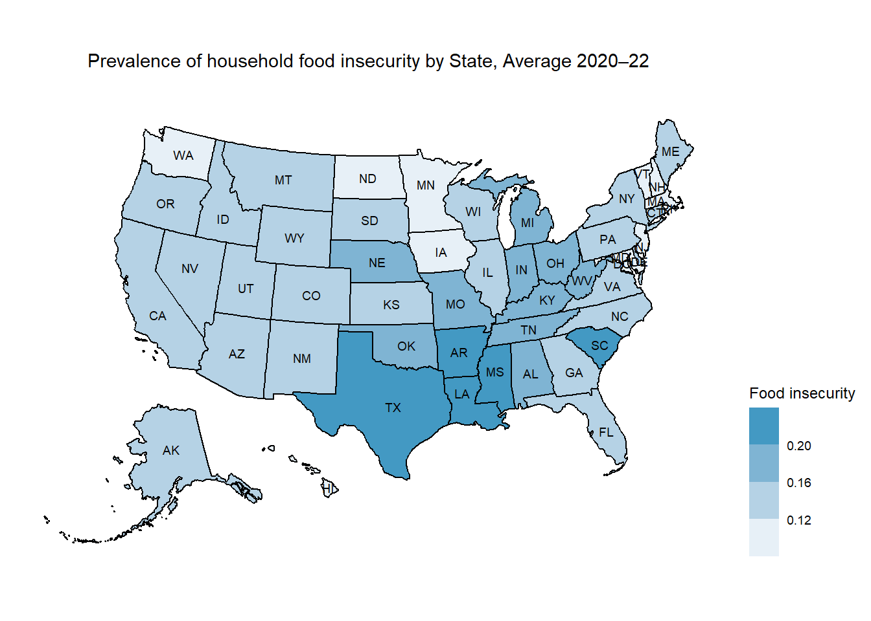
Southern States have higher Food insecurity rate

Slide 7
Conclusion
There is a Positive correlation between level of poverty and food insecurity
There are 6.4 million of households with children younger than 18 years old experience food insecurity. They tends to develop childhood adversity, including abuse, neglect, and household dysfunction. These are associated with negative long-term health and economic outcomes.
Southern States have higher Food insecurity rate

Slide 8
Reference
Statistical Supplement to Household Food Security in the United States in 2022
Childhood Adversity and Adult Reports of Food Insecurity Among Households With Children
Excel data for Story 6

