Slide 1
HiLo
Features
Package made available via GitHub
Low-fidelity wireframes for the app to show the proposed layout of the app.
use the Angular CLI to enforce standards across all of our front-end application repositories.
Employs Material2 components and DoC (Deck of Cards) API
The purpose of this demo is to demonstrate design and coding competencies. The end product will be an RC5+ Angular 2 App that employs the Angular-CLI to package and distribute the build. Goals
Create a play High/Low card game verses the end-user.
Employ Components to Keep it DRY
Utilize tutorials provided
Demonstrate ability to learn new subjects and tools
Benefits
Demonstrate both design thinking and approach to assignments
Highlight critical thinking skill but also use of resource and application
Demonstrate ability and desire to learn new material
Illustrate communication

Slide 2
HiLo: Gameplay
A quick look at App flow
Shuffle()
Deck Of
Cards
API
Start Game()
Play()
uDraw()
userBets()
Draw()
dDraw()
fEvaluate()
Exit()

Slide 3
HiLo: Modeling
A quick look at the Objects required.
OBJECT: Player
EVENT | When: | Calls: | Properties
Init | Dealer Welcomes User intros game Shuffles Deck draws card | Dialog Inherits Name Touts Score
METHOD | Description |  | Role | Dealer| player
 |  |  | Name | uDealer
 |  |  | Score

Slide 4
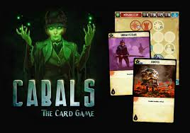
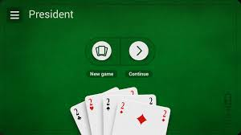
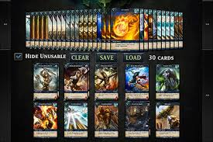
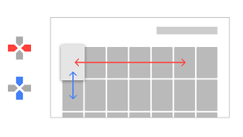
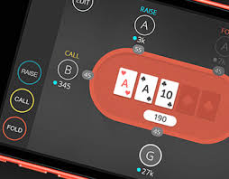
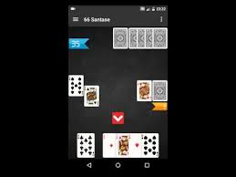
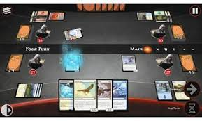
HiLo: Gameplay
The purpose of this demo is to demonstrate design and coding competencies. The end product will be an RC5+ Angular 2 App that employs the Angular-CLI to package and distribute the build.
Features
Material design
Responsive (Stretch)
Clean, and appropriate interface
View shows dealer, cards, user controls and game state

Slide 5
HiLo: UI
App Container {{ hILoPlay}}
The main application component should contain a navigation toolbar with the title of your app.
Hi-Lo: Welcome
The toolbar should also contain a button to change the theme of the page from light to dark..
The purpose of this demo is to demonstrate design and coding competencies. The end product will be an RC5+ Angular 2 App that employs the Angular-CLI to package and distribute the build.
Create a play High/Low card game verses the end-user.
Employ Components to Keep it DRY
Utilize tutorials provided
Demonstrate ability to learn new subjects and tools
The body of this component will contain the html tag for the component described below.
{{dialog}}
btn1
btn2
Features
Package made available via GitHub
Low-fidelity wireframes for the app to show the proposed layout of the app.
use the Angular CLI to enforce standards across all of our front-end application repositories.
Employs Material2 components and DoC API
Benefits
Demonstrate both design thinking and approach to assignments
Highlight critical thinking skill but also use of resource and application
Demonstrate ability an desire to learn new material
Illustrate communication

Slide 6
HiLo: UI
Hi-Lo: Choose Higher or Lower
App Container {{hiLoPlay}}
The purpose of this demo is to demonstrate design and coding competencies. The end product will be an RC5+ Angular 2 App that employs the Angular-CLI to package and distribute the build.
Create a play High/Low card game verses the end-user.
Employ Components to Keep it DRY
Utilize tutorials provided
Demonstrate ability to learn new subjects and tools
{{dialog}}
btn1
btn2
Features
Package made available via GitHub
Low-fidelity wireframes for the app to show the proposed layout of the app.
use the Angular CLI to enforce standards across all of our front-end application repositories.
Employs Material2 components and DoC API
Benefits
Demonstrate both design thinking and approach to assignments
Highlight critical thinking skill but also use of resource and application
Demonstrate ability an desire to learn new material
Illustrate communication

