Slide 1
Disjoint Set Union

Slide 2
Motivation
We need to handle 2 type of queries-
Add edge between 2 nodes
Check if there is a path between two nodes. (Are 1 nodes connected)

Slide 3
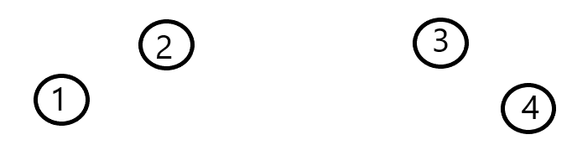
Add edges between 1-2, 2-3

Slide 4
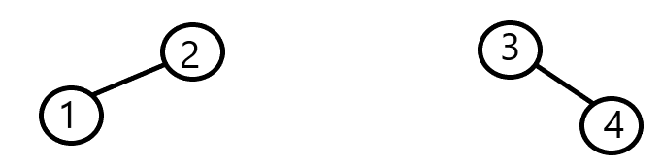
Check if path between 1 and 4 -> NO.
Now Add an edge between 2 and 3

Slide 5
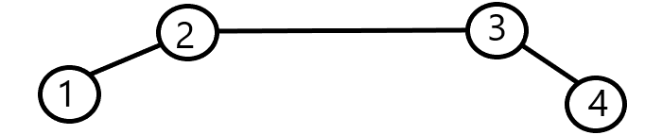
Check if path between 1 and 4-> YES

Slide 6
DSU...
Let say there are n Nodes…
Define an array Parent[]
Value of Parent of index i is ‘i’ initially

Slide 8
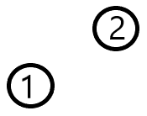
How to add edge between two elements?
Initially- Parent array - index 1 2 Parent [ ] 1 2

Slide 9
After adding an edge-
Now- Parent array - index 1 2 Parent [ ] 2 2
Change Parent of 1.
Now Parent is 2

Slide 10
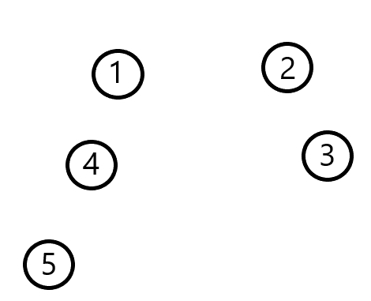
Index - 1 2 3 4 5
Parent- 1 2 3 4 5

Slide 11
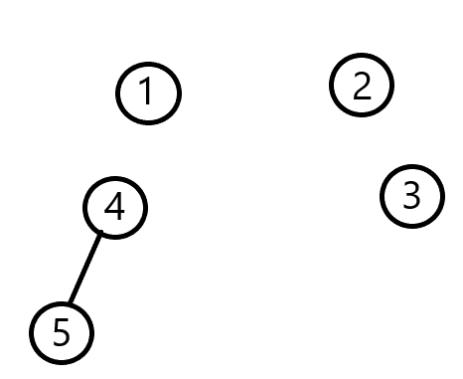
Add edge between 4-5
Index - 1 2 3 4 5
Parent- 1 2 3 4 4

Slide 12
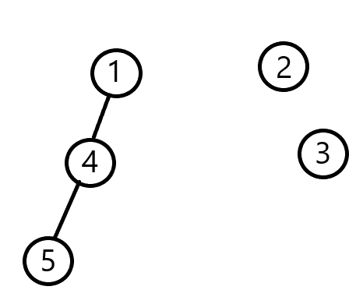
Add edge between 1-4
Index - 1 2 3 4 5
Parent- 1 2 3 1 4

Slide 13
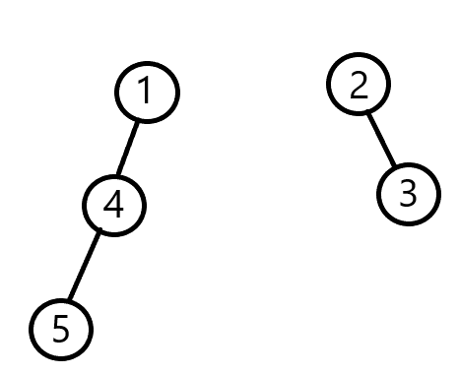
Add edge between 2-3
Index - 1 2 3 4 5
Parent- 1 2 2 1 4

Slide 14
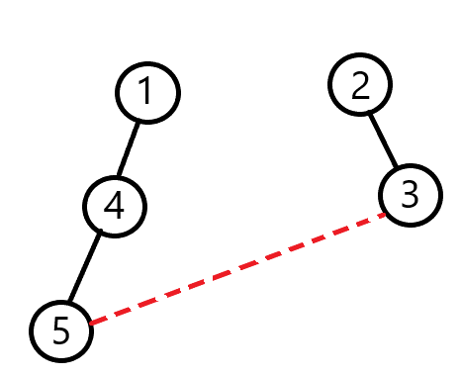
Add edge between 5 and 3
Index - 1 2 3 4 5
Parent- 1 2 2 1 4

Slide 15
5 calls 4 asking for his SUPER PARENT NODE.
1 is SUPER PARENT
4 calls 1 asking for his SUPER PARENT NODE.
Who is SUPER PARENT?
1 says I am SUPER PARENT. So it returns 1.
Returns 1
4 also returns value of 1
Who is SUPER PARENT?
Index - 1 2 3 4 5
Parent- 1 2 2 1 4
Returns 1

Slide 16
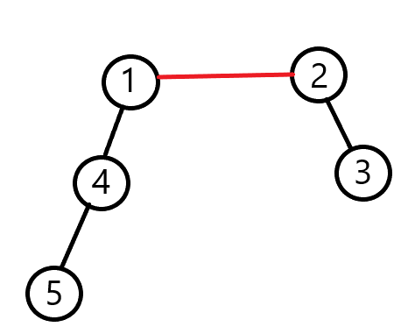
What we get is-
Super parent of 5 is 1
Super Parent of 3 is 2
NOW ADD EDGE BETWEEN 1-2
Index - 1 2 3 4 5
Parent- 1 1 2 1 4

Slide 17
We need 2 functions
Find (int node) -> to find the super parent of a node.
Union(int a,int b)-> to add edge between two nodes.

Slide 18
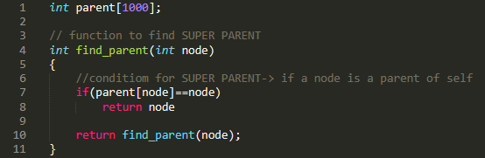
Find function

Slide 19
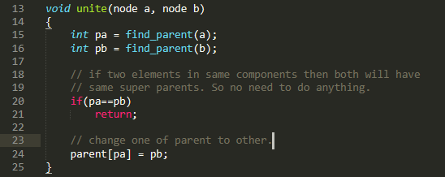
Union Function

Slide 20
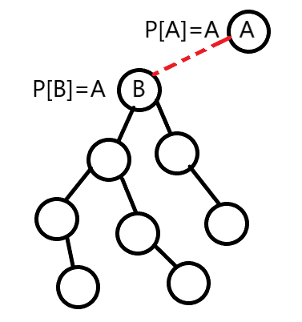
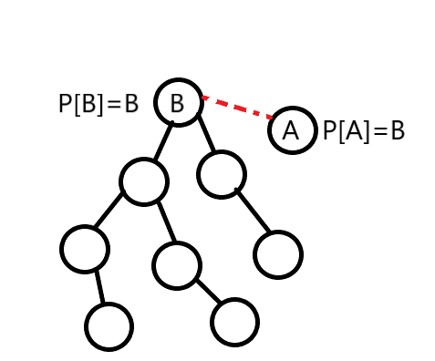
Optimisation 1

Slide 21
Solution- choose new super parent on basis of size of component.
Intially all nodes has size 1. Combine two nodes on basis of size only.

Slide 22
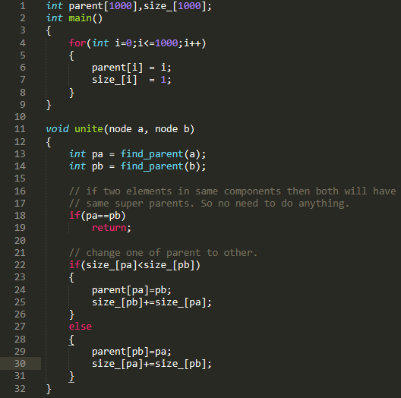
Initial conditon-
Every node is itself super parent
And size of component is 1.

Slide 23
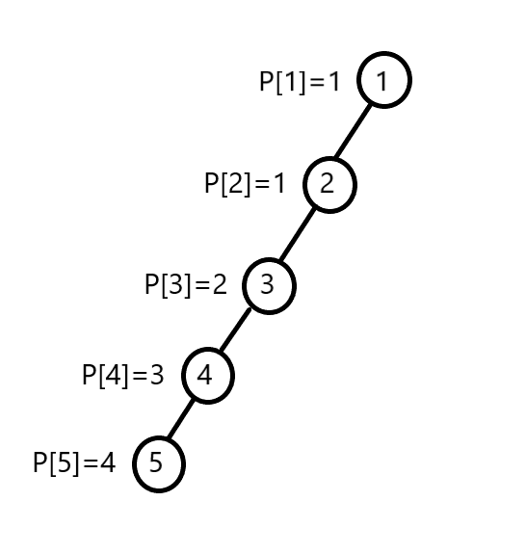
Optimisation 2- Path Compression
Returns 1
Why not all the nodes update themselves with
Parent [node] = 1 ???
Returns 1
Returns 1
Returns 1

Slide 24
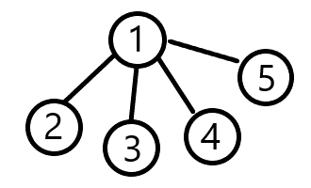
So finally it should look like this.
Index - 1 2 3 4 5
Parent- 1 1 1 1 1

Slide 25
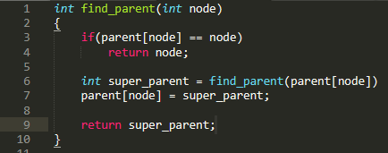

Slide 26
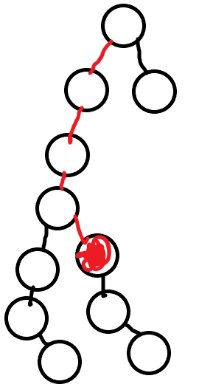
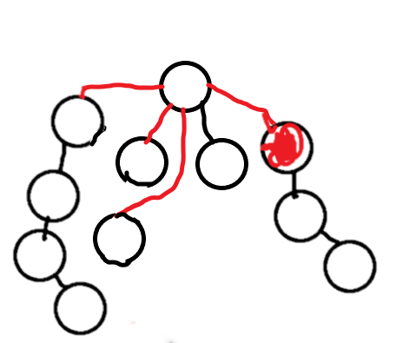
Complexity-
Complexity is O(n).
Because once u traversed over a unnecessary edge…. U will not go over it again.
In actual complexity is O(n*Alpha(n)) where Alpha(n) is reverse Ackermann function.

Slide 27
Qno.s
https://www.spoj.com/problems/NITTROAD/
https://codeforces.com/problemset/problem/371/D
https://www.spoj.com/problems/KOICOST/ (Do it urself)

Slide 28
First question-
Basically says to calculate no. of different connected components.
Now add all the edges.
Now check how many different super parents are there. As eac super Parent denotes its own Component.
(You can use for set for keeping unique entries or a simple array can also work).

Slide 29
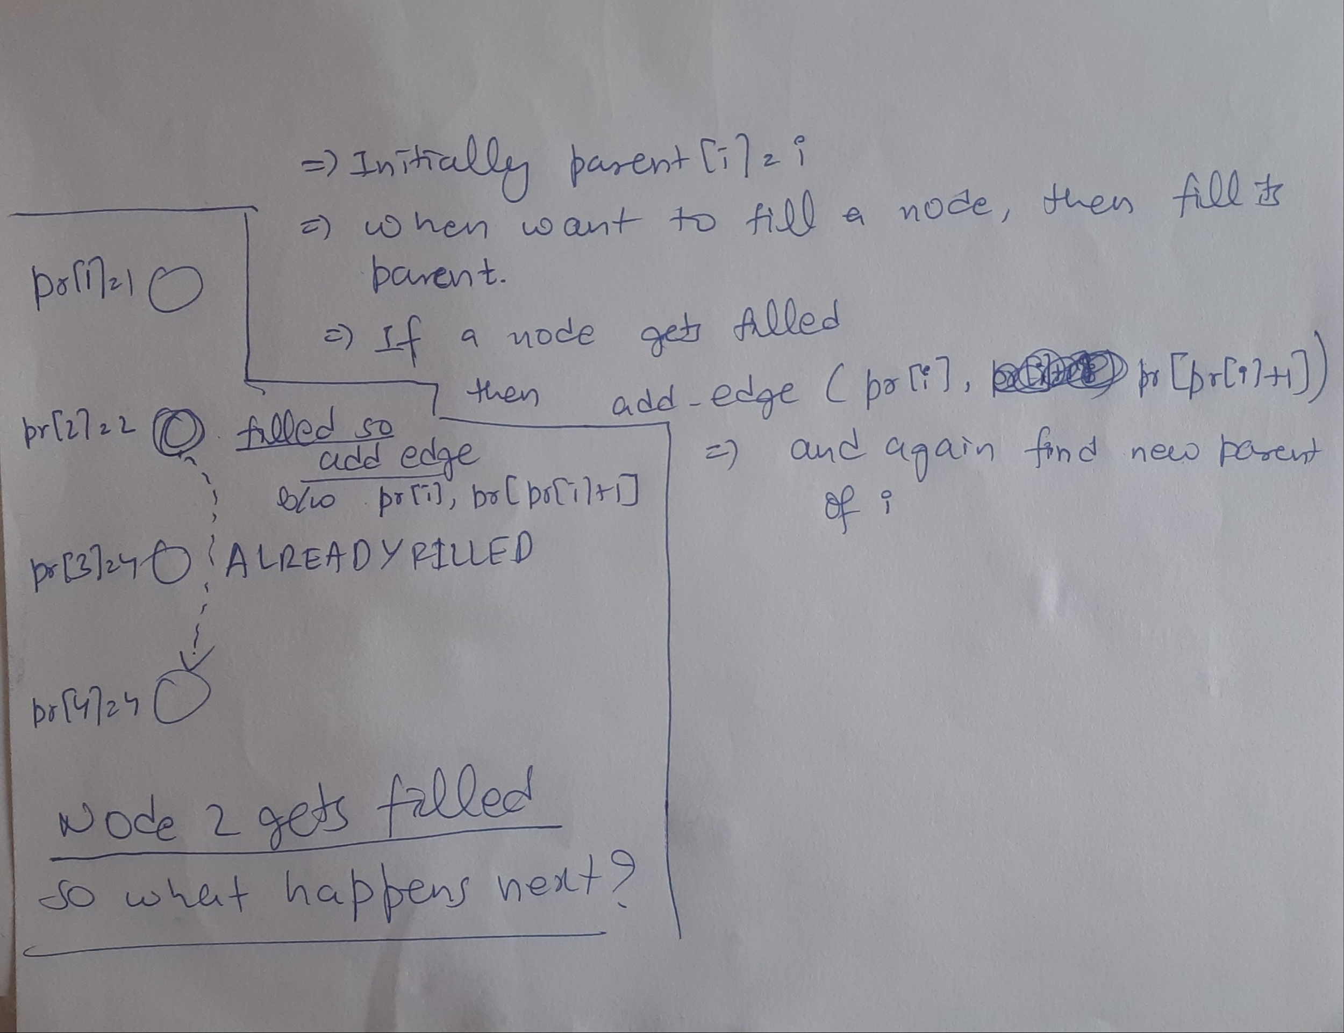
Second question

