Slide 1
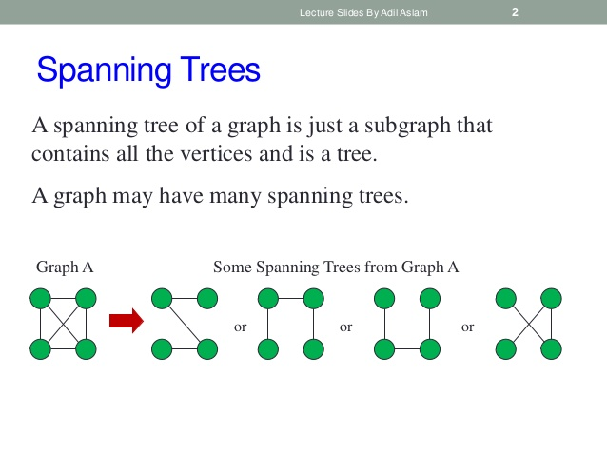
Notes:
No. of spanning tree in a complete graph = n^(n-2)

Slide 2
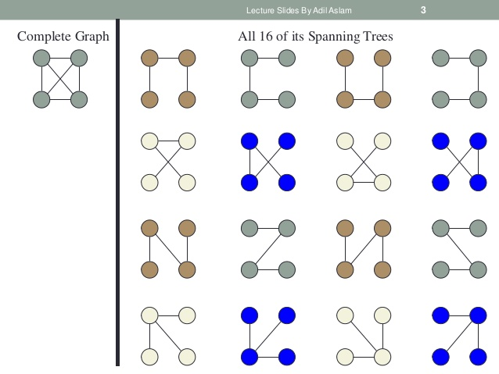

Slide 3
Minimum Spanning Tree
A minimum spanning tree or minimum weight spanning tree is a subset of the edges of a connected, edge-weighted undirected graph that connects all the vertices together, without any cycles and with the minimum possible total edge weight. That is, it is a spanning tree whose sum of edge weights is as small as possible.
Applications : Computer Networks

Slide 4
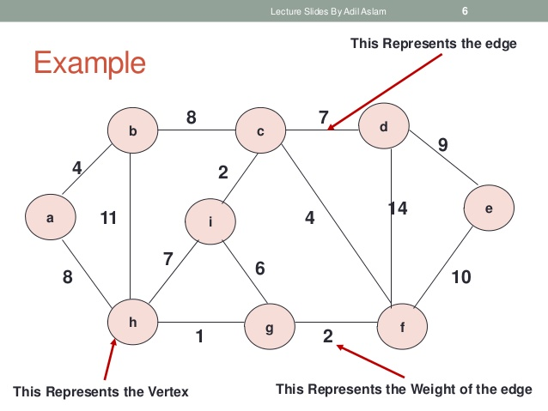

Slide 5
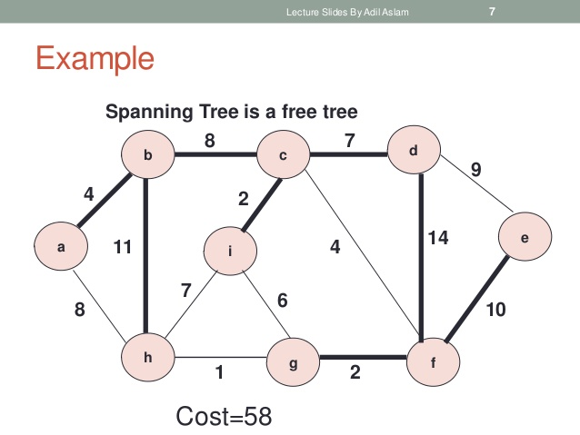

Slide 6
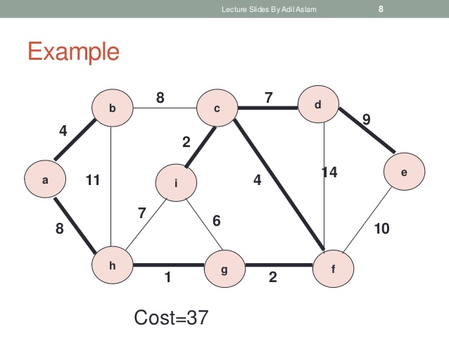

Slide 7
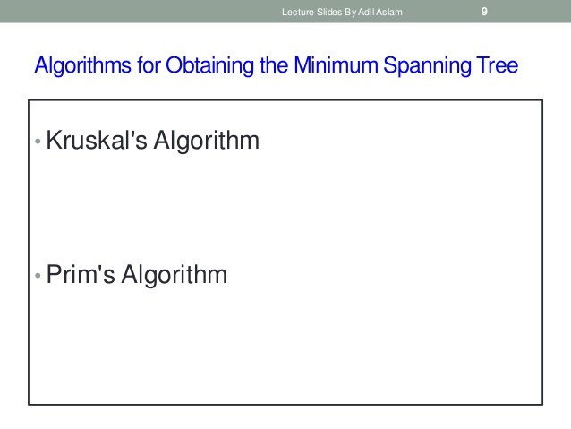

Slide 8
Kruskal’s Algorithm
Step 1: Sort the edges according to their weight.
Step 2 : Select the first |V|-1 edges such that they do not make circuit/loop with previously selected edges ( If the edges make a loop or not is checked using union and find functions of dsu).

Slide 9
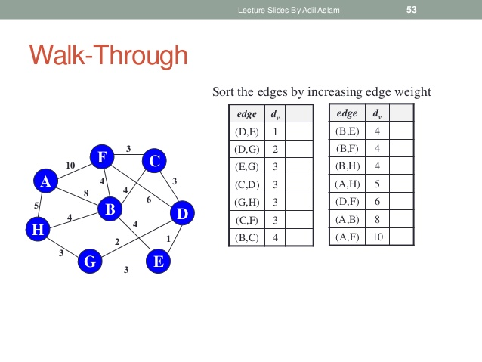

Slide 10
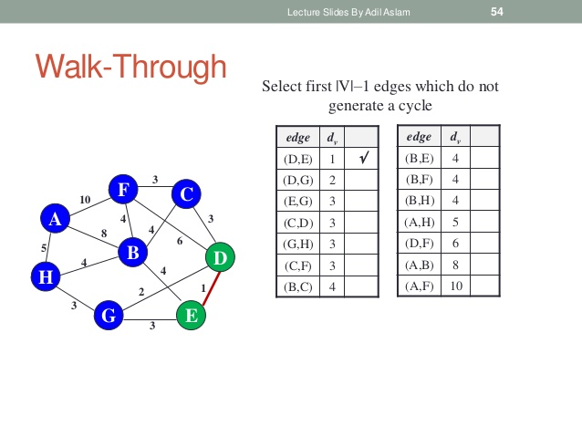

Slide 11
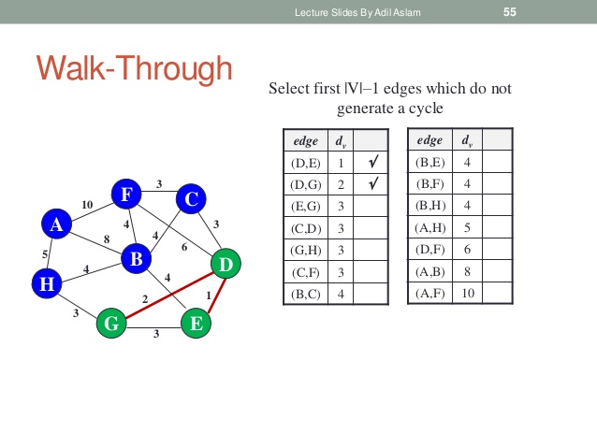

Slide 12
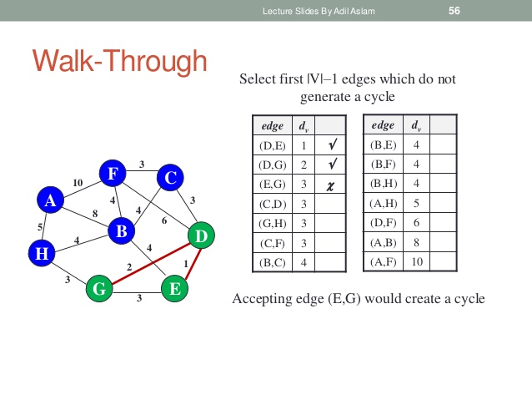

Slide 13
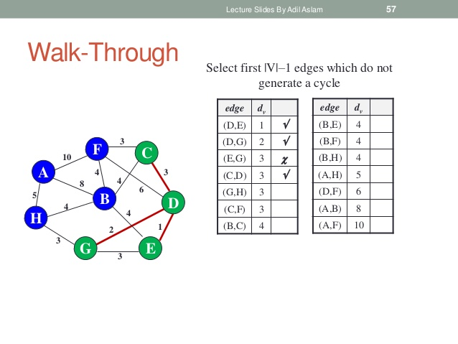

Slide 14
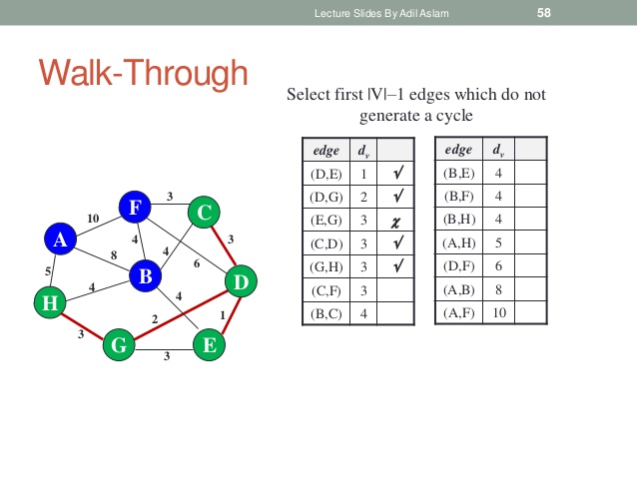

Slide 15
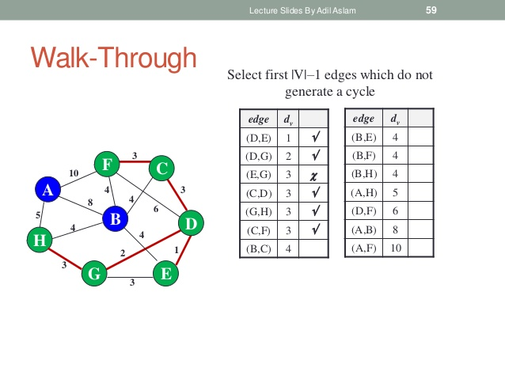

Slide 16
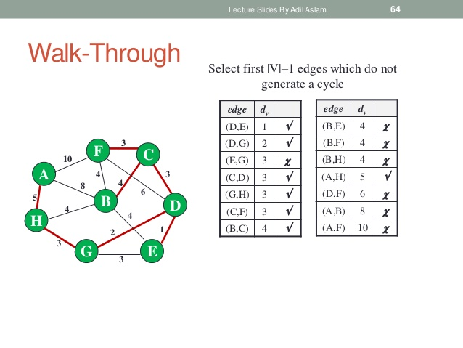

Slide 17
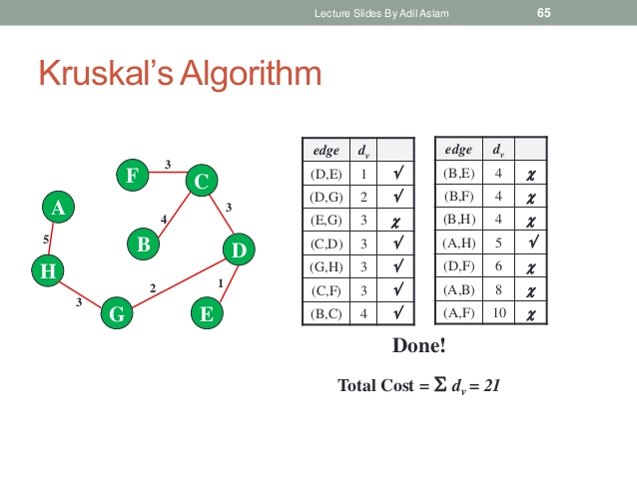
Notes:
How to check whether adding that edge creates a loop or not?

Slide 18
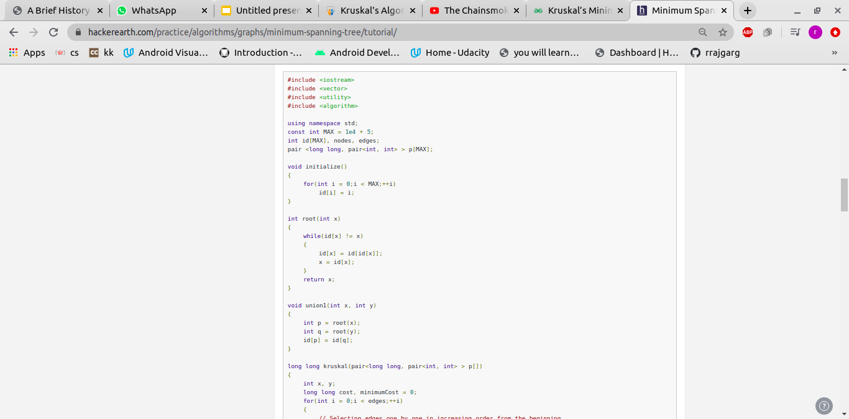
Code:

Slide 19
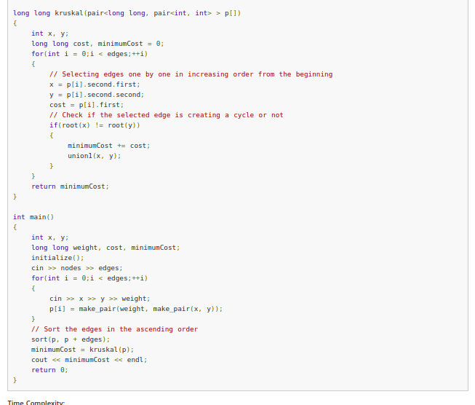

Slide 20
Complexity:
Time complexity: O(mlog(n)) where m is the number of edges and n is the number of nodes.
Notes:
MST in directed graph.

Slide 21
Ques:
There are N homes in a village, we have to facilitate water supply in each of them. We can either build a well in a home or connect it with pipe to some different home already having water supply. More formally, we can either build a new well in the home or connect it with a pipeline to some different home which either has it’s own well or further gets water supply from a different home and so on. There is some cost associated with both building a new well and laying down a new pipeline. We have to supply water in all homes and minimise the total cost.

Slide 22
Floyd Warshall
Algorithm

Slide 23
Floyd Warshall Algorithm
Dynamic programming approach.
All pair shortest path algorithm.
Works for graph with negative weight.
Application
Transitive closure of graph.

Slide 24
Floyd Warshall Algorithm
Pseudo Code
n ← rows [W].
D⁰ ← W
for k ← 1 to n
do for i ← 1 to n
do for j ← 1 to n
do d_{ij}^{(k)} ← min (d_{ij}^{(k-1)},d_{ik}^{(k-1)}+d_{kj}^{(k-1)} )
return D^{(n)}

Slide 25
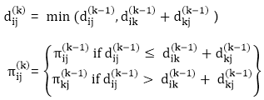
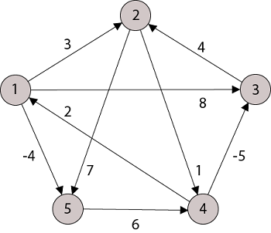
Floyd Warshall Algorithm
Example :-

Slide 26
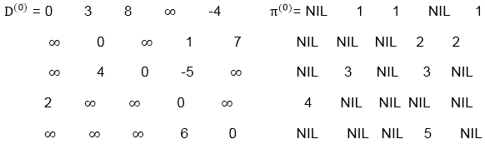
Floyd Warshall Algorithm
Step 0

Slide 27
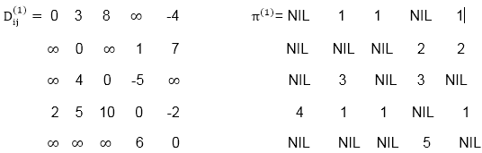
Floyd Warshall Algorithm
Step 1

Slide 28
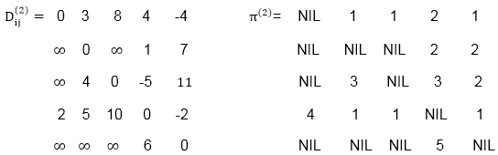
Floyd Warshall Algorithm
Step 2

Slide 29
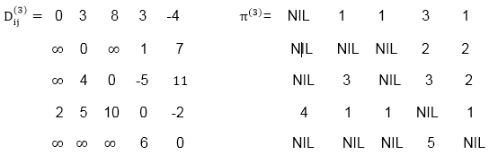
Floyd Warshall Algorithm
Step 3

Slide 30
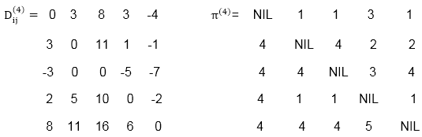
Floyd Warshall Algorithm
Step 4

Slide 31
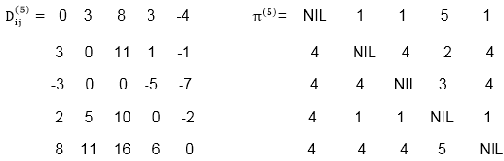
Floyd Warshall Algorithm
Step 5

Slide 32
Floyd Warshall Algorithm
Complexity
Time complexity - O(N^3).
Space complexity - O(N^2)

Slide 33
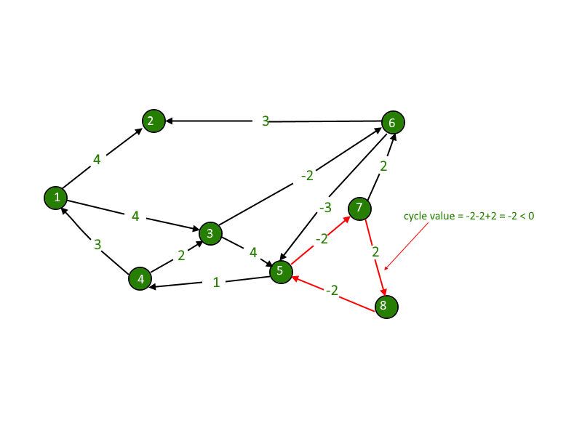
Floyd Warshall Algorithm
Negative Cycle Detection
If there exists an i from {1,..., n}
such that d_{ii}^{n} < 0.
then, graph has negative cycle.

