Slide 1
WordPress Test

Slide 2
version: '3'
services:
mysql1:
image: mysql:5.7
environment:
MYSQL_ROOT_PASSWORD: password
MYSQL_DATABASE: wordpress1
volumes:
- db1:/var/lib/mysql
mysql2:
image: mysql:5.7
environment:
MYSQL_ROOT_PASSWORD: password
MYSQL_DATABASE: wordpress2
volumes:
- db2:/var/lib/mysql
wordpress1:
image: wordpress
ports:
- "8000:80"
depends_on:
- mysql1
environment:
WORDPRESS_DB_HOST: mysql1
WORDPRESS_DB_USER: root
WORDPRESS_DB_PASSWORD: password
WORDPRESS_DB_NAME: wordpress1
wordpress2:
image: wordpress
ports:
- "8001:80"
depends_on:
- mysql2
environment:
WORDPRESS_DB_HOST: mysql2
WORDPRESS_DB_USER: root
WORDPRESS_DB_PASSWORD: password
WORDPRESS_DB_NAME: wordpress2
volumes:
db1:
db2:
Question1: Stand up two instances of WordPress using either the default WordPress Docker image or ours at https://gallery.ecr.aws/ibleducation/ibl-web-ce (our image is built using the Bedrock version of WordPress for added security).
Answer: Use docker compose to setup two WordPress services binding to different ports.

Slide 3
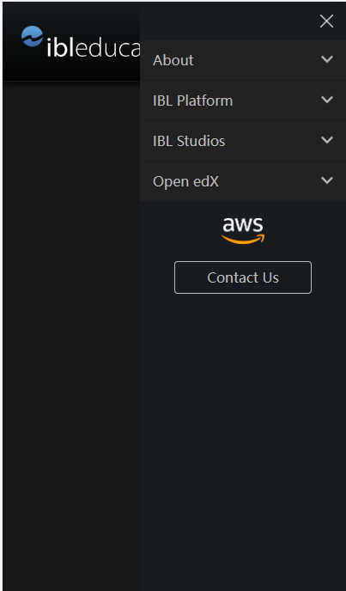
Question2: Create a WordPress theme that includes the header (in Desktop and Mobile) of ibleducation.com. Install this on both WordPress environments.
Answer:
1. Create a WordPress theme named IBLTheme.
2. view-source: https://ibleducation.com, copy header menu part and js scripts as well.
3. Install the theme to both environments.
4. Test the theme with desktop and mobile browser to verify header works well.
Better Solution:
It should read relative part of ibleducation site with code, after view-source the site, I gave up this idea for a few reasons. Maybe it could be reimplemented later.

Slide 4
<?php
/*
Plugin Name: Greeting API
Description: Exposes a simple API that stores a greeting message in the database.
*/
// Create database table for storing greeting message
function create_greeting_table()
// Register activation hook for creating database table
register_activation_hook( __FILE__, 'create_greeting_table' );
// Define API endpoint for storing greeting message
add_action( 'rest_api_init', function () {
register_rest_route( 'greeting-api/v1', '/store/', array(
'methods' => 'POST',
'callback' => 'store_greeting_message',
'permission_callback' => function ( $request ) {
$oauth = new OAuth2();
return $oauth->verifyAccessToken($request);
},
'args' => array(
'greeting' => array(
'required' => true,
'sanitize_callback' => 'sanitize_text_field'
)
)
) );
} );
// Store greeting message in database
function store_greeting_message()
// display the greetings in a table
function display_greetings() {
}
// create a new admin menu item that will display the greetings when clicked
function add_greetings_menu() {}
add_action( 'admin_menu', 'add_greetings_menu' );
Question3: Create a plugin that exposes an API that is secured behind an OAuth2 layer. It should take a single parameter (let’s call it “greeting”) and store it in its database. The plugin should also display the greeting on the WordPress Admin screen. Install this on both WordPress environments.
Answer:
1. Create a WordPress plugin named greeting-api.
2. Implement it with a few functions for table creating, hook register, greetings save to database, admin action and display etc.
3. With ‘permission_callback’ to secure API behind OAuth2 layer, and a fake OAuth2 to manually control for a test purpose.
4. Install it to both environments.
5. Testing with Postman
5.1 OAuth2 verify token returns True, the greetings saved to database and viewed from admin screen.
5.2 OAuth2 verify token returns False, the Postman client saw a ’40x’ message for authorization issue.

Slide 5
Question4: Create a Gutenberg block that, when installed on one WordPress environment, calls the API of the other WordPress environment with a custom greeting.
Answer:
1. Create a Gutenberg plugin named gutenpride with the help of:
Create a Block Tutorial | Block Editor Handbook | WordPress Developer Resources
2. Modify gutenpride.php for requirements
2.1 Use ‘server port’ to know who I am and send requests to another WordPress environment.
2.2 Use ‘update_option’ and ‘set_option’ to send request only once.
3. Test it with install, active, deactive, active the plugin, see the greetings from another WordPress environment only once.
<?php
function send_post_request_on_block_install() {
$request_ip = $_SERVER['REMOTE_ADDR'];
$running_port = (int) $_SERVER['SERVER_PORT'];
// Send greetings to different server
$port = $running_port == 8000 ? 8001: 8000;
$url = "http://192.168.22.126:$port/wp-json/greeting-api/v1/store/";
$args = array(
'body' => array(
'greeting' => "Greetings from Gutenberg Block with IP $request_ip",
),
);
wp_remote_post( $url, $args );
}
function create_block_gutenpride_block_init() {
register_block_type( __DIR__ . '/build' );
// Check if the block has already been installed
$block_installed = get_option( 'my_gutenberg_block_installed' );
if ( ! $block_installed ) {
// Set the flag to indicate that the block has been installed
update_option( 'my_gutenberg_block_installed', true );
// Call the HTTP POST request function when the block is installed
send_post_request_on_block_install();
}
}
add_action( 'init', 'create_block_gutenpride_block_init' );

