Slide 1
Design and Implementation of an Eating Home in a University Campus ABSTRACT
Staff and students eat food in the university without having an idea of where the food is prepared, if it is in a clean environment, how the food is being prepared, the content of the food and the services rendered are unprofessional. Because of these problems found within the restaurants available in the university, the researcher came up with an idea of an online meal booking system. The booking system is implemented alongside with a real kitchen that cub out the aforementioned problems encountered in restaurants within the university. Time on the part of the lecturer can also be well utilized with the introduction of this system, since they can sit at their offices and make orders via the internet/intranet if available in the university instead of leaving their offices to go get meals which can further lead to time wastage at the detriment of their piled up jobs.
The methodology adopted in solving the problems faced by the present system is the Rapid Application Development (RAD) which is a process of developing software utilizing visual prototypes along with Computer Aided Software Engineering (CASE) tools and in achieving the design of the proposed system was by using HTML (xml compliance), CSS, JAVASCRIPT and PHP(Hypertext Preprocessor) for dynamic web interfacing with MySQL as the database for collecting user entries.
The objective of this project is to design an online meal booking system where food preparation for a large number of staff members is a requirement on a daily basis, the system’s user interface is exceptionally user-friendly, the system requires minimal training, the system incorporates multiple users, and it’s a web based technology.

Slide 2
EXISTING SYSTEM
ANALYSIS OF THE PRESENT SYSTEM
The present system refers to the traditional way of going to buy your food from an eating home. It doesn’t have any information system that is used for this purpose.
Advantages of the present system
1. The system can be easily accessed since it is done manually.
2. The system to an extent is reliable since it is a manual system.
Disadvantages of the present system
1. The process can be time wasting, since you have to go there to purchase it yourself.
2. The process can be very frustrating when there is a high demand for the food.

Slide 3
PRESENT SYSTEM
ANALYSIS OF THE PROPOSED SYSTEM
The proposed system is an online university eating home, that is suppose to provide students, lecturers and non academic staffs the opportunity to order their food and drinks online and have it brought to them where ever they may be in the school environment.
Advantages of the proposed system
The proposed system is reliable since it is to be run by the school administration.
The proposed system is affordable.
The proposed system is time – efficient.
The proposed system is easy to use.
Disadvantages of the proposed system
The main problem of the proposed system is that requires some internet connectivity for it to function.

Slide 4
FLOW CHART OF PROPOSED SYSTEM

Slide 5
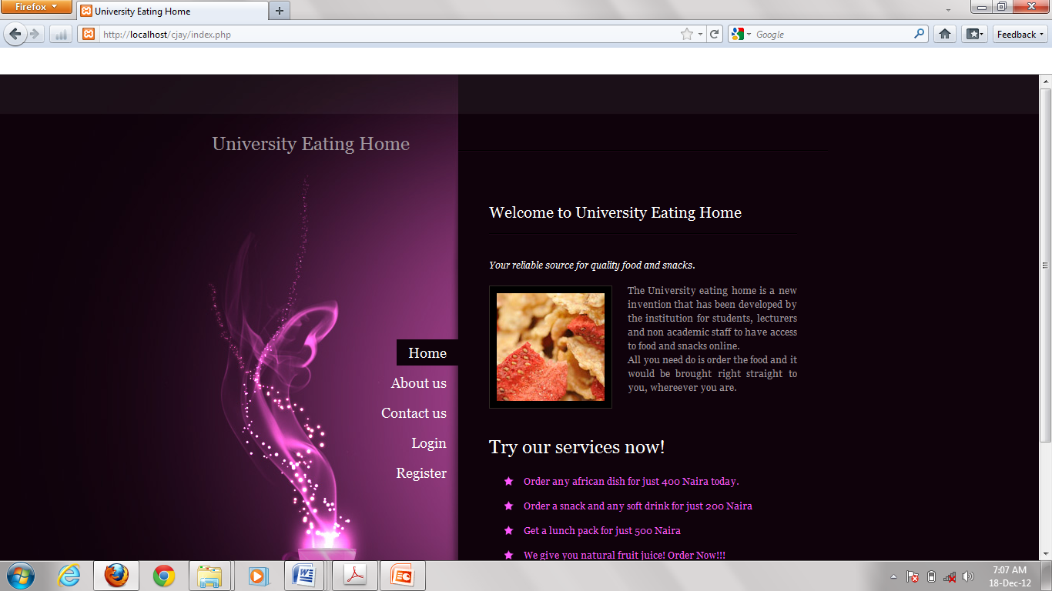
SNAPSHOT OUTPUT

Slide 6
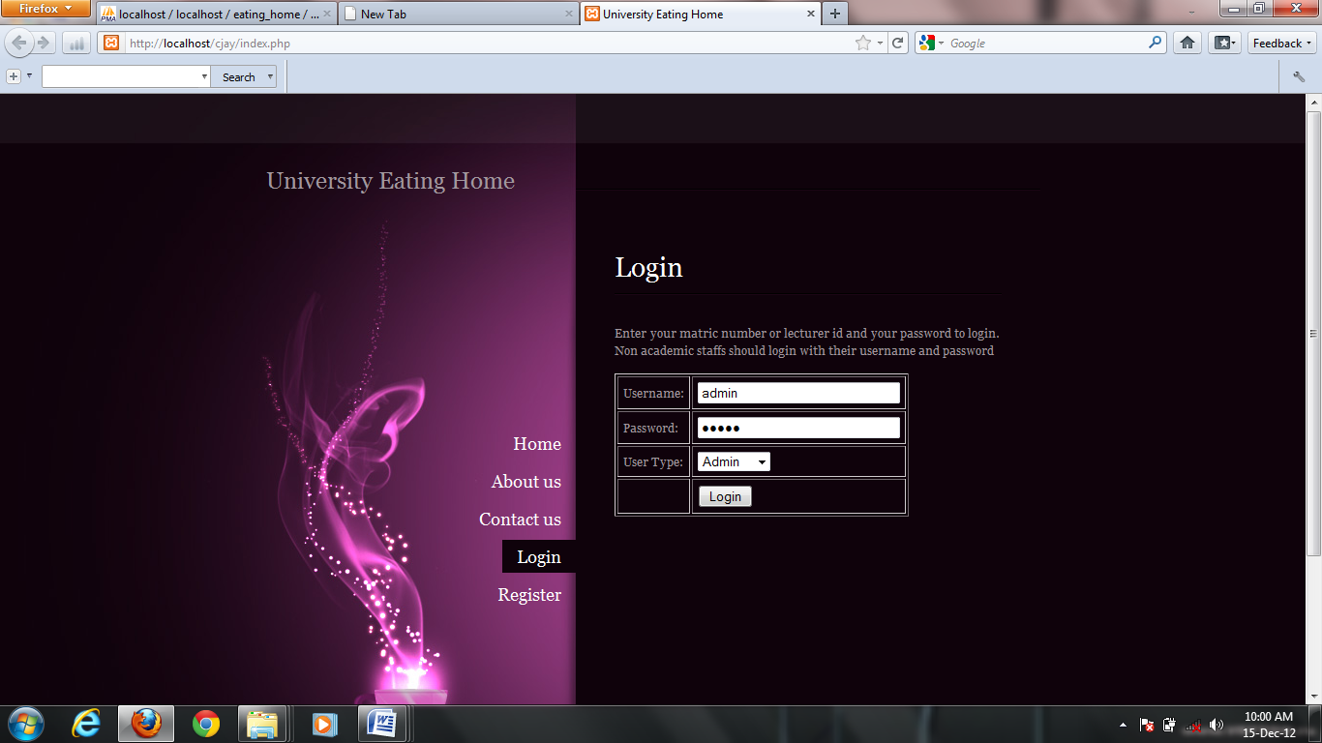

Slide 7
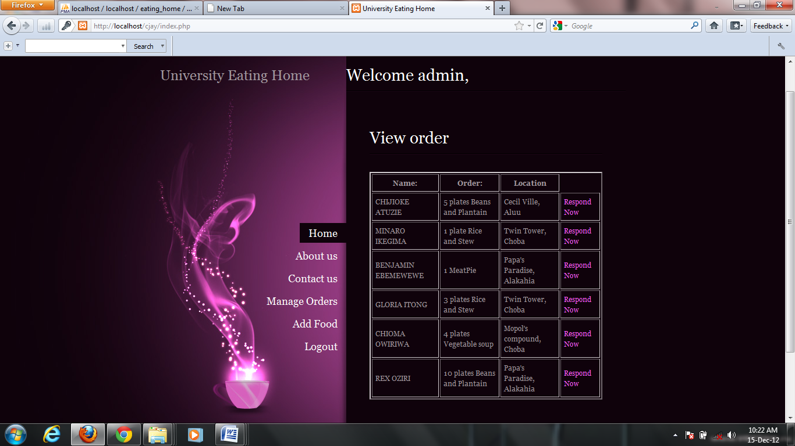

Slide 8
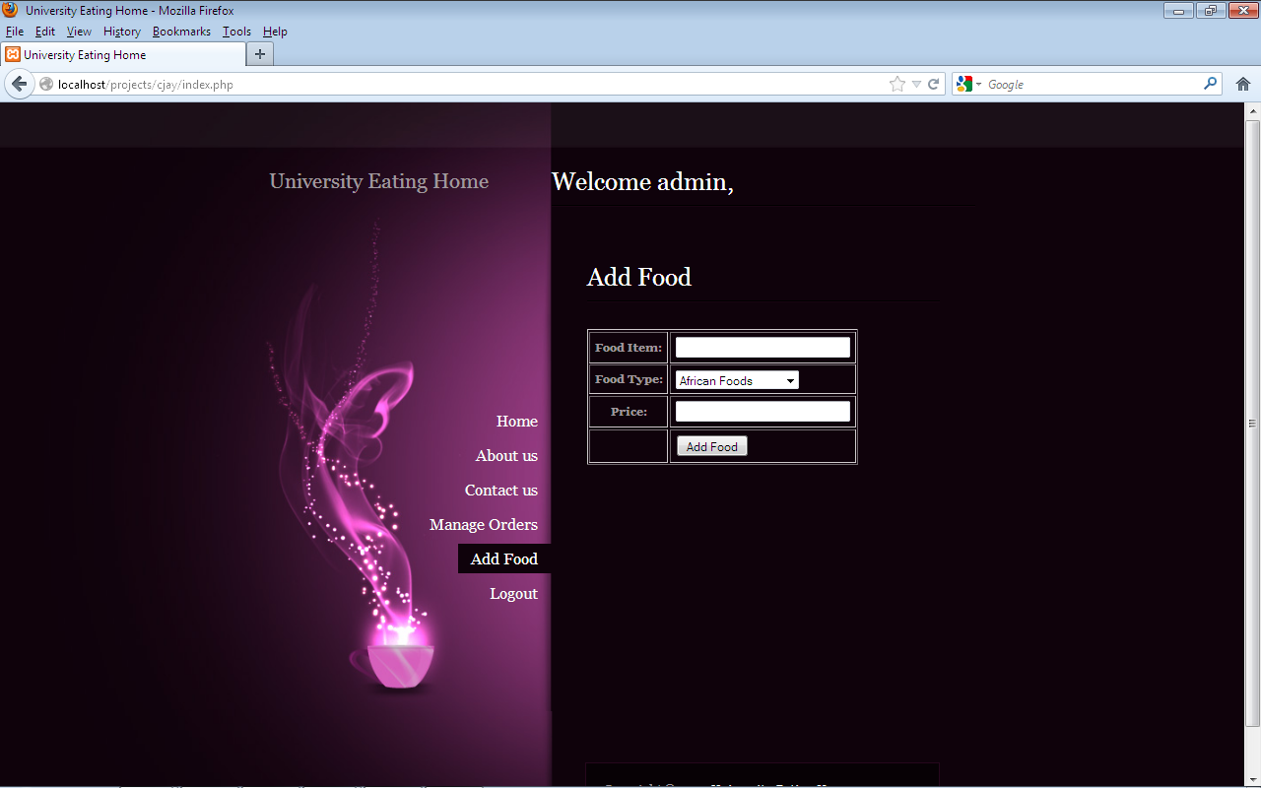

Slide 9
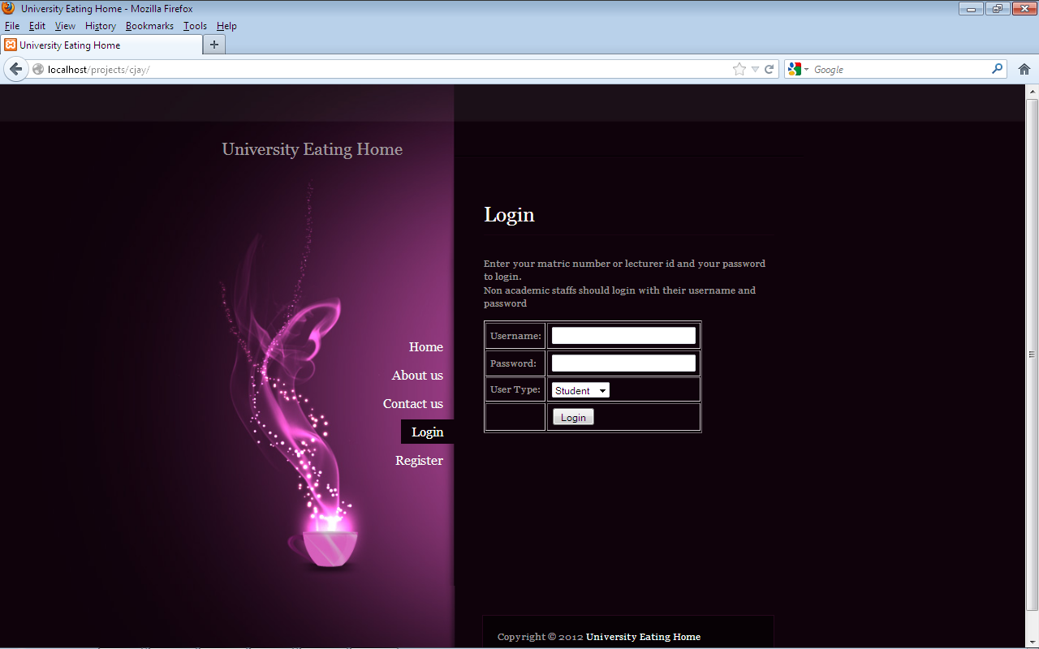

Slide 10
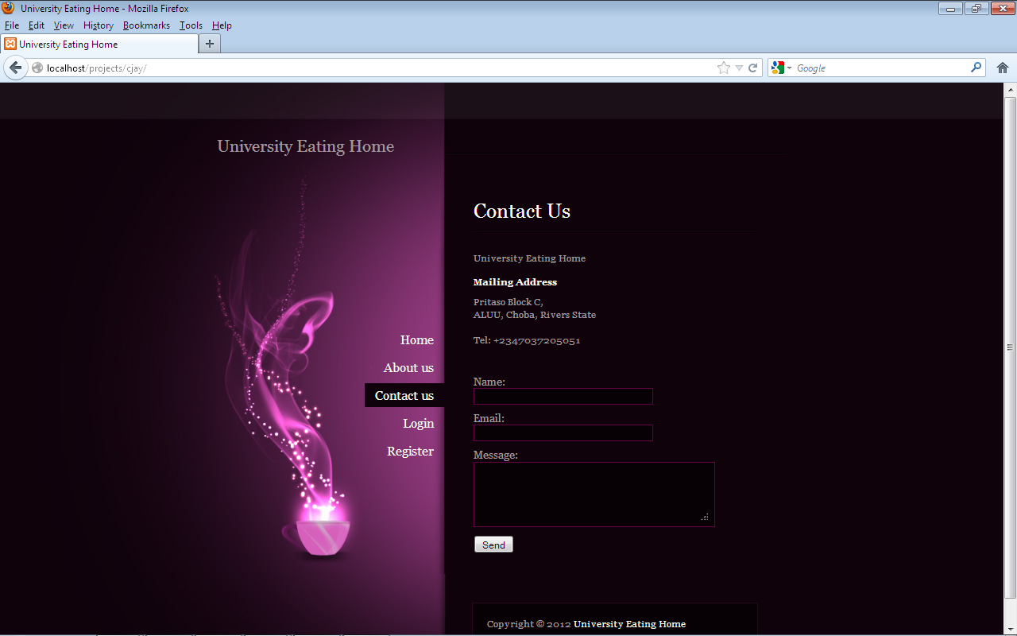

Slide 11
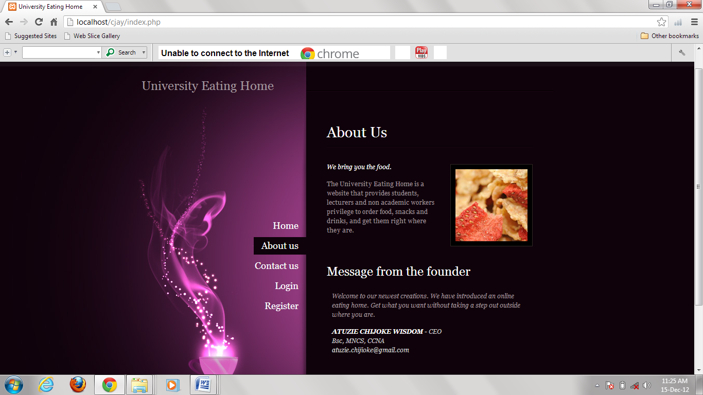

Slide 12
