Slide 1
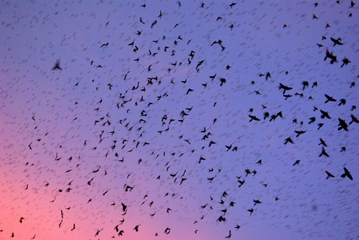
Particle Swarm Optimisation (I)
Algorithm Introduction
Dr. Wei Pang

Slide 2
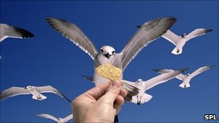
Background
Population-based optimisation inspired by the social behaviour of bird flocking and fish schooling.
  Each individual adjusts its own movement according to its own experience as well as other individuals’ experience. (Social Interaction)

Slide 3
Background (ctd.)
developed in 1995 by James Kennedy (social-psychologist) and Russell Eberhart (electrical engineer)
  Kennedy, J. and Eberhart, R.: Particle Swarm Optimization. Proceedings of the Fourth IEEE International Conference on Neural Networks, Perth, Australia. IEEE Service Center 1942-1948, 1995.
Notes:
Kennedy, J. and Eberhart, R.: Particle Swarm Optimization. Proceedings of the Fourth IEEE International Conference on Neural Networks, Perth, Australia. IEEE Service Center 1942-1948, 1995.

Slide 4

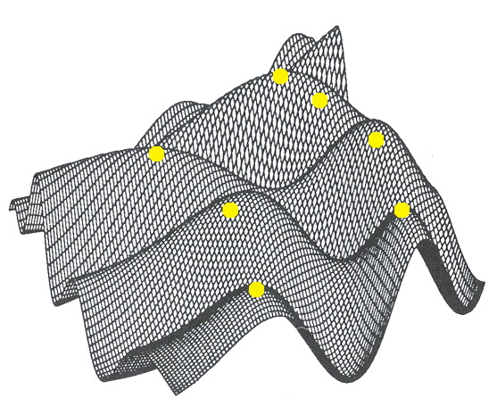
Basic Idea
A swarm is composed of some particles.
All particles are deployed in an n-dimensional search space
The fitness of a particle is the quality of its position in the search space.

Slide 5
Basic Idea(2)
Each particle flies over the search space with a certain velocity (speed and direction).
The velocity is influenced by the particle’s own best position so far and the global best solution found by its neighbours so far.
PSO is executed iteratively until it finds the best solution (s) or the stop criteria are met.

Slide 6
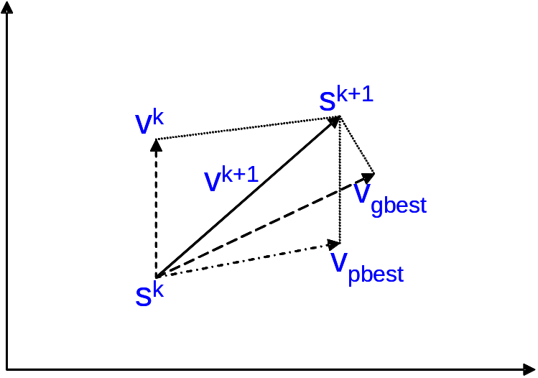
Updating the Velocity
y
x
Fig.1 Concept of modification of a searching point by PSO
s^{k} : current searching point. s^{k+1}: modified searching point. v^{k}: current velocity. v^{k+1}: modified velocity. v_{pbest} : velocity based on pbest. v_{gbest} : velocity based on gbest

Slide 7
What a particle does
In each time step, a particle has to move to a new position. It does this by adjusting its velocity.
  The adjustment is essentially this:
  The current velocity PLUS
  A weighted random portion in the direction of its personal best PLUS
  A weighted random portion in the direction of the neighbourhood best.
Having worked out a new velocity, its position is simply its old position plus the new velocity.

Slide 8
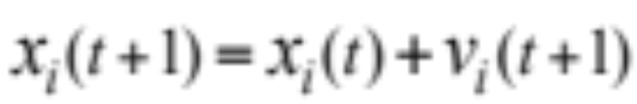
How to Determine Next Position
Personal Best
A random number between 0 and 1
PBest
p_{i}
Current Position
x
p_{g}
Global (team) Best
gBest
v

Slide 9
Why is That?
Momentum
  The force pulling the particle to continue its current direction
Cognitive component
  The force emerging from the tendency to return to its own best solution found so far
Social component
  The force emerging from the attraction of the best solution found so far in its neighborhood

Slide 10
Just Two Equations!
Velocity:
Position:

Slide 11
Pseudo Code
Initialise; // random deploy particles in the space
while (not teminated)
{ t = t +1
for i = 1:N // for each particle
{
Vi(t) = Vi(t-1) + c1*rand()*(Pi –Xi(t-1)) +c2*rand()*(Pg –Xi(t-1)) // update velocity
Xi(t) = Xi(t-1) + Vi(t) // update position
Fitness i(t) = f(Xi(t));
if needed, update Pi and Pg;
}// end for i
} // end for while

Slide 12
Parameters
Number of particles
C1 (importance of personal best)
C2 (importance of neighbourhood best)

Slide 13
About Vmax
Particles' velocities on each dimension are clamped to a maximum velocity Vmax. If the sum of accelerations would cause the velocity on that dimension to exceed Vmax, which is a parameter specified by the user. Then the velocity on that dimension is limited to Vmax.

Slide 14
Parameters selection
Different ways to choose parameters:
proper balance between exploration and exploitation
(avoiding premature convergence to a local optimum yet still ensuring a good rate of convergence to the optimum)
putting all attention on exploitation
(making possible searches in a vast problem spaces)
automatization by meta-optimization
Nebojša Trpković trx.lists@gmail.com
Slide <number> of 18

Slide 15
Parameters
Number of particles
(10—50) are reported as usually sufficient.
C1 (importance of personal best)
C2 (importance of neighbourhood best)
Usually C1+C2 = 4. No good reason other than experience
Vmax – too low, too slow; too high, too unstable.

Slide 16
The Flow Chart of PSO
Start
Initialize particles with random position
and velocity vectors.
For each particle’s position (p)
evaluate fitness
Loop until all particles exhaust
If fitness(p) better than
fitness(pbest) then pbest= p
Loop until max iter
Set best of pBests as gBest
Update particles velocity (eq. 1) and
position (eq. 3)
Stop: giving gBest, optimal solution.

Slide 17
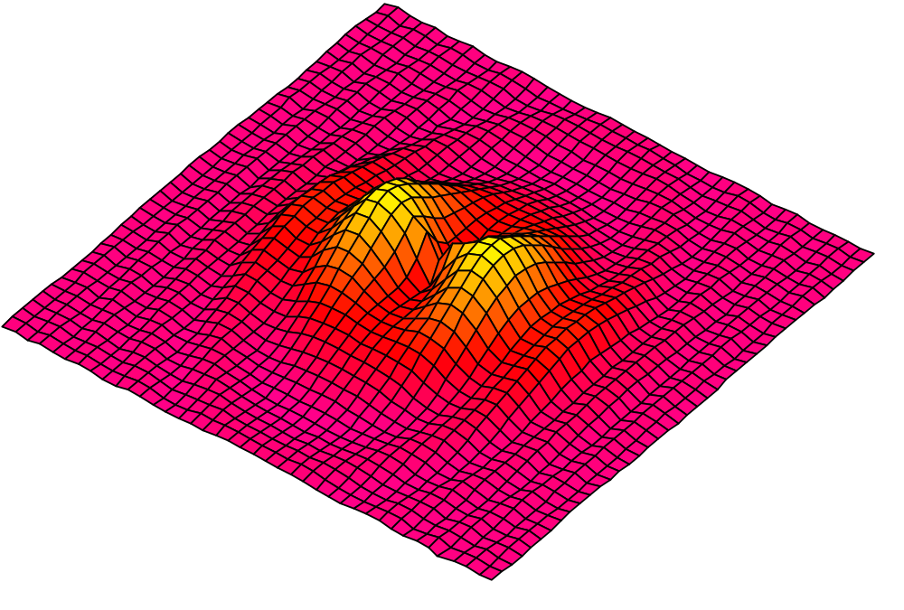
Initialisation. Positions and velocities
Notes:
Here you have another nice search space.
First step: you put some particles on it. You can do it at random or on a regular way, or both. How many? In practice, for most real problems with dimension between 2 and 100, a swarm size of 20 particles works quite good.
There are some mathematical ways to give an estimation, but a bit beyond the scope of this talk. Also, as we will see some variants use an adaptive swarm size.
Second step: you define a velocity for each particle, usually at random. You can set all initial velocities to zero but, experimentally, it is usually not the best choice.
Remember that what we call “velocity” is in fact a move, just because time is discretized.

Slide 18
Particle Swarm Optimization:
Swarm Topology
In PSO, there have been two basic topologies used in the literature
  Ring Topology (neighborhood of 3)
  Star Topology (global neighborhood)
I₀
I₀
I₁
I₁
I₄
I₄
I₃
I₂
I₃
I₂

Slide 19
Neighbourhoods
geographical
social
Notes:
Now, for each particle, we define what is called a neighbourhood. Although some variants use a “geographical” neighbourhood, that is to say compute distances and take the nearest particles, the most widely used neighbourhood is a “social” one: just a list of neighbours, regardless where they are.
So, you do not need to define a distance and that is a great advantage, for in some cases, particularly for discrete spaces, such a definition would be quite arbitrary.
Note that it can be proved (and it is intuitively quite obvious) that if the process converges any social neighbourhood tends to be also a geographical one.
Usually, in practice, social neighbourhoods are defined just once, at the very beginning, which is consistent with the principle “simple rules for simple agents”.
Now, the size of the neighbourhood could be a problem. Fortunately, PSO is not very sensitive to this parameter and most of users just take a value of 3 or 5 with good results.
Unlike for the swarm size, there is no mathematical formula, but like for the swarm size, there are some adaptive variants.

Slide 20
Neighbourhoods
Global
Notes:
Now, for each particle, we define what is called a neighbourhood. Although some variants use a “geographical” neighbourhood, that is to say compute distances and take the nearest particles, the most widely used neighbourhood is a “social” one: just a list of neighbours, regardless where they are.
So, you do not need to define a distance and that is a great advantage, for in some cases, particularly for discrete spaces, such a definition would be quite arbitrary.
Note that it can be proved (and it is intuitively quite obvious) that if the process converges any social neighbourhood tends to be also a geographical one.
Usually, in practice, social neighbourhoods are defined just once, at the very beginning, which is consistent with the principle “simple rules for simple agents”.
Now, the size of the neighbourhood could be a problem. Fortunately, PSO is not very sensitive to this parameter and most of users just take a value of 3 or 5 with good results.
Unlike for the swarm size, there is no mathematical formula, but like for the swarm size, there are some adaptive variants.

Slide 21
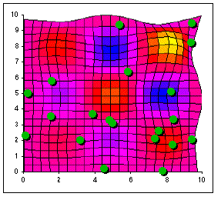
Animated illustration
Global optimum
Notes:
At the very beginning, particles are randomly put on the search space.
There is just one global optimum and several local ones.
Let us now run the player.
As you can see, the particles are quite rapidly forming some sub swarms around sub optimums. As soon as a particle is quite near of the global optimum, the others go also towards it, so the probability to really find it does increase.
Of course, if the run was longer all particles would finally go towards this global optimum

Slide 22
The Inertial Weight Factor
The use of the inertia weight w, which typically decreases linearly from about 0.9 to 0.4 during a run, has provided improved performance in a number of applications.
The larger the value of w, the better the global search ability
The smaller the value, the better the local search ability
Shi, Y. and Eberhart, R. (1998) Parameter selection in
particle swarm optimization. In Evolutionary Programming
VIZ: Proc. EP98, New York: Springer Verlag pp. 591-600.

Slide 23
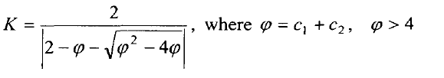
Constriction Factor
Clerc, M. (1999). The swarm and the queen: towards a
deterministic and adaptive particle swarm optimization.
Proc. I999 ICEC, Washington, DC, pp 195 1 - 1957.
Notes:
Take away some ‘guesswork’ for setting ω, ϕ1 and ϕ2
• An elegant method for preventing explosion, ensuring
convergence and eliminating the parameter vmax
• The constriction coefficient was introduced as:

Slide 24
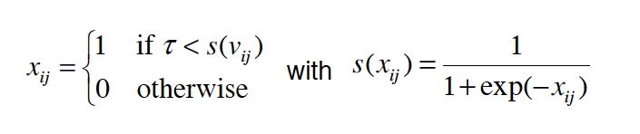
Discrete PSO
Binary PSO:
The velocity equation remains the same.
The position equation is as follows:
J. Kennedy and R. Eberhart. A discrete binary version of the particle swarm algorithm. In Proceedings of the IEEE International Conference on Systems, Man and Cybernetics, 4104-4108, IEEE Press, 1997
Notes:
PSO are originally proposed for continuous problems.
For discrete problems, it has to be modified.

Slide 25
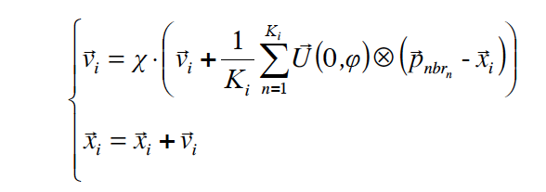
Fully Informed PSO
Each particle is influenced by all its neighbours.
The neighbourhood topology is very important.
Outperform the original PSO in many benchmark problems.
R. Mendes, J. Kennedy, and J. Neves, “The fully informed particle swarm: Simpler, maybe better,” IEEE Trans. Evol. Comput., vol. 8, pp.204–210, June 2004.

Slide 26
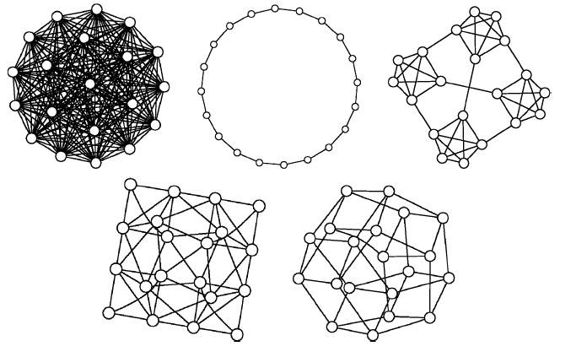
More Neighbourhood Relations
Ring
Four Clusters
Global
Torus (Von Neumann)
Pyramid
Mendes et. al. 2004, IEEE T EVOLUT COMPUT . 8 (13)
Notes:
Topologies used in the paper are presented in the following order:
All, where all vertexes are connected to every other; Ring, where every vertex
is connected to two others; Four clusters, with four cliques connected among
themselves by gateways; Pyramid, a triangular wire-frame pyramid, and Square,
which is a mesh where every vertex has four neighbors that wraps around on the
edges as a torus

Slide 27
Other PSOs
PSO for multi-objective optimisation problems
PSO with adaptive swarm size
PSO for permutation problems (TSP, N-Queen)
Lots of Hybrid PSO
  PSO+ mutation
  PSO + GA
  PSO+ Immune Algorithm
  ……

Slide 28
Theoretical Analysis of PSO
A very hard problem
Some mathematicians are very interested.
  Why/How PSO works
  Study the trajectories of particles
Simplified PSO on simple problems.

Slide 29
PSO Vs.GA
Similarity
  Random Population.
  Random Search.
  Not 100% success
Dissimilarity
  No Selection, Crossover, and Mutation in PSO
  In PSO, particles fly. In GA, chromosomes evolve.
  In PSO, particles update themselves.
  Particles have memories.
Advantages
  PSO is easy to implement
  Fewer parameters
Notes:
Both algorithms start with a group of a randomly generated population
Both update the population and search for the optimum with random techniques
Both systems do not guarantee success.
However, unlike GA, PSO has no evolution operators such as crossover and mutation.

Slide 30
Compared with Other EAs

Slide 31
Some PSO Applets to Try
PSO Visualisation:
  http://www.projectcomputing.com/resources/psovis/
Yuhui Shi:
  http://www.engr.iupui.edu/~shi/PSO/AppletGUI.html
OAT: Optimisation Algorithm Toolkit
  http://sourceforge.net/projects/optalgtoolkit/files/optalgtoolkit/1.4/

Slide 32
Further Reading
http://www.swarmintelligence.org/
Maurice Clerc
  http://clerc.maurice.free.fr/pso/
The Original PSO paper:
  http://www.engr.iupui.edu/~shi/Coference/psopap4.html

Slide 33
Videos
PSO for Optimizing Benchmark Functions
  http://vimeo.com/17407010
  http://vimeo.com/17201938
PSO for problems with deceiving features.
  http://www.youtube.com/watch?NR=1&v=VAASmSSsFaY
Robot Swarm Driven by PSO
  http://www.youtube.com/watch?v=RLIA1EKfSys

Slide 34
Next Lecture
Applications of PSO

Slide 35
Final Remarks
“
This algorithm belongs ideologically to that philosophical school
that allows wisdom to emerge rather than trying to impose it,
that emulates nature rather than trying to control it,
and that seeks to make things simpler rather than more complex.”
James Kennedy, Russell Eberhart

Slide 36
Particle Swarm Optimisation (II)
Algorithm Applications
Dr. Wei Pang

Slide 37
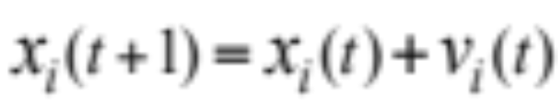
Last Lecture
Personal Best
PBest
p_{i}
Current Position
x
p_{g}
Global (team) Best
gBest
v

Slide 38
Last Lecture
Initialize; // random deploy particles in the space
while (not teminated)
{ t = t +1
for i = 1:N // for each particle
{
Vi(t) = Vi(t-1) + c1*rand()*(Pi –Xi(t-1)) +c2*rand()*(Pg –Xi(t-1)) // update velocity
Xi(t) = Xi(t-1) + Vi(t) // update position
Fitness i(t) = f(Xi(t));
if needed, update Pi and Pg;
}// end for i
} // end for while

Slide 39
Applications of PSO
Any optimisation problems!
  Some are better, some not so good.
Problem with Continuous Search Space
  Function Optimisation
  Training the Neural Nets.
Discrete Problems
  Combinatorial Optimsation. (Discrete)

Slide 40
No Free Lunch Theorem
No such algorithm can perform better than any other algorithms on all problems.
There is no such thing called the general problem optimiser.
However, there exist general problem solvers.

Slide 41
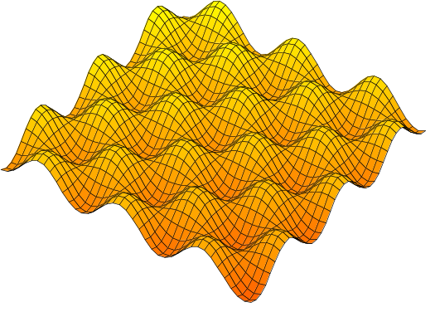
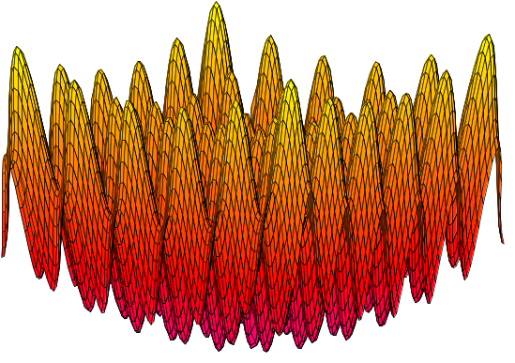
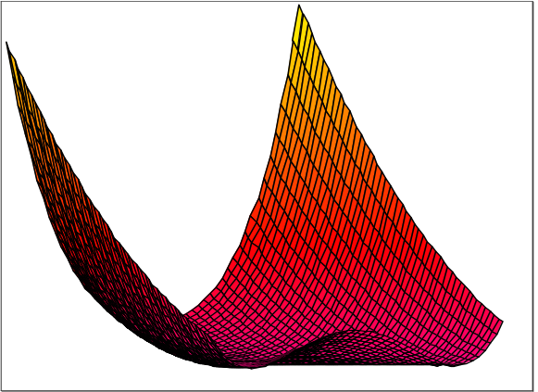
Some functions often used for testing real-valued optimisation algorithms
Griewank
Rastrigin
Rosenbrock
Notes:
Let us see now a few examples with some very well known test functions.
Of course far more tests have been done and there is now absolutely no doubt that PSO is efficient.

Slide 42
PSO Pseudo Code
Initialize; // random deploy particles in the space
while (not teminated)
{ t = t +1
for i = 1:N // for each particle
{
Vi(t) = Vi(t-1) + c1*rand()*(Pi –Xi(t-1)) +c2*rand()*(Pg –Xi(t-1)) // update velocity
Xi(t) = Xi(t-1) + Vi(t) // update position
Fitness i(t) = f(Xi(t));
if needed, update Pi and Pg;
}// end for i
} // end for while
Replaced with corresponding benchmark functions

Slide 43
The Videos
  http://vimeo.com/17407010

Slide 44
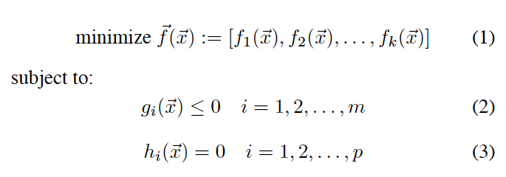


Multi-objective Problems
Decision Variables:
Objective Functions:
Constraint Functions:

Slide 45
The Pareto Frontier
Objective: Minimise f1 and f2
Area of Feasible Solutions
f2
D
D and E are dominated by C
B
C
Pareto Frontier
E
A and B are part of Pareto Frontier
A
f1

Slide 46
Multi-objective PSO
For each particle, calculate its m nearest neighbours in the fitness space with respect to f1
f2
B
Among this m neighbours, find the one with minimum value of f2.
A
Pbest, Gbest will only be replaced if they are dominated by a new solution.
f1
Hu & Eberhart, Multiobjective Optimization Using Dynamic Neighborhood Particle Swarm Optimization, CEC’02. Proceedings of the 2002 Congress on Evolutionary Computation, 2002.

Slide 47
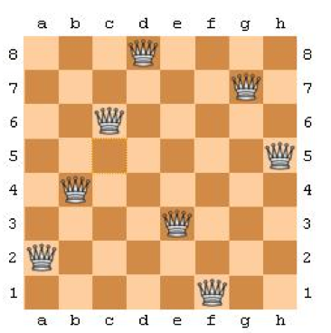
The N-Queen Problem
All Queens don’t attack each other

Slide 48
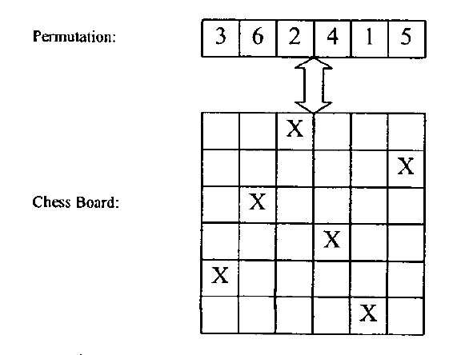
How to represent a particle
Each particle represents a permutation.
Hu et.al Swarm intelligence for permutation optimization: a case study of n-queens problem, Proceedings of the 2003 IEEE Swarm Intelligence Symposium 2003. SIS '03.

Slide 49
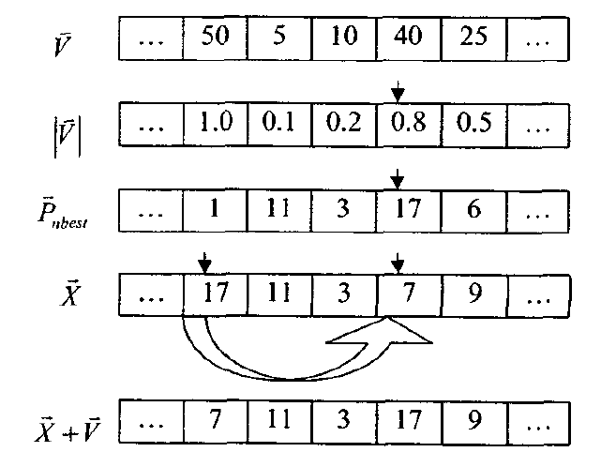
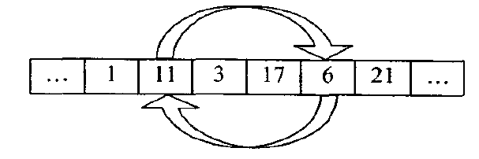
Velocity and Position Equations
Normalised Velocity (Speed), with numbers indicating the probabilities.
A swap
Mutation: If a particle is the same as the global best, it will be mutated.

Slide 50
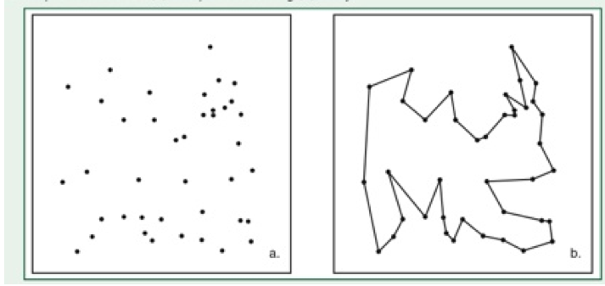
PSO for TSP
The travelling salesman problem:
Find the shortest path, in which each city is only visited once.

Slide 51
PSO for TSP: Swap Operator
A candidate solution of TSP:
S=(a1, a2, a3, …., an), where ai is the index of a city.
Swap Operator (SO):
SO (i, j) : swap the ith node and jth node
Example:
Suppose S=(1,3, 5, 2, 4)
S’=S + SO (1,2) = (1, 3, 5, 2, 4)+ (1,2)= (3,1,5, 2, 4)
“+” means applying an SO to S
Kangping Wang, Lan Huang, Chunguang Zhou, Wei Pang, Particle Swarm Optimisation for Travelling Salesman Problem, 2003 International Conference on Machine Learning and Cybernetics, Xi’an, China, pp. 1583-1585

Slide 52
PSO for TSP: Swap Sequence
Swap Sequence (SS):
A sequence of SO:
SS= (SO1, SO2, SO3, … SOn)
S and S’ are two solutions for TSP,
S’=S + SS= S+(SO1, SO2, .. SOn) means SO1, SO2, …. SOn apply to S one by one.
Basic Swap Sequence (BSS):
From S to S’, we may have many SS. The SS with least Swap Operators is BSS.

Slide 53
The Calculation of BSS
For two solutions A and B, and BSS:
A= B + BSS.
Therefore we define:
BSS=A-B (“-” means the difference between A and B)
To calculate BSS, simply swapping nodes in B according to A.
A:( 1 2 3 4 5)
B: ( 2 3 1 5 4 )
A(1)=B(3)=1, so the first SO is SO(1,3). Supose
B1=B+SO(1,3)=(1,3,2,5,4)

Slide 54
Calculation of BSS (ctd.)
A:( 1, 2,3,4,5)
B1=B+SO(1,3)=(1,3,2,5,4)
Now we see that A(2)=B1(3), so
B2=B1+SO(2,3)= (1,2,3,5,4)
Similarly, as A(4)=B2(5),
B3=B2+ SO(4,5)= (1, 2,3,4,5)
Becasue B3=A, finally
BSS= A-B = (SO(1,3), SO(2,3), SO (4,5))

Slide 55
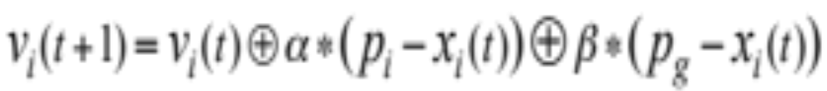
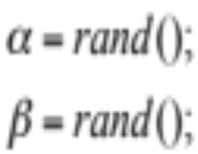
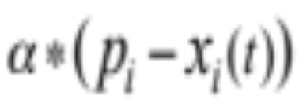
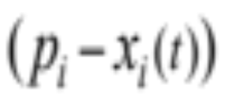

The Modification of the Two Equations
BSS
The Swap Operators in
should be maintained with the probability of

Slide 56
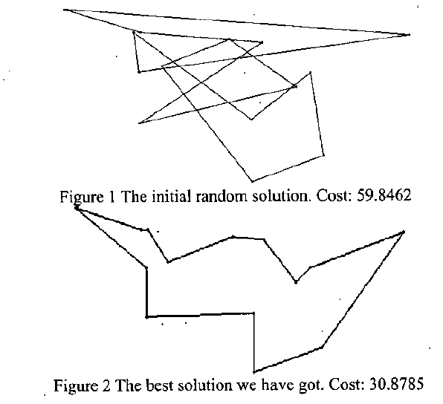
Experimental Results
Initial Solution
Best Solution
TSP benchmark (Burma14)

Slide 57
Further Study of PSO for TSP
Clerc gave a very good illustration about PSO for TSP in Chap. 8 of New Optimisation techniques in Engineering (2004)
Shi et.al. proposed a similar swap sequence approach scalable to larger TSP.
X.H.Shi, Y.C. Liang, H.P.Lee, C.Liu, Q.X.Wang, Particle swarm optimization-based algorithms for TSP and generalized TSP, Information Processing Letters 103 (2007) 169–176
Fuzzy Discrete PSO for TSP : Pang et.al. 2004 (CIT’04)
IFD-PSO: Shen et.al. proposed another fuzzy discrete PSO in 2006 (PRICAI 2006)

Slide 58
What we have learnt?
Map (Encode) a particle to a candidate solution
Velocity and Position Equations
Fitness Evaluation

Slide 59
Optional Reading
Smart Swarm: Using Animal Behaviour to Organise Our World (Peter Miller)
Other Swarm-based Algorithms
  Ant Colony Algorithm (1991)
  Artificial Bee Colony Algorithm (2005)
  Firefly Algorithm (2008)
  Cuckoo Search (2009)
  Bat Algorithm (2010)

