Slide 1


Evaluating Artificial Completeness
Anthony Chapman

Slide 2
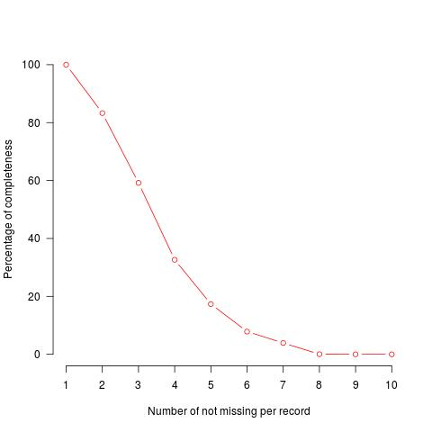
The Problem
How complete is the data?

Slide 3
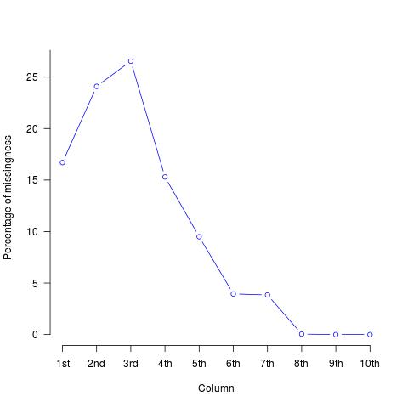
The Problem ctn...
What exactly is missing?

Slide 4

The Idea
Original Dataset
Complete
Subset
Artificial
Missing 1
Artificial
Missing 3
Artificial
Missing 2

Slide 5
The Idea ctn...
Artificial
Missing 1
Artificial
Missing 3
Artificial
Missing 2
MICE
MICE
MICE
Artificial
Complete 1
Artificial
Complete 3
Artificial
Complete 2

Slide 6
Clustering and Cluster Validation

Slide 7
Cluster Validation
Artificial Complete 1
Artificial Complete 2
Artificial Complete 3

Slide 8
The Idea Complete!
Complete
Subset
Artificial
Complete 1
Artificial
Complete 2
Artificial
Complete 3
Cluster
Outcome
Cluster
Outcome
Regression
Outcome
Regression
Outcome
Regression
Outcome
Regression
Outcome

Slide 9
The end
Thank you very much for listening, questions?
Anthony Chapman -
    a.s.chapman.10@aberdeen.ac.uk

