Slide 1


Evaluating Artificial Completeness
Anthony Chapman

Slide 2
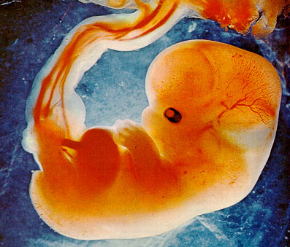
Fetal Growth vs Postnatal Outcomes

Slide 3
Evaluating Artificial Completeness
Anthony Chapman

Slide 4
The Solution - Imputation
Multiple Imputation by Chained Equations
Original Dataset
MICE
Artificially Complete
Dataset

Slide 5

The Idea
Original Dataset
Complete
Subset
Artificial
Missing 1
Artificial
Missing 3
Artificial
Missing 2

Slide 6
The Idea
Original Dataset
Complete
Data
Partially
Complete 1
Partially
Comlete 2
Missing

Slide 7
The Idea
Complete
Data
Artificial
Missing 1
Artificial
Missing 2
Artificial
Missing 3

Slide 8
The Idea
Complete
Data
Artificial
Missing 1
MICE
Artificial
Complete 3
Artificial
Missing 2
Artificial
Missing 3
MICE
MICE
Artificial
Complete 1
Artificial
Complete 2

Slide 9
The Idea ctn...
Artificial
Missing 1
Artificial
Missing 3
Artificial
Missing 2
MICE
MICE
MICE
Artificial
Complete 1
Artificial
Complete 3
Artificial
Complete 2

Slide 10
Clustering and Cluster Validation

Slide 11
The Idea Complete!
Complete
Subset
Artificial
Complete 1
Artificial
Complete 2
Artificial
Complete 3
?? Cluster
Outcomes
?? Cluster
Outcome
?? Cluster
Outcome
?? Cluster
Outcome
Regression
Outcome
Regression
Outcome
Regression
Outcome
Regression
Outcome

Slide 12
The end, any question?
Anthony Chapman -
    a.s.chapman.10@aberdeen.ac.uk

