Slide 1


Relationships Between
Fetal Growth and
Non Communicable Diseases
Anthony Chapman

Slide 2
Main objectives
Relate diseases to growth rates
Computationally efficient / automated data analysis
Confirm / deny IVF notions

Slide 3
First Impressions
Large Amounts of missing data!
Original Dataset
Complete
Data
Partially
Complete 1
Partially
Comlete 2
Missing

Slide 4
First Impressions
Large Amounts of missing data!
Original Dataset
MICE
Artificially Complete
Dataset

Slide 5
Research Questions
Can we analyse data with large amounts of missingness
Can we use clustering for pattern matching
What relationships can we find

Slide 6
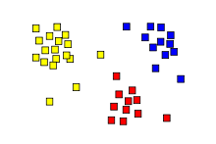
Methods
Multiple Imputation by Chain Equations
Cluster analysis
Original Dataset
MICE
Artificially Complete
Dataset

Slide 7
Future Plans
Finish automated artificial completeness
Obtain approvals
Data mining time

Slide 8
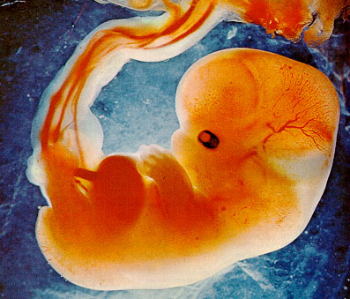
Fetal Growth vs Postnatal Outcomes

Slide 9
Evaluating Artificial Completeness
Anthony Chapman

Slide 10
The Solution - Imputation
Multiple Imputation by Chained Equations
Original Dataset
MICE
Artificially Complete
Dataset

Slide 11

The Idea
Original Dataset
Complete
Subset
Artificial
Missing 1
Artificial
Missing 3
Artificial
Missing 2

Slide 12
The Idea
Original Dataset
Complete
Data
Partially
Complete 1
Partially
Comlete 2
Missing

Slide 13
The Idea
Complete
Data
Artificial
Missing 1
Artificial
Missing 2
Artificial
Missing 3

Slide 14
The Idea
Complete
Data
Artificial
Missing 1
MICE
Artificial
Complete 3
Artificial
Missing 2
Artificial
Missing 3
MICE
MICE
Artificial
Complete 1
Artificial
Complete 2

Slide 15
The Idea ctn...
Artificial
Missing 1
Artificial
Missing 3
Artificial
Missing 2
MICE
MICE
MICE
Artificial
Complete 1
Artificial
Complete 3
Artificial
Complete 2

Slide 16
Clustering and Cluster Validation

Slide 17
The Idea Complete!
Complete
Subset
Artificial
Complete 1
Artificial
Complete 2
Artificial
Complete 3
?? Cluster
Outcomes
?? Cluster
Outcome
?? Cluster
Outcome
?? Cluster
Outcome
Regression
Outcome
Regression
Outcome
Regression
Outcome
Regression
Outcome

Slide 18
The end, any question?
Anthony Chapman -
    a.s.chapman.10@aberdeen.ac.uk

