Slide 1


Evaluating Artificial Completeness
Anthony Chapman

Slide 2
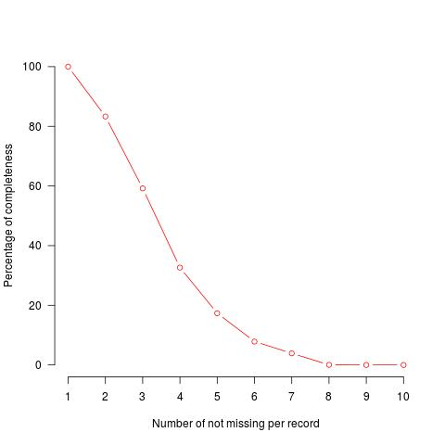
The Problem - Missingness
How complete is the data?

Slide 3
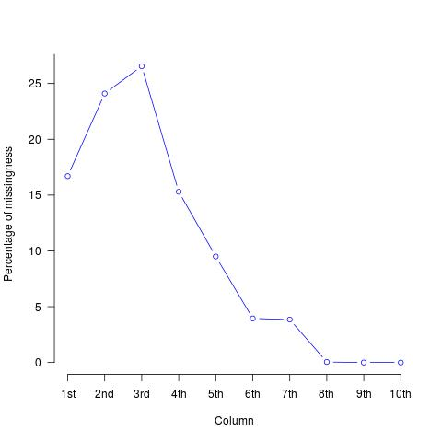
The Problem - Missingness ctn...
What exactly is missing?

Slide 4
Imputation

Slide 5

The Idea
Original Dataset
Complete
Subset
Artificial
Missing 1
Artificial
Missing 3
Artificial
Missing 2

Slide 6
The Idea ctn...
Artificial
Missing 1
Artificial
Missing 3
Artificial
Missing 2
MICE
MICE
MICE
Artificial
Complete 1
Artificial
Complete 3
Artificial
Complete 2

Slide 7
Clustering and Cluster Validation

Slide 8
The Idea Complete!
Complete
Subset
Artificial
Complete 1
Artificial
Complete 2
Artificial
Complete 3
Cluster
Outcome
Cluster
Outcome
Regression
Outcome
Regression
Outcome
Regression
Outcome
Regression
Outcome

Slide 9
The end, any question?
Anthony Chapman -
    a.s.chapman.10@aberdeen.ac.uk

