Slide 1


Evaluating Artificial Completeness
Anthony Chapman

Slide 2
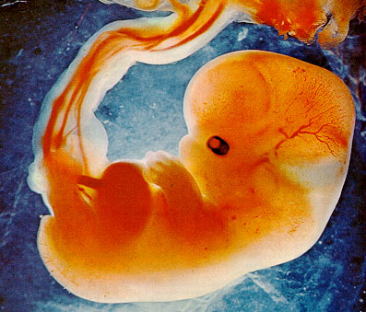
Fetal Growth vs Postnatal Outcomes

Slide 3
Evaluating Artificial Completeness
Anthony Chapman

Slide 4
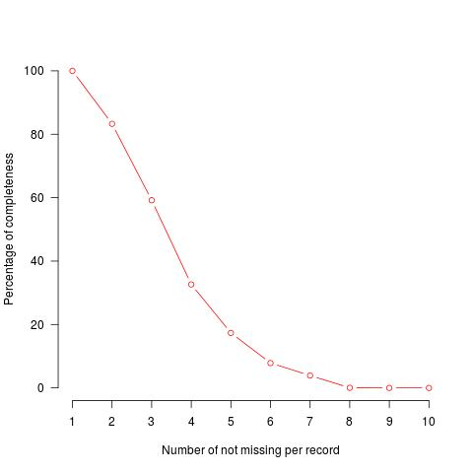
The Problem - Missingness
How complete are the data?

Slide 5
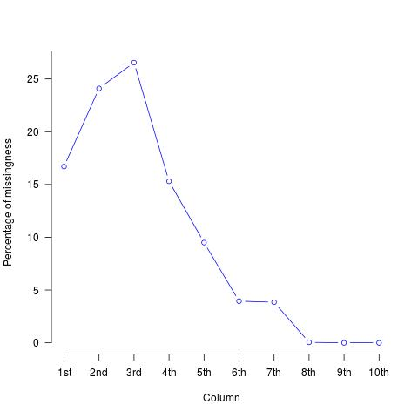
The Problem - Missingness ctn...
What exactly is missing?

Slide 6
The Solution - Imputation
Multiple Imputation by Chained Equations
Original Dataset
MICE
Artificially Complete
Dataset

Slide 7

The Idea
Original Dataset
Complete
Subset

Slide 8
The Idea

Slide 9
The Idea
Original Dataset
Complete
Subset
Artificial
Missing 1
Artificial
Missing 3
Artificial
Missing 2

Slide 10
The Idea ctn...
Artificial
Missing 1
Artificial
Missing 3
Artificial
Missing 2
MICE
MICE
MICE
Artificial
Complete 1
Artificial
Complete 3
Artificial
Complete 2

Slide 11
Clustering and Cluster Validation

Slide 12
The Idea Complete!
Complete
Subset
Artificial
Complete 1
Artificial
Complete 2
Artificial
Complete 3
?? Cluster
Outcomes
?? Cluster
Outcome
?? Cluster
Outcome
?? Cluster
Outcome
Regression
Outcome
Regression
Outcome
Regression
Outcome
Regression
Outcome

Slide 13
The end, any question?
Anthony Chapman -
    a.s.chapman.10@aberdeen.ac.uk

